Slide 1


ICMIB -2025
Paper ID: 301
Neuro-Symbolic Sentiment Analysis: Integrating Lexicon Features With Deep Learning Models
Naga Charitavya Madala, Dept. of Computer Science and Engineering
Sai Durga Saradhi Pranu Deepak Tallapudi, Dept. of Computer Science and Engineering
Venkata Srikari Malladi, Dept. of Computer Science and Engineering
Rajiv Senapati, Dept. of Computer Science and Engineering
PRESENTED BY
Venkata Srikari Malladi
5th International Conference on Machine Learning, IoT and Big Data (ICMIB) -2025, 4th – 6th April, 2025
Organized By:
Department of Computer Science & Engineering, Parala Maharaja Engineering College, Berhampur, Odisha, India

Slide 2
ICMIB -2025
Presentation Outline
Introduction
Literature Survey
Problem Statement
Methodology
Results & Discussion
Conclusion & Future Work
Selected References

Slide 3
ICMIB -2025
Introduction
Social media, especially Twitter, plays a crucial role in sentiment analysis for businesses like aviation.
Challenges include unstructured data, slang, abbreviations, multilingual content, and sarcasm.
This study proposes a hybrid sentiment analysis approach combining:
Neuro-Symbolic Sentiment Analysis (lexicon-based + deep learning).
Topic-Driven Sentiment Analysis (latent variable techniques).
Machine learning models used: Logistic Regression, Naïve Bayes, SVM, Random Forest, and FCNN.
K-fold cross-validation ensures robustness across binary and multiclass classifications.
Experimental validation on airline sentiment datasets shows high accuracy and explainability.

Slide 4
ICMIB -2025
Literature Survey
Dependency-Based Neural Networks Uses dependency weighting for sentiment polarity detection, Enhances feature extraction by considering syntactic dependencies.
Multi-Level Graph Neural Networks (MLGNN) Integrates local & global variables for improved sentiment pattern capture, Uses scaled dot-product attention and multi-size node connections.
Heterogeneous GNN for Aspect-Based Sentiment Analysis Captures complex word-aspect relationships for fine-grained sentiment analysis.
RoBERTa for Twitter Sentiment Analysis Handles noisy, informal text & adapts to changing trends.
Sentiment Drift Analysis on Trending Topics (Smith et al., 2023) Detects real-time sentiment shifts on Twitter.
Multi-Layered Network for Emotion Analysis Models emotional content & user interactions in tweets.
Attentional GNN (AGNN) for Social Media Sentiment Uses social graph information for better sentiment prediction
Handling Data Imbalance in Sentiment Analysis Uses SMOTE & boosting with KNN to improve classification accuracy.
Sentiment & Emotional Analysis in Healthcare Examines professional well-being & emotional impact in healthcare settings.

Slide 5
ICMIB -2025
Problem Statement
Sentiment analysis on social media data presents challenges due to its unstructured nature, including slang, abbreviations, multilingual content, and sarcasm. Traditional machine learning models often struggle with accurate classification and interpretability, limiting their effectiveness in real-world applications.This research addresses these challenges by proposing a Neuro-Symbolic Sentiment Analysis approach that integrates symbolic lexicon-based features with deep learning models. Additionally, Topic-Driven Sentiment Analysis leverages latent variable techniques to improve contextual understanding. The goal is to enhance classification accuracy and explainability, making sentiment analysis more scalable and interpretable across different domains.

Slide 6
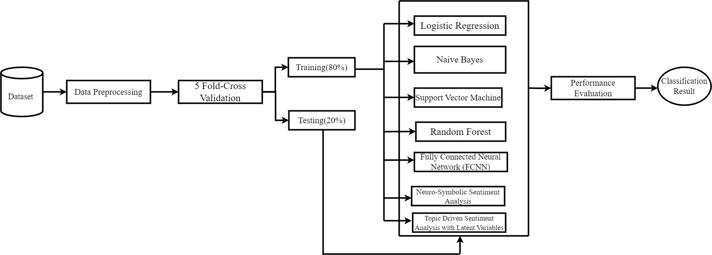
ICMIB -2025
Methodology
Dataset & Preprocessing:
📌 Dataset: Kaggle Airline Sentiment Dataset (14,640 tweets)
📌 Sentiment Labels: Favorable, Neutral, Negative
📌 Preprocessing Steps:
Removing special characters, URLs, stopwords
Tokenization & Lemmatization
Feature Extraction: TF-IDF & GloVe Embeddings
📌 Data Split: 80% Training, 20% Testing (Stratified Sampling)

Slide 7
ICMIB -2025
Methodology
Hybrid Sentiment Analysis Approach
Neuro-Symbolic Sentiment Analysis:Lexicon Features (VADER, AFINN) + Deep Learning (BERT Embeddings)
Topic-Driven Sentiment Analysis:Latent Dirichlet Allocation (LDA) for extracting key themes (e.g., delays, customer service)
Machine Learning Models Used:
Baseline: Logistic Regression
Traditional ML: Naïve Bayes, SVM, Random Forest
Deep Learning: Fully Connected Neural Networks (FCNN)
Performance Evaluation:
5-Fold Cross-Validation applied to all models
Metrics: Accuracy, Precision, Recall, F1-Score
Visual Element: Add a Performance Metrics Table

Slide 8
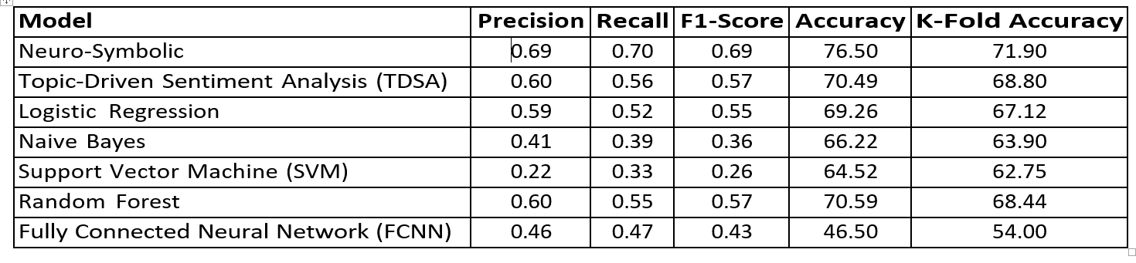
ICMIB -2025
Results and Discussion
Overview:
Combines lexicon-based and deep learning approaches for sentiment analysis.
Uses latent variable techniques to analyze thematic implications in social media data.

Slide 9
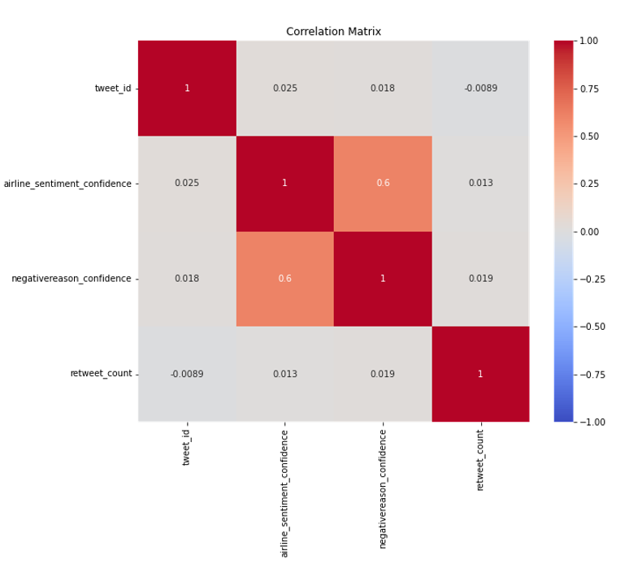
ICMIB -2025
Results and Discussion
Key Findings:
Performance metrics (Accuracy, Precision, Recall, F1 Score, Support) shown in Table .
Correlation matrix shows weak correlations, except 0.603 between airline sentiment confidence & negative reason confidence (Figure).
Tweet properties like length and retweet count are largely independent of sentiment.

Slide 10
ICMIB -2025
Conclusion and Future Scope
Conclusion:
Comprehensive sentiment analysis framework using both classic ML and deep learning.
Neuro-Symbolic Sentiment Analysis captures explicit & nuanced patterns.
Topic-Driven Sentiment Analysis improves sentiment classification with contextual themes.
Strong generalization across unseen data with 5-fold cross-validation.
Scalable & interpretable for other domains beyond airlines.
Future Work:
Multimodal Data Integration (text, images, audio) for richer sentiment insights.
Advanced Sentiment Tasks: Expanding to sarcasm detection, emotion recognition.
Real-Time Sentiment Analysis for streaming data applications.
Improved Interpretability: Explainable AI models for transparent decision-making.

Slide 11
ICMIB -2025
Selected References
1 AlBadani, B., Shi, R., Dong, J., Al-Sabri, R., Moctard, O.B.: Transformer-based graph convolutional network for sentiment analysis. Applied Sciences12(3), 1316 (2022).
2. Bai, X., Fei, R., Liu, Z., Chen, X.: Fine-grained sentiment analysis based on heterogeneous graph neural network. 2022 6th Asian Conference on Artificial Intelligence Technology (ACAIT), pp. 1–6. IEEE (2022).
3. Bai, X., Fei, R., Liu, Z., Chen, X.: Fine-grained sentiment analysis based on heterogeneous graph neural network. 2022 6th Asian Conference on Artificial Intelligence Technology (ACAIT), pp. 1–6. IEEE (2022).
4. Kaggle: Crowdflower Twitter Airline Sentiment Dataset. [Available Online](https://www.kaggle.com/datasets/crowdflower/twitter-airline-sentiment) (2015).
5. Wang, M., Hu, G.: A novel method for Twitter sentiment analysis based on attentional-graph neural network. Information 11(2), 92 (2020).
6. Nguyen, A., Longa, A., Luca, M., Kaul, J., Lopez, G.: Emotion analysis using multilayered networks for graphical representation of tweets. IEEE Access 10, 99467–99478 (2022).
7. Wang, M., Hu, G.: A novel method for Twitter sentiment analysis based on attentional-graph neural network. Information 11(2), 92 (2020).
8. Lubis, A., Irawan, Y., Junadhi, J., Defit, S.: Leveraging k-nearest neighbors with SMOTE and boosting techniques for data imbalance and accuracy improvement. Journal of Applied Data Sciences 5(4), 1625–1638 (2024).
9. Keshavarz, Z., Gorji, M., Houshyar, Z., Tamajani, Z.T., Martin, J.: The professional quality of life among healthcare providers and its related factors. Asian Journal of Social Health and Behavior 2(1), 32–38 (2019).

Slide 12
ICMIB -2025
Thank you

