Slide 1
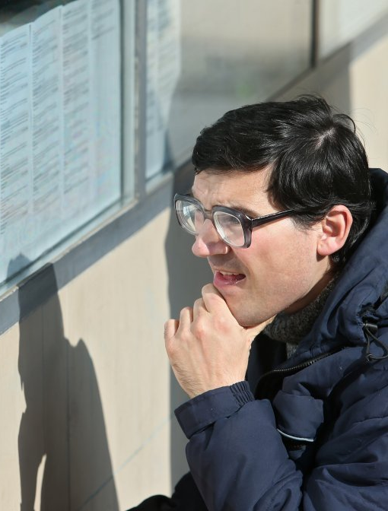
HACKTX 2026 · META TRACK
Introducing Spots
A social AR experience we’re building toward Meta Ray-Ban Display.
Every place
has stories
Look through your glasses to find notes people left around you. Reply by voice and get to know the people behind them.
You might already visit the same places. Spots gives you a reason to say hello.
Notes:
Typography: Optimistic VF from Meta homepage font source https://static.xx.fbcdn.net/rsrc.php/yQ/r/-pkMfchyeAZ.woff2. Photography is credited in the relevant slide notes. Interface mockups are illustrative; the reference artwork is a repository test fixture.
0:00–0:10. “Introducing Spots. Look through your glasses to discover notes people left around you, reply by voice and get to know them.” Product vision: discover stories in shared places, respond through AI-powered voice conversations, and connect with the people behind them. Current prototype uses ordinary camera-equipped glasses and a phone. The Instagram-style mock only shows the intended glasses UI. No native Display integration is claimed. Cover photo: Sanjin Strukic / PIXSELL via tportal. Source: https://www.tportal.hr/biznis/clanak/pokrecete-biznis-provjerili-smo-koliko-novca-ove-godine-mozete-dobiti-od-drzave-foto-20230217 . Original: https://www.tportal.hr/media/thumbnail/w1000/1923212.jpeg . This authentic photo shows an ordinary glasses wearer reading a noticeboard. It is contextual photography, not Spots hardware or a live demonstration. Image is unchanged apart from slide cropping.

Slide 2
META’S CHALLENGE
Bring people closer together with AI
“Build the AI-powered social product you wish existed, or one that helps strengthen connections you care about in new ways.”
THE PROBLEM WE’RE EXPLORING
You could love the same music and visit the same places as someone nearby, but never meet them. Spots gives you a way to leave a note, find something in common and start talking.
Source: Meta track brief, page 1. We’re starting with the places and things people share.
Notes:
Typography: Optimistic VF from Meta homepage font source https://static.xx.fbcdn.net/rsrc.php/yQ/r/-pkMfchyeAZ.woff2. Photography is credited in the relevant slide notes. Interface mockups are illustrative; the reference artwork is a repository test fixture.
0:10–0:30. “Meta asked us to bring people closer together with AI. People who share interests often visit the same places without ever meeting. Spots gives them a way to start talking through the stories they leave there.” The challenge is open ended; the concert scenario is our product hypothesis, not a problem definition imposed by Meta. Brief source: /Users/srikarkolipaka/Downloads/Meta Track HackTX.pdf, page 1. Official rules, page 3, require meaningful AI and judge Human Connection 30%, AI Centrality 25%, Originality 20%, Execution & Demo Quality 25%. Source: /Users/srikarkolipaka/Downloads/[External] HackTX 2026 — Meta-Sponsored Track Round 1 Official Rules.pdf. Do not present the Meta–Gallup study as proof of this particular unmet need.

Slide 3
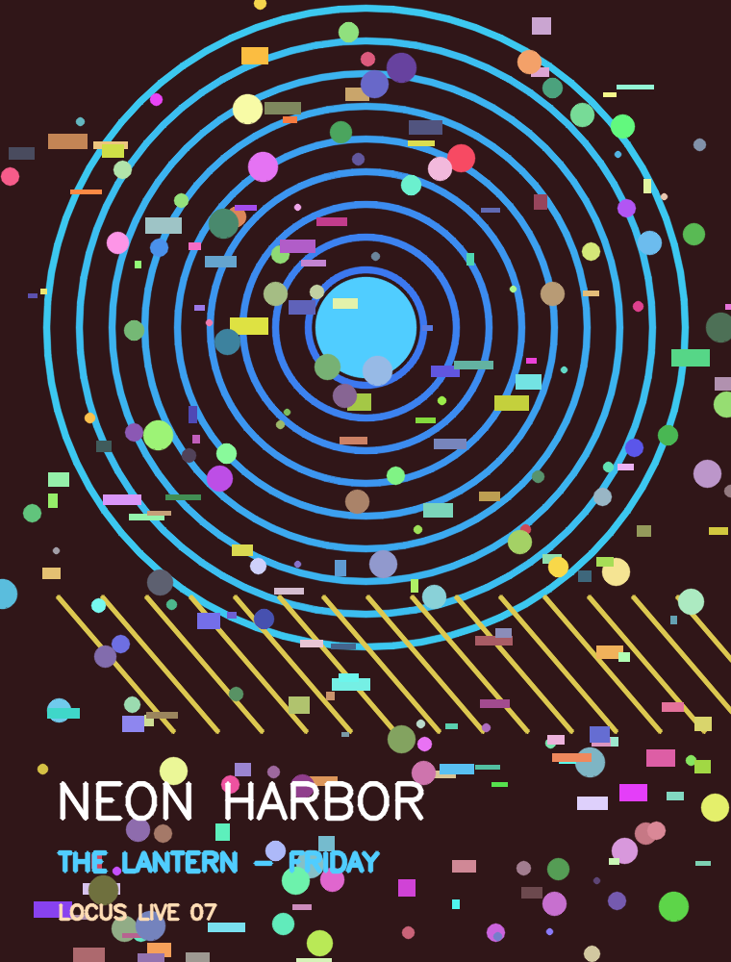
How Spots works
Leave a note on a spot we’ve added to Spots, like this poster. Someone else can look at it through their glasses, find your note and reply by voice. For this demo, our Instagram-style mock shows what you’d see through the glasses.
What our mock demo shows
How you’d reply through your glasses
Maya
M
Maya
Anyone want to go Friday?
Anyone want to go Friday?
Open conversation
Say “post note” to reply
The Instagram-style screen is only a demo mock. We’re working toward showing this through the glasses.
Notes:
Typography: Optimistic VF from Meta homepage font source https://static.xx.fbcdn.net/rsrc.php/yQ/r/-pkMfchyeAZ.woff2. Photography is credited in the relevant slide notes. Interface mockups are illustrative; the reference artwork is a repository test fixture.
0:30–0:50. “Maya attaches an invitation to this concert poster. Our Instagram-style mock stands in for what someone would see through the glasses when they look at the enrolled poster. A voice reply becomes editable text before it is shared.” The Instagram-style interface is only a visualization for the demo because the team cannot show the UI in the glasses. It is not a product discovery channel or planned native Instagram integration. The mock and camera experience should resolve the same object_id and note_id. No real Instagram accounts or DMs are connected. Speech transcription is the current AI role; object matching is classical vision. Standard Ray-Ban Meta is displayless. Meta Ray-Ban Display is a separate device. Source: https://developers.meta.com/wearables/faq/

Slide 4
Who this helps
PEOPLE WITH SHARED INTERESTS
Psychographics over demographics
Spots is for people who have something in common but haven’t had a reason to talk yet. A note on something they both notice can be that first hello.
We want to help people connect through what they care about and how they spend their time.
Clues to shared interests
If you choose to share it, we could use what you often look at, search for and the places you visit.
Maybe you’re into the same band, have a favorite dish to recommend or keep coming back to the same mural. That’s something you can connect over.
You choose who to connect with
You decide what to share, which notes to reply to and whether you want to keep talking.
The poster is just one example. Spots is about shared interests, wherever you find them.
Notes:
Typography: Optimistic VF from Meta homepage font source https://static.xx.fbcdn.net/rsrc.php/yQ/r/-pkMfchyeAZ.woff2. Photography is credited in the relevant slide notes. Interface mockups are illustrative; the reference artwork is a repository test fixture.
0:50–1:05. “Spots brings together people who share an interest, even if they differ in age, race, gender or background. We plan to use psychographics: shared interests and habits, including what people choose to share about what they look at, search for and the places they visit. Each person chooses whether to connect.” These are audience and product principles, not a claim that a working recommender has been implemented or evaluated for bias. Proposed signals include opted-in interests, viewing patterns, searches and places visited. Search and location access are future concepts requiring explicit permission and an available integration. The current prototype does not access Instagram search history or continuously track gaze or location. The concert poster is a demo example, not a demographic restriction. The intended device audience is Meta Ray-Ban Display users; current hardware is a camera prototype. Instagram is a mock. We do not claim that transcription alone proves a reduction in loneliness or a lasting relationship.

Slide 5

THE GLASSES EXPERIENCE
Say it through
your glasses
Look at a spot we’ve added and say “post note.” Say what’s on your mind, and AI turns your voice into a written note that stays there.
On Meta Ray-Ban Display, we want you to read or hear your note, then say when you’re ready to share it.
For now, the demo phone shows what we want you to do through the glasses.
Notes:
Typography: Optimistic VF from Meta homepage font source https://static.xx.fbcdn.net/rsrc.php/yQ/r/-pkMfchyeAZ.woff2. Photography is credited in the relevant slide notes. Interface mockups are illustrative; the reference artwork is a repository test fixture.
1:05–2:05. Explain the intended glasses interaction first: look at the poster, say “post note,” speak a message, hear the transcript, and confirm or cancel by voice. Native Meta integration and voice review/confirmation are product goals, not verified current capabilities. Then switch to the actual prototype. Enroll the poster once before judging and seed an explicitly team-created invitation. The judge wears the prototype and speaks. A teammate can operate the phone stand-in, show or read the actual transcript, obtain the judge’s approval, and tap Post note. Label the manual step as a simulation of the intended glasses controls. Show the actual saved reply in another browser to demonstrate rediscovery. Allocate 10 seconds to orient, 10 to speak, 15 to transcribe/review, 10 to confirm, 10 to second-client proof, and five buffer. Configure camera/mic permissions and the transcription provider before the timer. Use only commands supported by the current app. Keep a typed fallback. Do not reset the backend between panels. The official Meta artist lifestyle photograph is credited to Meta, via https://www.androidcentral.com/wearables/meta-ray-ban-display-glasses . It shows a person wearing Display and a Neural Band, not someone looking at a poster. Original image: https://cdn.mos.cms.futurecdn.net/oVnsftwc9t73XF7NHVtDK3.jpg . This is not a screenshot of Spots or proof of a native integration.

Slide 6
Technical architecture
We start by saving a photo of the poster. When the camera sees it again, the app matches it to that photo and uses its saved ID to bring back the right conversation.
Camera match
Saved poster ID
Shared conversation
object_id
“Anyone want
to go Friday?”
concert-poster
SIFT / ORB
FastAPI + SQLite
React loads the thread
AI turns your recording into text. In the glasses experience we’re building toward, you’d hear your note and confirm it by voice before it’s saved.
Notes:
Typography: Optimistic VF from Meta homepage font source https://static.xx.fbcdn.net/rsrc.php/yQ/r/-pkMfchyeAZ.woff2. Photography is credited in the relevant slide notes. Interface mockups are illustrative; the reference artwork is a repository test fixture.
2:05–2:25. “SIFT or ORB matches the enrolled poster image. Its stable ID retrieves the conversation through FastAPI and SQLite, and React displays the notes. Speech AI creates the editable reply, which is saved only after confirmation.” OpenCV supplies camera video. Browser MediaRecorder captures microphone audio; a configured adapter transcribes speech. SIFT/ORB is classical computer vision, not a learned Meta embedding or YOLO classifier. This is reference recognition, not a shared 3D anchor or a way to identify a unique physical copy. Identical posters require added context. The artwork is the actual reference fixture from the reviewed repository, not a live camera capture. Source: https://github.com/arnavvalvekar/meta-glasses-notes/tree/72c3d3e7ccd1d74f610d008a89951f4de0f379a9

Slide 7
NEXT STAGES
Spots
PLANNED · OPT-IN
What comes next
Someone shares
your interests
Sam
Next, we want to help you meet people who share your interests or keep coming back to the same spots, if you’re open to it. Maybe a note leads to a chat, then a plan to hang out. We also want to bring the experience onto Meta Ray-Ban Display.
You’re both into street art and left notes at this mural.
Say hello
Simulated profile · Example only
These recommendations are something we want to build next.
Notes:
Typography: Optimistic VF from Meta homepage font source https://static.xx.fbcdn.net/rsrc.php/yQ/r/-pkMfchyeAZ.woff2. Photography is credited in the relevant slide notes. Interface mockups are illustrative; the reference artwork is a repository test fixture.
2:25–2:40. “Next, we want to help people connect over shared interests and places, if they choose to. We also want to bring this onto Meta Ray-Ban Display.” The Sam screen is a native editable mockup with a simulated profile. No live interest recommender or real Instagram data access is claimed. Coarse location is opt in, and profiles must participate; do not infer strangers’ identities or interests from faces or every glance. These future AI recommendations are distinct from current transcription.

Slide 8
KEY FEATURES
Here’s what you can do
With Spots, you can find out what people have to say about the things around you and join in through your glasses.
Discover stories
Look at a spot we’ve added to find the notes and stories people left there.
Leave a voice note
Say what you want to share, and AI turns your voice into a note that stays with that spot.
Talk back
Read or listen to someone’s note, then say what you want to reply through your glasses.
Leave it for someone else
Your note stays with that spot, so someone else can find it even after you’ve left.
Connect with people
Next, we want to suggest people who share your interests and favorite places, if you’re open to it.
Our Instagram-style screen is just a demo mock. Glasses support and recommendations are still planned.
Notes:
Typography: Optimistic VF from Meta homepage font source https://static.xx.fbcdn.net/rsrc.php/yQ/r/-pkMfchyeAZ.woff2. Photography is credited in the relevant slide notes. Interface mockups are illustrative; the reference artwork is a repository test fixture.
2:40–2:55. Recap the product’s broader features: discover a story, leave a voice note, reply through the glasses, leave a note for someone else to find, and eventually opt into introductions based on shared interests and places. Finish with: “The people we have the most in common with might already be going to the same places we do.” The poster is one example, not the product boundary. Native display interactions, AI conversational features beyond transcription, and recommendations are part of the vision; the prototype uses reference matching, transcription adapters, and stored conversations. Keep one backend so later viewers can rediscover actual saved notes.

Slide 9
RESEARCH & Q&A
Research behind our pilot
About 70%
The report found that some people felt both connected and lonely.
of respondents said they felt socially connected.
Meta–Gallup, 2023
These were separate survey questions.
About 25%
Commuters who were asked to talk with a stranger reported a better experience than those who sat alone.
of respondents said they felt lonely.
Epley & Schroeder, 2014
Exact figures: 72% felt very/fairly connected and 24% felt very/fairly lonely.
Neither study tested Spots, so these findings support a hypothesis rather than prove our product’s impact.
Notes:
Typography: Optimistic VF from Meta homepage font source https://static.xx.fbcdn.net/rsrc.php/yQ/r/-pkMfchyeAZ.woff2. Photography is credited in the relevant slide notes. Interface mockups are illustrative; the reference artwork is a repository test fixture.
Hidden research appendix. Meta–Gallup 2023 uses weighted estimates from ages 15+ in 142 countries/areas, interviewed June 2022–February 2023. Exact values: 72% very/fairly connected and 24% very/fairly lonely. Separate estimates do not quantify overlap; the report independently states that some people had connections but still felt lonely. Not UT-specific or current-year data. Source, printed page 2: https://www.gallup.com/file/analytics/513347/Gallup-Meta-Global%20State%20of%20Social%20Connections%20Report-2023.pdf . Epley & Schroeder 2014 commuter intervention found better experiences in the conversation condition; forecast and intervention findings include separate samples. Source: https://faculty.haas.berkeley.edu/jschroeder/Publications/Epley%26Schroeder2014.pdf . Additional supporting research in presenter guide: https://academic.oup.com/jcmc/article/21/4/265/4161784 ; https://journals.sagepub.com/doi/pdf/10.1177/0146167214529799

Slide 10
RESEARCH & Q&A
How we’ll measure impact
What we’ll ask | How we’ll check
Did someone reply? | We’ll compare replies to a Spot with replies to the same message shown only in a feed.
Did they make plans? | We’ll ask whether the exchange led to a plan that both people chose.
Did they reconnect? | We’ll follow up to ask whether they chose to talk or meet again.
Did they
keep talking?
After someone discovers a Spot, we’ll ask whether the exchange led to a conversation, a shared plan or another voluntary interaction.
This is a proposed pilot; we haven’t collected results yet.
Notes:
Typography: Optimistic VF from Meta homepage font source https://static.xx.fbcdn.net/rsrc.php/yQ/r/-pkMfchyeAZ.woff2. Photography is credited in the relevant slide notes. Interface mockups are illustrative; the reference artwork is a repository test fixture.
Hidden proposed evaluation, no impact results. Measure replies separately from mutual plans and voluntary reconnection. The first comparison isolates the added value of returning to an object’s conversation instead of merely viewing an invitation in a feed. Recheck the team’s actual app state before claiming any feature beyond the reviewed implementation: https://github.com/arnavvalvekar/meta-glasses-notes/tree/72c3d3e7ccd1d74f610d008a89951f4de0f379a9

Slide 11
RESEARCH & Q&A
Prototype scope and safeguards
How does Instagram fit?
Our prototype uses camera-equipped glasses and a phone to simulate Spots. The finished experience is envisioned for Instagram and Meta Ray-Ban Display.
Our mock feed lets people discover invitations. It has no access to real Instagram accounts or DMs.
What does the matcher know?
The demo matches registered objects to reference photos. Shared 3D place mapping is not implemented.
What is AI doing today?
AI transcribes voice notes today. AI conversations and interest recommendations are planned.
In the finished product, the wearer would record and confirm notes through the glasses. The phone currently stands in for those controls.
Can notes target a person?
We plan to allow notes on registered inanimate objects only. People and faces would not be note targets.
Notes:
Typography: Optimistic VF from Meta homepage font source https://static.xx.fbcdn.net/rsrc.php/yQ/r/-pkMfchyeAZ.woff2. Photography is credited in the relevant slide notes. Interface mockups are illustrative; the reference artwork is a repository test fixture.
Hidden appendix for two-minute Q&A. Standard Ray-Ban Meta is displayless; Meta Ray-Ban Display is a different product. Shared persistence requires one backend and stable IDs. A phone tap currently confirms a prototype draft. The intended product uses spoken review and confirmation through the glasses; those controls must be implemented before claiming them as working. Protection from notes targeting people is a product requirement, not a verified enforcement feature: allow only registered inanimate targets, prohibit person/face anchors, confirm the target image and text, provide reporting/removal. AI centrality is currently limited to transcription; planned interest recommendations must not be presented as built. Sources: https://developers.meta.com/wearables/faq/ ; https://github.com/arnavvalvekar/meta-glasses-notes/tree/72c3d3e7ccd1d74f610d008a89951f4de0f379a9

