Slide 1

AI-Powered Campus Event Management and Recommendation System
SOA Project Review-2
22/09/2026 – 1:20 p.m
 | Under the Guidance of Ms. K Venkateswari Assistant Professor, Department of Computer Science and Engineering, KLH CSE Bowrampet Campus
Team Members Name: G Anirudh, Ch Srikar Reddy, M Mahidhar Roll Number:2420030758,2420030509,2420030756

Slide 2
Outline of Project Work
Focus
Introduction
Literature Survey
Challenges
Research Objectives
Conclusion & Future Work
References
Publications Details

Slide 3
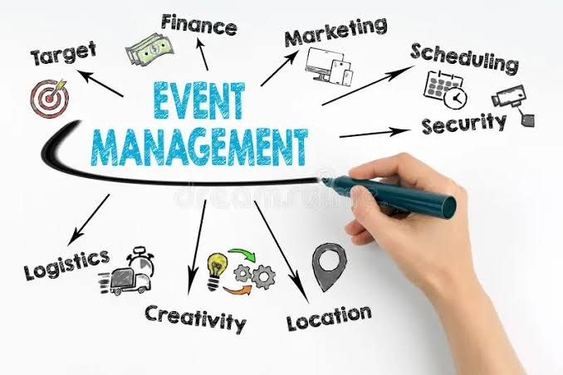
Problem Statement
The Central Problem:
Campus events are often announced through multiple disconnected channels such as WhatsApp groups, social media, notices, and separate registration links. This makes it difficult for students to discover events relevant to their interests and can result in missed participation opportunities.
At the same time, event organizers have to manage event creation, registrations, updates, and participation data across different platforms, making the overall process inefficient.

Slide 4
Objectives
Research & System Design
  Study existing campus event-management and event-recommendation systems.
  Identify gaps in current methods of campus event discovery and management.
  Analyze student preferences and event characteristics relevant to personalized recommendations.
  Design a modular architecture integrating event management, registration, recommendation, and participation tracking.
  Develop an AI-based recommendation approach to suggest relevant events to students.
  Define evaluation metrics for recommendation relevance, usability, engagement, and system performance.
Implementation & Evaluation
  Implement student, organizer, and administrator modules.
  Develop event creation, discovery, registration, and notification functionalities.
  Integrate the AI recommendation module with the event-management system.
  Evaluate the system using recommendation accuracy, response time, user satisfaction, and participation/engagement.
  Maintain a reproducible workflow covering development, testing, evaluation, and documentation.

Slide 5
Literature Survey
Authors | Title of the Paper | Methodology | Inferences | Limitation/Future work
Qiao et al. [1] | Event Recommendation in Event-Based Social Networks, AAAI, 2014 | •Bayesian probabilistic model •Heterogeneous social relationships • Implicit user feedback | • Recommends events using social relationships and user feedback. • Demonstrates the usefulness of heterogeneous social information for event recommendation. | • Focuses mainly on social-network event recommendation. • Campus-specific event management and student engagement are not addressed.
Liu et al. [2] | Combining Heterogeneous Social and Geographical Information for Event Recommendation, AAAI, 2014 | • Social relationship modeling • Geographical information • Implicit feedback | • Combines social and geographical factors to improve event recommendation. • Shows that contextual information can improve recommendation relevance. | • Geographical and social factors may not fully represent individual campus preferences. • Does not provide an integrated campus event-management platform
Macedo et al. [3] | Context-Aware Event Recommendation in Event-Based Social Networks, ACM RecSys, 2015 | • Context-aware recommendation • User preferences • Event context • Cold-start handling | • Uses contextual information to improve event recommendations. • Addresses the difficulty of recommending newly created events with limited interaction history. | • Designed for general event-based social networks. • Institutional event administration and participation tracking are outside the scope.

Slide 6
Problem Gap Identification
Existing Research
Existing studies focus mainly on event recommendation using social, geographical, contextual, and user-preference information.
Context-aware approaches improve recommendation relevance and help address the cold-start problem for new events.
Most research evaluates recommendation techniques as a standalone recommendation problem.
Identified Gap
Limited focus on campus-specific event management and student engagement.
Event creation, discovery, registration, participation tracking, and recommendation are not integrated into one system.
Existing approaches do not sufficiently address the requirements of a controlled institutional environment such as a college campus.
There is a need to combine personalized event recommendation with centralized event management

Slide 7
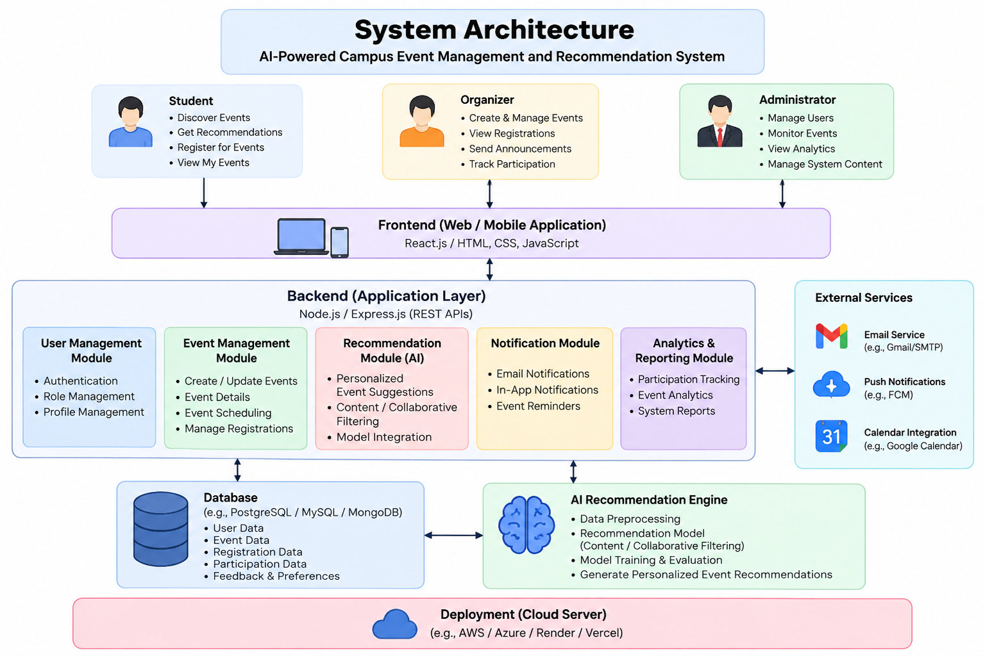
Innovation, Creativity, and Novelty
Key Innovative Features
AI-Based Personalized Recommendations
Recommends relevant campus events based on student interests, preferences, and previous participation.
Centralized Event Management
Combines event creation, discovery, registration, updates, and participation tracking in a single platform.
Context-Aware Event Ranking
Considers factors such as event category, student interests, timing, and participation history to improve recommendations.
New-Event Recommendation
Uses event attributes and content to recommend newly created events even when sufficient historical participation data is unavailable.
Student Engagement Analytics
Analyzes registrations and participation patterns to provide useful insights for event organizers.
Scalable Campus Architecture
The modular design can be extended from a single campus to multiple colleges or institutions.

Slide 8
Progress Since Review-1
Completed Since Review-1
  Generated and structured three core datasets — Attendance, Events, and Interactions — that will train and evaluate the recommendation engine.
  Implemented the AI recommendation engine using sentence-transformer embeddings (all-MiniLM-L6-v2) with cosine similarity, plus a survey-based cold-start path for new users.
  Built and deployed a functional front-end (CampusConnect) covering the landing page and the interest/event-mode onboarding flow.
  Verified end-to-end user flow: interest capture → event-mode preference → personalized recommendations, running locally end to end.
Planned for Review-2
  Complete the organizer and administrator modules (event creation, registration management, participation tracking).
  Evaluate recommendation accuracy, response time, and user satisfaction against the defined metrics.
  Finalize documentation and prepare the reproducible workflow for final submission.

Slide 9
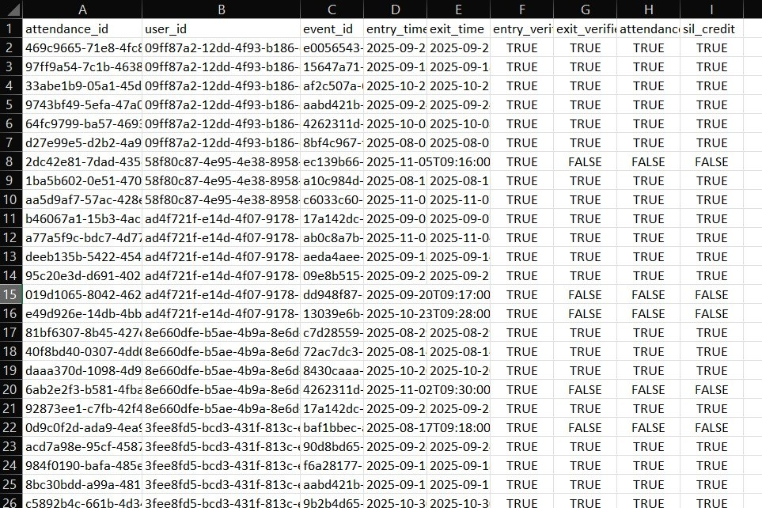
Dataset Details — Attendance
Attendance Dataset
Logs entry and exit activity for every student against each event using QR-based verification.
Key fields: attendance_id, user_id, event_id, entry_time, exit_time, entry_verified, exit_verified, attendance_confirmed, sil_credit.
Dual entry/exit verification flags let the system confirm genuine, full-duration participation, not just a sign-in.
Feeds the “attended” signal used downstream by the interaction and recommendation datasets.

Slide 10
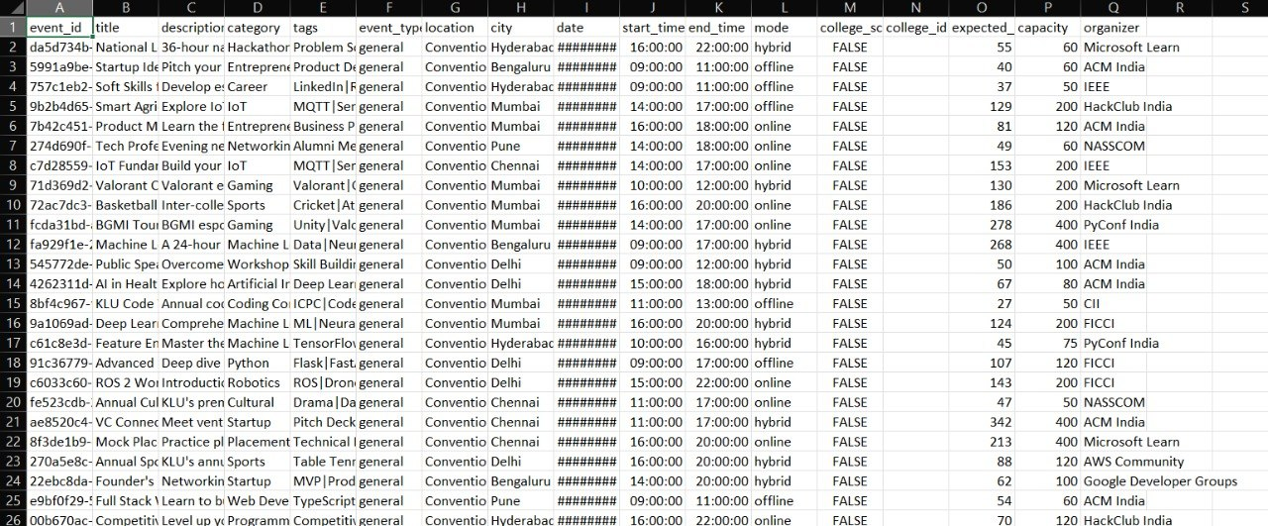
Dataset Details — Events
Events Dataset
Captures full event metadata: title, description, category, tags, mode (online/offline/hybrid), schedule, and capacity.
Spans a wide category mix — hackathons, workshops, technical talks, cultural, sports, placements, and startup/pitch events.
Each event is linked to an organizer (ACM India, IEEE, HackClub, NASSCOM, Microsoft Learn, and others) and a college-specific flag.
Content-rich fields (title, description, tags) are what the recommendation engine embeds for similarity matching.

Slide 11
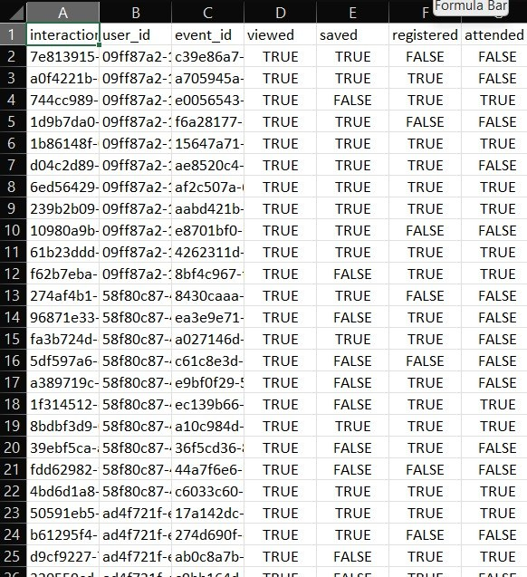
Dataset Details — Interactions
Interactions Dataset
Tracks each user's engagement funnel per event through four boolean flags: viewed, saved, registered, attended.
Implicit signals (viewed, saved) combine with explicit signals (registered, attended) to describe real interest.
Forms the core training signal for the AI recommendation engine, paired with the interaction-weighting scheme.
Links directly to the Attendance and Events datasets via shared user_id and event_id keys.

Slide 12
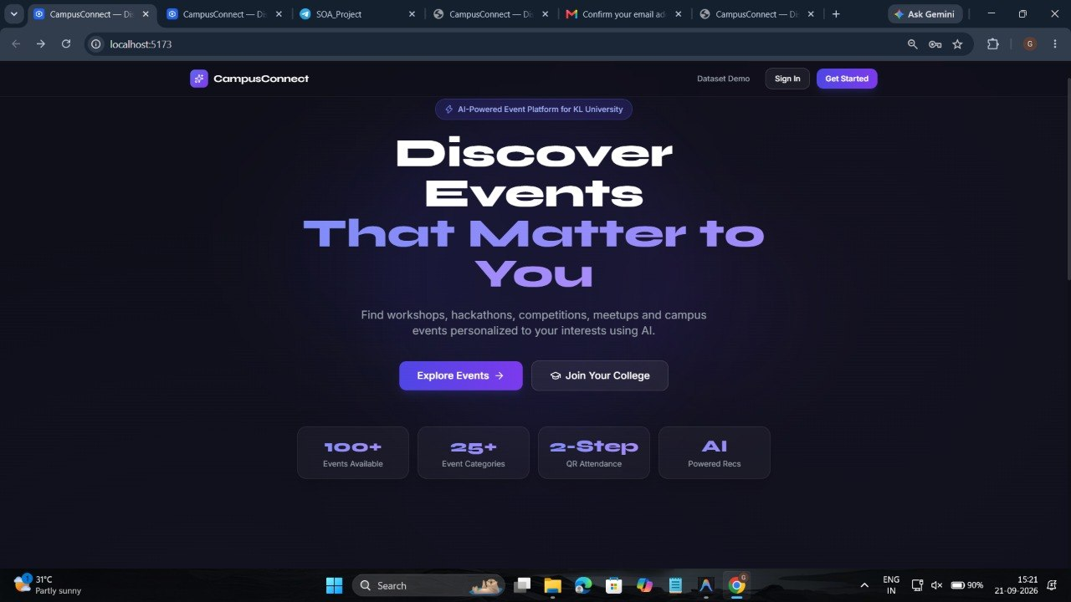
Front-End Implementation — Home Page
Home Page
Landing page for CampusConnect, the AI-powered event platform built for KL University.
Surfaces platform scale at a glance: 100+ events, 25+ categories, 2-step QR attendance, AI-powered recommendations.
Primary calls to action — “Explore Events” and “Join Your College” — route new users straight into the funnel.
Running end to end on a local dev server, confirming the front end is functional and demo-ready.

Slide 13
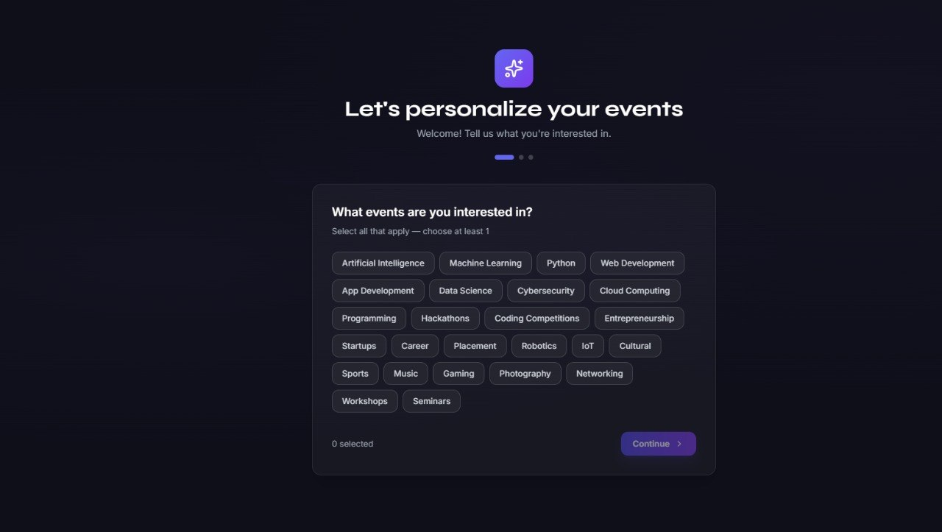
Front-End Implementation — Event Personalization
Onboarding – Interests
Step 1 of the onboarding flow: new users select interest tags (AI, ML, Web Dev, Hackathons, Cultural, Sports, and more).
Multi-select interface feeds directly into the recommendation engine's cold-start preference vector.
At least one interest is required before continuing, guaranteeing every profile starts with usable signal.

Slide 14
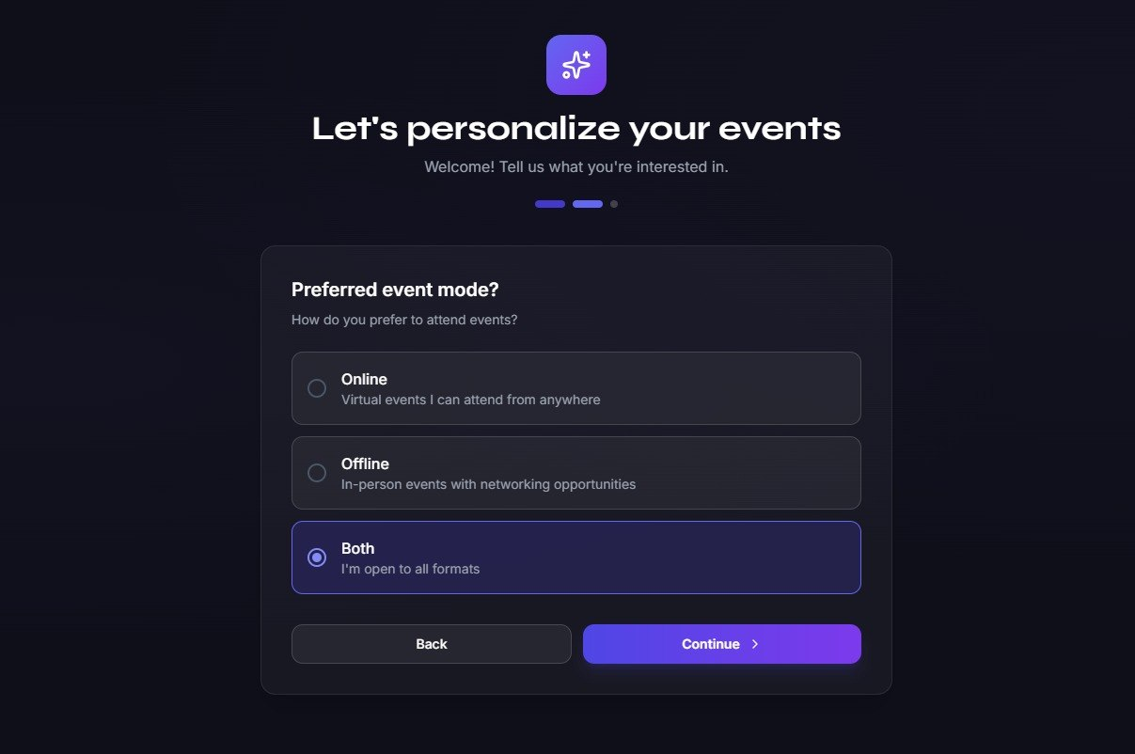
Front-End Implementation — Mode of Event
Onboarding – Event Mode
Step 2 of onboarding: captures the student's preferred event mode — Online, Offline, or Both.
Combines with the interest tags from step 1 to shape the personalized event feed shown next.
A progress indicator keeps users oriented on how many onboarding steps remain.

Slide 15
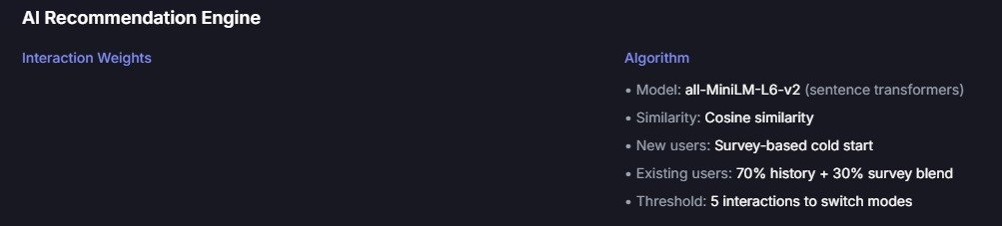
Front-End Implementation — Algorithm Used
AI Recommendation Engine
Embedding model: all-MiniLM-L6-v2 (sentence transformers) encodes event content for similarity matching.
Similarity metric: cosine similarity between user and event embeddings.
Cold start: new users are matched using survey-based preferences from onboarding.
Existing users: recommendations blend 70% interaction history with 30% survey signal, switching modes after a 5-interaction threshold.

