Slide 1

Team 01 : Clinic Plus
Team Members:
Ankita Kar
Ankush Mishra
Shreya Iyer
SriKathiravan
Cohort Code : INTCHN20SE001

Slide 3
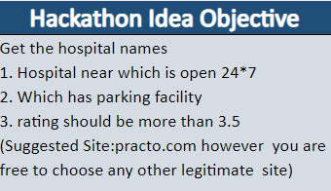
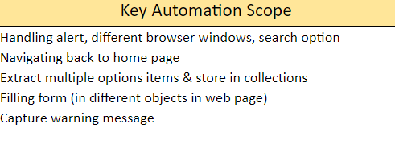
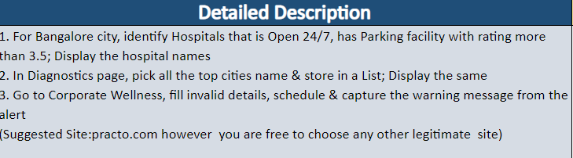
Overview ( www.practo.com)

Slide 4
Understanding the problem
Functional Requirements
Functional Requirement No. | Function Requirement Description
FR0 | It should be compatible for multiple browsers.
FR1 | User should be able to access the website.
FR2 | User should be able to search Hospital near him
FR3 | User should be able to apply filters
FR4 | Hospitals with rating more than 3.5 should be displayed
FR5 | It should be able to access all the results coming out.
FR6 | It should create error message on invalid details

Slide 5
Manual Testing Link :
https://docs.google.com/spreadsheets/d/1iT-Y8m0fbBJc5qxCZ2co5FYNtdk6tLl0NFTvvfFLk5w/edit#gid=845186007

Slide 6
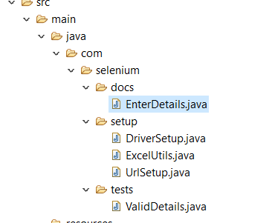
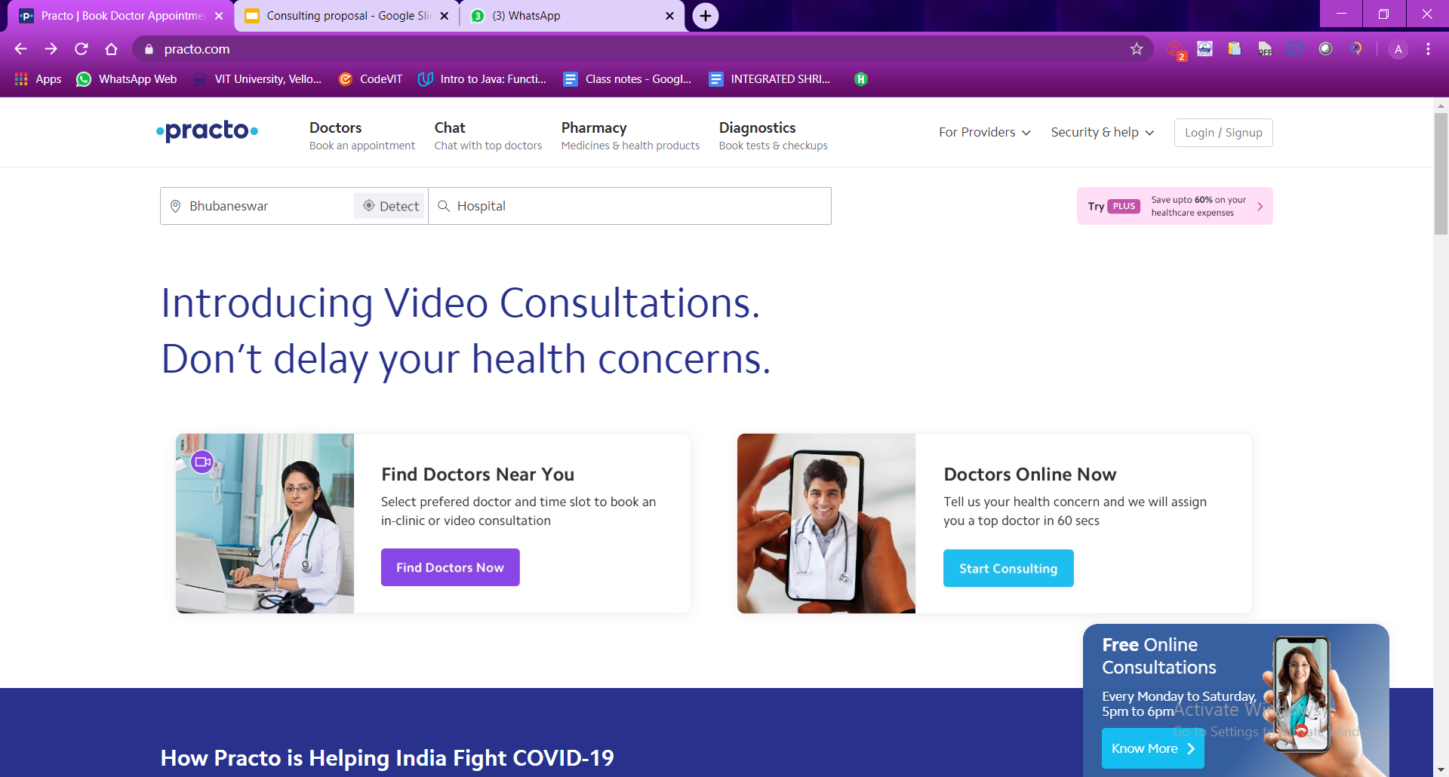
List of Classes

Slide 7
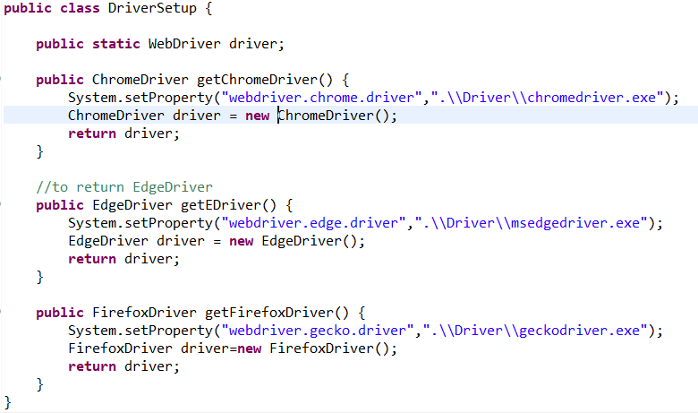
Driver Setup

Slide 8
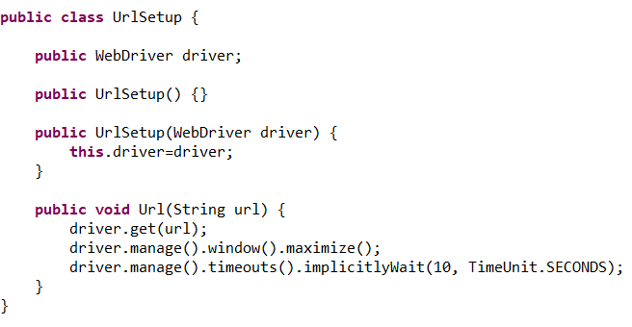
URL Setup

Slide 9
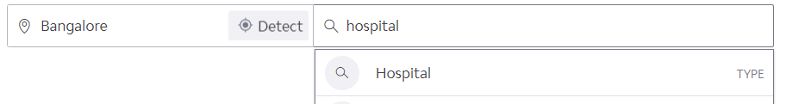
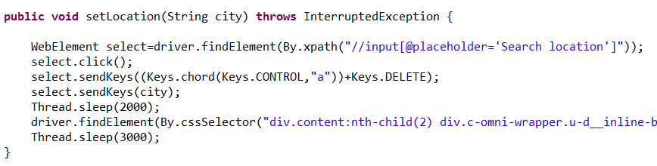
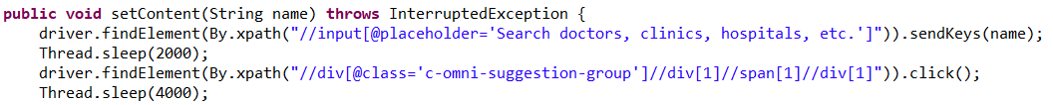
Step 1 : Identifying “Hospitals” for “Bangalore”

Slide 10
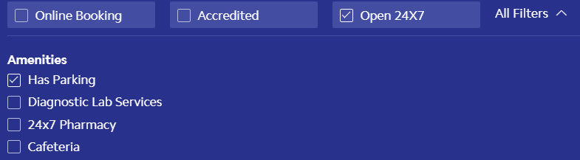
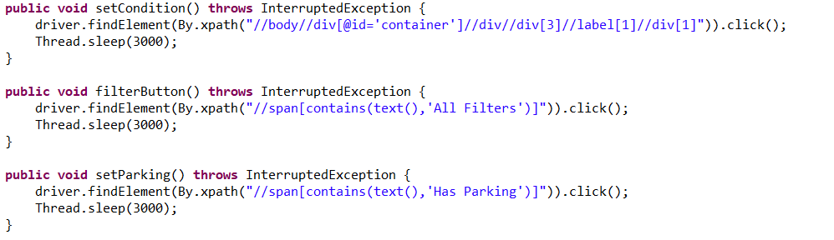
Step 2 : Applying filters for “Open 24*7” and “Parking”

Slide 11
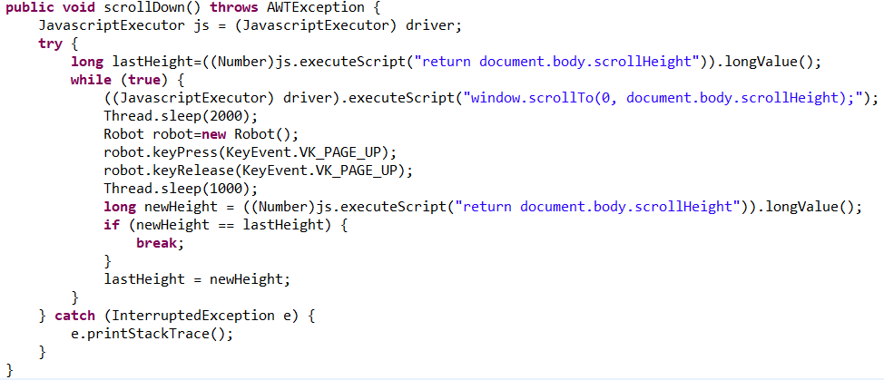
Step 3 : Hospitals with rating above “ 3.5 Stars ”

Slide 12
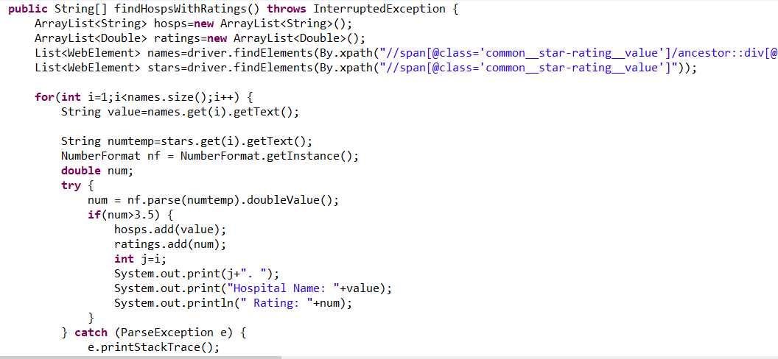
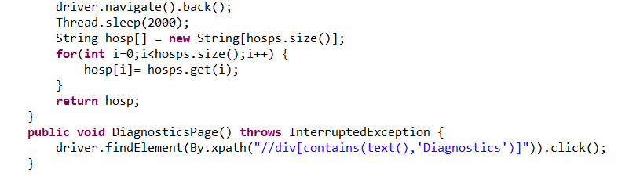

Slide 13
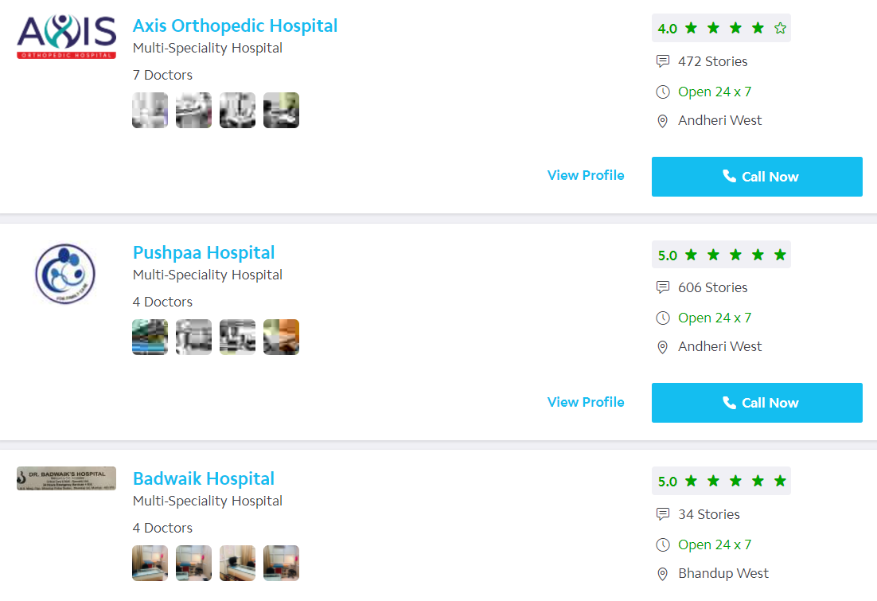
1. Hospital Name: NU Hospitals Rating: 4.5
2. Hospital Name: Jayashree Multispeciality Hospital Rating: 4.0
3. Hospital Name: Springleaf Healthcare Rating: 4.0
4. Hospital Name: NU Hospitals Rating: 4.5
5. Hospital Name: Cloudnine Fertility - IVF Centre, Old Airport Road Rating: 5.
6. Hospital Name: Cloudnine Fertility - IVF Centre, Jayanagar Rating: 4.5
7. Hospital Name: Trustwell Hospitals Rating: 5.0
8. Hospital Name: Cloudnine Fertility - IVF Centre, Whitefield Rating: 5.0 (To be continued)
Top Hospitals

Slide 14
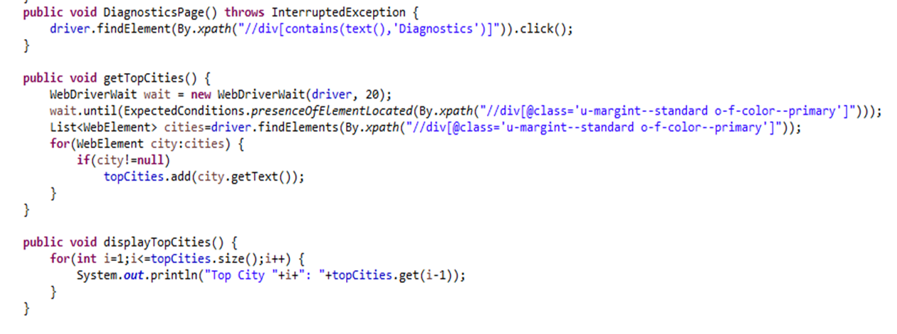
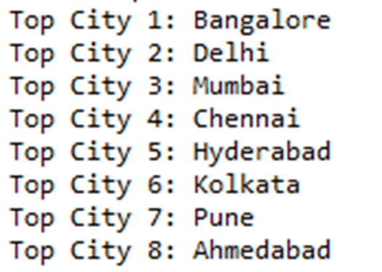
Step 4 : Go To Diagnostics Page and Display Top Cities

Slide 15
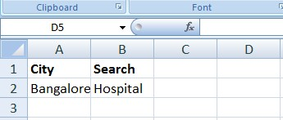
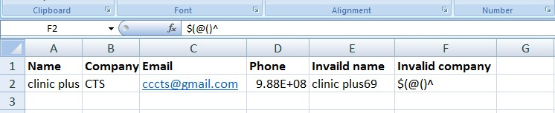
TEST CLASS : EXCEL UTILS
RETRIEVING DATA FROM EXCEL

Slide 16
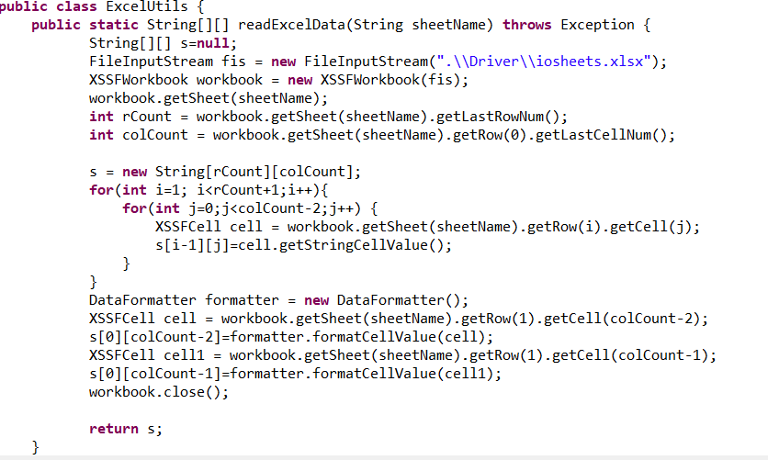

Slide 17
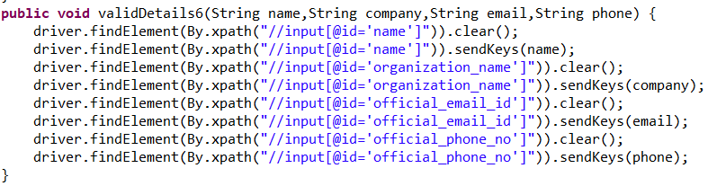
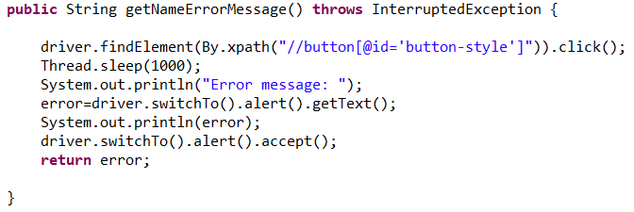
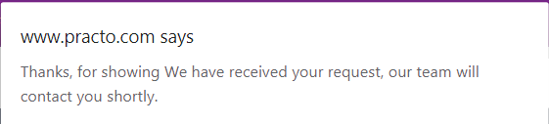
Step 5 : To enter valid Details and retrieve “Success Text”

Slide 18
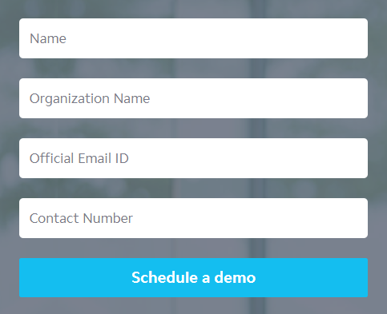
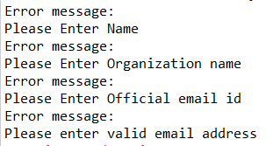
Step 6 : To enter invalid details in “Corporate Wellness”
All fields are left empty
Only “Name” is entered
Only “Name” and “Organization name” are entered
Only “Name”, “Organization name”, and “Official Email-id” are entered
List of Invalid Test Cases :

Slide 19
TEST CLASS : VALID DETAILS

Slide 20
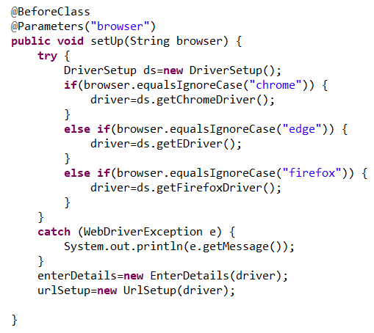
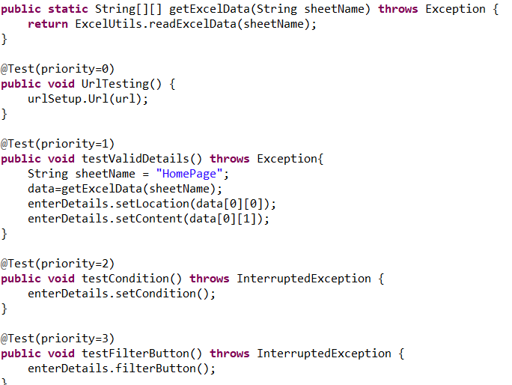

Slide 21
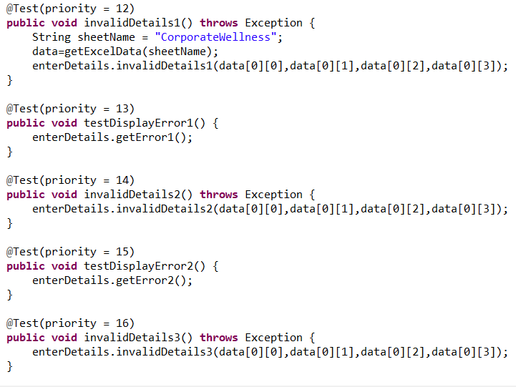
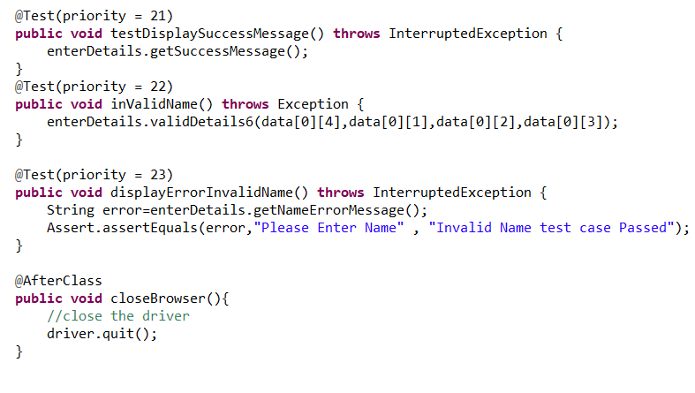

Slide 22
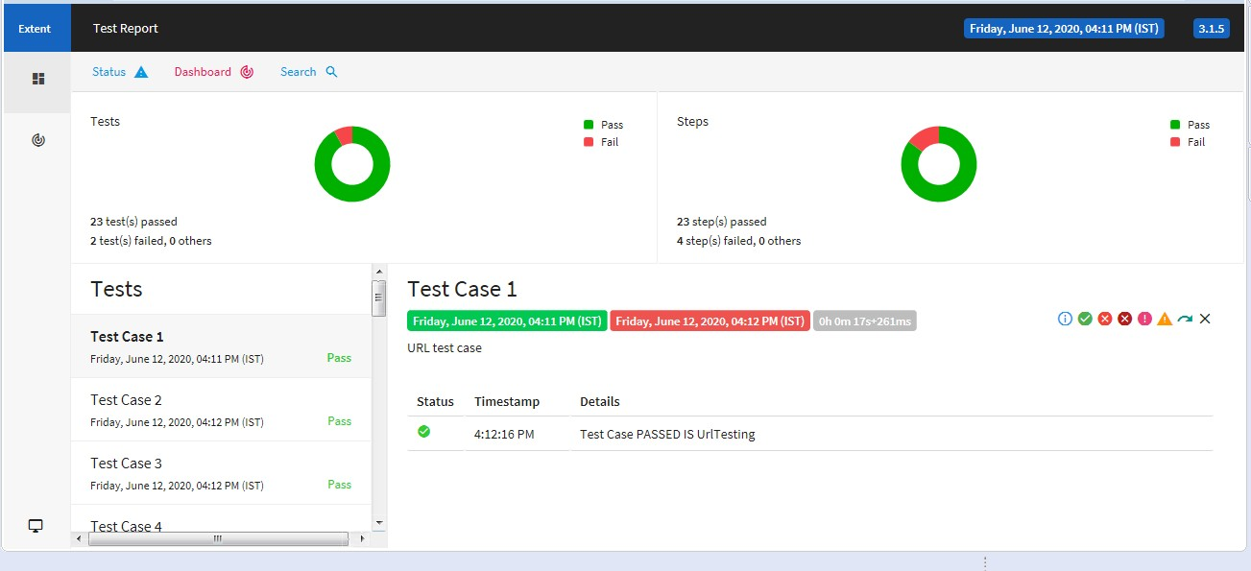
EXTENT REPORT

Slide 23
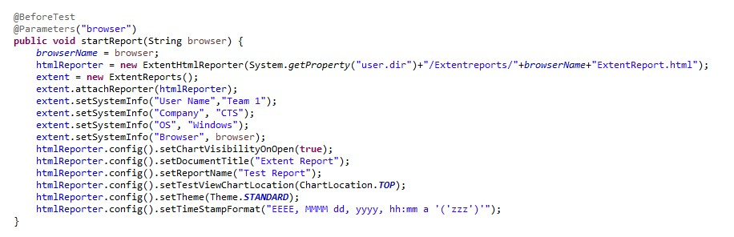

Slide 24
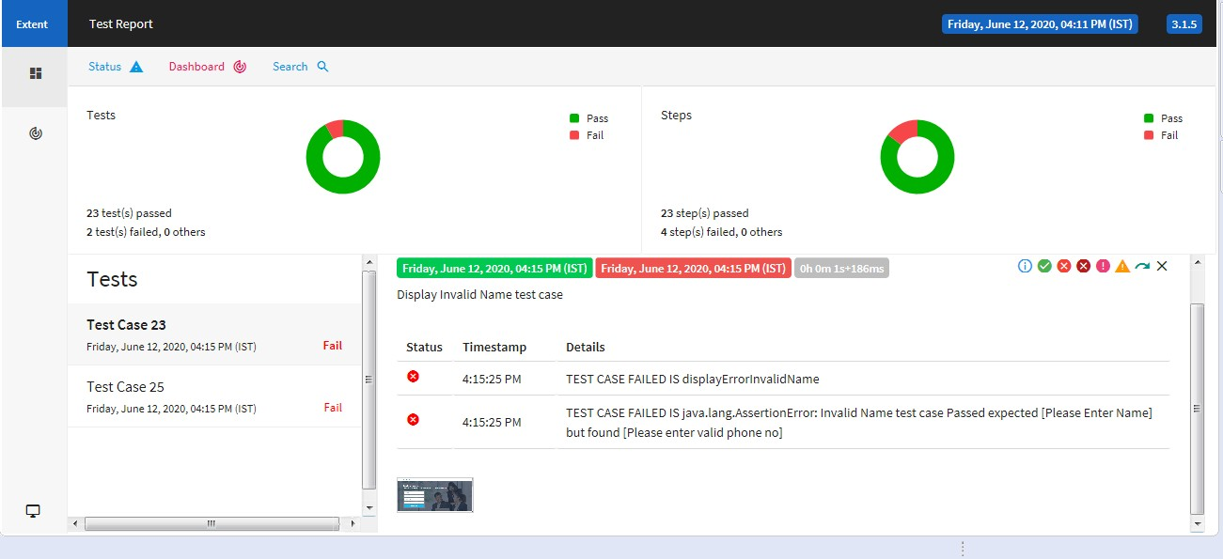
FAILDED TEST CASE WITH SCREENSHOT

Slide 25
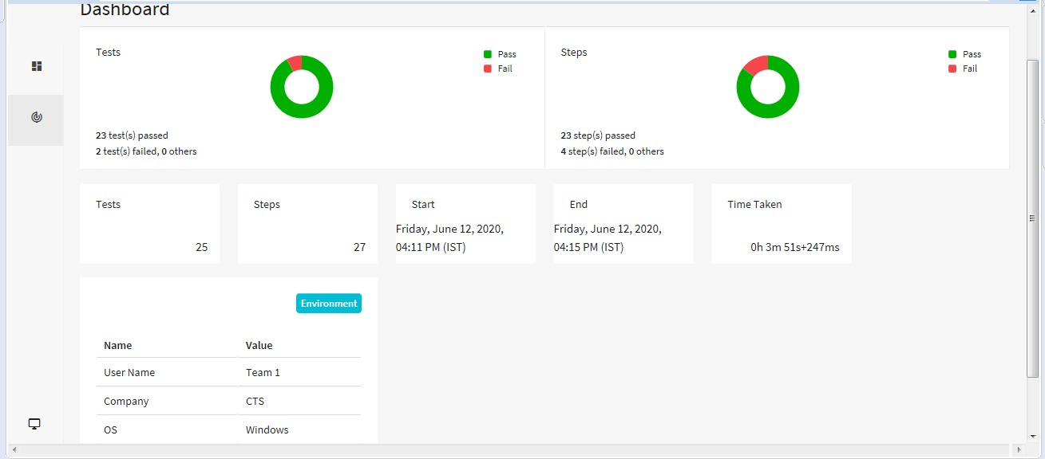
STATUS

Slide 26
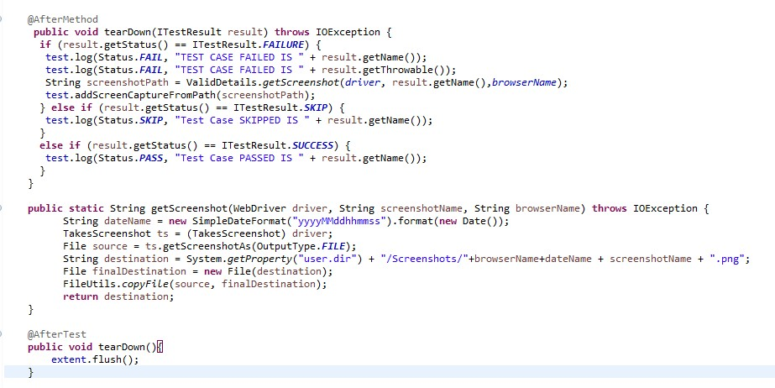

Slide 27
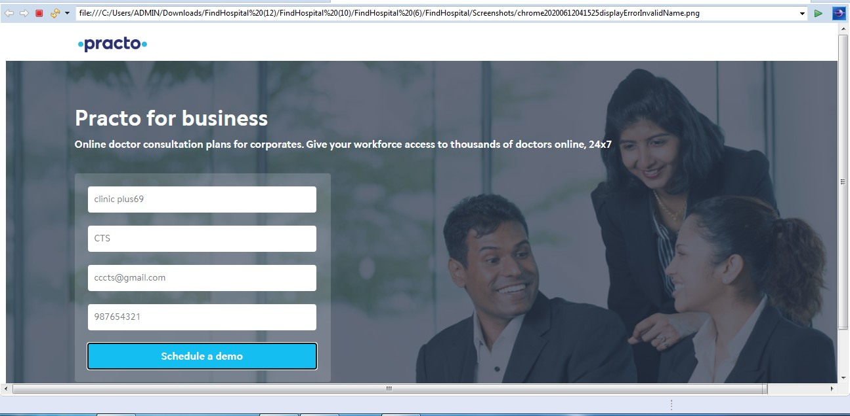
SCREENSHOT AT RUNTIME

Slide 28
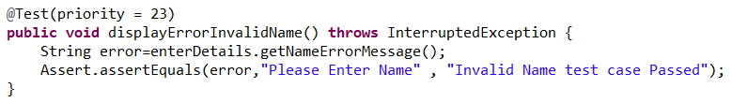
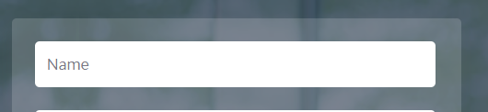
BUG REPORT 1
BUG ID : 01
INPUT: clinicplus69
BUG DESCRIPTION : The “NAME” field accepts Alphanumeric value and does not return error message.

Slide 29

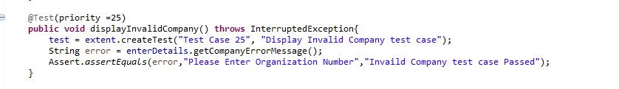
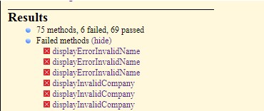
BUG REPORT 2
BUG ID : 02
INPUT: $(@()^
BUG DESCRIPTION : The “ORGANISATION NAME” field accepts Alphanumeric value and does not return error message.

Slide 30
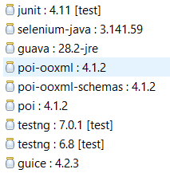
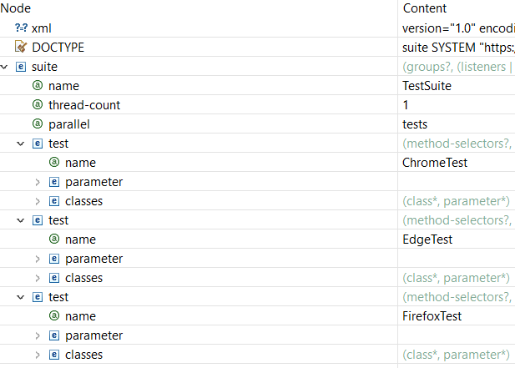
DEPENDENCIES
TESTNG FILE

Slide 31
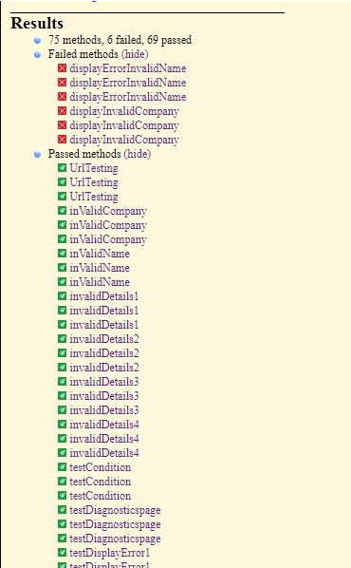
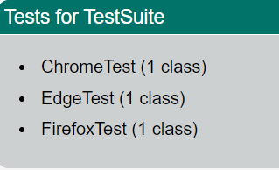
TEST SUITE

Slide 32


