Slide 1

Project Title - Seasonal Agriculture Performance Analysis
Muppidi Sri Kumar
Malla Reddy College Of Engineering
AICTE STU ID : STU679c9a8c8b9a01738316428

Slide 2

PROBLEM STATEMENT
Agricultural performance changes across seasons due to variations in rainfall, temperature, humidity, soil conditions, farming practices, resource usage and market conditions. Raw data alone does not clearly show these seasonal differences. The problem is to analyze the agricultural dataset and identify meaningful patterns, relationships and variations in yield, production, profitability and resource efficiency across seasons.

Slide 3
This project performs Exploratory Data Analysis on seasonal agricultural data. The analysis compares crop yield, production, revenue, profit, environmental conditions, water usage, irrigation methods and regional performance. Statistical summaries, comparison charts, scatter plots, correlation analysis and distribution analysis are used to identify useful seasonal patterns and support data-driven agricultural planning.
PROJECT DESCRIPTION

Slide 4

WHO ARE THE END USERS?
• Farmers and agricultural planners • Agricultural researchers and analysts • Government and policy-making bodies • Irrigation and resource management teams • Agribusiness organizations • Students and researchers working on agricultural analytics

Slide 5

TECHNOLOGY USED
Programming & Analysis • Python • Pandas and NumPy • Matplotlib and Seaborn Tools • Google Colab • CSV Dataset • Data Visualization and Exploratory Data Analysis

Slide 6
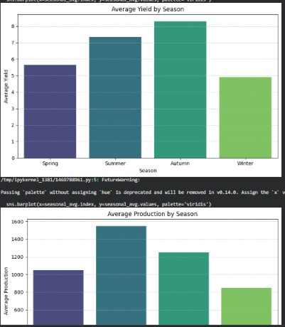
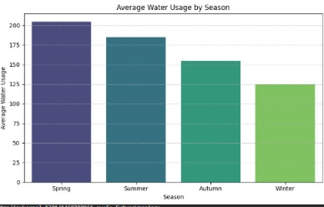
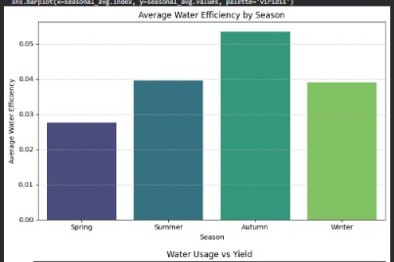
RESULTS
Seasonal Performance Comparison
Key observation: Yield and production vary noticeably by season. Water usage is highest in Spring and decreases towards Winter, while water efficiency is strongest in Autumn.

Slide 7
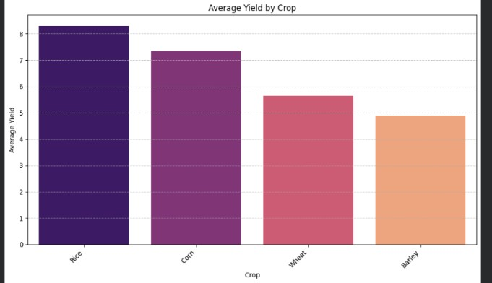
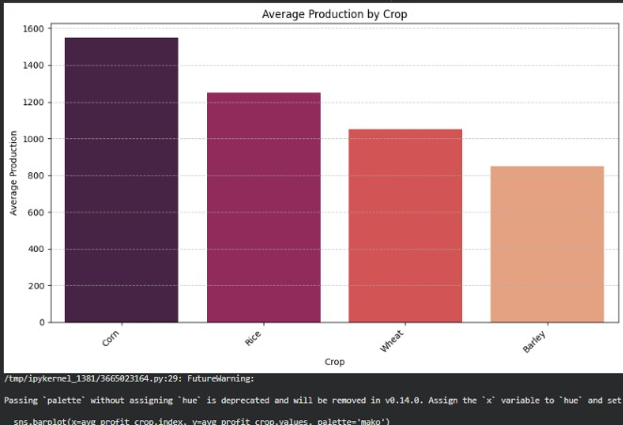
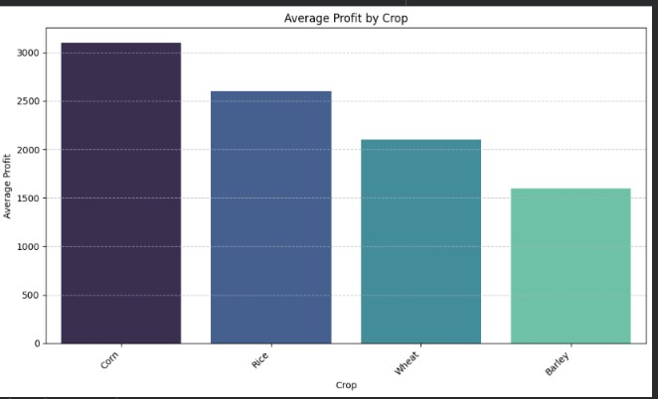
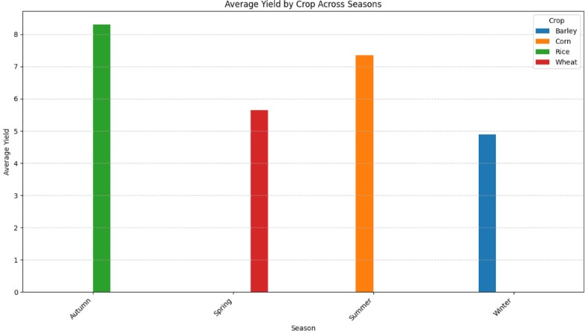
RESULTS
Crop Performance and Profitability
Key observation: Crop performance differs significantly. Rice shows the highest average yield, while Corn shows the highest average profit and production in the analyzed data.

Slide 8
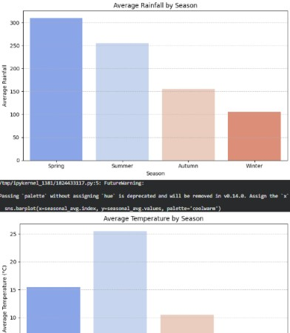
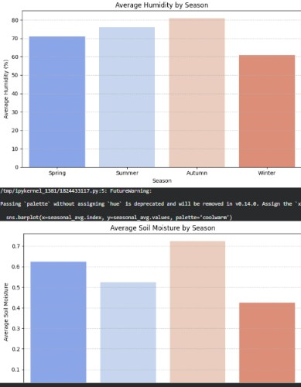
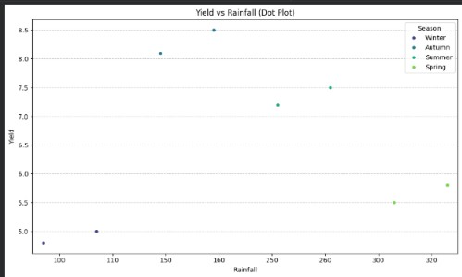
RESULTS
Environmental Conditions Across Seasons
Key observation: Environmental conditions change strongly between seasons. Spring has the highest rainfall, Autumn has higher humidity and soil moisture, while Summer records the highest average temperature.

Slide 9
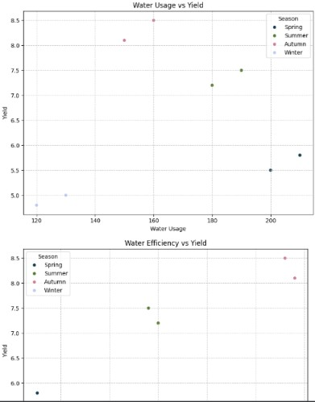
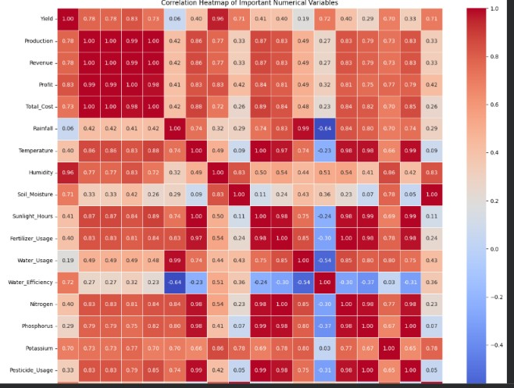
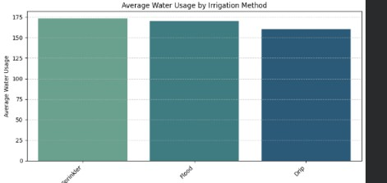
RESULTS
Resource Usage, Irrigation and Variable Relationships
Key observation: Sprinkler irrigation has the highest average water usage among the methods shown. The correlation heatmap highlights strong relationships among production, revenue, profit and agricultural input variables.

Slide 10
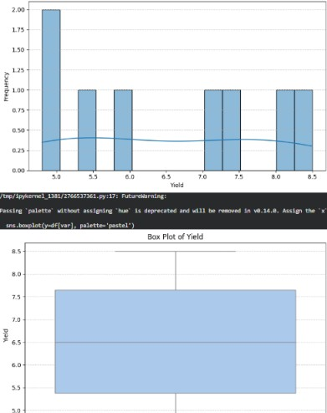
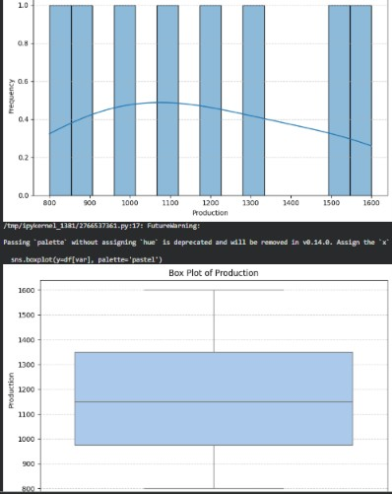
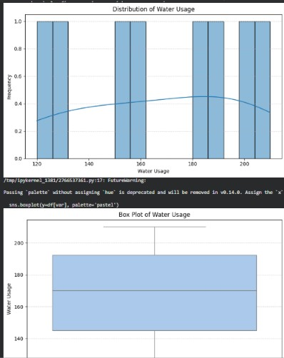
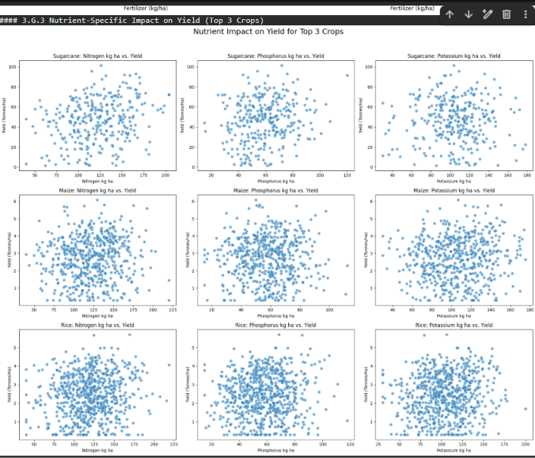
RESULTS
Distribution and Outlier Analysis
The histograms and boxplots were used to examine the distribution of yield, production and water usage and to identify possible extreme observations without automatically removing them.

Slide 11
FUTURE SCOPE
• Include real-time weather and market price data. • Expand the dataset with more crops, regions and multiple years. • Build predictive models for crop yield and profitability. • Develop an interactive dashboard for seasonal monitoring. • Use GIS and satellite data for region-level agricultural analysis. • Provide personalized recommendations for irrigation and crop planning.

Slide 12
GitHub Link
https://github.com/Srikumarsk/Seasonal_Agriculture_Performance_Analysis
Repository Contents:
Project Presentation (PPT)
Problem Statement
Agricultural Dataset (CSV)
Python Source Code and Data Analysis

Slide 13
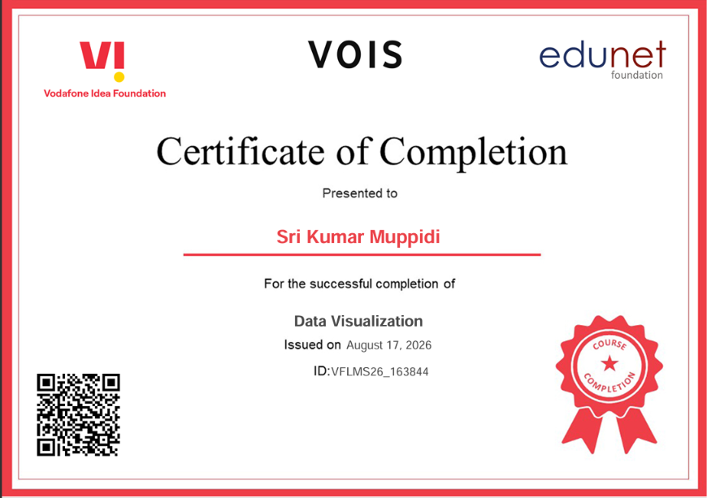
VOIS Course Completion Certificate

Slide 14
THANK YOU
.
.

