Slide 1
U.S. Bank ICM (ATM Cash Forecasting)

Slide 2
Used RandomForestRegressor algorithim to train the model

Slide 3
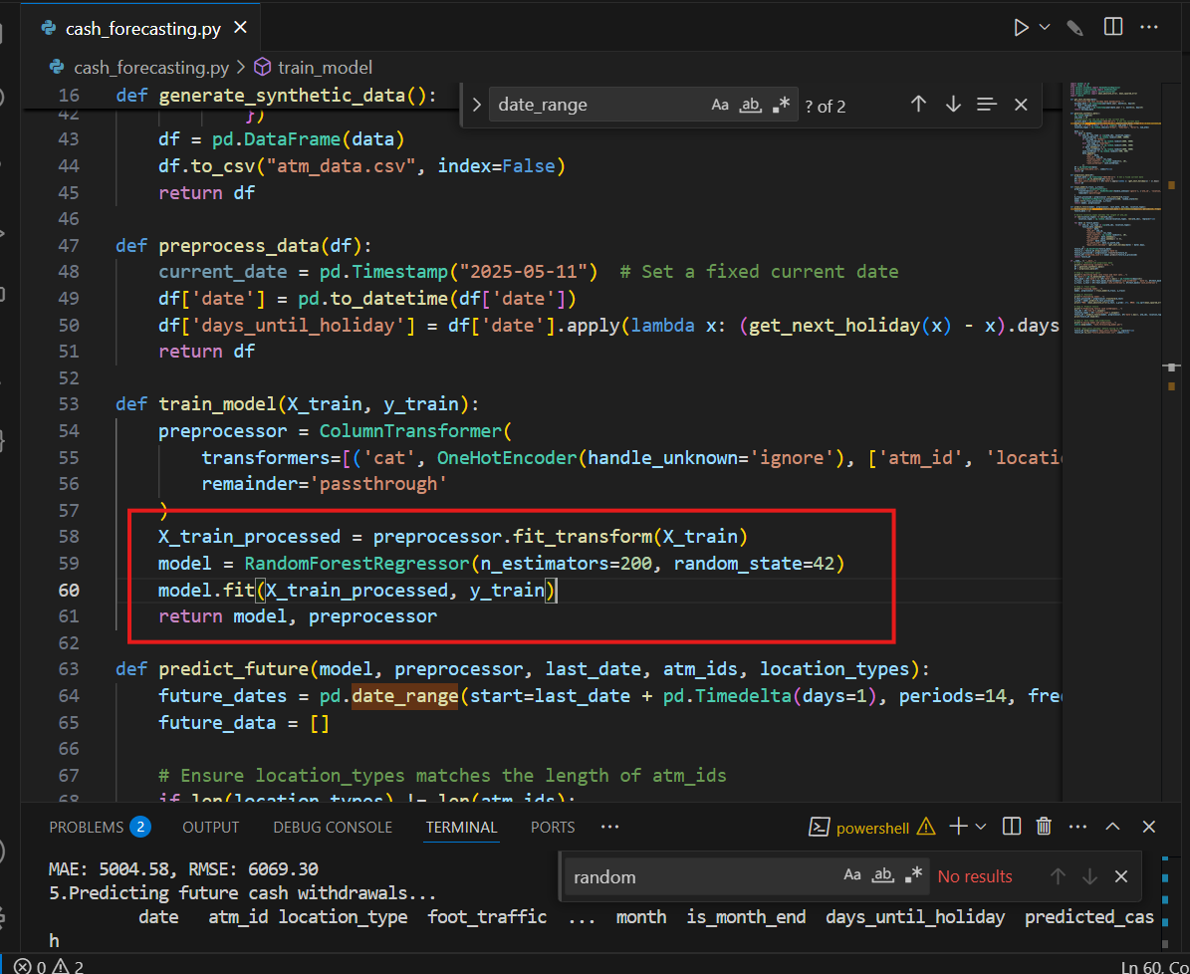

Slide 4
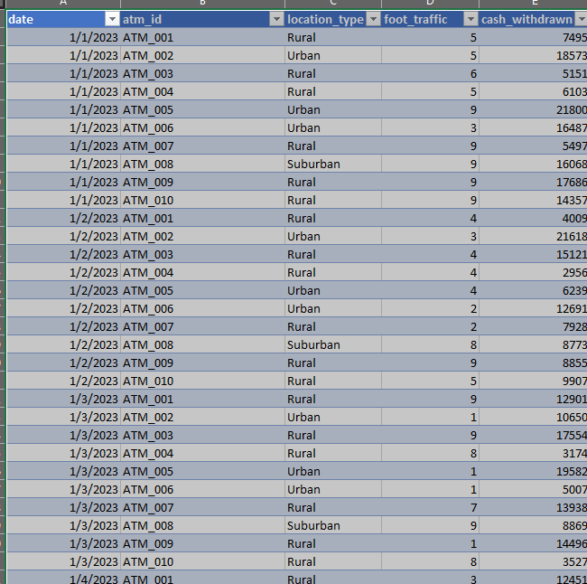
Synthetic ATM transaction data generated for last two years as below to train the model

Slide 5
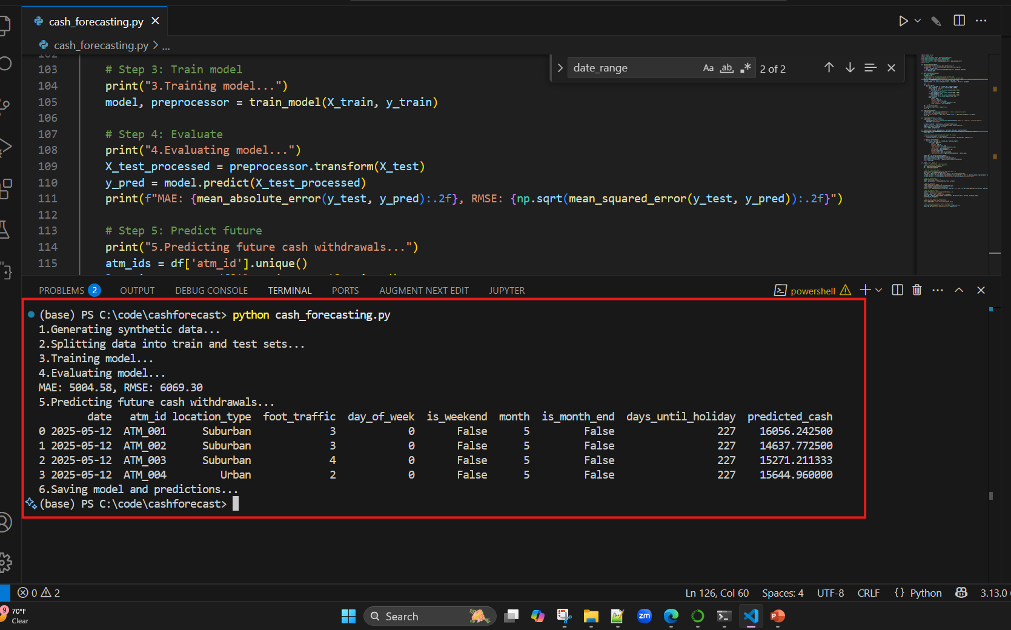
Steps to train and predict

Slide 6
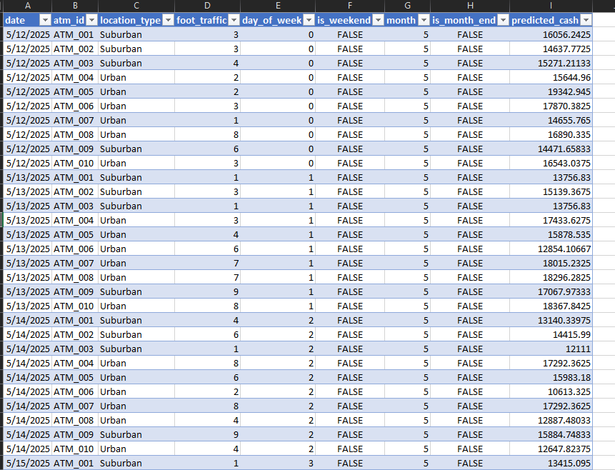
Predictions result for the next 14 days

Slide 7
Algorithm used : RandomForestRegressor Language : Python IDE : Visual Studio Code Lib used: pandas numpy scikit-learn joblib

