Slide 1

Enhancing Information Integrity A Machine Learning and NLP Approach to Fake News Detection
Phase 1 Presentation
Srilakshmi Yelamacharla
Pranay Kumar Pokala
Hima chandrika kondisetty

Slide 2
Literature Review
Detecting fake news has become increasingly important in today's digital age, where misinformation can spread rapidly and have significant consequences. Here's a brief literature review highlighting some key studies and approaches in the field of fake news detection:
"Fake News Detection on Social Media: A Data Mining Perspective" by Shu et al. (2017):
This study proposes a framework for detecting fake news on social media using data mining techniques. They explore features such as linguistic characteristics, user engagement, and propagation patterns to distinguish between fake and real news.
Used Logistic Regression and NLP Technique(Term Frequency-Inverse Document Frequency)
"Fake News Detection: A Deep Learning Approach" by Patel et al. (2018):
Patel et al. propose a deep learning-based approach for fake news detection, leveraging techniques such as Convolutional Neural Networks (CNNs) and Long Short-Term Memory (LSTM) networks. They demonstrate the effectiveness of their approach on a large dataset of news articles.
Used Multi Layer Perceptron and NLP Technique(Stance Detection)

Slide 3
Literature Review
"Detection of Fake News in Social Media Networks" by Wang et al. (2018):
Wang et al. present a comprehensive survey of fake news detection techniques in social media networks. They discuss various approaches, including content-based, user-based, and propagation-based methods, highlighting their strengths and limitations.
Used Classification Algorithms, Python script, and statistical methods
"A Survey of Fake News Detection Methods" by Sharma et al. (2019):
Sharma et al. provide an extensive survey of fake news detection methods, categorizing them into linguistic, network-based, and hybrid approaches. They discuss the challenges associated with each approach and identify future research directions.
Survey on all previous approaches (Solutions or Mitigation Techniques)
"Fake News Detection Using Natural Language Processing" by Jin et al. (2020):
Jin et al. propose a fake news detection framework based on Natural Language Processing (NLP) techniques. They extract linguistic features from news articles and use machine learning algorithms to classify them as fake or real
Used NLP Techniques and Logistic Regression(Count Vectorizer)

Slide 4
Our Dataset
The dataset is a collection of news articles
https://www.kaggle.com/code/therealsampat/fake-news-detection/input Number of files: 2 Total size: 116.37 MB
Document 1: Fake.csv Size: 62.79MB
Number of rows: 23481 Number of columns: 4
Document 2: True.csv Size: 53.58MB
Number of rows: 21417 Number of columns: 4

Slide 5
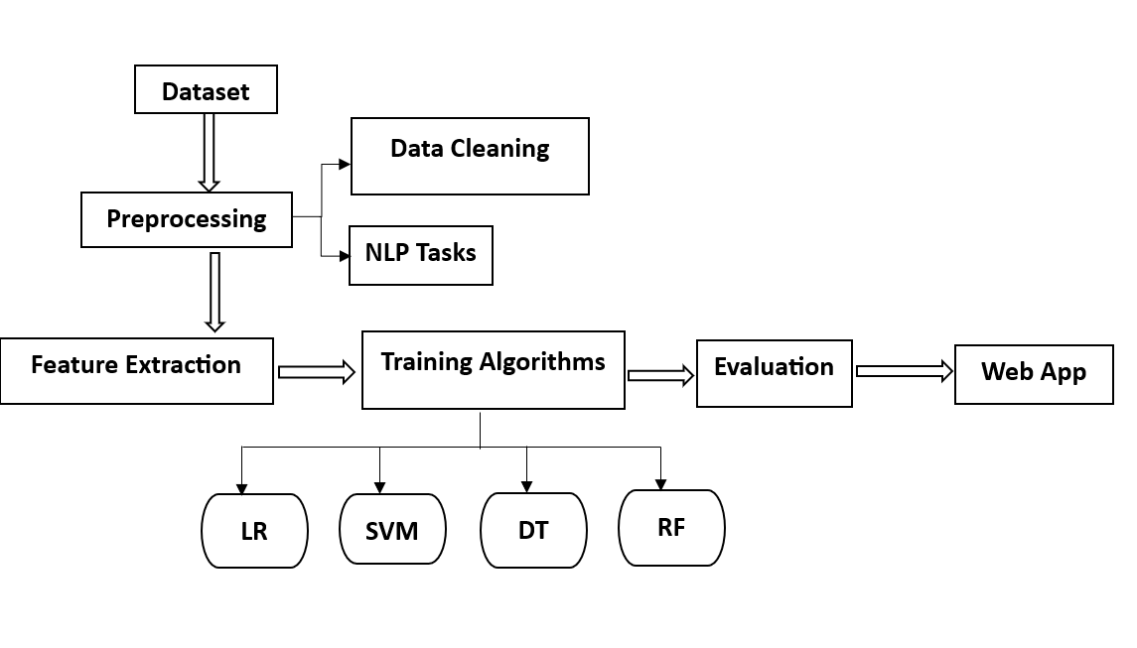
Our Approach

Slide 6
What’s New
Integrating NLP Techniques while pre-processing
Using Word2Vec Embedding Technique for capturing semantic relationships between words
Using Parallel Processing to improve Efficiency
Using Streamlit interface

Slide 7
Data Preprocessing
Combined two datasets real and fake
Created a target variable in each dataset i.e 1 for real data and 0 for fake data
Ensured that there are no null values

Slide 8
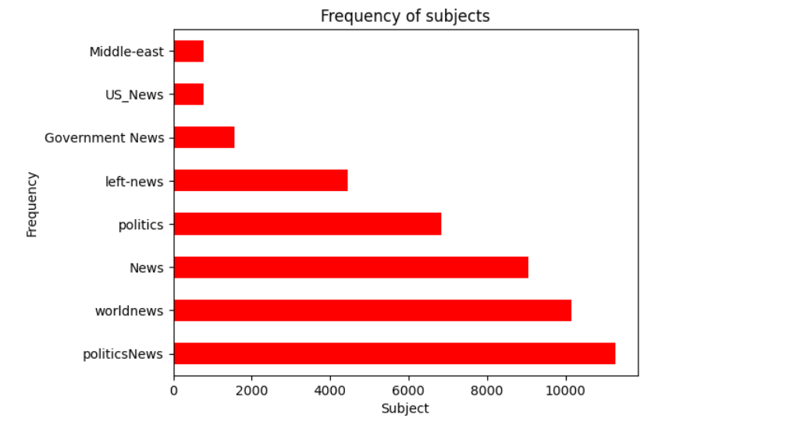
Data Visualization Frequency of Subjects

Slide 9
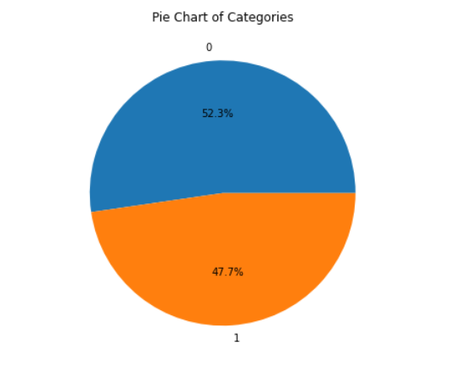
Pie Chart depicting Target variable

Slide 10
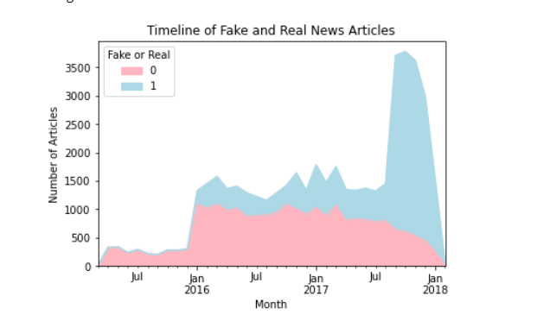
Timeline of Fake and Real News Articles

Slide 11
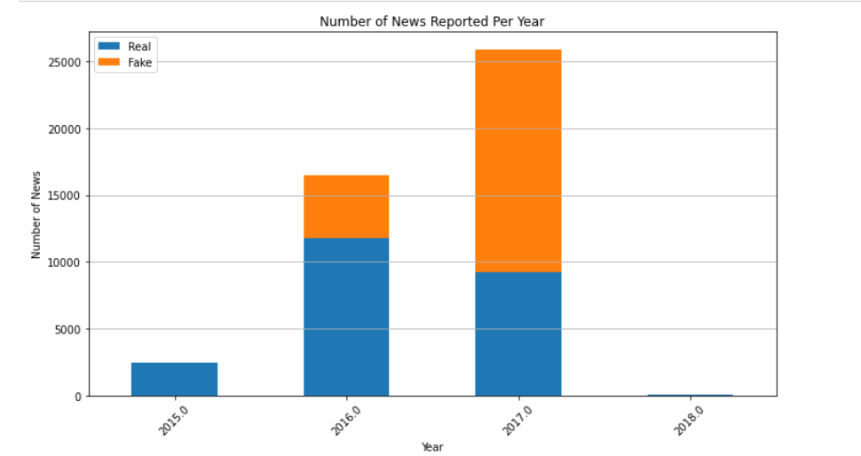
News Reported per year

Slide 12
References
https://arxiv.org/abs/2002.00838
https://gvpress.com/journals/IJRIA/vol8_no1/vol8_no1_2020_03.html
https://mau.diva-portal.org/smash/record.jsf?pid=diva2%3A1479925&dswid=2519

Slide 13

Thank you

