Slide 1
Improving Performance of Distributed Systems through Frequent Block Access Pattern-Based Prefetching Algorithm

Slide 2
SUBMITTED BY
P.Sri Lakshmi (AP19110010219)
A.Krishna Teja (AP19110010181)
J.Manogna (AP19110010153)
K.Mohananjali (AP19110010182)

Slide 3
Outline
Introduction
Architecture of the DFS
Proposed Algorithm
Simulation Results
Conclusion

Slide 4
Introduction
Distributed File System (DFS) is used as the back end in a cloud computer system
◦ Efficient storage and retrieval of large data
Web applications deployed in cloud
◦ Performs read operations more frequently and less frequently carry out write/update operations
◦ Improving performance of read operations of the DFS is an important research problem
Prefetching file blocks and keep it in the local cache
◦ Improves performance of the DFS
◦ Which files and which file blocks to prefetch?

Slide 5
Introduction
In this paper, we have proposed
frequent block access pattern-based prefetching algorithm.
A new placement algorithm for file blocks by considering main memory, solid state drives (SSDs)
The proposed algorithm
Increases the hit ratio of the local cache and local SSD cache
Reduces the average read access time of the distributed file system.

Slide 6
Outline
Introduction
Architecture of the DFS
Proposed Algorithm
Simulation Results
Conclusion

Slide 7
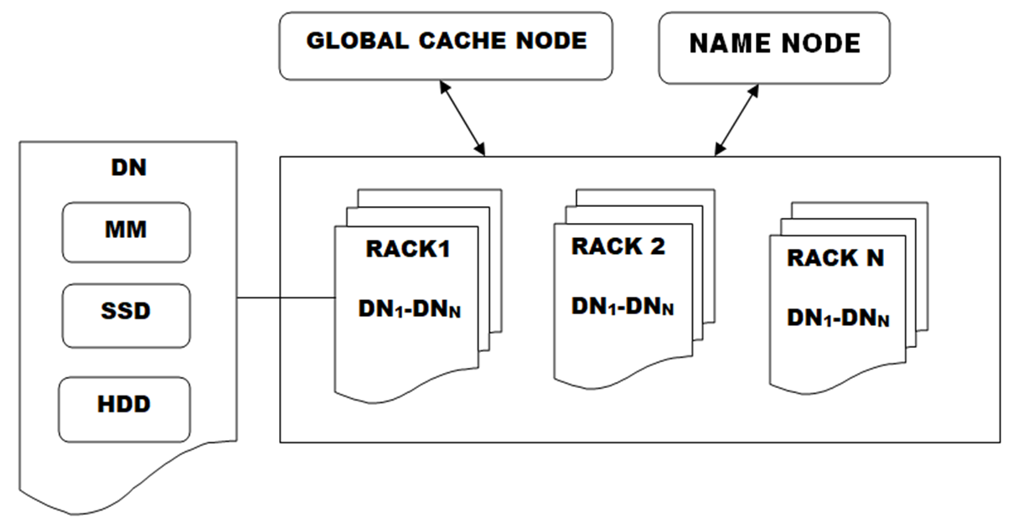
Architecture of the DFS

Slide 8
Architecture of the DFS Contd…
The DFS we have considered consists of
a name node (NN),
a global cache node (GCN) and
multiple data nodes (DNs).
NN – Maintains information about the files stored in data nodes.
GCN - Maintains a global cache (GC) which can be accessed by client application programs running in all DNs.
DN-Execute client application programs and also store and retrieves file blocks.
Each node contains 3 levels of memory
Main memory, SSD and Hard disk

Slide 9
Outline
Introduction
Architecture of the DFS
Proposed Algorithm
Simulation Results
Conclusion

Slide 10
Calculating Support For File and Confidence for block access patterns
Logs are maintained in all DNs which record details of file block requests issued by client application programs.
From the log entries, support values for the files and confidence for block access patterns(BAPs) are calculated.
Support for a file F1= no. of entries of F1/ total log entries.
Confidence for Block Access Patterns of [F1B1B2] = no.of times F1B1B2 appears/total no.of times F1B1 appears
All BAPs for F1 are arranged in descending order and the top (fap_th) percent of BAPs are considered as FBAP s for F1.

Slide 11
Procedure For Prefetching and filling
Support values are calculated for each file present in the log.
Confidence values for BAPs of each file are calculated.
The list of BAPs are sorted in descending order based on confidence value.
From this sorted list, the local cache and SSD cache of a data node are filled according their respective size.
The same procedure is followed for prefetching and filling the global cache node local cache and SSD cache by considering the confidence value w.r.t all DNs.
A fresh prefetching is initiated when hit ratio falls below the threshold and this will not affect the regular operations of the system.

Slide 12
Procedure for Reading From the DFS
A client application program (CAP) which is executing in a particular DN has to read a file block (FB) by using the following procedure.
◦Checks local cache of the DN where it is requested and can be read directly. (if not available)
◦Checks local cache of GCN. If it is available, then BAP with FB is transferred to the local cache of DN where it is requested. (if not available)
◦Checks SSDcache of DN where it is requested and copy BAP with FB to local cache. (if not available)
◦Checks SSDcache SSD of GCN. If it is available, then BAP with FB is transferred to the local cache of DN where it is requested. (if not available)
◦Checks in the file system.

Slide 13
Procedure for writing to the DFS
A CAP running in DN may write a FB to the DFS by using the following procedure.
◦Invalidating all the entries of existing block.
◦Writing a new block which doesn’t exist.

Slide 14
Outline
Introduction
Architecture of the DFS
Proposed Algorithm
Simulation Results
Conclusion

Slide 15
Simulation Experiments
We have considered
◦Ten racks (R1 to R10).
◦Ten data nodes (DN1 –DN10) for each rack.
◦Log with 1000000 entries of read requests.
◦10000 files are present in the DFS environment.
◦Each file consists of 100 blocks.
◦Block size 4kb.
◦Each request length varies from 5 to 15 blocks.
We have implemented support-based (SBMS) algorithm and frequent block access pattern-based (FBAP) algorithm and compared the performance of both.
We first calculated support for all the files in the log.
For every file we extracted file block access patterns by calculating confidence values.

Slide 16
Simulation Experiments contd….
we have placed the file block access patterns in main memory and SSDs as per the procedure discussed above.
For every run in simulation, we examined 10000 sessions of read and write requests.
Calculated the average read access time for every run.
We have observed the performance by varying the local cache size from 100 to 500 blocks and fixed the global cache size as 3000 and 5000 blocks.
Performance is measured in terms of Average read access time and hit ratios.
We found that the proposed FBAP algorithm performs better than SBMS algorithms.

Slide 17
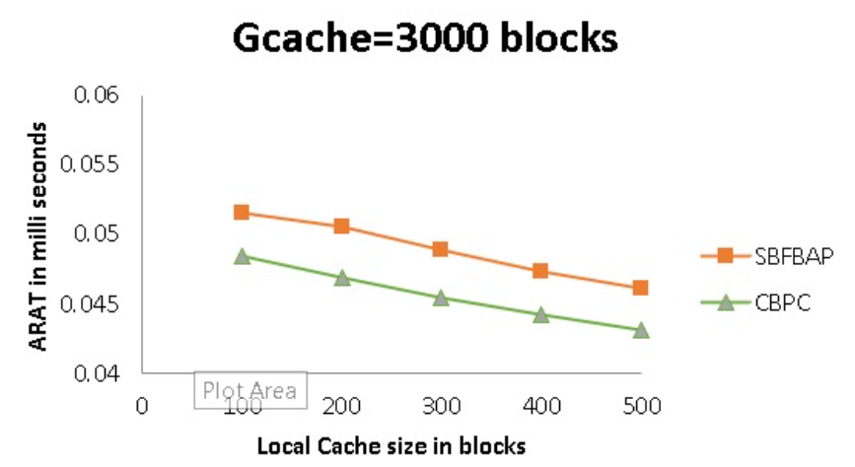
Results
We have observed the performance by varying the local cache size from 100 to 500 blocks and fixed the global cache size as 3000 blocks.
We found that the proposed FBAP algorithm performs well.

Slide 18
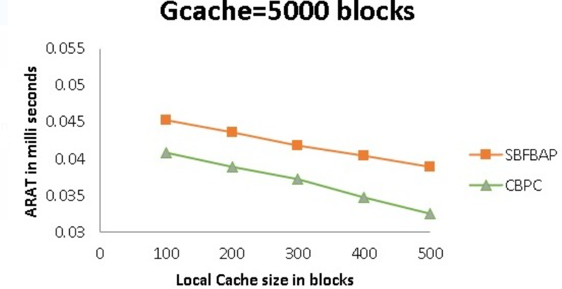
Results
We can observe similar performance, in which the global cache size is fixed as 5000 blocks.

Slide 19
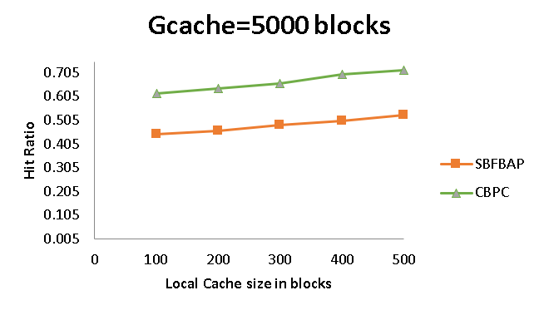
Results
In Fig, we have observed the performance by varying the size of local cache from 100 blocks to 500 blocks and by fixing the global cache size as 5000 blocks. We found that, the local cache hits are more for FBAP algorithm.
This is due to the reason that moving block access patterns instead of individual blocks whenever there is a hit in global cache.

Slide 20
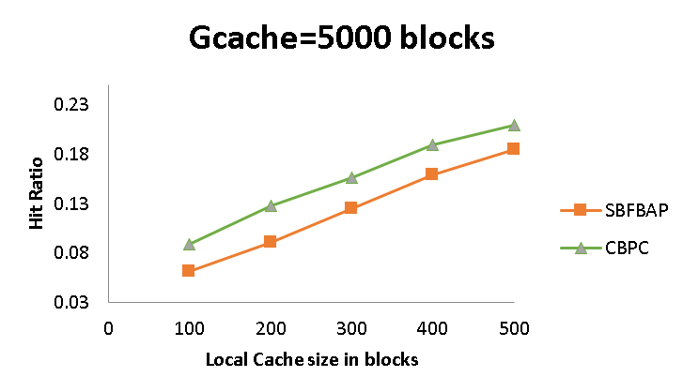
Results
We can also observe that, SSD hits are also more in the data nodes for the proposed FBAP algorithm

Slide 21
Outline
Introduction
Architecture of the DFS
Proposed Algorithm
Simulation Results
Conclusion

Slide 22
Conclusion
We conclude that the proposed FBAP algorithm performs better than the SBMS under different cache sizes of data nodes and global cache node.
The results of our simulation experiments indicate that the proposed frequent block access pattern-based algorithm performs better than the support-based algorithm.
In future, we wish to implement the proposed algorithm in Hadoop distributed file system to prove its efficiency.

Slide 23
THANK YOU

