Slide 1
Data Analysis Project - Predicating Transactions
3/26/26
Srilatha Alla

Slide 2
Agenda
Date
1.
Problem Definition, Solution
2.
Data Collection
3.
Data Cleaning
4.
Exploratory Data Analysis (EDA)
5.
Data Processing
6.
Data Visualization
7.
Conclusion and Q/A

Slide 3
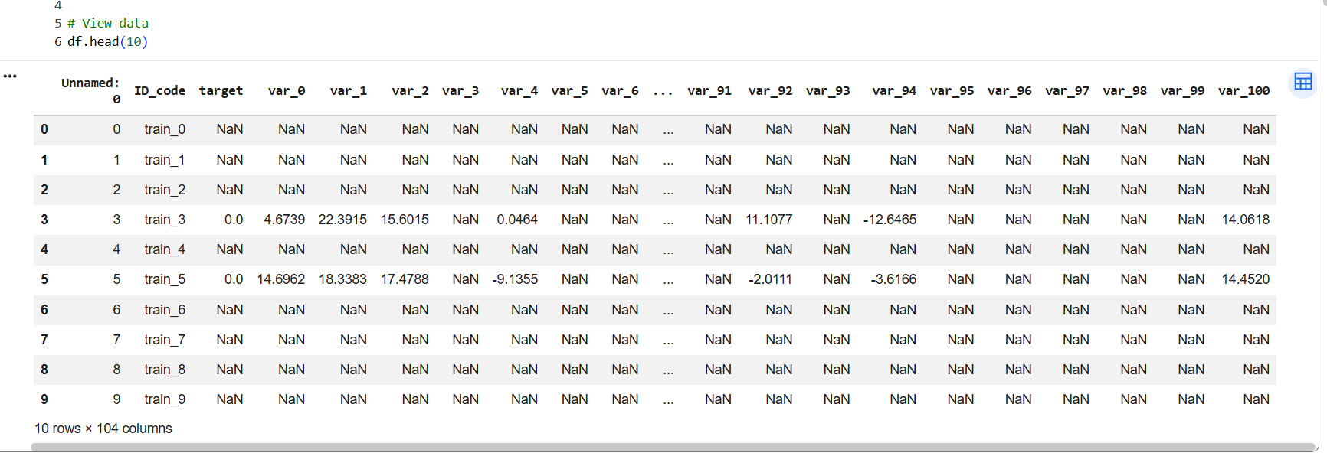
Problem Definition
Date
Analyze customer transaction data
Goal: predict if a customer will make a transaction (1 or 0)
This is a Supervised binary classification problem
Target (transaction 0/1)
Similar to real-world problems:
Customer satisfaction prediction
Purchase prediction
Loan repayment prediction
Use Gaussian Naïve Bayes for classification

Slide 4
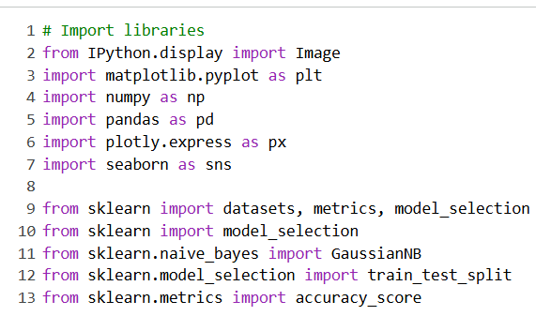
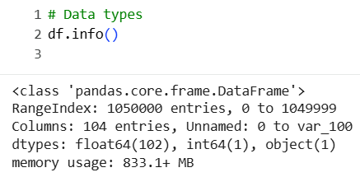
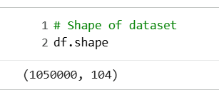
Data Collection
Date
Importing necessary python modules to analyze the data
Dataset imported from AWS S3

Slide 5
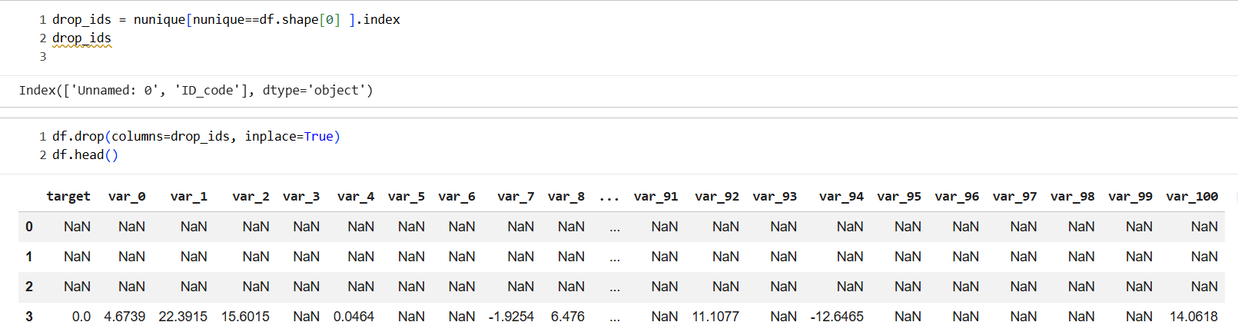
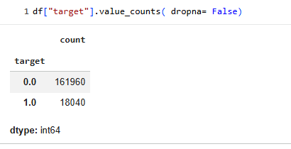
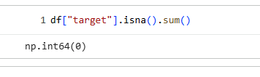
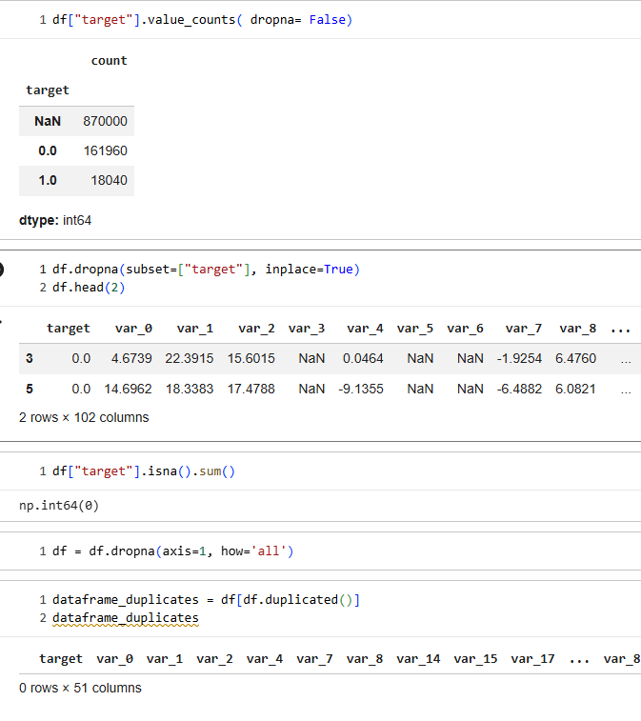
Data Cleaning
Removing Unique Identifiers
Removing Null Values
Removing Redundant data

Slide 6
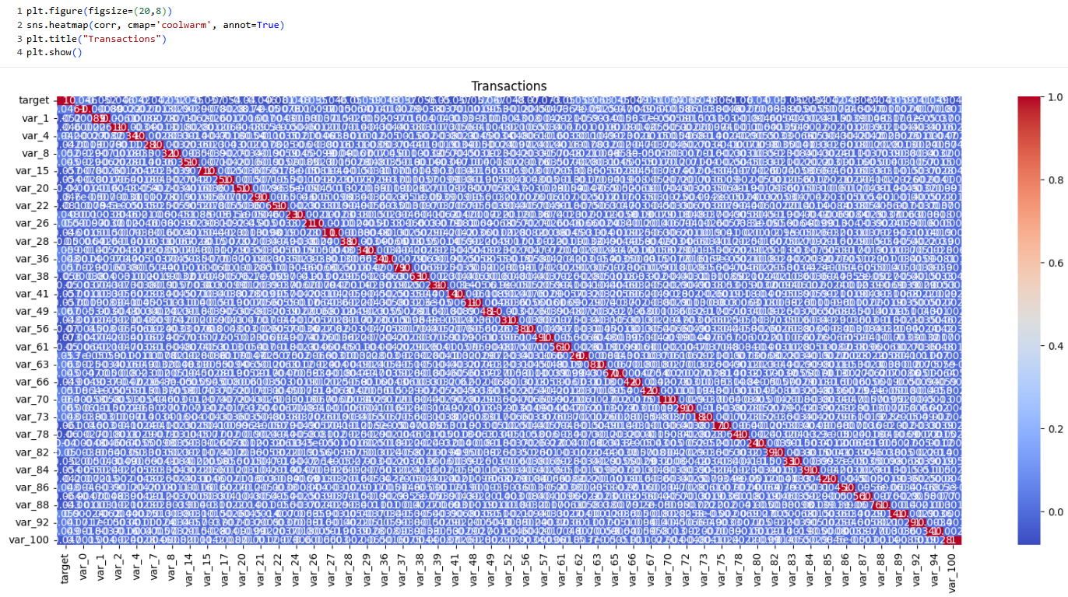
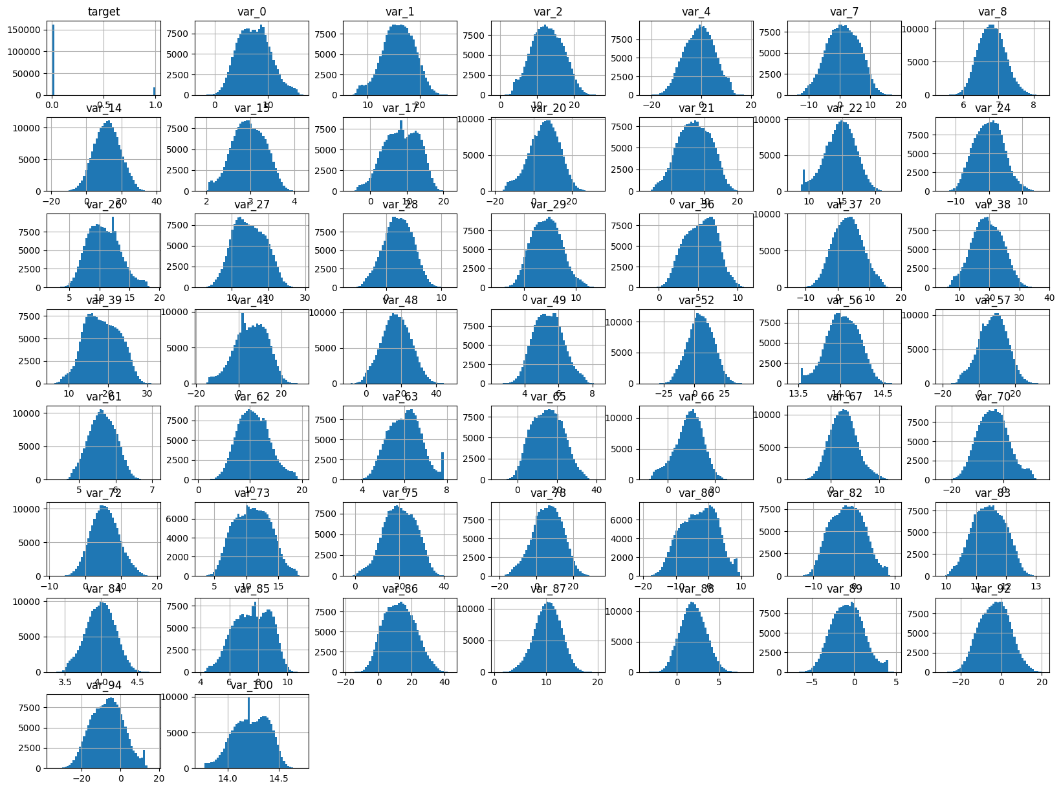
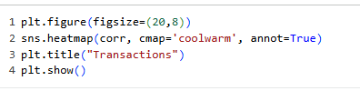
Exploratory Data Analysis (EDA)
Date

Slide 7
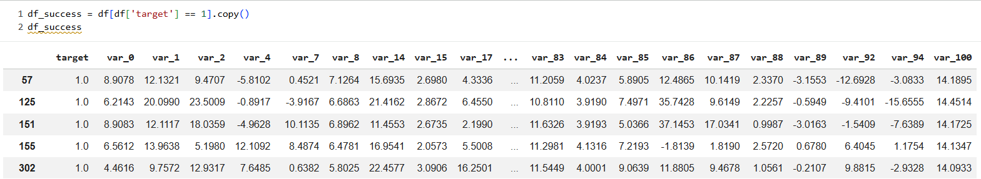
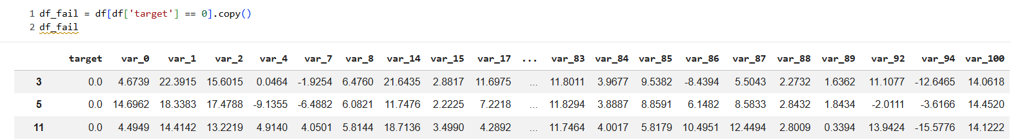
Data Processing
Divide the dataset into 2 dataframes
Success Target = 1
(18040 rows × 51 columns)
Fail target = 0
(161960 rows × 51 columns)

Slide 8
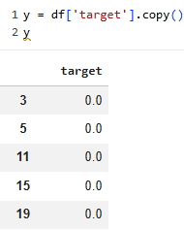
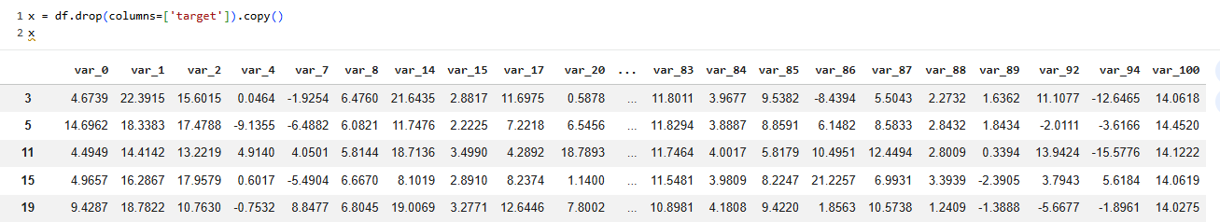
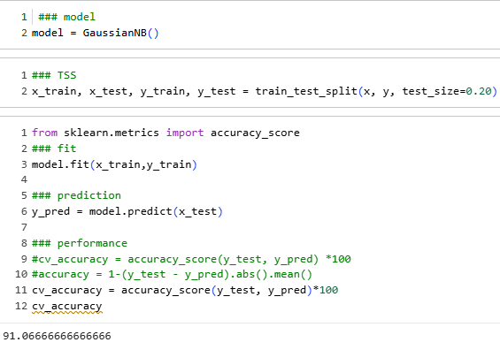
Data Processing
Date
Separated the target and predictors
Create a model
Split the training and testing set
Fit the data
Prediction
Check the accuracy

Slide 9
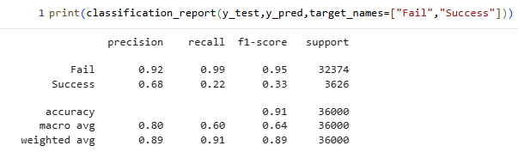
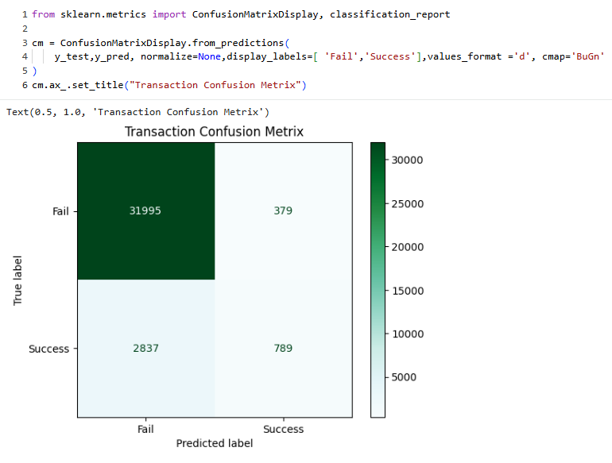
Data Processing
Date
Classification Matrix
Confusion Matrix
Since 90% of the data belongs to one class, the model becomes biased. This shows that accuracy alone is not a reliable metric.

Slide 10
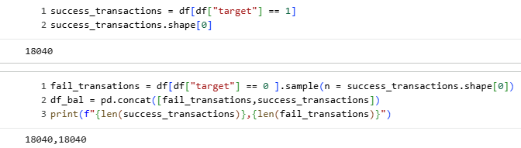
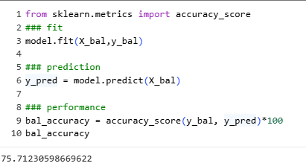
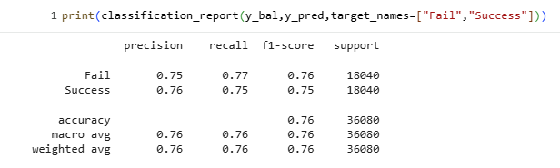
Data Processing
Date
50/50 - Balanced the dataset
Divide the balance set into target and predicators
Training and Testing
Classification report - Much predicting successful transactions

Slide 11
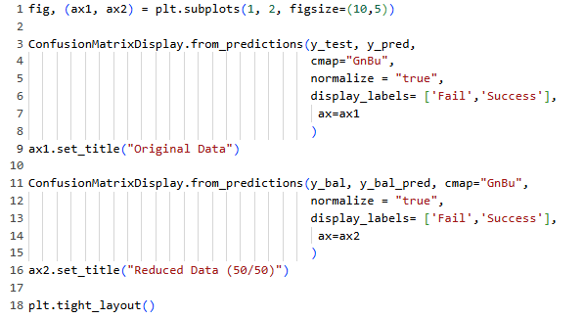

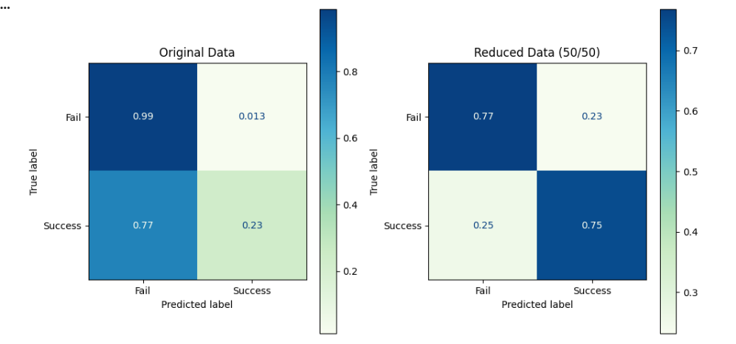
Data Visualization
Date
Confusion matrix of original data and 50/50 data.
This shows important of balancing our data set.
We have to make sure that data is aligned.
The balanced model gives a more reliable prediction, and Gaussian Naïve Bayes performs reasonably well for this problem.

Slide 12

Any questions? Ask away!
Date

