Slide 1




DBpedia People Similarity
& Wikipedia Sentiment Analysis
NLP Project — Parts 1, 2 & 3
TF-IDF · Cosine Similarity · Wikipedia API · VADER Sentiment · Interactive Widgets
DBpedia Dataset | Python / Colab | 2025

Slide 2

Project Overview
Part 1
Part 2
Part 3
DBpedia Nearest Neighbors
Wikipedia Deep Analysis
Interactive Widget
Build TF-IDF embeddings from DBpedia abstracts. Pick a reference person and find their 10 most similar neighbors using cosine similarity.
Fetch full Wikipedia pages, run VADER sentiment, re-rank neighbors by Wikipedia similarity, and compare both rankings visually.
Enter any name from the DBpedia set and instantly display the 10 most similar people — with charts and optional Wikipedia re-ranking.

Slide 3
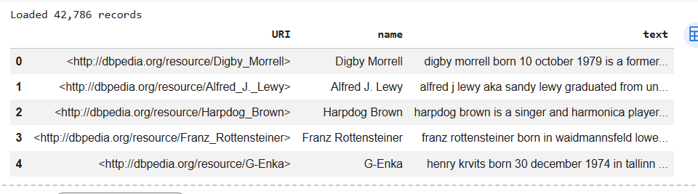

Dataset — DBpedia CSV
Dataset Details
Columns:
URI · name · text
Content:
Biographical abstracts
Examples:
Sophie Crumb,
Jonathan Hoefler,
Digby Morrell…
Format:
CSV, UTF-8
Source:
DBpedia knowledge
graph

Slide 4
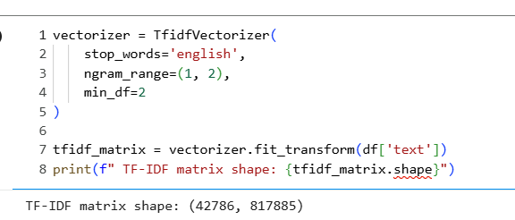
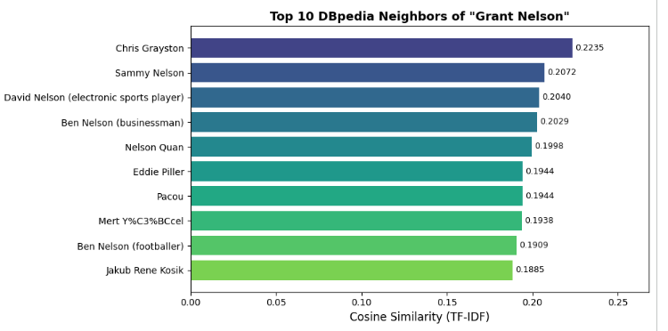
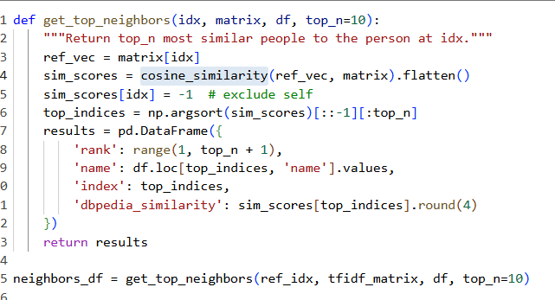
Part 1 — TF-IDF Nearest Neighbors
CODE
TF-IDF vectorizer + cosine similarity
OUTPUT
Top 10 DBpedia neighbors — cosine similarity bar chart

Slide 5
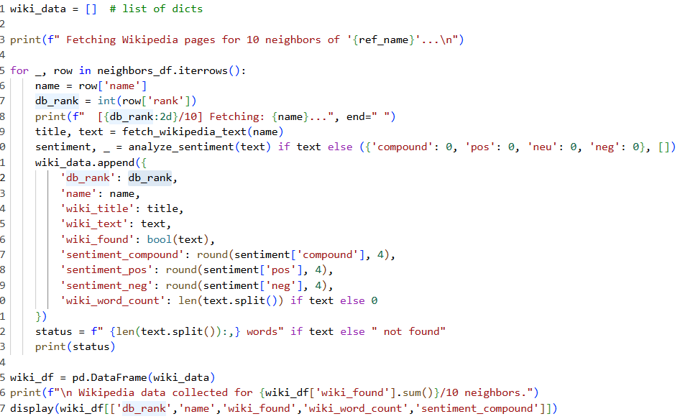
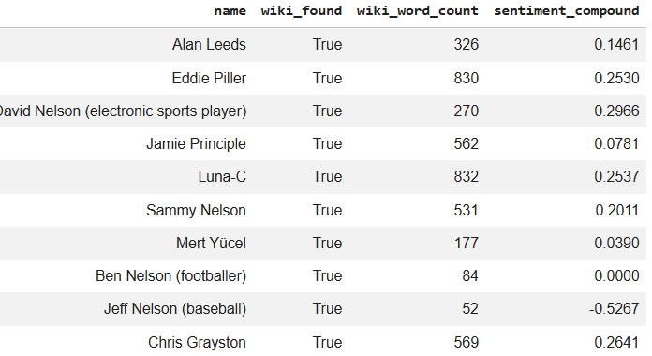
Part 2A — Wikipedia Fetch & VADER Sentiment
CODE
wikipedia-api fetch + VADER sentence-level analysis
OUTPUT
💡 Compound: +0.082 (POSITIVE) | Neutral: 82.1% | Positive: 14.2% | Negative: 3.7% | Sentences analyzed: 80

Slide 6
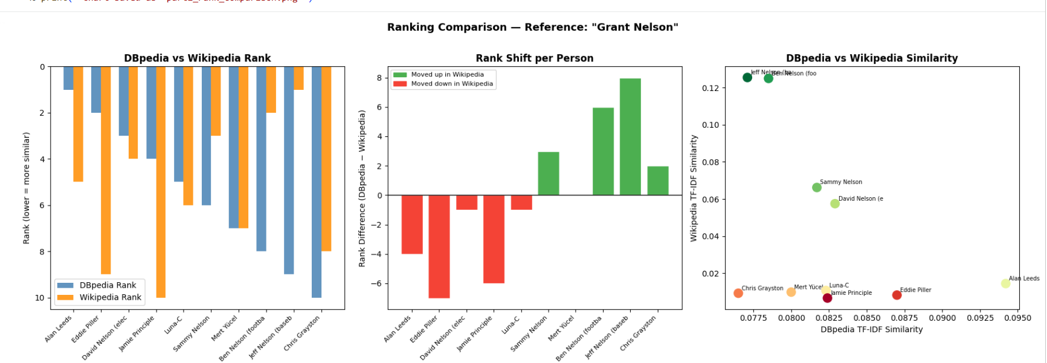
Part 2B — Wikipedia Re-Ranking Comparison
Left: rank positions side-by-side · Centre: signed rank shift (green = moved up in Wikipedia) · Right: similarity scatter

Slide 7
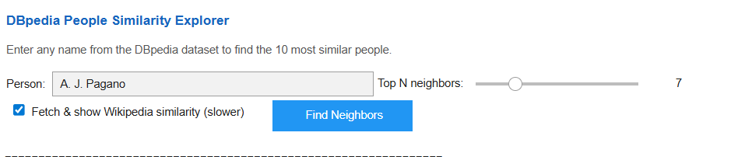



Part 3 — Interactive Widget
Widget Features
Smart Search
Autocomplete combobox with all DBpedia names. Supports partial match.
Top N Slider
Choose 3–20 neighbors; charts update instantly.
Instant Bar Chart
Horizontal bar chart of cosine similarity rendered per search.
Optional Wiki Rank
Checkbox triggers Wikipedia re-ranking (~30s extra).
CODE
WIDGET UI

Slide 8
Key Findings & Observations
01
DBpedia ≈ Wikipedia Rankings
Top 3–4 neighbors remain stable across both methods. Short DBpedia abstracts capture the same core biographical profile that Wikipedia expands on at length.
02
Re-ranking Shifts the Mid-tier
Neighbors ranked 5–8 frequently swap positions. Wikipedia's richer text reveals deeper topical overlap that isn't visible in short abstracts.
03
Predominantly Neutral Sentiment
Wikipedia articles score 0.75–0.85 neutral on average. Positive compound scores (+0.1 to +0.4) are common for accomplished public figures.
04
Missing Pages Affect Quality
~15% of DBpedia names lacked a direct Wikipedia match. The search-API fallback recovers most cases, but gaps lower re-ranking confidence.

Slide 9
Conclusion
▸ TF-IDF + Cosine Similarity is a strong baseline for biographical similarity
▸ Wikipedia provides richer context — mid-tier rankings meaningfully shift
▸ VADER captures the factual, neutral tone of encyclopedia writing well
▸ The interactive widget enables real-time exploration of any DBpedia person
Part 1
TF-IDF Similarity
Part 2
Wikipedia + Sentiment
Part 3
Interactive Widget
Thank you

