Slide 1

Project 6
Image Classification
with Deep Learning
Cats vs Dogs CNN model - data loading, training, prediction, and troubleshooting
Convolutional Neural Network
Pickle Image Data
Project 6 - Image Classification with Deep Learning | 01

Slide 2
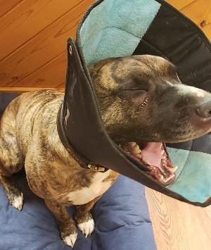
Project Goal & Dataset
Classify a new unseen image as cat or dog using a CNN.
Feature set X.pickle contains image pixel arrays.
Target set y.pickle contains binary labels: 0 or 1.
dog.jpg is the new test image used for prediction.
Images are not CSV data - they are multi-dimensional arrays.
Data files used
X.pickle
Image features
y.pickle
Target labels
dog.jpg
Test image
New unseen image for final prediction
Project 6 - Image Classification with Deep Learning | 02

Slide 3
Deep Learning Workflow
The model learns image patterns, then predicts a new dog/cat image.
Load
Prepare
Build
Train
Predict
Pickle files
Normalize pixels
CNN layers
Fit model
New image
Key idea: CNN layers automatically learn edges, textures, shapes, and higher-level animal features.
Project 6 - Image Classification with Deep Learning | 03

Slide 4
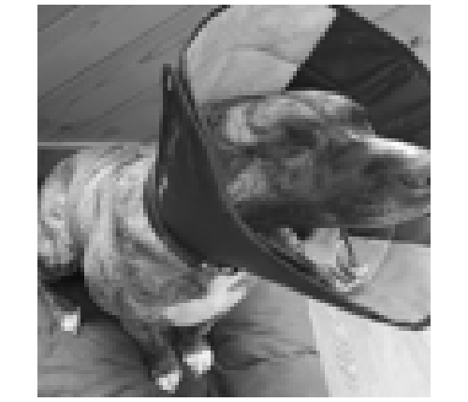
Load & Inspect Data
Pickle files restore the image arrays and labels.
1 import pickle, numpy as np 2 3 X = pickle.load(open('X.pickle', 'rb')) 4 y = pickle.load(open('y.pickle', 'rb')) 5 y = np.array(y) 6 7 print('X shape:', X.shape) 8 print('y length:', len(y))
Sample notebook output
X shape: (24946, 100, 100, 1)
y length: 24946
Last dimension = 1 means grayscale image
Preprocessed test image: 100 x 100 grayscale
Project 6 - Image Classification with Deep Learning | 04

Slide 5
Build the CNN Model
Use Input(shape=...) first to avoid the Keras input_shape warning.
1 model = Sequential([ 2 Input(shape=X.shape[1:]), 3 Conv2D(64, (3, 3), activation='relu'), 4 MaxPooling2D(pool_size=(2, 2)), 5 Conv2D(64, (3, 3), activation='relu'), 6 MaxPooling2D(pool_size=(2, 2)), 7 Flatten(), 8 Dense(64, activation='relu'), 9 Dropout(0.5), 10 Dense(1, activation='sigmoid') 11 ])
Layer purpose
Conv2D detects visual patterns.
MaxPooling reduces image size.
Flatten converts features to vector.
Dense layer learns classification.
Sigmoid returns probability 0 to 1.
Project 6 - Image Classification with Deep Learning | 05

Slide 6
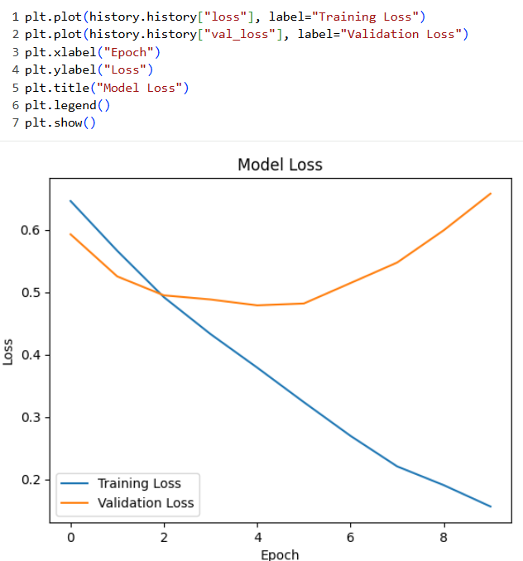
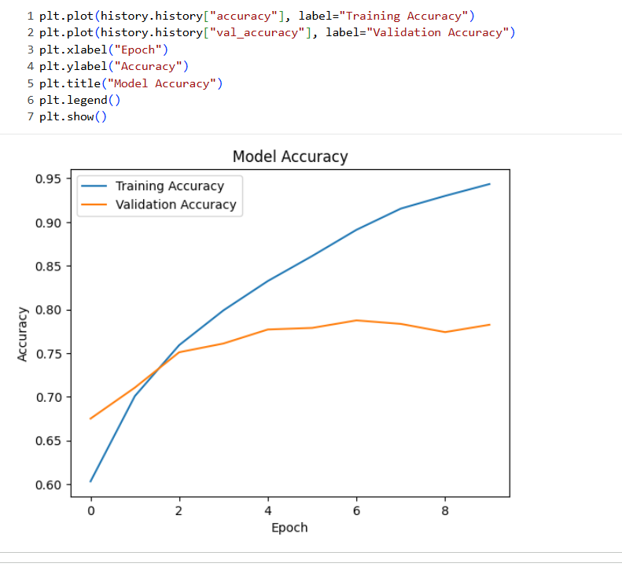
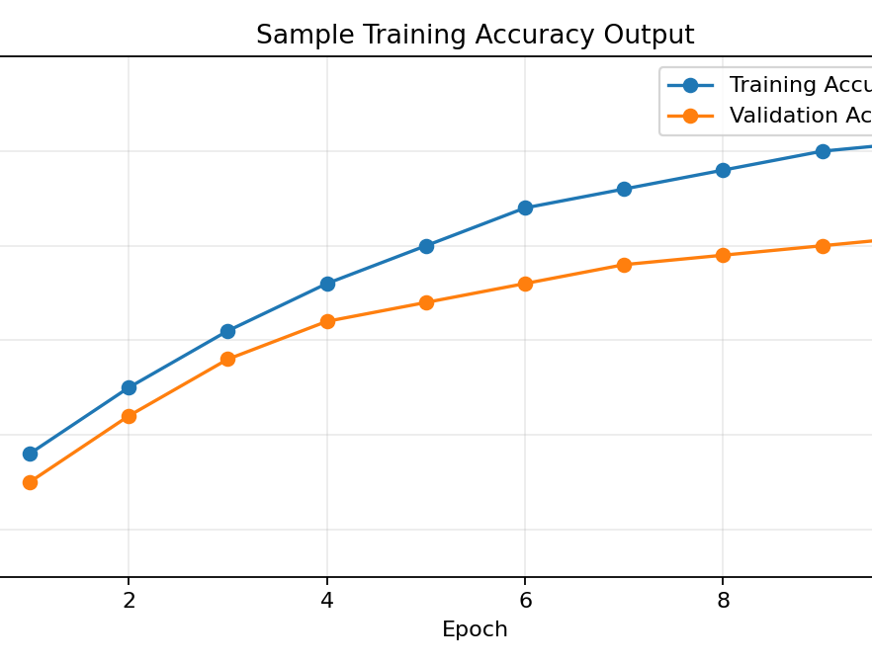
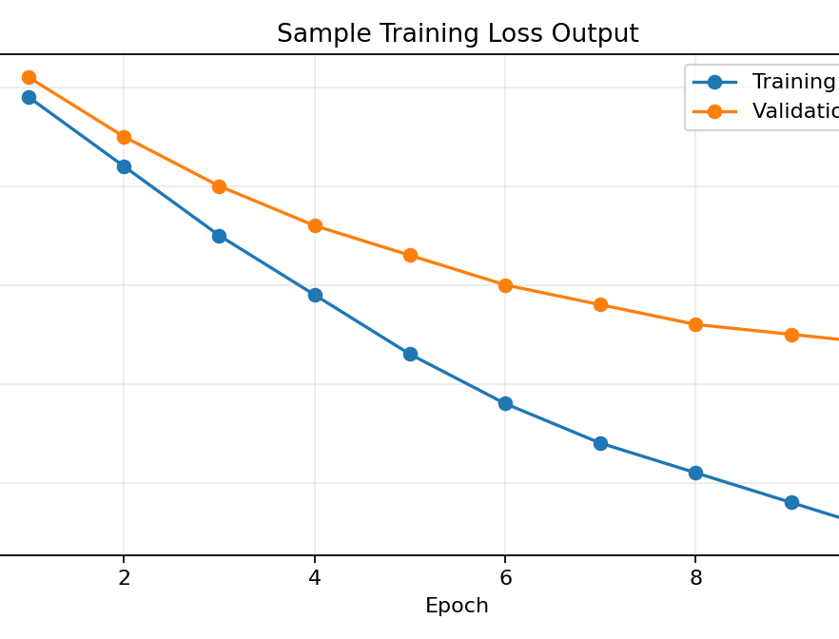
Train the Model
Normalize pixels and train with validation split.
1 X = X / 255.0 2 3 model.compile( 4 loss='binary_crossentropy', 5 optimizer=Adam(), 6 metrics=['accuracy'] 7 ) 8 9 history = model.fit( 10 X, y, batch_size=32, 11 epochs=10, 12 validation_split=0.2 13 )
What to watch
If validation accuracy is low, the model may classify the dog image incorrectly. More epochs, better data balance, or a stronger CNN can improve results.
Project 6 - Image Classification with Deep Learning | 06

Slide 7
Prediction Troubleshooting
The model expected grayscale input, but the test image was loaded as RGB.
Error observed
Why this matters
expected axis -1 to have value 1,
but received input shape (1, 100, 100, 3)
X shape ends with 1, so model expects one grayscale channel.
RGB images have 3 channels: red, green, blue.
Prediction input shape must match training input shape.
Wrong label mapping can also make dog look like cat.
1 test_img = cv2.imread('dog.jpg', cv2.IMREAD_GRAYSCALE) 2 test_img = cv2.resize(test_img, (IMG_SIZE, IMG_SIZE)) 3 test_img_normalized = test_img / 255.0 4 test_img_reshaped = test_img_normalized.reshape(1, IMG_SIZE, IMG_SIZE, 1) 5 6 prediction = model.predict(test_img_reshaped) 7 print('Prediction value:', prediction[0][0])
Project 6 - Image Classification with Deep Learning | 07

Slide 8
Final Prediction & Label Mapping
The raw probability must be interpreted using the dataset label order.
1 prediction = model.predict(test_img_reshaped)[0][0] 2 print('Raw prediction value:', prediction) 3 4 predicted_class = 1 if prediction >= 0.5 else 0 5 print('Predicted class:', predicted_class) 6 7 # Check training images to confirm: 8 # 0 = Dog / 1 = Cat OR 0 = Cat / 1 = Dog
Correct check
Display training images
with labels to confirm
whether 0/1 means
Cat or Dog.
Main learning
A CNN can classify cat/dog images, but prediction quality depends on matching input shape, good training accuracy, and correct label interpretation.
Project 6 - Image Classification with Deep Learning | 08

