Slide 1


Bank of Baroda Hackathon - 2022
Technology Partner
Team Name :Bankqueues
Team bio :Madupu Srilekha , BV Raju Institute of Technology,Narsapur (BVRITN)
Date :20-09-2022

Slide 2
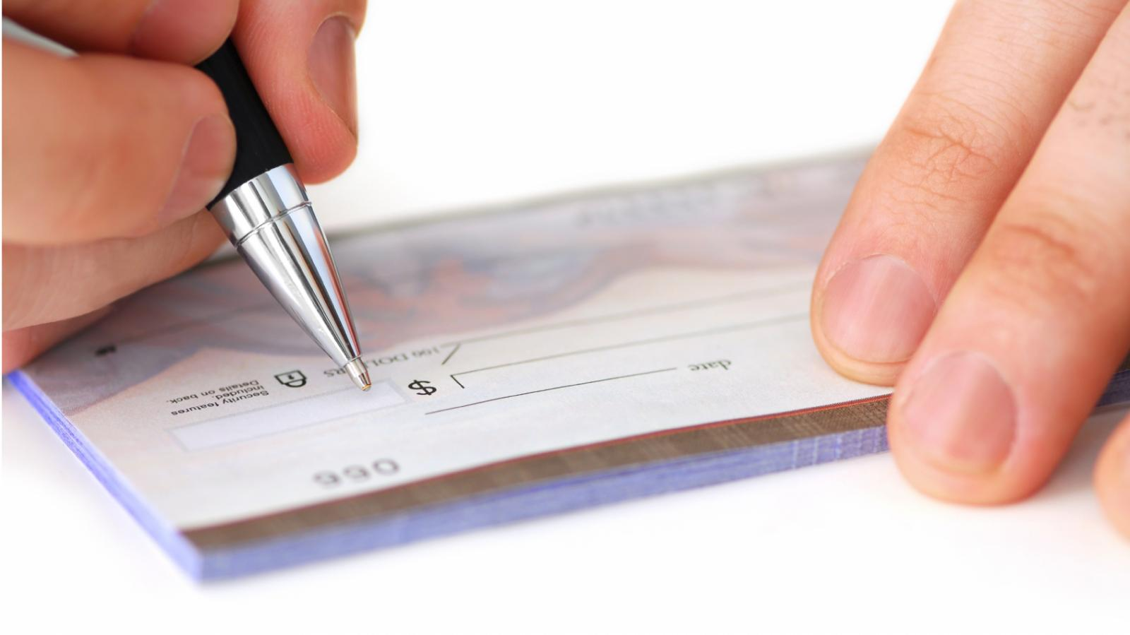

PROBLEM STATEMENT Automated Cheque Processing
We stand on the brink of a technological revolution that will fundamentally alter the way we live, work, and relate to one another. Our nearby future is all about Artificial Intelligence, a fusion of technologies that automate our routine business as well as life activities. Companies and organizations have started exploring and implementing the importance and benefits of AI in various fields of our life. Banking is one of the important and vast sectors that directly links in our daily life.
And when it comes to the banking sector, bulk amounts of check processing is a complex functionality. But what if we say that it can be easily automated and streamlined by using ML and AI technology!
?
+
=
Cheque
AI and ML and OCR
Let’s see what the combo does…………….

Slide 3
RESOLUTION
Our solution uses OCR Check Deposit Recognition system which is complemented with the ICR technology (Intelligent Character Recognition) through which accurate details from various handwritten characters (both front and back side )of the cheque can be obtained at ease. It will also validate the value and the amount of words entered in the cheque . For this we will create an API.
Our API will be able to automate the cheque clearing process by :
1. Automation of the clearing process using AI/ML/ICR/OCR techniques
2. Automatic Data Entry & Technical verification
3. Signature Verification
4. Support Multilingual
5. Reduce Human Efforts
6. Reduce Processing time
7. Detecting Potential Frauds

Slide 4
User Segment & Pain Points
Any Company/Organization that uses cheques for payments instead of cash can use our API.
Using which they will be able to check for fraud /invalid cheques and thus save alot of their time which would have been wasted incase the check would have been invalidated by the bank.
Benefits of our solution….
Check fraudulent identification within a matter of seconds
Bulk cheque processing can be validated at ease
Overcome cheque fraudulent at ease
Provide instant feedback to your customers
Avoid traditional wait times for deposit availability

Slide 5
Pre-Requisite
Most product’s currently available in the market use older signature verification techniques which are not only prone to wrong output but also are not able to process large amount of signature verifications at the same time.
Most of the banks are using manual methods which take a lot of time to process and also during depositon of money into one’s account.

Slide 6
Azure tools or resources
We will be using : Azure cloud storage 1. To store database of user signatures 2. To store the data fields (like name , account number…)scanned from the cheque.

Slide 7
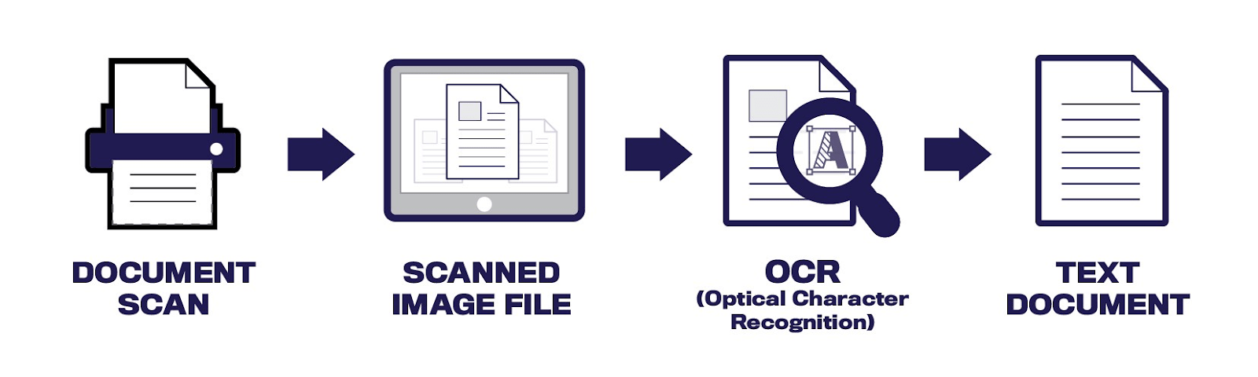
Methodology
&ICR

Slide 8
Functional Documents
https://cedar.buffalo.edu/~srihari/papers/ICGVIP2006-sig.pdf
https://www.impira.com/blog/acronyms-explained-ai-rpa-icr-ml-and-automl

Slide 9
Scalability
By using our API we can solve more than 10 cheques within the cheques.

Slide 10
Key Differentiators & Adoption Plan
OCR Check processing system is complemented with the ICR technology , so accuracy is more Since our tool is fundamentally an API instead of an user interface that’s why it will be easier to integrate into different pipeline’s and could also be used for other use cases . To adopt the API all you need to do is to call the API with a valid api key and input image and it will return the output.
For instance if a web application needs to verify the signature of the user then it can send the signature as an image to the API and in the response , it will tell whether the signature is valid or not.

Slide 11
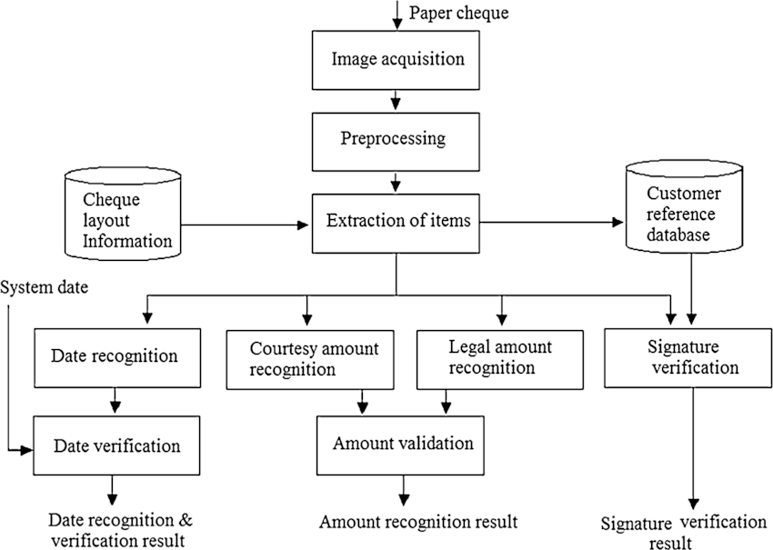
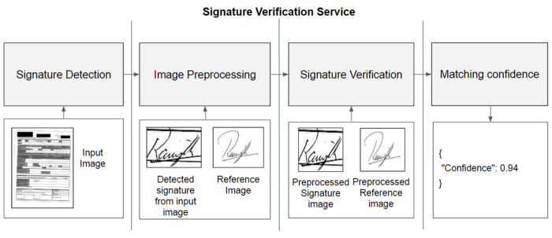
Processes….

Slide 12
GITHUB
https://github.com/Srilekha-09/Automated-check-processing

Slide 13
Thank You
Madupu Srilekha

