Slide 1
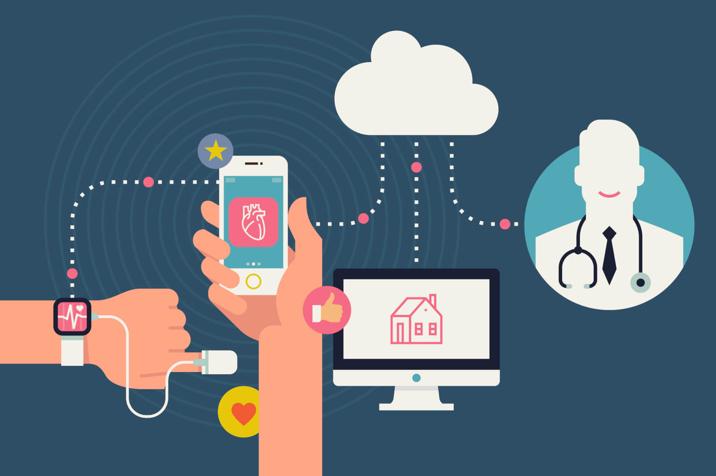
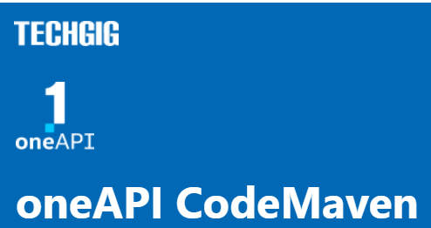
Theme:
Healthcare for underserved communities
Team Name:
Tech squads
Team Members:
Madupu Srilekha

Slide 2
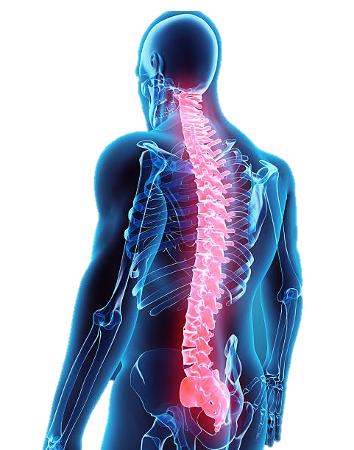
Theme Chosen and Motivation
The theme of the project is to address the healthcare disparities faced by underserved communities. The project aims to develop a healthcare platform that can provide personalized care to patients in underserved communities. The platform will leverage the power of Intel® One API AI Analytics Toolkit and Libraries and SYCL/DPC++ Libraries to identify health risks and develop customized treatment plans for patients. The goal is to improve the health outcomes of underserved communities by providing access to advanced healthcare services. Ultimately, the project aims to help underserved communities lead healthier lives.
This project aims to bridge the healthcare gap for underserved communities and provide them with the tools they need to lead healthier lives. By leveraging technology and collaboration with healthcare providers, we can make a meaningful impact in improving the health outcomes of underserved communities.

Slide 3
Proposed Tech Architecture
The mHealthApp architecture is designed to address the healthcare needs of underserved communities. The app collects health data from sensors and other sources, which is preprocessed and partitioned using the Intel oneAPI MKL(oneDAL).
The processed data is then used to train machine learning models using the Intel oneAPI AI Analytics Toolkit, including the Intel Optimized Frameworks and the Intel oneAPI AI Analytics Toolkit and Libraries. The app also includes features to remove language barriers using NLP libraries.
The final product is a user-friendly dashboard that provides users with personalized healthcare recommendations and insights.

Slide 4
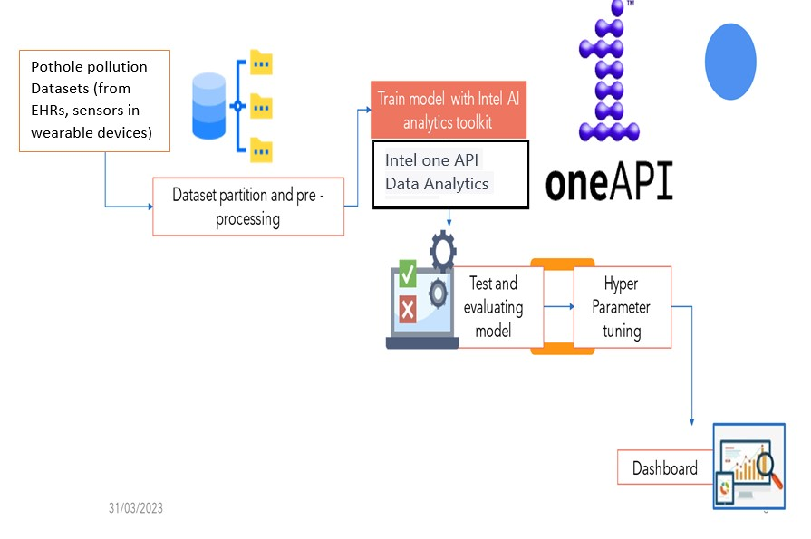
ARCHITECTURAL FLOW-
Intel oneAPI Data Analytics Library (oneDAL)

Slide 5
We have developed a solution using machine learning algorithms, IOT and AI via Intel ONEAPI We have developed a wearable belt that will enable real-time monitoring of the patient's spinal activity, including his movements. This information will be collected, analysed, and sent to the doctor, the patient, and any family members via an Android or iOS app, It shows information of the bend angle,strain,and pressure exerted. suggest particular workouts and stretching regimens to help and treat their condition. By continually monitoring and providing feedback which can assist in preventing further damage to the spine and supporting healing and recovery. The vibrations or electric impulses transmitted to the spines by devices placed into the belt can be used if the patient has been experiencing severe pain and movement imbalances. Which acts like a therapy.
Product Development

Slide 6
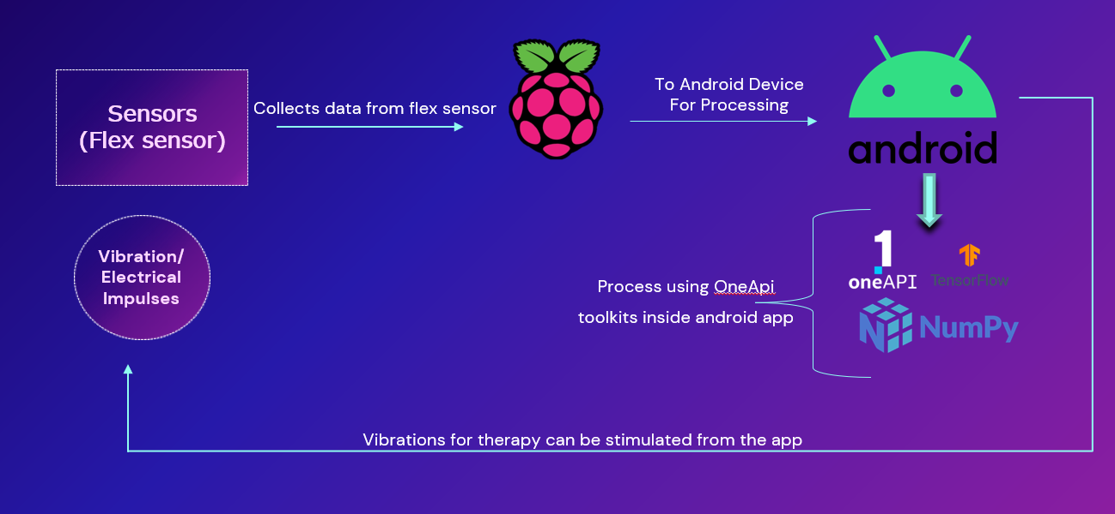
Process flow

Slide 7
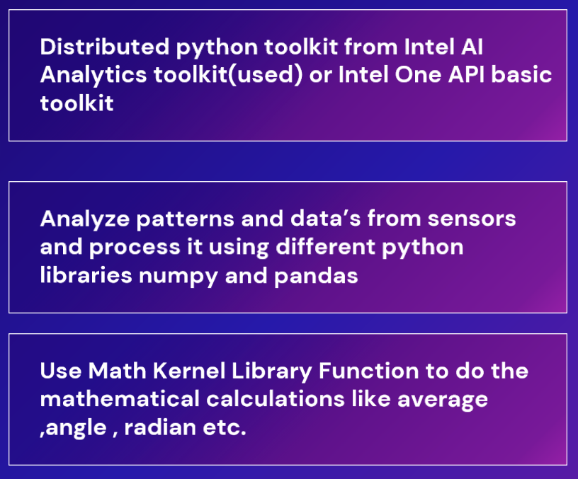
Intel oneApi Concepts used

Slide 8
Impact of inclusion of oneAPI
The inclusion of oneAPI in the mhealth app proposed tech architecture can lead to significant improvements in performance, scalability, and functionality. OneAPI's optimized libraries for machine learning, deep learning, and data analytics can help the application process and analyze large amounts of health data.
The parallel processing capabilities of modern CPUs and GPUs can accelerate computationally intensive tasks, resulting in faster processing and analysis of health data. OneAPI's cross-platform capabilities can increase the potential user base and reach of the application.
Finally, the scalability of oneAPI can ensure a seamless user experience as the user base and data volumes grow.

Slide 9
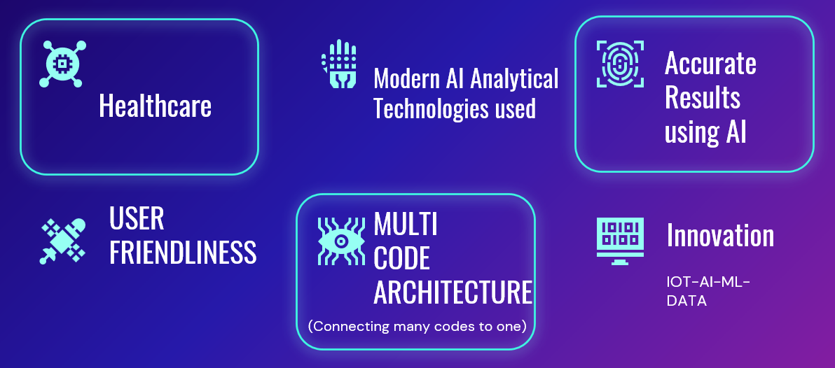
Features

Slide 10
Innovation Quotient and Scalability
Innovation quotient and scalability are essential factors for the success of a technology-based product like the mhealth app.
OneAPI can enhance the innovation quotient of the mhealth app by introducing novel features and functionalities that differentiate it from other health applications.
Additionally, oneAPI's scalability can enable mhealth app to handle increased user demand, data volumes, and processing requirements as the user base grows.
This scalability can ensure a seamless user experience even as the user base and data volumes increase. Overall, by leveraging oneAPI, mhealth app can improve its innovation quotient and scalability, ensuring its success in the competitive health technology market.

Slide 11
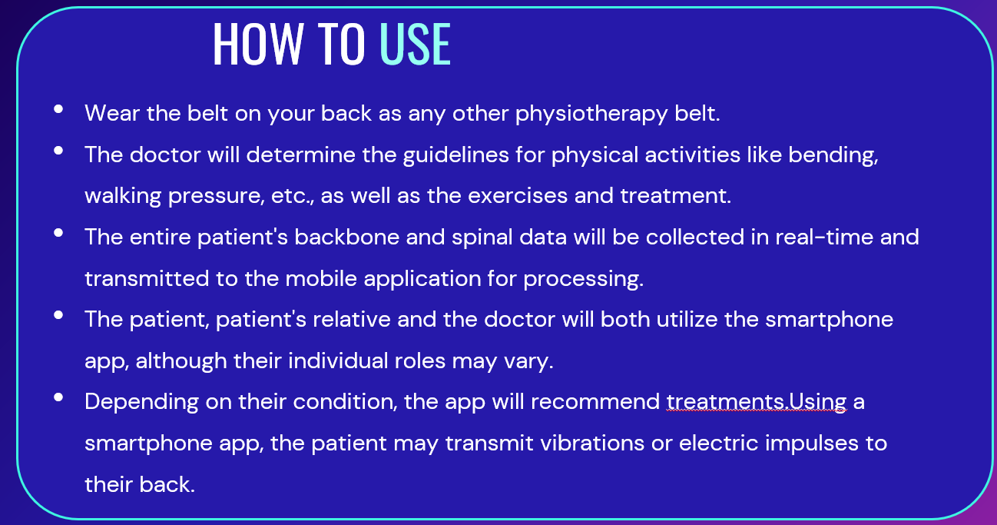

Slide 12
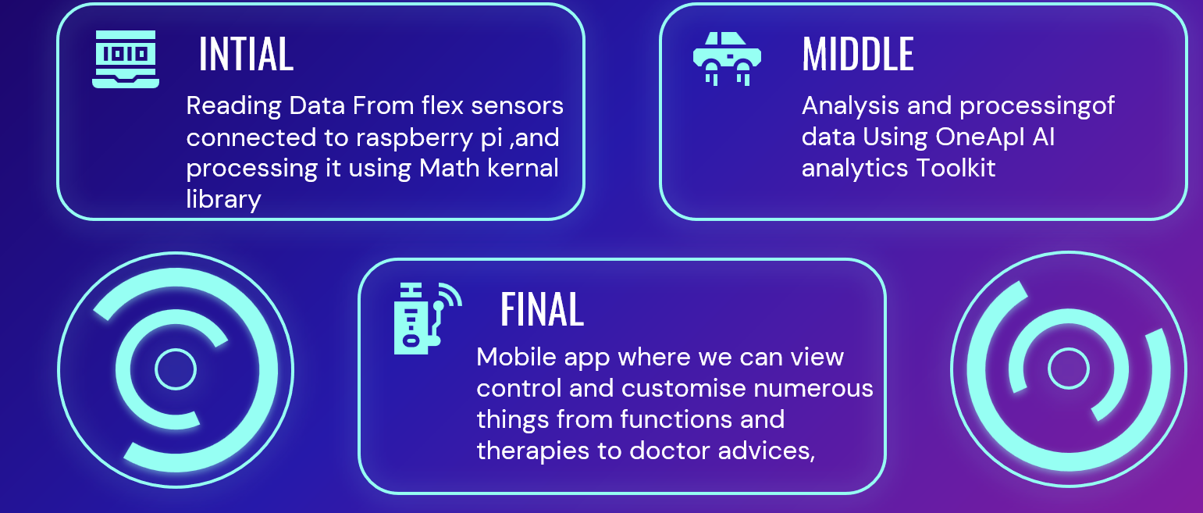
Stages of development

Slide 13
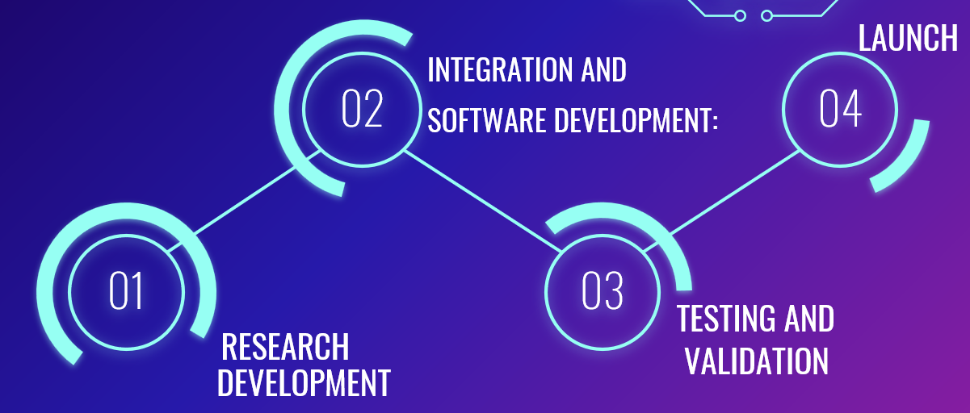
Project timeline

Slide 14
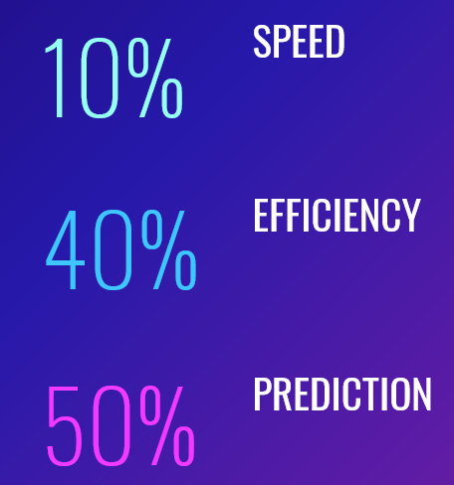
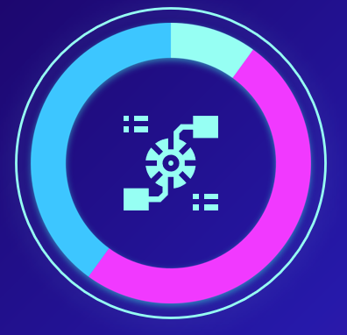
Project performance

Slide 15
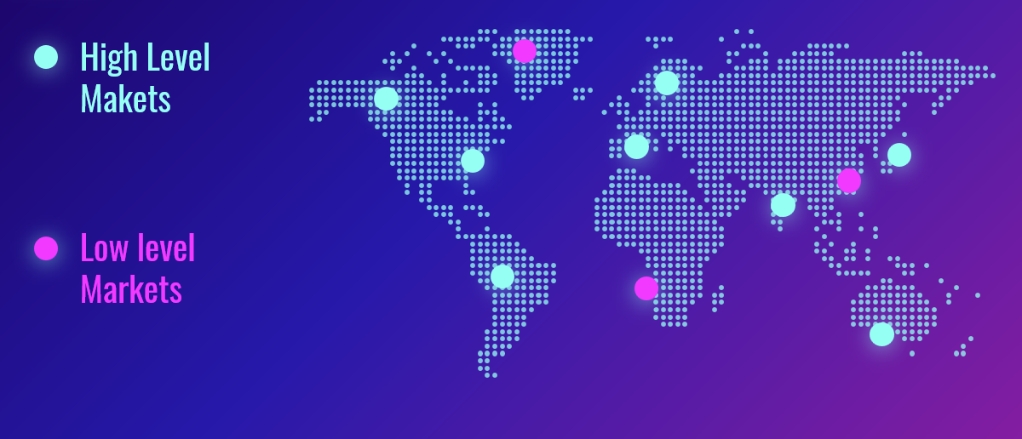
Market outrearch

Slide 16
Quick Summary
The mhealth app with smart belt proposed tech architecture aims to develop a mobile health application that can process and analyze large amounts of health data, provide personalized recommendations and insights to users, and ensure a seamless user experience.
To achieve these goals, the architecture will leverage oneAPI to accelerate performance, implement advanced features, ensure cross-platform compatibility, and enable scalability as the user base grows. By utilizing oneAPI's optimized libraries for machine learning, deep learning, and data analytics, the mhealth app can differentiate itself from other health applications in the market and enhance its innovation quotient. Ultimately, the oneAPI-based tech design for the mHealth app can guarantee the application's success in the cutthroat health technology market.

Slide 17
Solution https://drive.google.com/file/d/1BtQ2CqMnJE9AkgwbigQ7fisVxpWaocH0/view?usp=share_link Code file https://drive.google.com/file/d/15DWnc3bQpV39MhbVK8w1N3-RUOQi_eud/view?usp=sharing, https://drive.google.com/file/d/17MqRDnfnh9OoSkhUWIoiI3kG8eH-ZJ8x/view?usp=sharing, https://drive.google.com/file/d/1BtQ2CqMnJE9AkgwbigQ7fisVxpWaocH0/view?usp=sharing, https://drive.google.com/file/d/1TaE50H_v85o9UJV32HEEUohPN2mF6qP-/view?usp=sharing, https://drive.google.com/file/d/1X_P2Z8yBUuvpTaB37mRA3Ys4PCvyTg-7/view?usp=sharing, https://drive.google.com/file/d/1ikg1f7s1LF1UiYecPbXszr6RFWkBrhrp/view?usp=sharing, https://drive.google.com/file/d/1vC19XU4uvqW3uc1JI-CfIrgsbC8egJPJ/view?usp=sharing

Slide 18
Github https://github.com/Srilekha-09/mhealth Demo video https://drive.google.com/file/d/1Qx8rxTClMSAqpThGjPPUnpoSOwv-fLnk/view?usp=share_link

