Slide 1
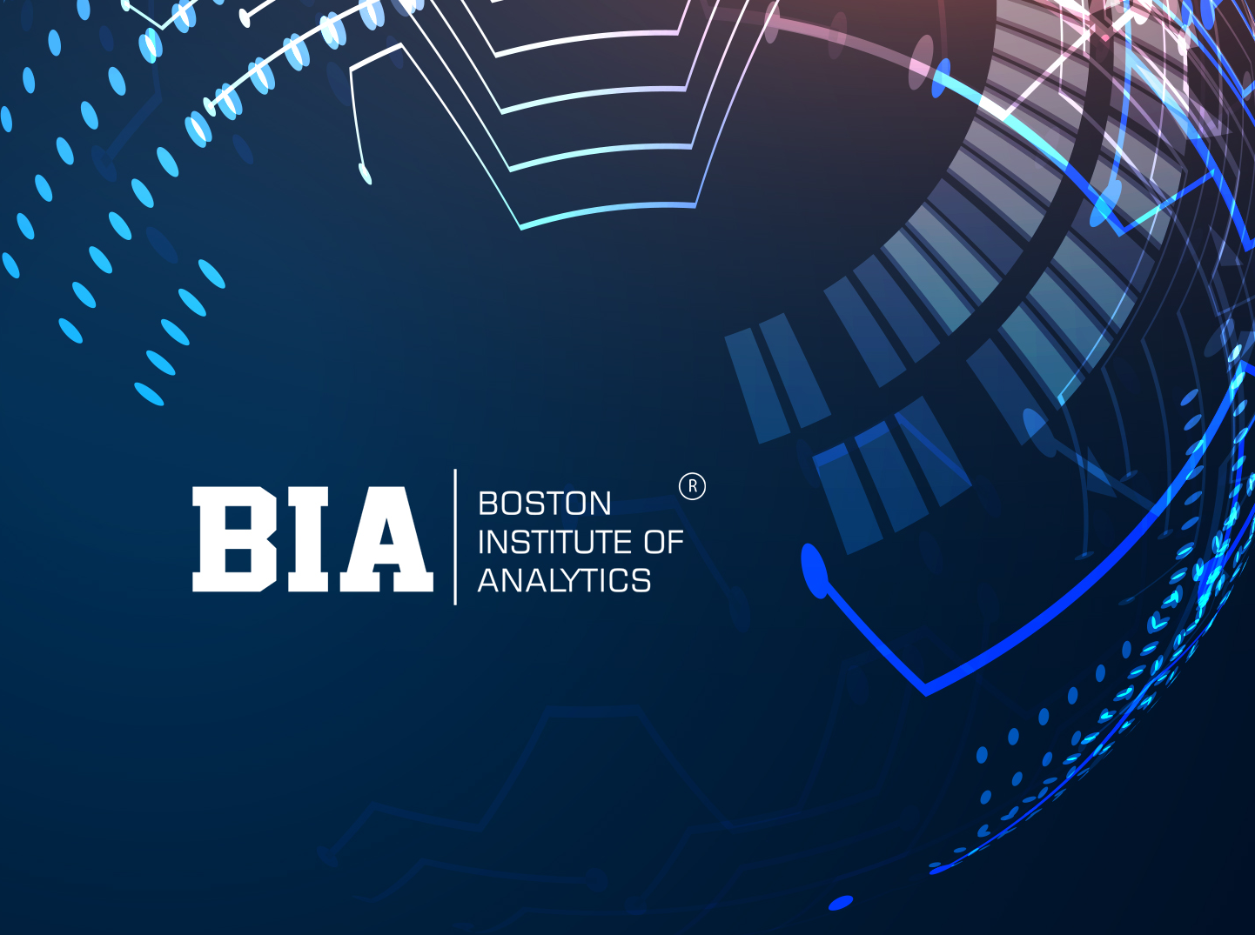

Slide 2
ANALYZING LIVER DISEASE IN INDIAN PATIENTS PROJECT
Liver disease is a significant health concern globally, and in India, it poses a substantial burden on public health
In this context, this modeling project aims to analyze a dataset specific to liver disease in Indian patients, leveraging advanced machine learning techniques.
We're diving into a project to understand and tackle liver disease among people in India.
The goal? To predict and catch liver problems early, so doctors can help people better.

Slide 3
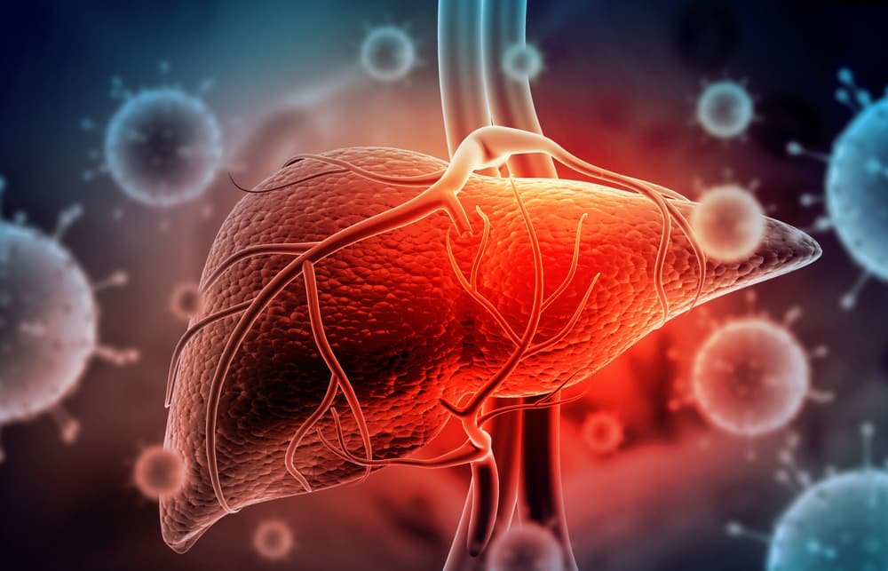
Aspartate Aminotransferase
Total Protiens
Albumin
Albumin and Globulin Ratio
Total Bilirubin
Direct Bilirubin
Alkaline Phosphotase
Alamine Aminotransferase

Slide 4
OVERVIEW:
This data set contains 416 liver patient records and 167 non liver patient records collected from North East of Andhra Pradesh, India.
Based on chemical compounds(bilirubin,albumin,protiens,alkaline phosphatase) present in human body and tests like SGOT , SGPT the outcome mentioned whether person is patient i.e needs to be diagnosed or not.
The roadmap is clear: analyze the data, building a model, and pave the way for more effective liver disease management across India. This project isn't just about data; it's about making a positive impact on people's lives.

Slide 5
Check Null Values:
Dealing with missing or null values is a crucial aspect of our analysis on liver disease in Indian patients.
I have filled the null values with the mean value in the dataset.
CONVERTING CATEGORICAL VARIABLE TO INDICATOR VARIABLE
i.e “gender”
Many algorithms and statistical models require numerical input. By converting the "gender" variable into indicator variables, to transform it into a format that can be easily processed by these algorithms.

Slide 6
3
2
1
MODEL SELECTION

Slide 7
3
2
1.LOGISTIC REGRESSION:
Logistic regression is a math trick for predicting things with two options, like yes or no. It's like using a special formula to guess the chance of an event happening based on some factors. Super handy for making simple predictions!
REASON:-
the dataset is not massive, logistic regression can be efficient. It doesn't require a vast amount of data to perform well, which can be beneficial when working with medical data that might be limited.

Slide 8
3
1
2.RANDOM FOREST:
Random Forest is a teamwork algorithm where a bunch of decision trees collaborate to make better predictions by leveraging the collective wisdom of the "forest." It's great for handling complex data and making more accurate predictions in various scenarios.
REASON:-
Random Forest's ability to handle complex relationships, provide variable importance insights, and robustly handle various data challenges makes it a compelling choice for this dataset.

Slide 9
2
1
Support Vector Machines (SVM) :
It is a powerful algorithm used for binary classification in technical terms. It's great for situations where you want a clear boundary between two groups, like predicting if , or in our case, figuring out if someone might have a particular health condition or not.
REASON:-
SVM can perform well even when the dataset is relatively small. In medical research, where obtaining extensive data can be challenging, SVM's ability to handle smaller sample sizes is beneficial.

Slide 10


