Slide 1
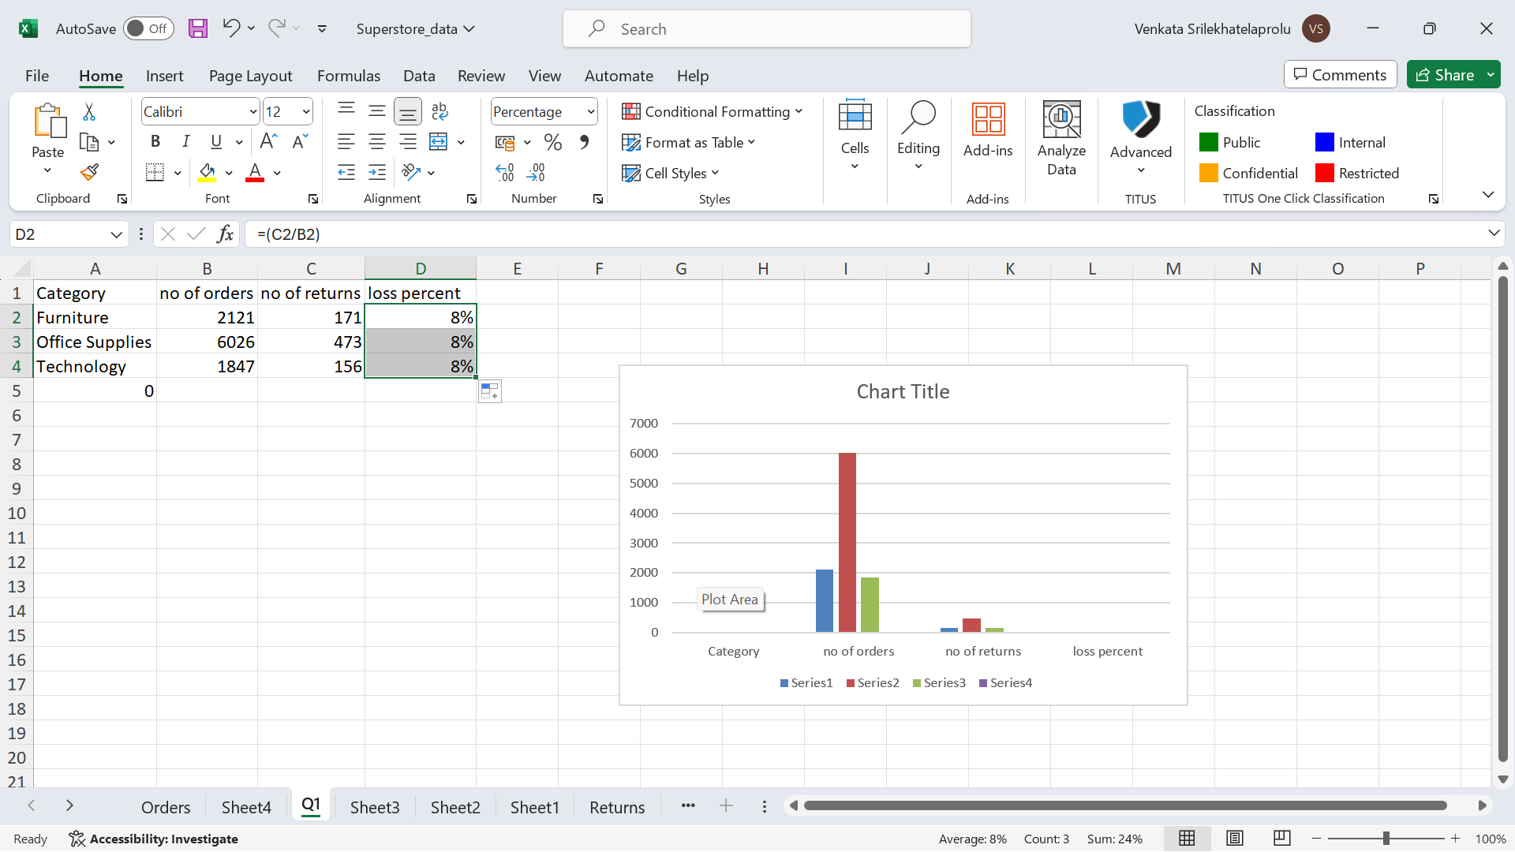
Q1. Return Analysis: Here we have calculated the total no of orders and total no of returns for each category and added a new column called returns in sheet4 and used it all to find the loss percentage of the respective category.
Formulas:
=XLOOKUP(B2,Returns!B:B,Returns!A:A,"no") is used to make a column of returned products so that the return analysis can be done easily . Loss percent is count using return ‘rate/order rate’.
Insights: from this analysis we can see that the return rate is more for the category of Office suppliers and then it is Furniture and Technology have almost similar returns which get to mean that the quality of technology categorised products is nice compared to that of furniture and office suppliers which also have the highest no of orders where the loss percent is almost same to all

Slide 2
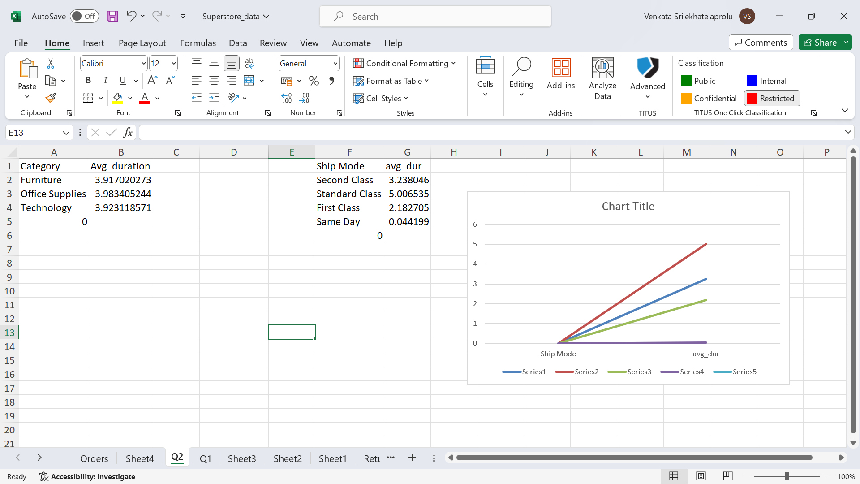
Q2.Shipping analysis: we have seen here the shippimg average duration for all modes of shipping by adding a column called duration in the sheet of orders and get to compare the shipping duration of all modes and get to know that Standard class has the slowest shipping time than any other mode where same day delivery time is the fastest delivery mode anyone can opt to
Formulas:
Here I used shipping date- delivery date to get the duration of the delivery and got the column and to get the average of the duration for respective shipping mode I used =AVERAGEIF(Orders!E:E,'Q2'!F2,Orders!W:W) in Q2 sheet and calculated the respective average delivery time for each shipping mode
Insights: Hence we can say that same day delivery mode is the fastest one can opt to get the fast delivery where standard class is the slowest one but not slow enough when compared to second class shipping mode.

Slide 3
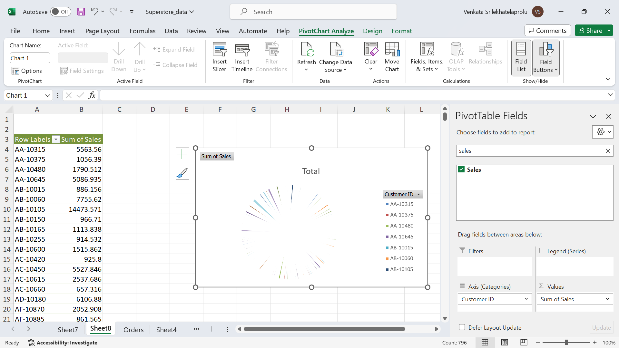
Q3: Customer Segmentation : Here we are segmenting customers based on the total sales or sum of sales they have abd then had a visual representation of pie chart for the customers for the respective sum of sales and then segmented respectively based on the sum of sales
I just used the pivot table here to have the sum pof sales for the respective customer and had the pie chart for a proper segmentation of the customers
Insights: The segment with so much of densed color is the customers who have a profitable sales and where the left segmented customers have the less profitable sales

Slide 4
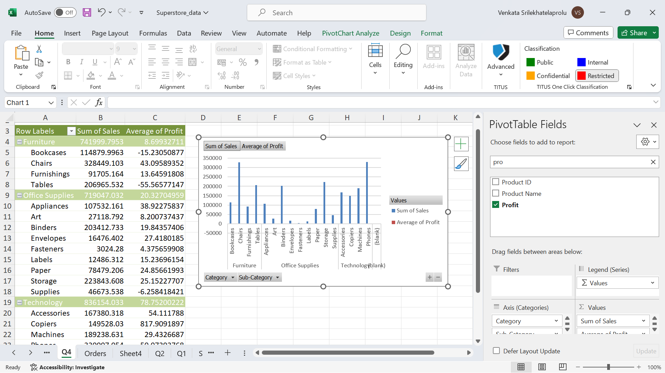
Q4:Product Performance: Here we calculated sum of sales for respective category and sub category and their profit averages also and are compared on a column chart for clear relevance
Here we used the pivot table to get the sum of sales for category and sub category and put them on a column charts respectively
Insights: Here we can clearly say that the top selling category is furniture in which the chairs has the highest sales amount and so the average profit is high for the technology which says that inspite of having the top selling product in furniture ,technology is scoring the nice gross income compared to all other categories

Slide 5
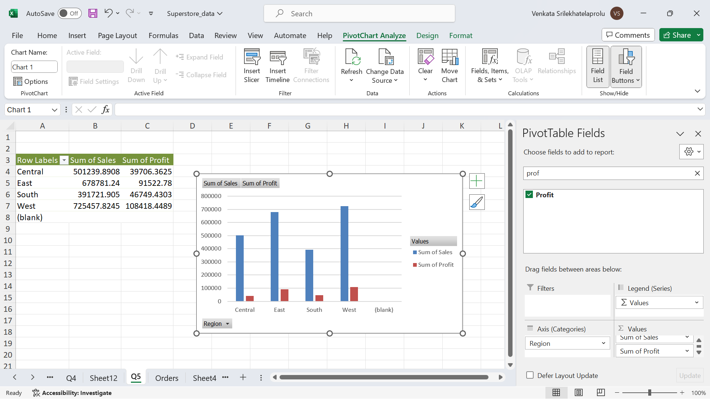
Q5:Regional analysis and Insights : Here we are comparing the sales across the region and also the profitable income across the regions by looking at the columnchart here we can say that West region has the highest sales and so is the profit. And then is the East region which is slightly similar to West region So East-West region has the best sales and profit

Slide 6
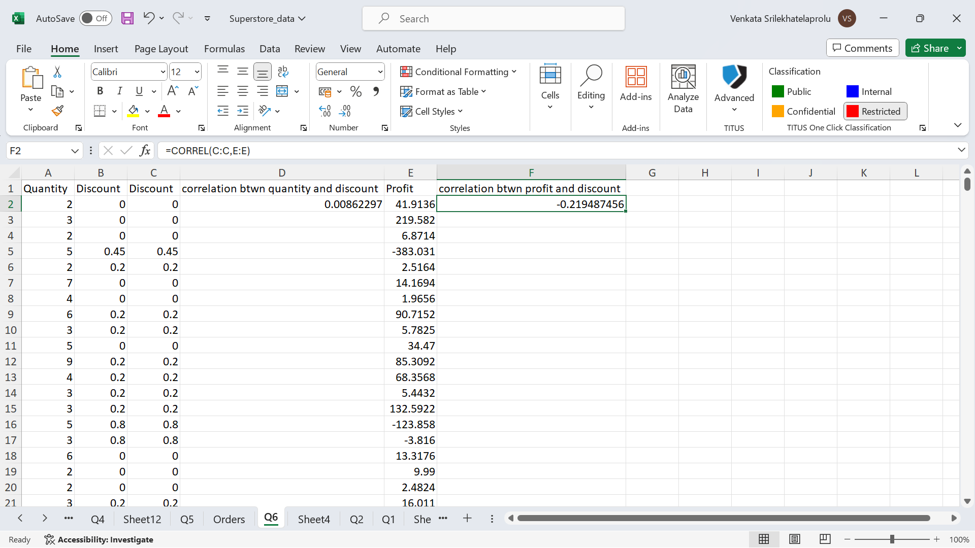
Q6:Discount analysis: Here we are calculating the impact of both profit margin and the quantity sold on the discount rate by using the formula of correlation =correl(quantity_column,discount_column) and then similarly for the profit margin
Hence , we can see that it is having a negative impact on profit because of the discount rate which says that discount rate should be reduced and at the same time w ehave positive effect on quantity sold because of discount which says that people are buying more with discounts .

Slide 7
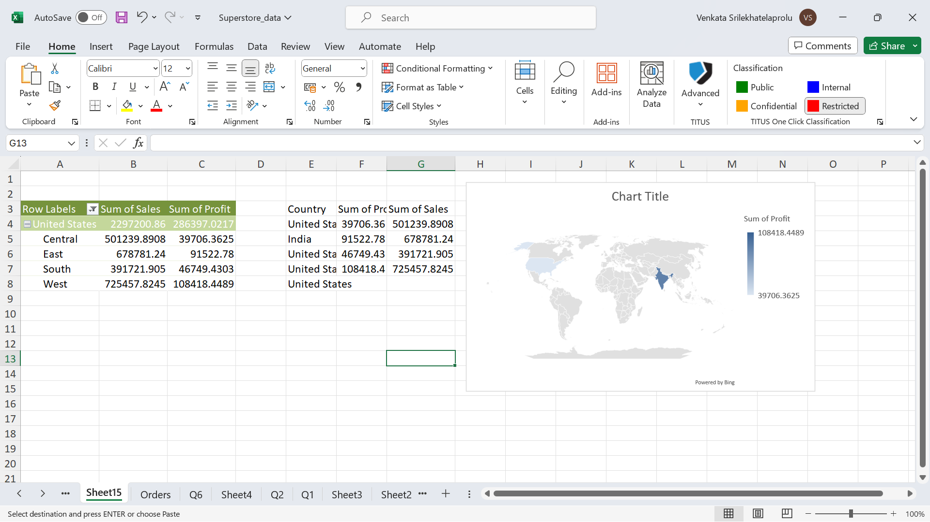
Q7:market expansion: Here we have checked the potential and the market stability by calculating the sales and profit of a particular region in a country and then it is strategically plotted on the map chart about the proper region that is capable of establishing a good growthful market
From this analysis we can say that India has a proper place for good establishment of the market

Slide 8
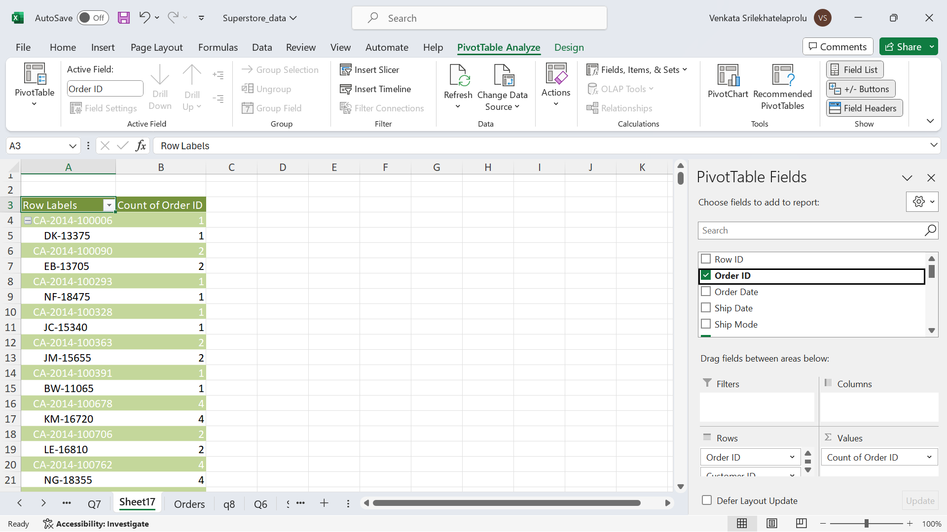
Q8:retention analysis: here we can see the repeated orders of each customer after filtering the customers with more than one order then we can conclude that they are having repeated orders and also retention rate can be found by calculating the total numb of repeated orders by total no of unique orders which gives the retention rate which can be calculate dfrom the following data
Retention cajn be improved by allowing customers go under the data analysis over their history of orders and considering their repeated orders and then recommending the so orders based on the analysis.

Slide 9
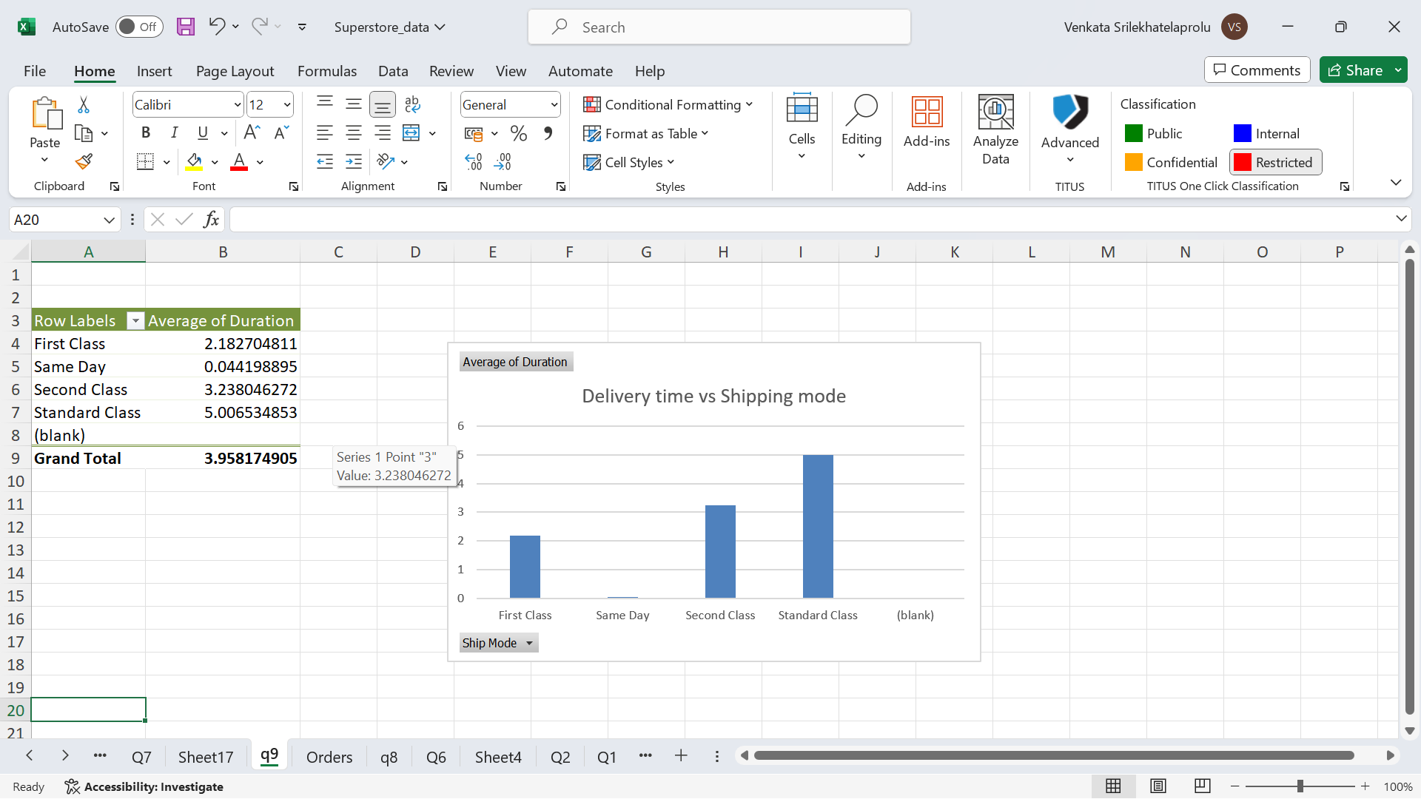
Q9: Dashboard: We are creating this dashboard for the superstore data where we will be comparing the important metrics like sales, profits, discounts, quantity sold across the regions, countries, and for the respective categories and sub categories
Here one can clearly understand the effective of each shipping mode for all kinds of categories.

Slide 10
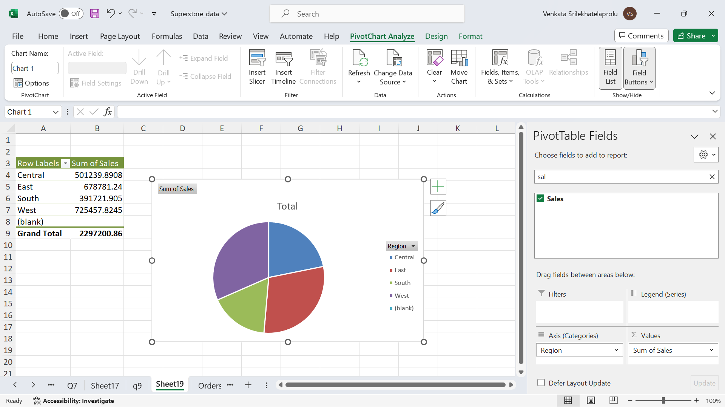
Here we are looking at the sales across four regions on a mpie chart and getting to know which region is more of sales and which is relatively less

Slide 11
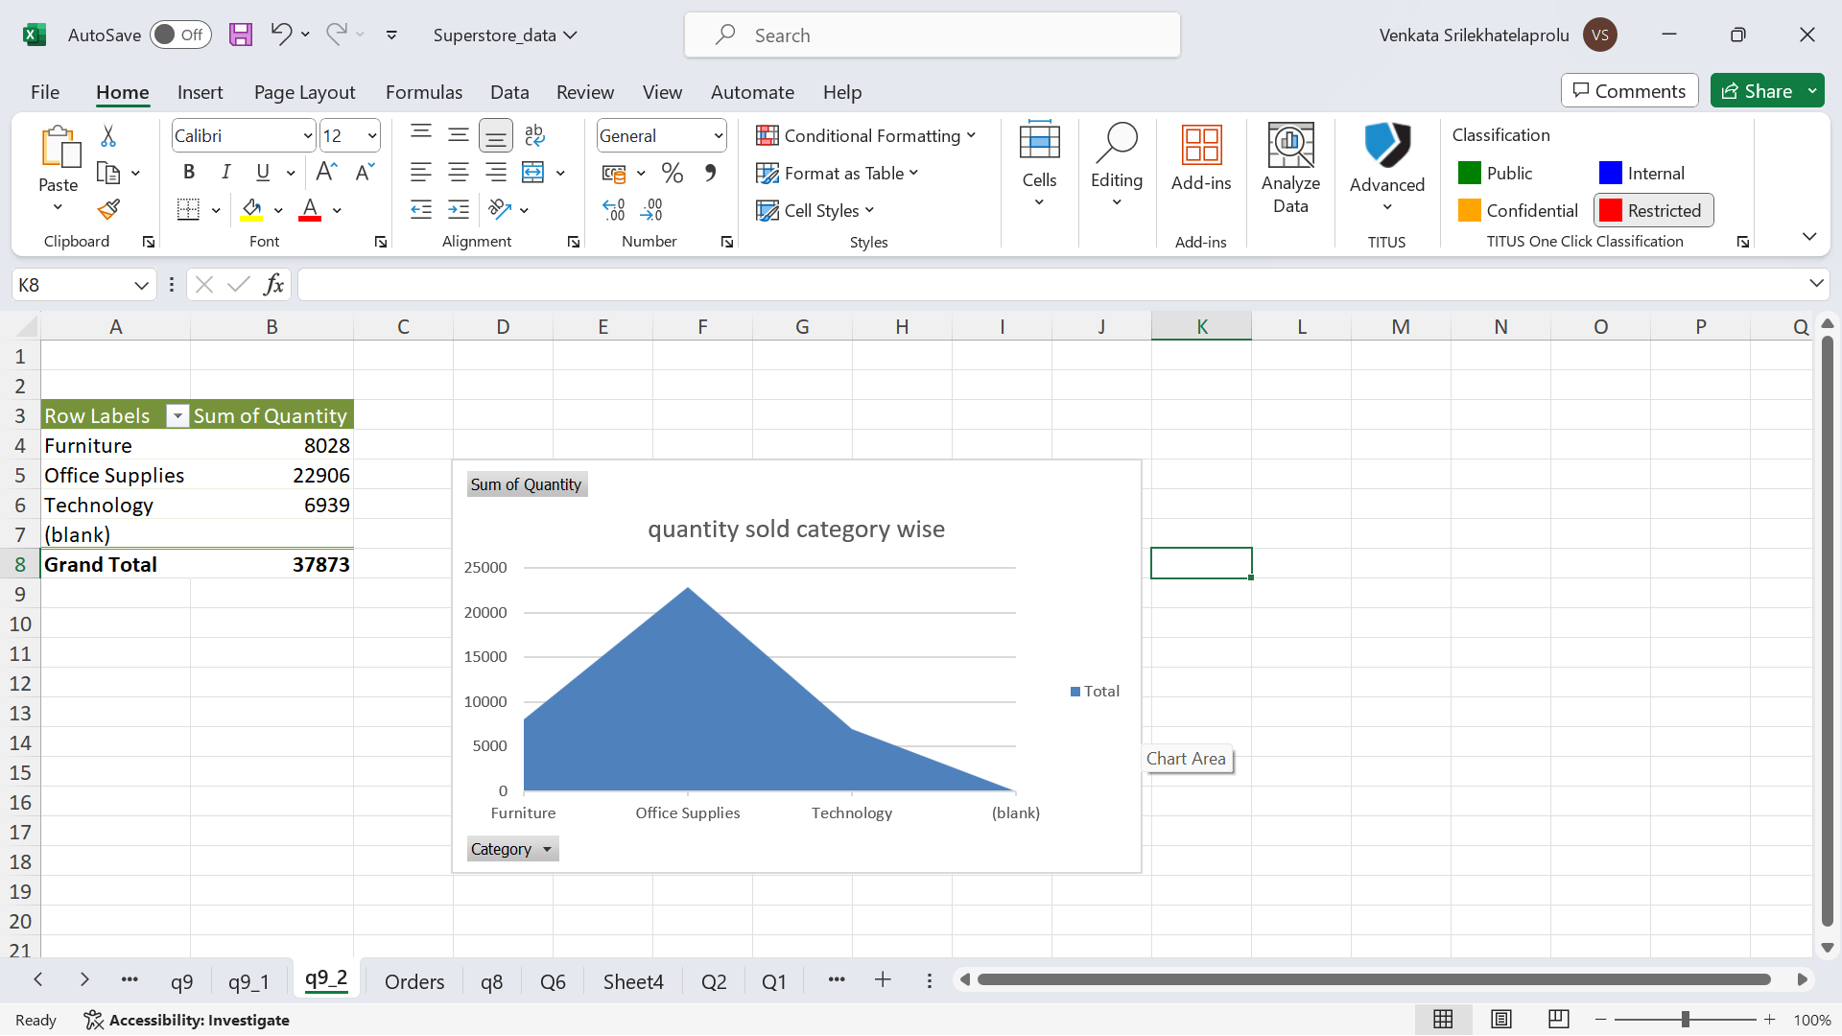
Here we are seeing the category products which are mostly sold out and which is having less quantity sold out which givesa insight about the category which is topselling and which is bringing much enhancement to the whole gross of the store

Slide 12
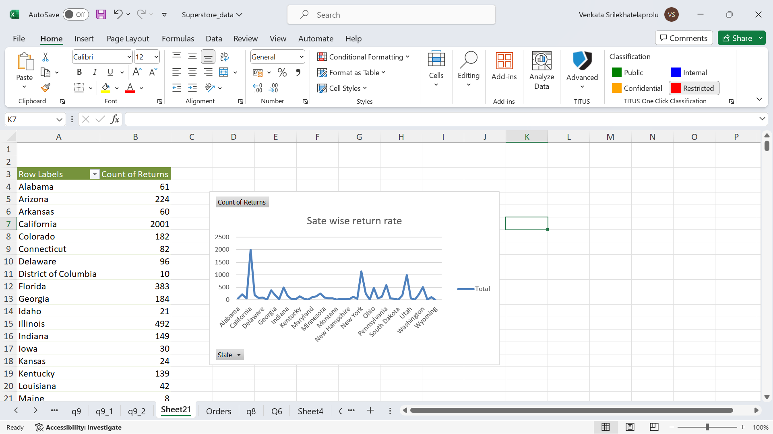
Here we can see the return of the products by the customers across the respective state of the country and California is having the highest rate of return compared to any other state

