Slide 1
EXCEL FINAL ASSESSMENT
Srilekha Telaprolu
4323-LVADSUSR130
28-02-2024

Slide 2
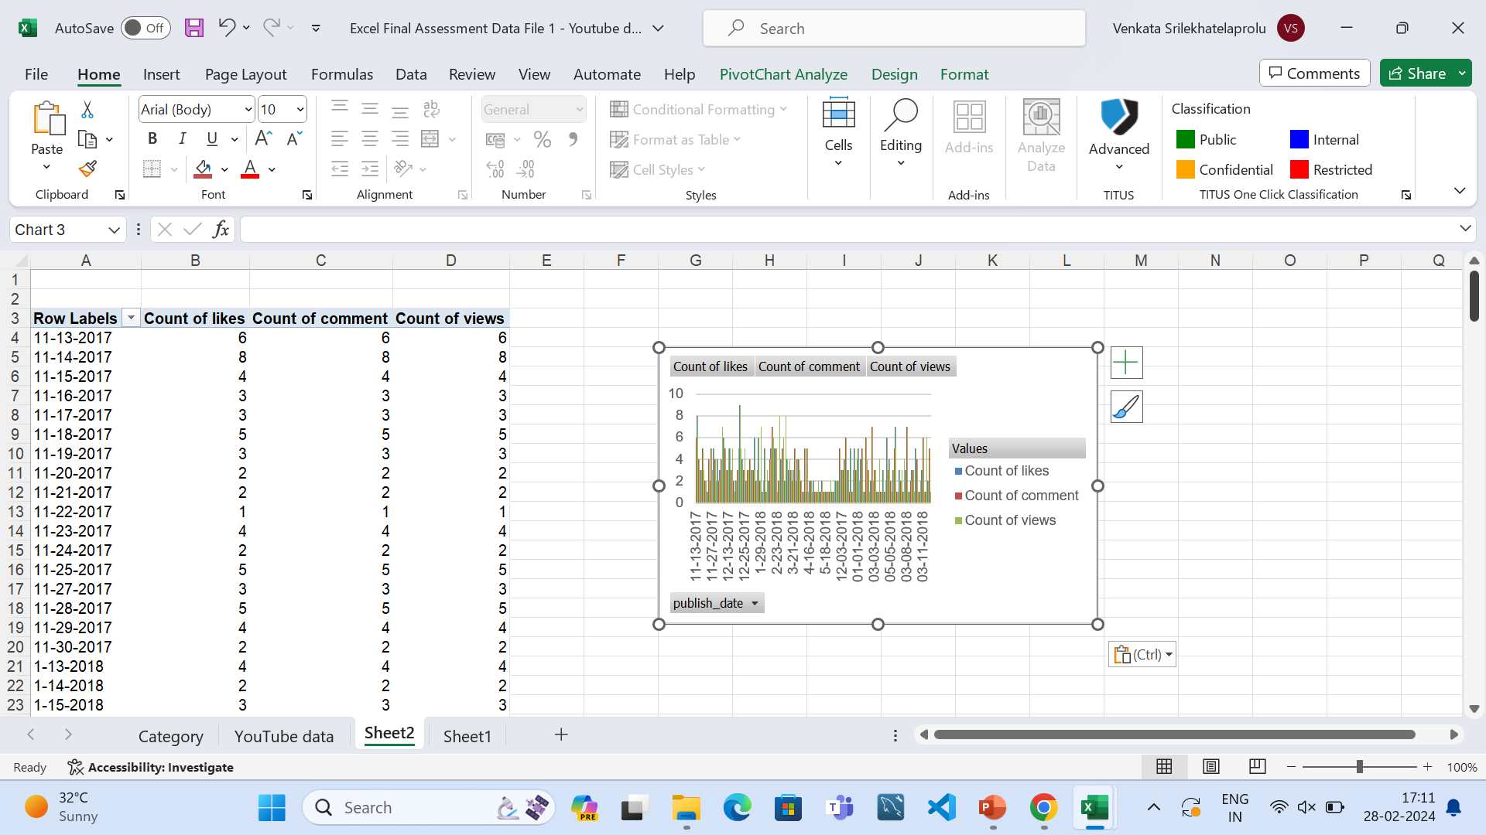
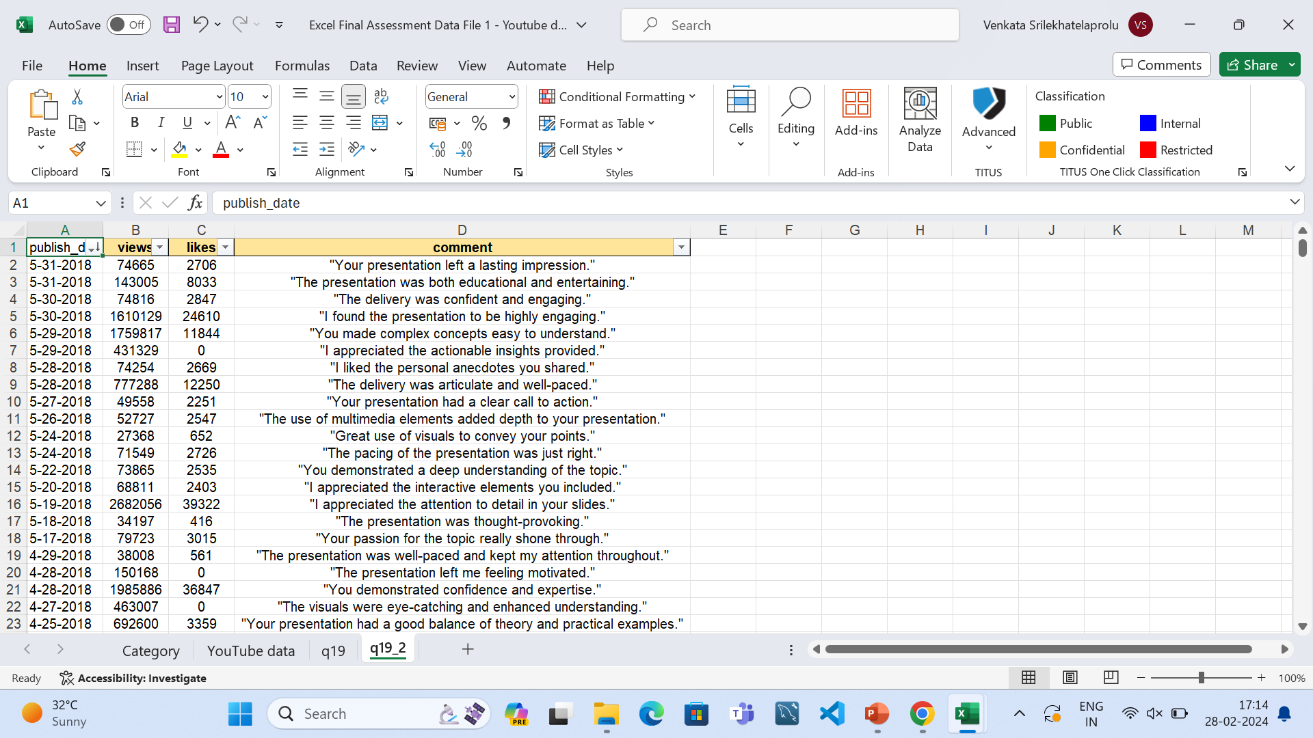
Q19.
Here we can see the analysis of likes and comments amd views count over the period of time

Slide 3
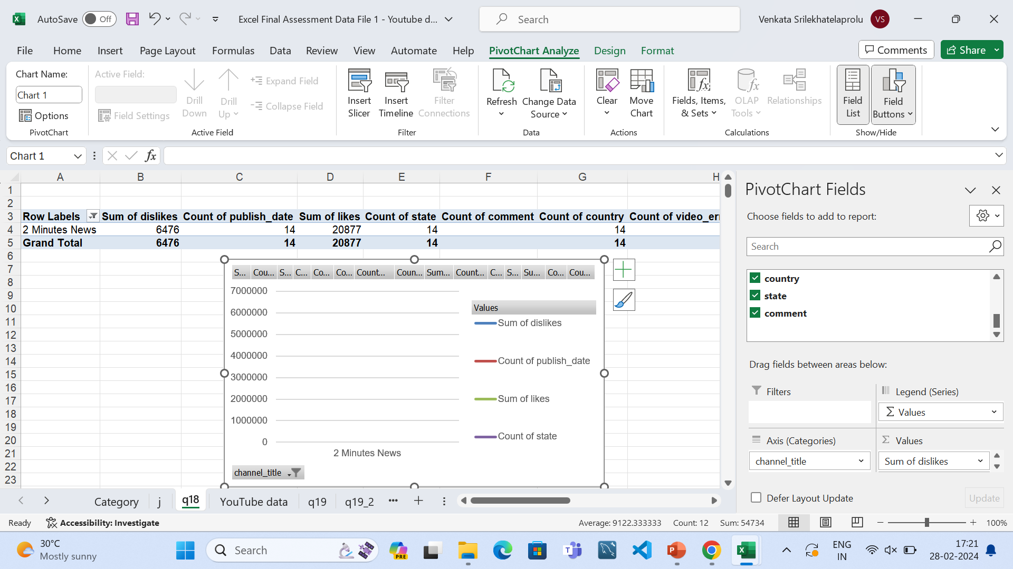
Q18.

Slide 4
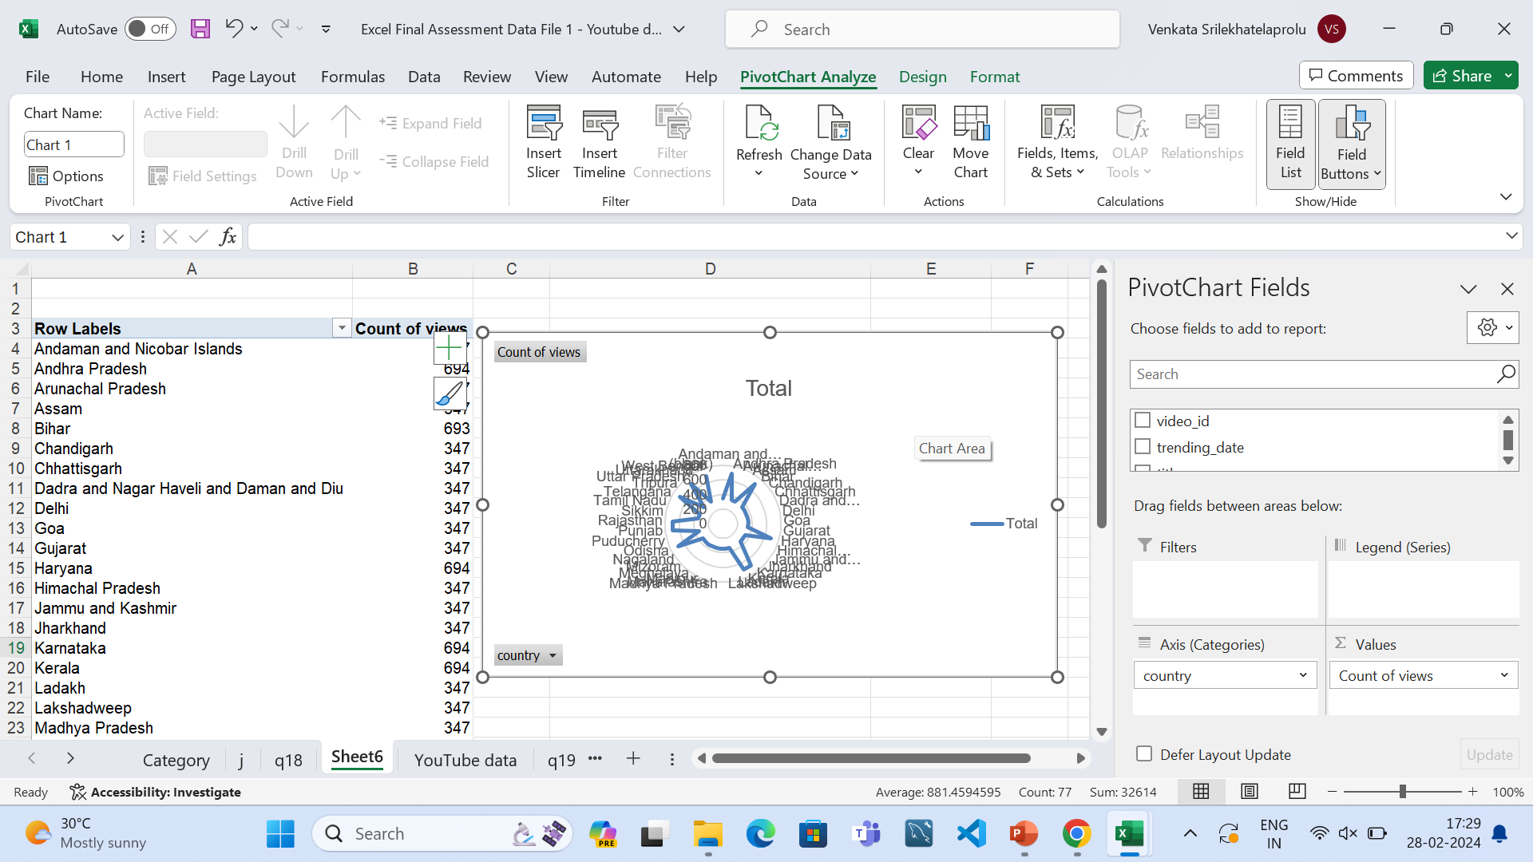
q16

Slide 5
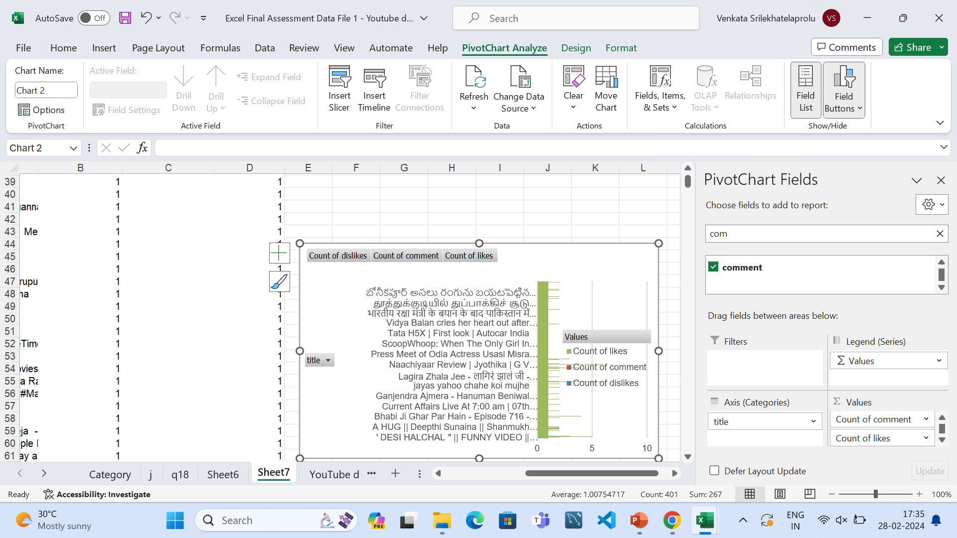
q17

