Slide 1

Applied Machine Learning Final project: Home Credit Default Risk
Group 36 Team Members:
Yashvanth Guntupalli
Sri Lekha Malraju
Revanth Sai Chowdary Rayala
Vinay Chandra Makineni

Slide 2
Contents:
Four P’s
Final Project : PyTorch Deep Learning Models: Classifcation
Conclusion and Results

Slide 3

Four P’s:
Past :
In the first phase , we performed EDA and performed baseline model with logistic regression. We got satisfactory results but with less AUC score. To improve the results we tried balancing the data which wasn’t very successful.
So, In the second phase we performed feature engineering, Hyperparameter tuning and modelling pipelines. To find the best models, we implemented models using Logistic regression, Decision tree, Random forest, XG Boost, Lasso regression using hyperparameter tuning (Grid search CV) and we used a couple of metrics for each model to evaluate the models.

Slide 4
Four P’s Contd:
Present:
In the present phase 3, we first performed some Exploratory data analysis to get more knowledge on the data set.
Then we implemented Deep Learning models like Multi layer perceptron and used AUC metric to evaluate the model.
Planned :
As a stretch goal, we will develop and implement and new multitask loss function in PyTorch. We are planning to find a way to improve AUC of our deep learning models with multiple perspectives.
We then submitted our results on Kaggle.

Slide 5

Four P’s Contd:
Problems :
We could further develop the accuracy however not AUC of our baseline model with our deep learning model.
Through the phases, we were unable to further develop AUC of classification regardless of several attempts like utilizing different models and tuning hyperparameters.

Slide 6
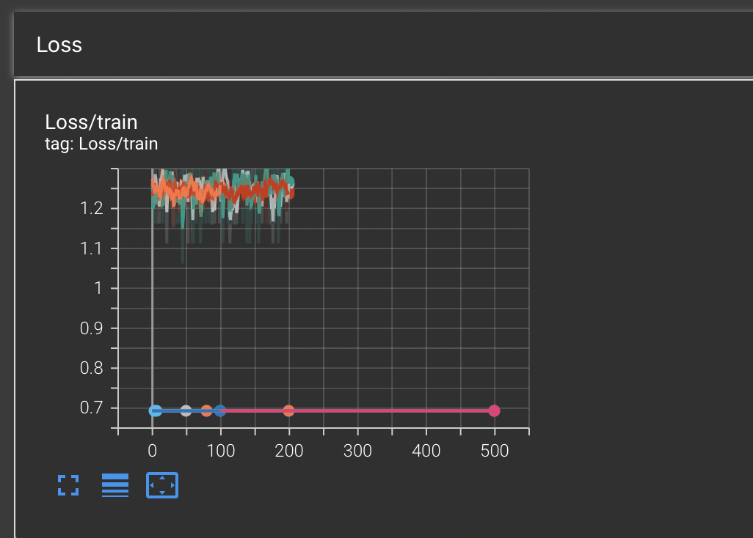
Deep learning models: Classification
We developed a Multilayer perceptron model for binary classification:
In phase 3, we built a deep learning model. We implemented a binary classification Machine learning model with Python using Pytorch. We elucidate a model, trained and evaluated the model. We did it by building a neural network (NN) of one linear layer, RELU layer, and sigmoid function.
The linear NN achieved a high AUC of 0.52 and test accuracy was 93.20%.
We visualised the loss function using the Tensor board

Slide 7
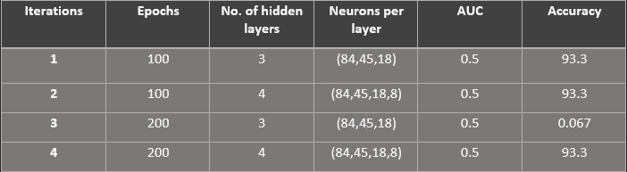
Results and Discussion:
These are the results we got for different experimentation.
From the results we observed that MLP classification improves the baseline test accuracy but not the AUC scores.
For MLP classification we used feature engineered data.

Slide 8
Results and Discussion Cont’d:
For doing Hyperparameter tuning, we tried training the Multi layer perceptron model with different number of parameters like the batch size, epochs and neurons. Then we tabulated the results by testing the model with the AUC score and observed that there is no difference in the AUC score but the accuracy decreased when the neurons are changed.
We trained the Multi layer perceptron model. Multi layer perceptron (MLP) is a supplement of feed forward neural network. It consists of three types of layers—the input layer, output layer and hidden layer. The input layer receives the input signal to be processed. We visualized the BCE Loss function using TensorBoard.
Discussing about the results, we got a bad AUC score compared to the classification models but got a better accuracy score.
To summarise the project, in phase 1, we performed some EDA and built the baseline model. In the second phase, we performed feature engineering and also did hyperparameter tuning with multiple classification models like Random Forest, Logistic Regression,Lasso Regression and Decision Trees. In Phase 3, we did some additional EDA and built a MLP model and tested the model with the AUC model.

Slide 9
Conclusion:
The object of the HCDR project is to foresee the repayment capacity of the financially under-served populace. This project is important because well-established predictions are necessary to both the loaner and borrower. HomeCredit will need accuracy of the highest level to make sure the data is predicted correctly as it involves people's lives. Our aim for the next phases is to increase the the AUC score and accuracy of the model to more than 95% and all of this should be done within milliseconds of time.
Many people struggle to get loans due to insufficient or non-existent credit histories. Unfortunately, this population is often taken advantage of by untrustworthy lenders. Home credit strives to broaden financial intrusion for the unbanked population by providing a positive and safe borrowing experience. In order to make sure this underserved population has a positive loan experience, Home Credit makes use of a variety of alternative data--including telco and transactional information--to predict their clients' repayment abilities.
In phase 1, we performed Exploratory Data Analysis where we found a lot of insights about the data and we gained a lot of knowledge on how find important information from the data. After that, we built a baseline model using pipelines using Logistic Regression where we got a good understanding on how to build models and train them and test them using various metrics.
In Phase 2, we performed ferature engineering and understood how to create meaningful features to make the model better. Then we performed Hyperparameter tuning using GridSearchCV where we understood how to increase the accuracy utilizing multiple models.
In Phase 3, We implemeted an MLP model and then test the model with AUC score. Finally, we did not get the scores we desired but we can satisfactorily say that we gained a lot of confidence and knowledge to build a Machine Learning Application.

Slide 10

Thank you

