Slide 1
Lung Cancer Prediction
B565 Data Mining
Rohith Venkata Reddy
Srilekha Malraju

Slide 2
Project Description
Lung Cancer is one of the dreadful diseases prevailing in the medical field. Several deaths are being caused by Lung Cancer and there are several research studies performed on the cause factors.
In this project, we are using several Machine Learning techniques to predict the level of Lung Cancer in a patient based on different attributes related to patient. Some of the attributes are Smoking habits, Alcohol consumption level, Air pollution which the patient is exposed to.

Slide 3
Data
This dataset is considered from Kaggle.
Different features include Age, Gender, Air pollution, Alcohol use and many other.
Age has numeric values, and all other features are categorical values which shows the level of feature of the patient.
Example: Level of genetic risk of the patient is 5.
The level feature indicates the level of Lung Cancer of the patient.

Slide 4
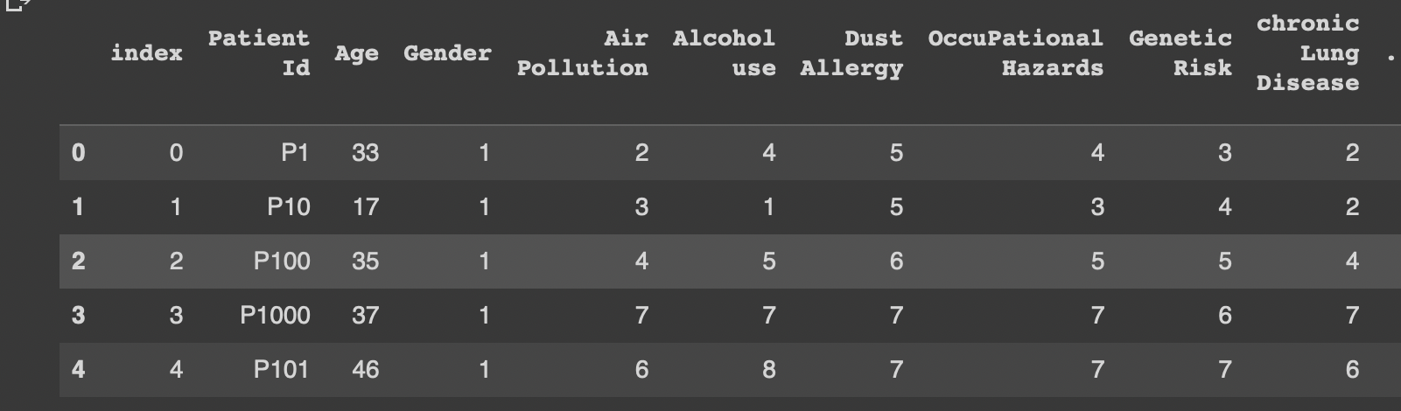
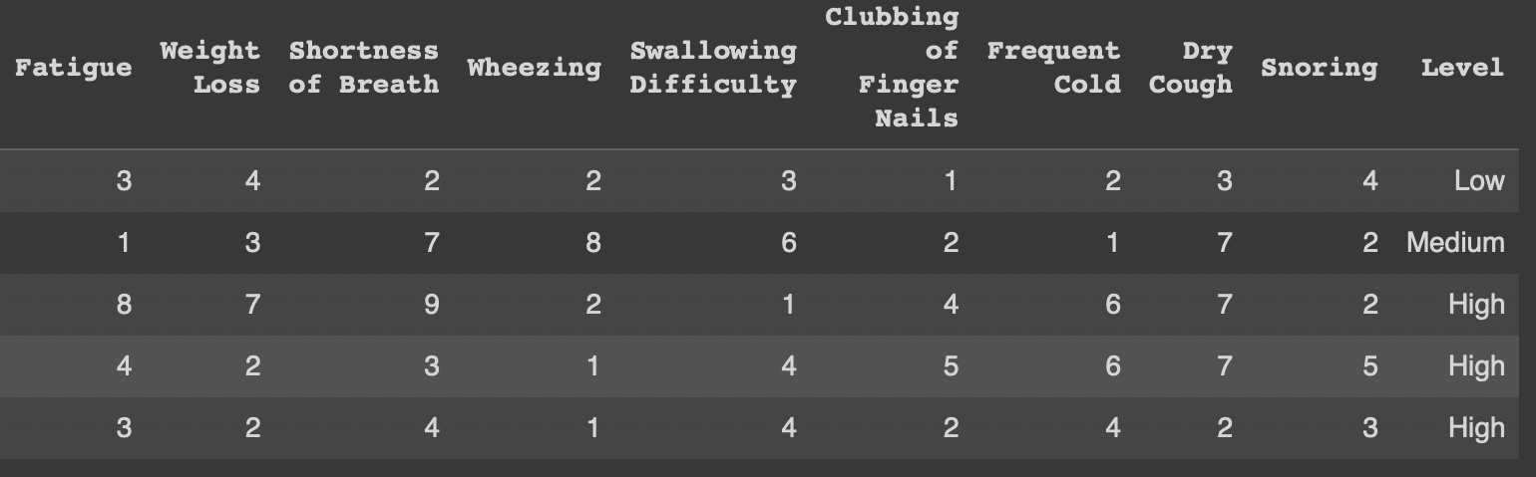
Sample data

Slide 5
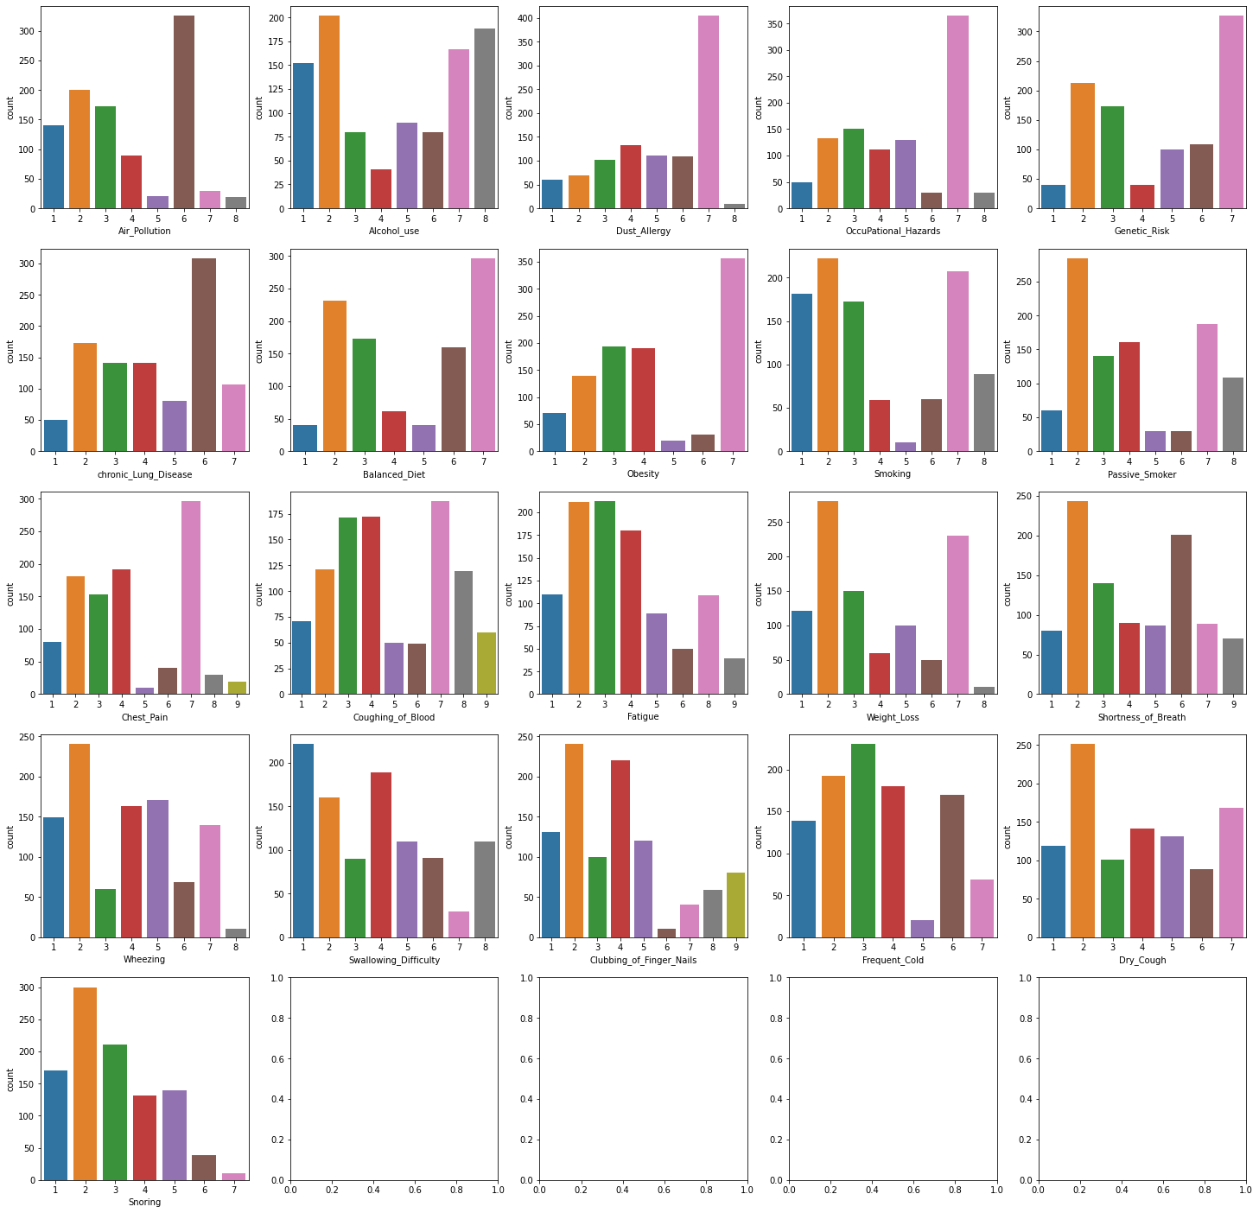
EDA

Slide 6
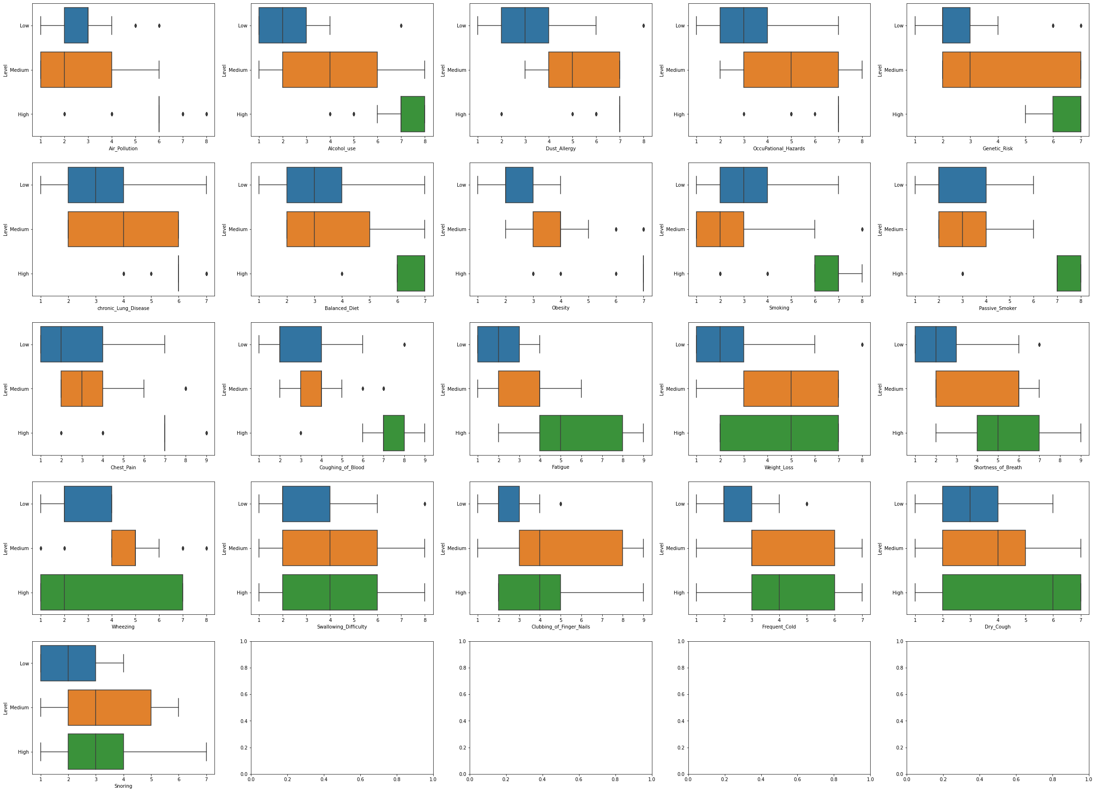
EDA

Slide 7
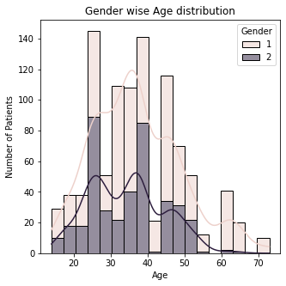
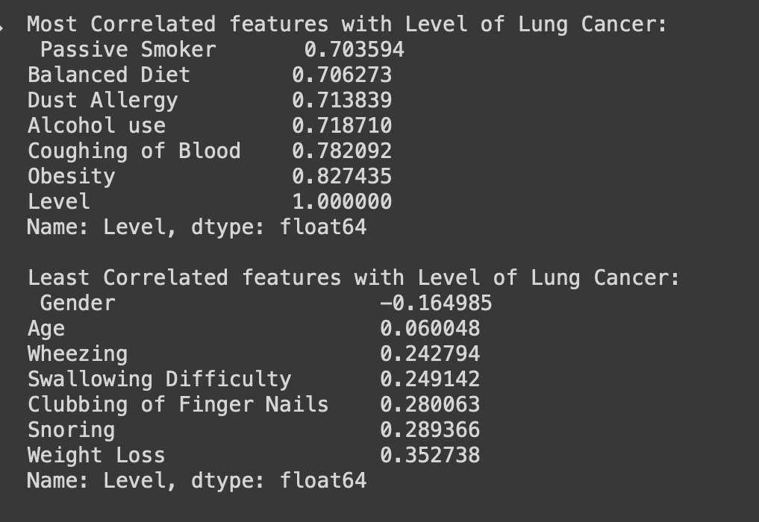
EDA

Slide 8
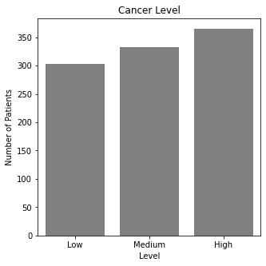
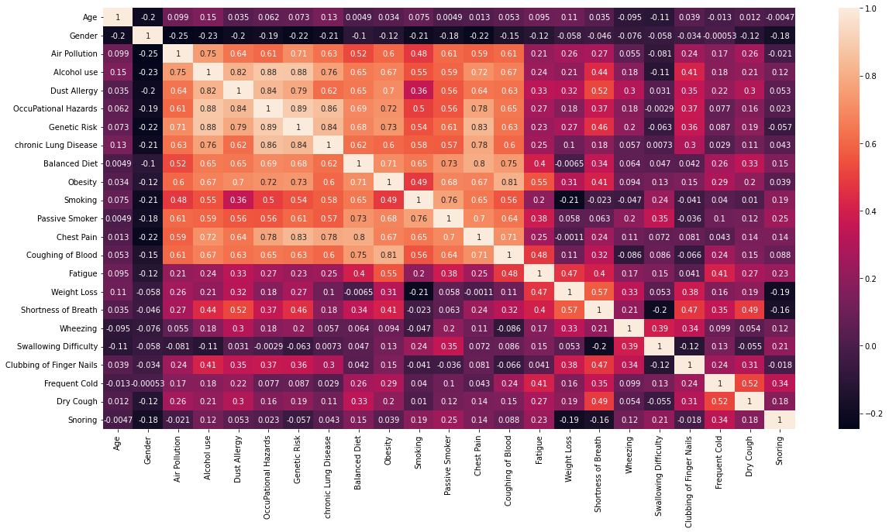
EDA

Slide 9
Observations from EDA
The high levels of Air Pollution, Alcohol Use, Dust Allergy, Genetic Risk, Obesity, Chronic Lung disease, Chest Pain, Coughing blood are in proportional with the number of patients with Lung Cancer.
According to the Correlation analysis, we can say that highly correlated features with Level of lung cancer are Alcohol Use, Coughing of blood and Obesity.
From the box plot, we can understand the data distribution of each feature with Level of Lung Caner.
The missing values count is zero.

Slide 10
Machine Learning Models
Implemented multiple models to achieve:
Best Accuracy Score
Less Mean Square Error
Best K-Fold Cross Validation Accuracies

Slide 11
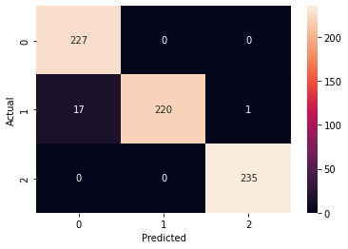
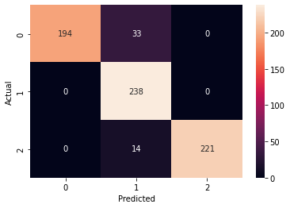
Machine Learning Models
Implemented Logistic and Linear Regression Model.
Linear Regression Model did not perform well for this dataset with less less accuracy score and high MSE.
Logistic Regression Confusion Matrix
Linear Regression Confusion Matrix

Slide 12
Reporting Model Accuracies
Model | Accuracy | MSE | K-Fold=10 Min Accuracy | K-Fold=10 Mean Accuracy | K-Fold=10 Max Accuracy
Logistic Regression | 0.9742 | 0.0257 | 0.9 | 0.9733 | 1
Linear Regression | 0.9328 | 0.0671 | 0.8865 | 0.9287 | 0.9789
Ridge Regression | 0.9414 | 0.0585 | 0.8872 | 0.9289 | 0.9777
Gaussian Naïve Bayes | 0.9 | 0.1342 | 0.8666 | 0.9233 | 0.9666
Bernoulli Naïve Bayes | 0.9 | 0.1342 | 0.8666 | 0.9266 | 0.9666
Random Forest Regression | 1.0 | 0 | 0.9233 | 0.9877 | 0.9998
Support Vector Regression | 1.0 | 0 | 0.9736 | 0.9813 | 0.99
Stochastic Gradient Descent | 0.9642 | 0.0357 | 0.8711 | 0.9182 | 0.952

Slide 13
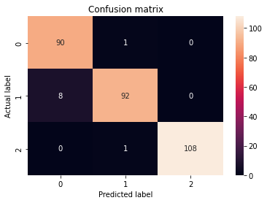
Deep Learning Model
Train Score: 0.1619
Train Accuracy: 0.9671
Loss: 0.1620
Test Score: 0.1599
Test Accuracy: 0.9666
Loss: 0.1600

Slide 14
Results & Conclusion
Random Forest Regression and Support Vector Regression performs better with accuracy score 1.0.
This might be a case for improper sampling, hence we computed k-fold cross validation.
With k-fold cross validation, mean accuracies are higher compared to other models
Gaussian Naïve Bayes and Bernoulli Naïve Bayes does not perform well for this dataset when compared to other models.
Deep Learning model gives same accuracies on both train and test data.

Slide 15
THANK YOU

