Slide 1


AIR QUALITY INDEX PREDICTION MODEL WITH PYTHON
NAME : NADELLA SRILEKYA
AICTE STUDENT ID : STU645a315fb83de1683632479

Slide 2

Learning Objectives
To understand the concepts of Air Quality Index (AQI) and how various pollutants like PM2.5, PM10, NO2, and CO affect air quality.
To practice data preprocessing techniques, including handling missing values, feature selection, and data scaling.
To build and train regression models, such as Linear Regression and Random Forest Regressor, for AQI prediction.
To evaluate model performance using metrics like RMSE and R², gaining insights into model accuracy and reliability.
To strengthen machine learning skills by experimenting with hyperparameter tuning and comparing model outcomes.
To visualize relationships between pollutants and AQI using plots, helping to identify trends and patterns in air quality data.
GOAL
Source :
www.freepik.com/

Slide 3
Tools and Technology used
Python
Pandas
Numpy
Matplotlib
Seaborn
Scikit-learn
Jupyter Notebook

Slide 4
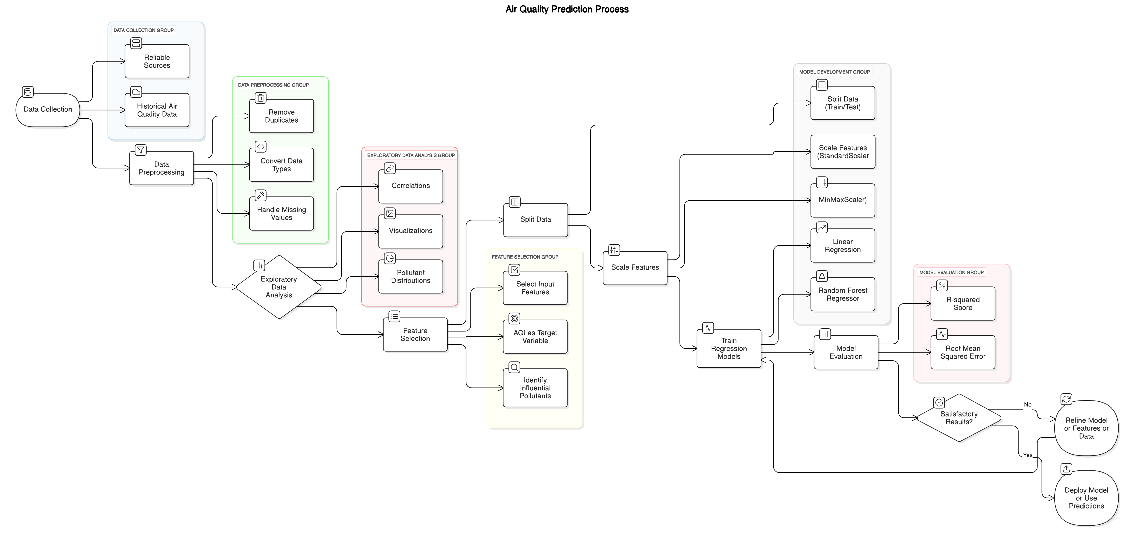
Methodology

Slide 5
Problem Statement:
Air pollution poses a significant threat to public health and the environment, making it crucial to accurately predict Air Quality Index (AQI) levels. The goal of this project is to develop a machine learning model that forecasts AQI based on pollutant concentrations (such as PM2.5, PM10, NO2, CO, etc.). By leveraging historical air quality data, the model aims to provide timely predictions, enabling authorities and individuals to take preventive measures. This project focuses on building a reliable predictive model using regression techniques, ensuring effective data preprocessing, feature selection, and model evaluation. Ultimately, the system aims to enhance public awareness and support proactive responses to deteriorating air quality.

Slide 6
Solution:
Data Collection: Collect historical air quality data, including pollutant concentrations (PM2.5, PM10, NO2, CO, etc.) and corresponding AQI values, from reliable sources.
Data Preprocessing: Clean the dataset by handling missing values (using mean imputation or other techniques), removing duplicates, and converting data types as needed. Ensure the data is prepared for model training.
Exploratory Data Analysis (EDA): Analyze pollutant distributions, check for correlations between pollutants and AQI, and visualize trends using plots like scatter plots, heatmaps, and histograms.
Feature Selection: Identify the most influential pollutants affecting AQI and select them as input features (independent variables) while using AQI as the target variable (dependent variable).
Model Development: Split the data into training and testing sets, scale the features, and train regression models (e.g., Linear Regression, Random Forest Regressor) to predict AQI values.
Model Evaluation: Evaluate model performance using metrics such as Root Mean Squared Error (RMSE) and R-squared (R²) score to check accuracy and fit.

Slide 7
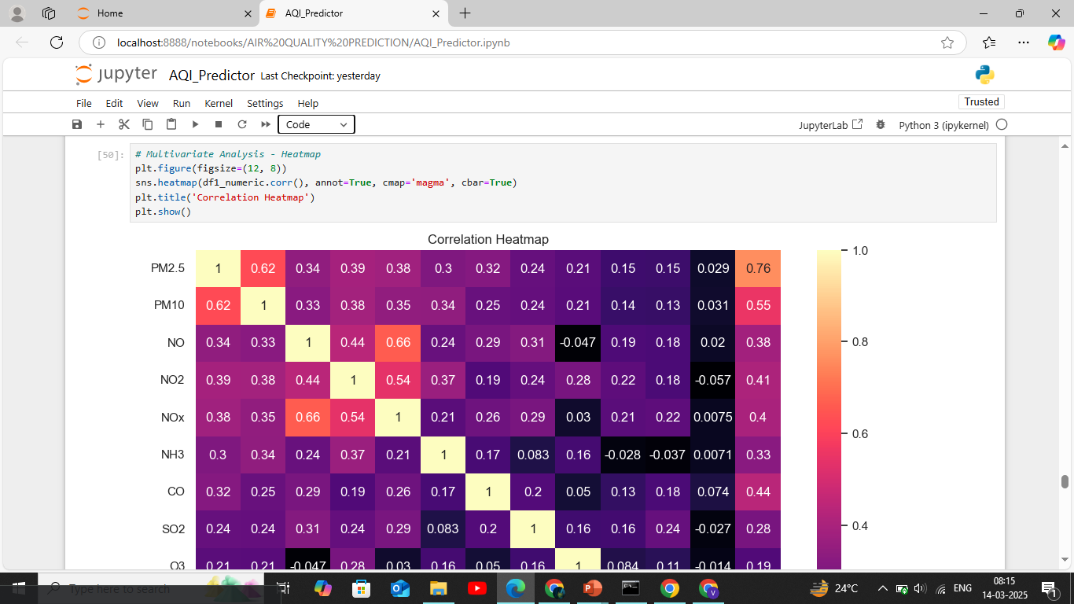
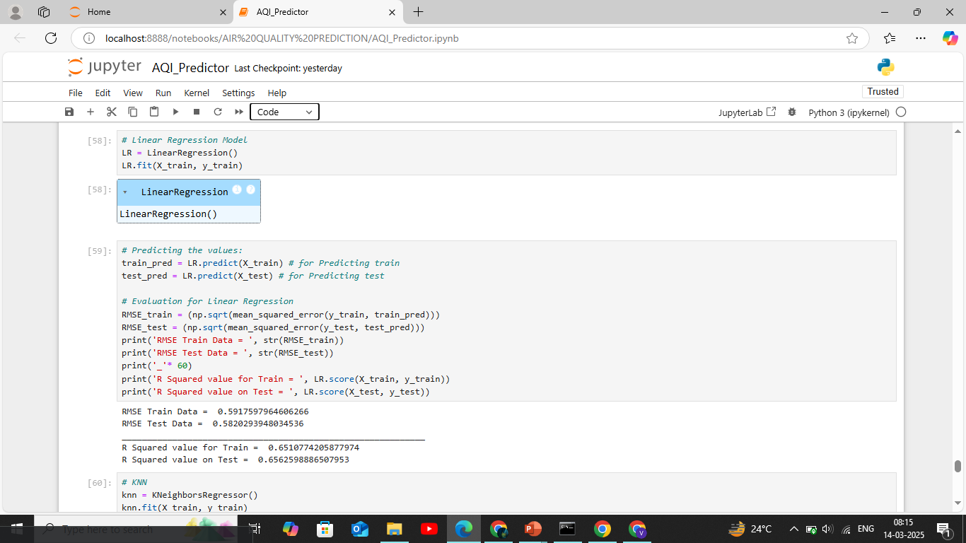
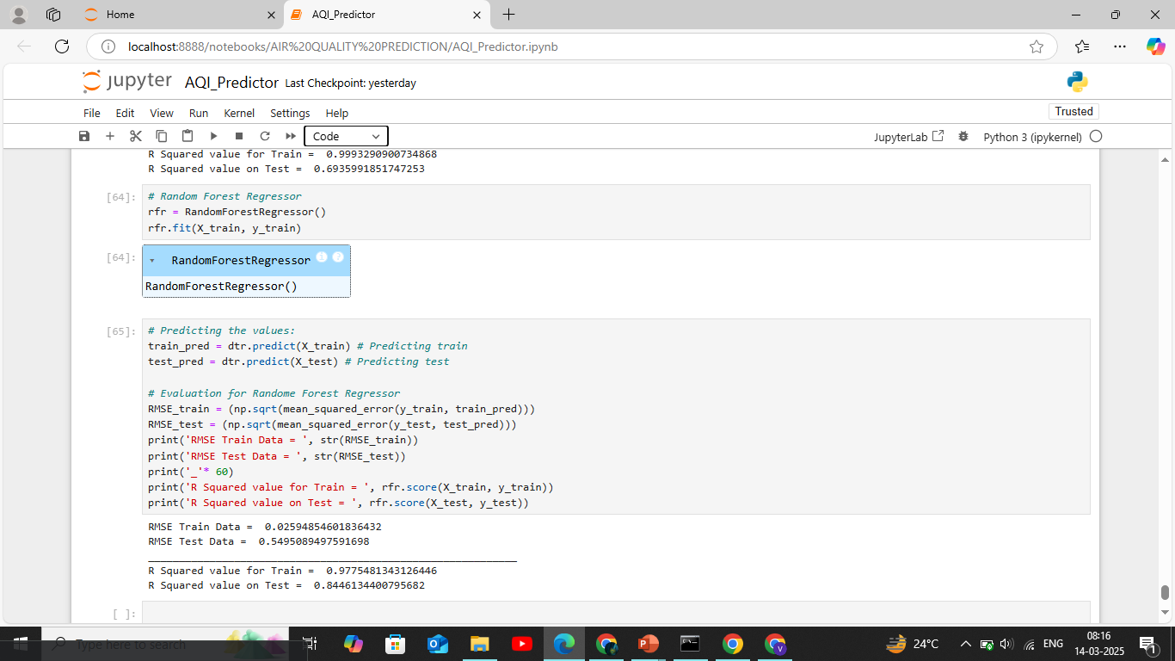
Screenshot of Output:

Slide 8
Conclusion:
The AQI Prediction project successfully demonstrates the use of machine learning techniques to estimate air quality based on pollutant concentration data. By collecting, cleaning, and analyzing historical air quality data, we identified key pollutants that significantly impact AQI values. Through model training and evaluation, we compared various regression algorithms and selected the most accurate model for predicting AQI. The project highlights the importance of data preprocessing, feature selection, and model optimization in building reliable predictive models. Ultimately, this system provides a data-driven approach to forecast air quality, aiding in environmental monitoring and helping communities take proactive measures to reduce air pollution exposure.

