Slide 1

Pandas

Slide 2
Pandas
Let’s focus on learning about Pandas!
Created by Wes McKinney, Pandas stands for Panel Data library.
It is the most popular data analysis library for Python and it comes with many tools that we will use throughout the course!

Slide 3
Pandas
This section we’ll learn about:
Series and DataFrames
Missing Data
Groupby
Operations
Data I/O (Input and Output)
Exercises

Slide 4
Let’s get started!

Slide 5
Series

Slide 6
Pandas
A series is the basic building block of Pandas.
It holds an array of information organized by an Index.

Slide 7
Pandas
NumPy array has data with an index
Index | Data
0 | 8,550,405
1 | 3,971,883
2 | 2,720,546
3 | 2,296,224
4 | 1,567,442

Slide 8
Pandas
Series is built on top of a NumPy array
Index | Data
0 | 8,550,405
1 | 3,971,883
2 | 2,720,546
3 | 2,296,224
4 | 1,567,442

Slide 9
Pandas
Series is built on top of a NumPy array and can have a Named Index
Index | Named Index | Data
0 | New York City | 8,550,405
1 | Los Angeles | 3,971,883
2 | Chicago | 2,720,546
3 | Houston | 2,296,224
4 | Philadelphia | 1,567,442

Slide 10
Pandas
Let’s explore Series with Pandas!

Slide 11
DataFrames
Part One

Slide 12
Pandas
A DataFrame is simply multiple series that share the same index!
It is essentially a tabular data storage format.

Slide 13
Pandas
DataFrame has multiple columns
Index | Pop | Size Sq Mi | Year Founded
New York City | 8,550,405 | 302.6 | 1624
Los Angeles | 3,971,883 | 503 | 1781
Chicago | 2,720,546 | 234 | 1833
Houston | 2,296,224 | 669 | 1837
Philadelphia | 1,567,442 | 141.7 | 1682

Slide 14
Pandas
Each of these columns is a Series object
Index | Pop | Size Sq Mi | Year Founded
New York City | 8,550,405 | 302.6 | 1624
Los Angeles | 3,971,883 | 503 | 1781
Chicago | 2,720,546 | 234 | 1833
Houston | 2,296,224 | 669 | 1837
Philadelphia | 1,567,442 | 141.7 | 1682

Slide 15
Pandas
Let’s build some DataFrames and explore a few operations on them!

Slide 16
DataFrames
Part Two

Slide 17
Missing Data

Slide 18
Pandas
Sometimes data will be missing from your original source, yet many forecasting methods can’t work with a missing data point!
So what can we do?

Slide 19
Pandas
Missing Data has only 3 options:
Keep the missing data (NaN), if the forecasting method can handle it.
Drop the missing data (the entire row including the timestamp).
Fill in the missing data with some value (best estimated guess).

Slide 20
Pandas
There is no “correct” approach, since each case will be different.
It will be up to you to decide what method to choose.
Fortunately, by their very nature, many sources of time series data rarely have missing information.

Slide 21
Pandas
Let’s explore missing data methods with Pandas!

Slide 22
Groupby

Slide 23
Pandas
Often you may want to perform an analysis based off the value of a specific column, meaning you want to group together other columns based off another.
In order to do this, we to perform 3 steps.

Slide 24
Pandas
Group By Operations involve:
Split
Apply
Combine
Pandas does all of this for this with a simple method call: .groupby()

Slide 25
Pandas
Category | Data Value
A | 10
A | 5
B | 2
B | 4
C | 12
C | 6

Slide 26
Pandas
A | 10
A | 5
Category | Data Value
A | 10
A | 5
B | 2
B | 4
C | 12
C | 6
B | 2
B | 4
C | 12
C | 6

Slide 27
Pandas
A | 10
A | 5
Aggregate Function
SUM
Category | Data Value
A | 10
A | 5
B | 2
B | 4
C | 12
C | 6
Category | Result
A | 15
B | 6
C | 18
B | 2
B | 4
C | 12
C | 6

Slide 28
Pandas
A | 10
A | 5
Aggregate Function
MEAN
Category | Data Value
A | 10
A | 5
B | 2
B | 4
C | 12
C | 6
Category | Result
A | 7.5
B | 3
C | 9
B | 2
B | 4
C | 12
C | 6

Slide 29
Pandas
Pandas will automatically make the grouped by column the index of the new resulting DataFrame.
Let’s explore group by with Pandas!

Slide 30
Operations

Slide 31
Pandas
In this lecture we’re going to cover a few more operations (methods and attributes) that you can call off of Series and DataFrames in Pandas.

Slide 32
Data Input
and Output

Slide 33
Pandas
Pandas can read a variety of tabular data formats.
Keep in mind, for this course, we will provide all the data for you in CSV files.
Please refer to the documentation if you wish to connect to your own data sources!

Slide 34
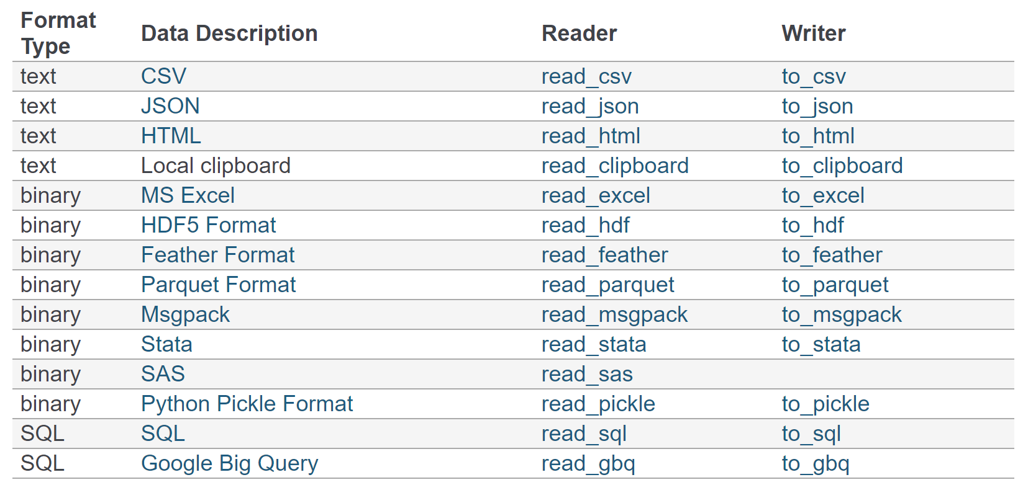
Pandas

Slide 35
Pandas
More info, search for: Pandas IO
Let’s work through a few examples!

Slide 36
Pandas Exercises

Slide 37
Pandas Exercise
Solutions

