Slide 1

Time Series
with Pandas

Slide 2
Time Series with Pandas
It is now time to shift our focus to dealing with time series data!
Pandas has many tools specifically built for working with time stamped data.

Slide 3
Time Series with Pandas
In this section we will discuss:
DateTime Index Basics
Time Resampling
Time Shifting
Rolling and Expanding
Time Series Visualization
Time Series Project Exercise

Slide 4
Datetime Index

Slide 5
Time Resampling

Slide 6
Time Shifting

Slide 7
Rolling and Expanding

Slide 8
Visualizing Time Series Data with Pandas

Slide 9
EWMA Code Along

Slide 10
ETS Decomposition Code Along

Slide 11
ARIMA Models

Slide 12
Python for Finance
We will now discuss one of the most common time series models, ARIMA.
Please note, this is an optional section of the course.

Slide 13
Python for Finance
For various reasons we will discover later on, ARIMA models often don’t work well with historical stock data.
However, they are so fundamental to understanding time series analysis that it is still worth the time to go over them.

Slide 14
Python for Finance
ARIMA models can be complex!
Make sure to make full use of the various links and extra resources presented throughout this section if you want to later use ARIMA models for other problems.

Slide 15
Python for Finance
AutoRegressive Integrated Moving Average (ARIMA) model is a generalization of an autoregressive moving average (ARMA) model.

Slide 16
Python for Finance
Both of those models (ARIMA and ARMA) are fitted to time series data either to better understand the data or to predict future points in the series (forecasting).

Slide 17
Python for Finance
ARIMA (Autoregressive Integrated Moving Averages)
Non-seasonal ARIMA
Seasonal ARIMA

Slide 18
Python for Finance
We will start by discussing non-seasonal ARIMA models and then move on to seasonal ARIMA models.
The python examples at the end will be using seasonal ARIMA.

Slide 19
Python for Finance
ARIMA models are applied in some cases where data show evidence of non-stationarity, where an initial differencing step (corresponding to the "integrated" part of the model) can be applied one or more times to eliminate the non-stationarity.

Slide 20
Python for Finance
Differencing is actually a very simple idea, but let’s put it on hold for now, and talk a bit more about ARIMA!
We’ll touch back on differencing later on.
Let’s talk about the major components of ARIMA.

Slide 21
Python for Finance
Non-seasonal ARIMA models are generally denoted ARIMA(p,d,q) where parameters p, d, and q are non-negative integers.
Let’s discuss what these three components are!

Slide 22
Python for Finance
Parts of ARIMA model
AR (p): Autoregression
A regression model that utilizes the dependent relationship between a current observation and observations over a previous period

Slide 23
Python for Finance
Parts of ARIMA model
I (d): Integrated.
Differencing of observations (subtracting an observation from an observation at the previous time step) in order to make the time series stationary.

Slide 24
Python for Finance
Parts of ARIMA model
MA (q): Moving Average.
A model that uses the dependency between an observation and a residual error from a moving average model applied to lagged observations.

Slide 25
Python for Finance
Stationary vs Non-Stationary Data
To effectively use ARIMA, we need to understand Stationarity in our data.
So what makes a data set Stationary?
A Stationary series has constant mean and variance over time.

Slide 26
Python for Finance
A Stationary data set will allow our model to predict that the mean and variance will be the same in future periods.
Let’s take a look at a few examples!

Slide 27
Python for Finance
Mean needs to be constant
Stationary
Non-Stationary

Slide 28
Python for Finance
Variance should not be a function of time
Stationary
Non-Stationary

Slide 29
Python for Finance
Covariance should not be a function of time
Stationary
Non-Stationary

Slide 30
Python for Finance
There are also mathematical tests you can use to test for stationarity in your data.
A common one is the Augmented Dickey–Fuller test (we will see how to use this with Python’s statsmodels)

Slide 31
Python for Finance
If you’ve determined your data is not stationary (either visually or mathematically), you will then need to transform it to be stationary in order to evaluate it and what type of ARIMA terms you will use.

Slide 32
Python for Finance
One simple way to do this is through “differencing”.
The idea behind differencing is quite simple, let’s see an example...

Slide 33
Python for Finance
First Difference
Second Difference
Original Data
Time1 | 10
Time2 | 12
Time3 | 8
Time4 | 14
Time5 | 7
Time1 | NA
Time2 | 2
Time3 | -4
Time4 | 6
Time5 | -7
Time1 | NA
Time2 | NA
Time3 | -6
Time4 | 10
Time5 | -13

Slide 34
Python for Finance
You can continue differencing until you reach stationarity (which you can check visually and mathematically)
Each differencing step comes at the cost of losing a row of data.

Slide 35
Python for Finance
For seasonal data, you can also difference by a season.
For example, if you had monthly data with yearly seasonality, you could difference by a time unit of 12, instead of just 1.

Slide 36
Python for Finance
Another common technique with seasonal ARIMA models is to combine both methods, taking the seasonal difference of the first difference.

Slide 37
Python for Finance
With your data now stationary it is time to go back and discuss the p,d,q terms and how you choose them.
A big part of this are AutoCorrelation Plots and Partial AutoCorrelation Plots.
Let’s move on to discuss them!

Slide 38
AutoCorrelation Plots

Slide 39
Python for Finance
An autocorrelation plot (also known as a Correlogram ) shows the correlation of the series with itself, lagged by x time units.
So the y axis is the correlation and the x axis is the number of time units of lag.

Slide 40
Python for Finance
Let’s explain this idea of correlation with a simple example.
We’ll start off by trying to imagine how to calculate the plot value for x=1

Slide 41
Python for Finance
Imagine taking your time series of length T, copying it, and deleting the first observation of copy #1 and the last observation of copy #2.

Slide 42
Python for Finance
Now you have two series of length T−1 for which you calculate a correlation coefficient.
This is the value of the vertical axis at x=1 in your plots.

Slide 43
Python for Finance
It represents the correlation of the series lagged by one time unit.
You go on and do this for all possible time lags x and this defines the plot.
Let’s see some typical examples!

Slide 44
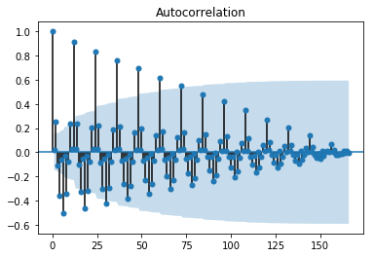
Python for Finance
Gradual Decline

Slide 45
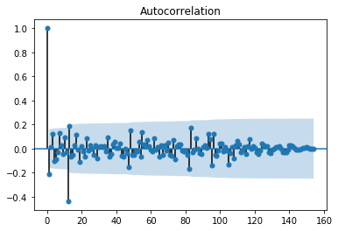
Python for Finance
Sharp Drop-off

Slide 46
Python for Finance
The actual interpretation and how it relates to ARIMA models can get a bit complicated, but there are some basic common methods we can use for the ARIMA model.

Slide 47
Python for Finance
Our main priority here is to try to figure out whether we will use the AR or MA components for the ARIMA model (or both!) as well as how many lags we should use.

Slide 48
Python for Finance
In general you would use either AR or MA, using both is less common.
When actually applying the AR and MA terms, you will set values of p or q.

Slide 49
Python for Finance
If the autocorrelation plot shows positive autocorrelation at the first lag (lag-1), then it suggests to use the AR terms in relation to the lag

Slide 50
Python for Finance
If the autocorrelation plot shows negative autocorrelation at the first lag, then it suggests using MA terms.
This will allow you to decide what actual values of p,d, and q to provide your ARIMA model.

Slide 51
Python for Finance
p: The number of lag observations included in the model.
d: The number of times that the raw observations are differenced
q: The size of the moving average window, also called the order of moving average.

Slide 52
Python for Finance
There are also partial autocorrelation plots!
These are a little more complicated than autocorrelation plots, but let’s show you the basics.

Slide 53
Python for Finance
In general, a partial correlation is a conditional correlation.
It is the correlation between two variables under the assumption that we know and take into account the values of some other set of variables.

Slide 54
Python for Finance
For instance, consider a regression context in which y = response variable and x1, x2, and x3 are predictor variables.
The partial correlation between y and x3 is the correlation between the variables determined taking into account how both y and x3 are related to x1 and x2.

Slide 55
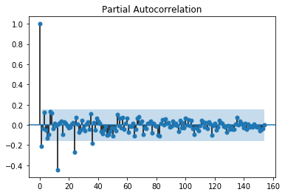
Python for Finance
Let’s see an example of what the plot can look like:

Slide 56
Python for Finance
Typically a sharp drop after lag "k" suggests an AR-k model should be used.
If there is a gradual decline, it suggests an MA model.

Slide 57
Python for Finance
Identification of an AR model is often best done with the PACF.
Identification of an MA model is often best done with the ACF rather than the PACF.
View the notebook and resource links for more details.

Slide 58
Python for Finance
Finally once you’ve analyzed your data using ACF and PACF you are ready to begin to apply ARIMA or Seasonal ARIMA, depending on your original data.
You will provide the p,d, and q terms for the model.

Slide 59
Python for Finance
An ARIMA will then take three terms p,d, and q. (We’ll see this in the coding example)
For seasonal ARIMA there will be an additional set of P,D,Q terms that we will see.

Slide 60
Python for Finance
Alright, now it is time to see all of this in action with Python and statsmodels!
Let’s get started!

Slide 61
Pandas Time
Series Exercise
SET TWO SOLUTIONS

