Slide 1

Time Series Analysis
with Statsmodels

Slide 2
Python for Time Series
Now that we know the necessary foundational tools to work with Time Series data, it is time to move on to learning about the main tool for time series forecasting: Statsmodels library!

Slide 3
Python for Time Series
Statsmodels is a Python module that provides classes and functions for the estimation of many different statistical models, as well as for conducting statistical tests, and statistical data exploration.

Slide 4
Python for Time Series
Section Goals
Introduction to Statsmodels
ETS Decomposition
Moving Averages
Holt Winters Methods
Statsmodels Time Series Exercises

Slide 5
Introduction to Statsmodels

Slide 6
Python for Time Series
Let’s learn how to call a function test from Statsmodels.
Statsmodels has lots of useful statistical tests built in.
We will learn about the Hodrick-Prescott filter.

Slide 7
Python for Time Series
Let’s begin discussing some important Time series concepts.
Time series data has particular properties, let’s take a look at some plots and discuss some important terms!

Slide 8
Python for Time Series
Trends
Horizontal/Stationary
Upward
Downward

Slide 9
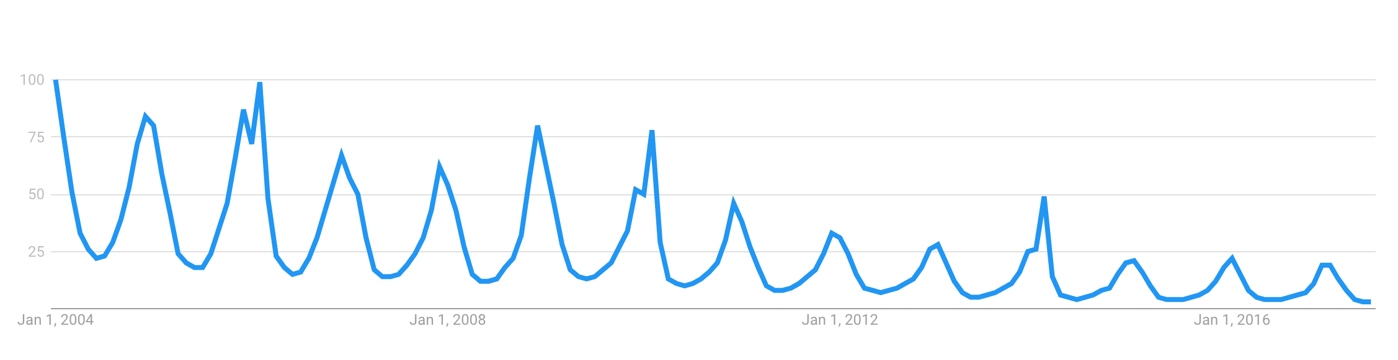
Python for Time Series
Seasonality - Repeating trends
Google Trends - “Snowboarding”

Slide 10
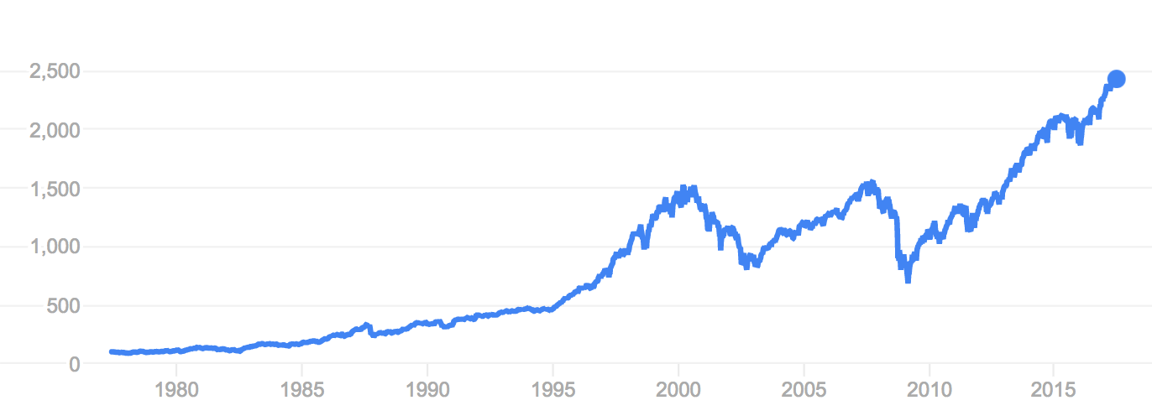
Python for Time Series
Cyclical - Trends with no set repetition.
SP500

Slide 11

Python for Time Series
The Hodrick-Prescott filter separates a time-series y_t into a trend component τ_t and a cyclical component c_t

Slide 12
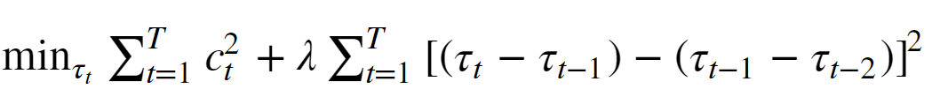
Python for Time Series
The components are determined by minimizing the following quadratic loss function, where λ is a smoothing parameter:

Slide 13
Python for Time Series
The λ value above handles variations in the growth rate of the trend component.

Slide 14
Python for Time Series
When analyzing quarterly data, the default lambda value of 1600 is recommended. Use 6.25 for annual data, and 129,600 for monthly data.

Slide 15
Python for Time Series
Let’s explore how to use this basic functionality with Statsmodels.
Also make sure you have activated our provided environment before beginning!

Slide 16
Time Series Basics

Slide 17
Python for Time Series
Now that we understand some of the very basics, let’s begin to learn about the most popular library in Python for handling time series data, statsmodels!

Slide 18
Statsmodels

Slide 19
Python for Time Series
The most popular library in Python for dealing with Time Series data is the statsmodels library.
It is heavily inspired by the R statistical programming language.

Slide 20
Python for Time Series
Statsmodels is a Python module that allows users to explore data, estimate statistical models, and perform statistical tests.

Slide 21
Python for Time Series
An extensive list of descriptive statistics, statistical tests, plotting functions, and result statistics are available for different types of data and each estimator.

Slide 22
Python for Time Series
Statsmodels is already included in the provided environment file.
To manually install you can use:
conda install statsmodels

Slide 23
Python for Time Series
Let’s explore the documentation and then run through a simple demonstration of what we can use statsmodels for in relation to time series data.

Slide 24
ETS Models

Slide 25
Python for Time Series
ETS Models (Error-Trend-Seasonality)
Exponential Smoothing
Trend Methods Models
ETS Decomposition
We’ll work with several of these with the python statsmodels library!

Slide 26
Python for Time Series
Statsmodels provides a seasonal decomposition tool we can use to separate out the different components.
We've already seen a simplistic example of this in the Introduction to Statsmodels section with the Hodrick-Prescott filter.

Slide 27
Python for Time Series
ETS (Error-Trend-Seasonality) Models will take each of those terms for “smoothing” and may add them, multiply them, or even just leave some of them out.
Based off these key factors, we can try to create a model to fit our data.

Slide 28
Python for Time Series
Time Series Decomposition with ETS (Error-Trend-Seasonality).
Visualizing the data based off its ETS is a good way to build an understanding of its behaviour.

Slide 29
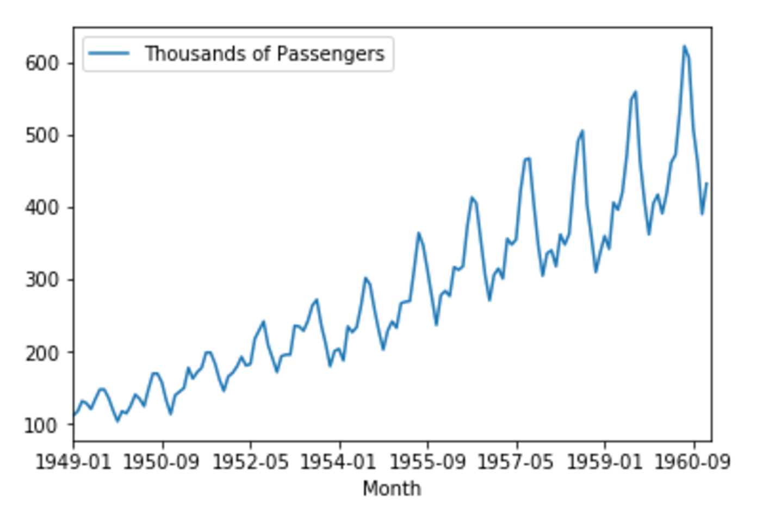
Python for Time Series
ETS Decomposition - Airline Passengers

Slide 30
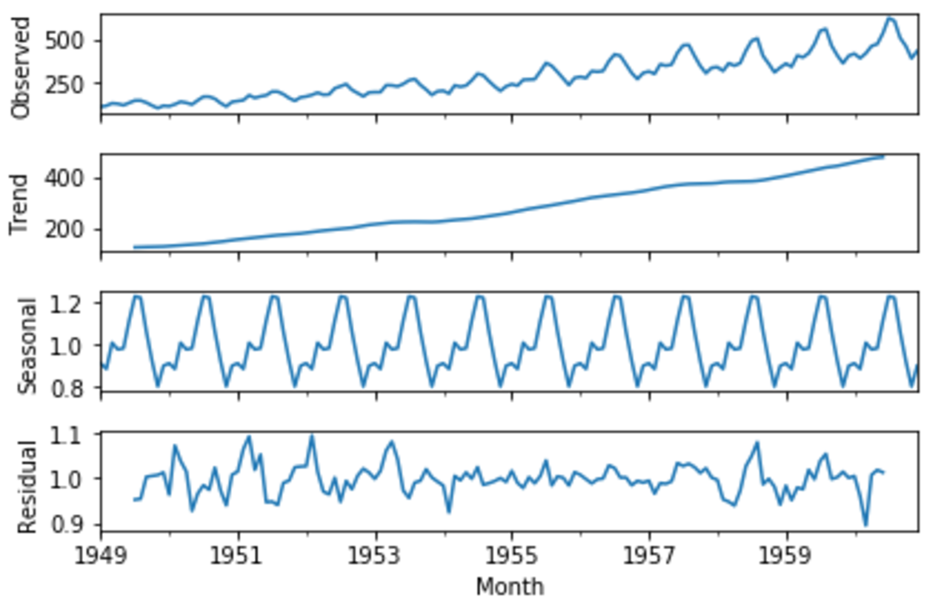
Python for Time Series
ETS Decomposition - Airline Passengers

Slide 31
Python for Time Series
We apply an additive model when it seems that the trend is more linear and the seasonality and trend components seem to be constant over time (e.g. every year we add 10,000 passengers).

Slide 32
Python for Time Series
A multiplicative model is more appropriate when we are increasing (or decreasing) at a non-linear rate (e.g. each year we double the amount of passengers).

Slide 33
Python for Time Series
Let’s explore how to perform an ETS decomposition with Statsmodels!

Slide 34
EWMA Models

Slide 35
Python for Time Series
We’ve previously seen how calculating simple moving averages can allow us to create a simple model that describes some trend level behavior of a time series, for example...

Slide 36
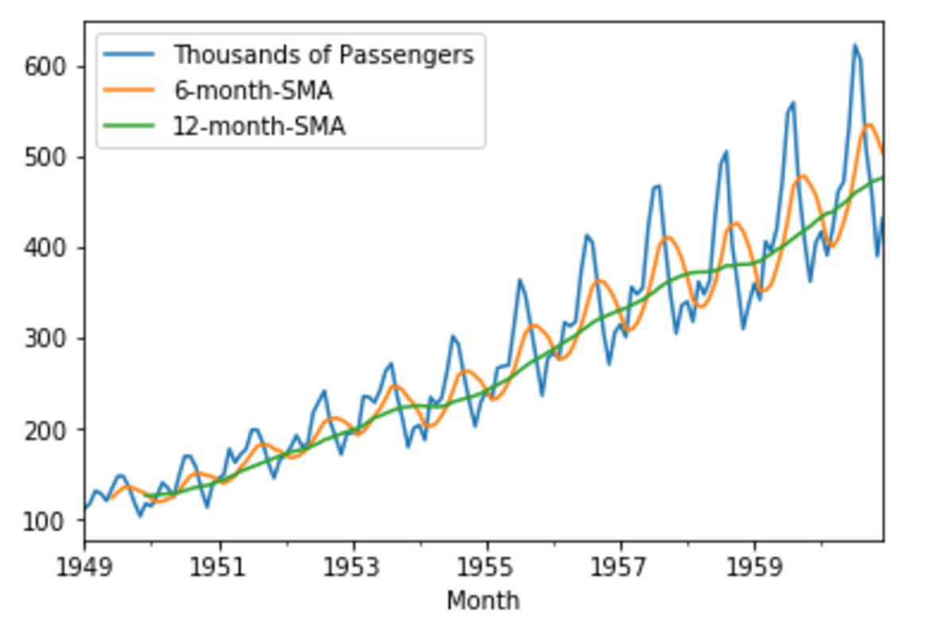
Python for Time Series
SMA - Simple Moving Averages

Slide 37
Python for Time Series
We could theoretically attempt to use these simple moving averages to build a generalized model for the real world time series we’re analyzing.
Later on, we’ll discover much more sophisticated models for this.

Slide 38
Python for Time Series
We could expand off the idea of an SMA (simple moving average) by utilizing a EWMA (Exponentially weighted moving average).
As issue with SMA is that the entire model will be constrained to the same window size.

Slide 39
Python for Time Series
It would be nice if we could have more recent data be weighted more than older data.
We do this by implementing a EWMA instead of SMA.

Slide 40
Python for Time Series
EWMA- Exponentially Weighted Moving Averages
Basic SMA has some "weaknesses".
Smaller windows will lead to more noise, rather than signal

Slide 41
Python for Time Series
EWMA- Exponentially Weighted Moving Averages
Basic SMA has some "weaknesses".
It will always lag by the size of the window

Slide 42
Python for Time Series
EWMA- Exponentially Weighted Moving Averages
Basic SMA has some "weaknesses".
It will never reach to full peak or valley of the data due to the averaging.

Slide 43
Python for Time Series
EWMA- Exponentially Weighted Moving Averages
Basic SMA has some "weaknesses".
Does not really inform you about possible future behaviour, all it really does is describe trends in your data.

Slide 44
Python for Time Series
EWMA- Exponentially Weighted Moving Averages
Basic SMA has some "weaknesses".
Extreme historical values can skew your SMA significantly

Slide 45
Python for Time Series
EWMA- Exponentially Weighted Moving Averages
Basic SMA has some "weaknesses".
To help fix some of these issues, we can use an EWMA (Exponentially-weighted moving average).

Slide 46
Python for Time Series
EWMA will allow us to reduce the lag effect from SMA and it will put more weight on values that occurred more recently (by applying more weight to the more recent values, thus the name).

Slide 47
Python for Time Series
The amount of weight applied to the most recent values will depend on the actual parameters used in the EWMA and the number of periods given a window size.

Slide 48
Python for Time Series
Let’s code out an example of using pandas to create EWMA in the next lecture!

Slide 49
Holt Winters Method

Slide 50
Python for Time Series
Previously with Exponentially Weighted Moving Averages (EWMA) we applied Simple Exponential Smoothing using just one smoothing factor α (alpha).
This failed to account for other contributing factors like trend and seasonality.

Slide 51
Python for Time Series
Note: We won’t use Holt-Winters for forecasting just yet, that will come in the next section of the course!
For now, we’ll focus on fitting the Holt-Winters model to an underlying time series data set.

Slide 52
Python for Time Series
Holt (1957) and Winters (1960) extended Holt’s method to capture seasonality.
The Holt-Winters seasonal method comprises of the forecast equation and three smoothing equations.

Slide 53
Python for Time Series
One for the level ℓ_t , one for the trend b_t , and one for the seasonal component s_t , with corresponding smoothing parameters α , β and γ .

Slide 54
Python for Time Series
There are two variations to this method that differ in the nature of the seasonal component.

Slide 55
Python for Time Series
The additive method is preferred when the seasonal variations are roughly constant through the series, while the multiplicative method is preferred when the seasonal variations are changing proportional to the level of the series.

Slide 56
Python for Time Series
Let’s explore the Holt-Winters methods , which allow us to add on double and triple exponential smoothing.

Slide 57
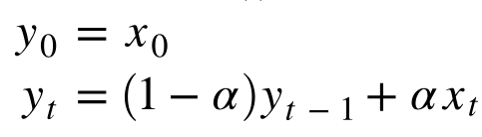
Python for Time Series
Single Exponential Smoothing

Slide 58
Python for Time Series
In Double Exponential Smoothing (aka Holt's Method) we introduce a new smoothing factor β (beta) that addresses trend:

Slide 59
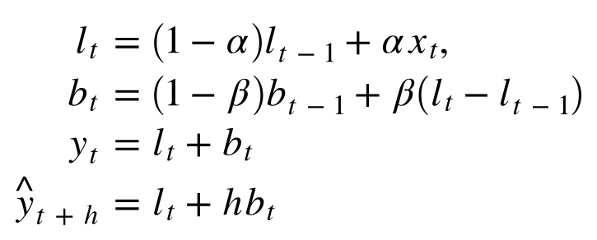
Python for Time Series
Double Exponential Smoothing

Slide 60
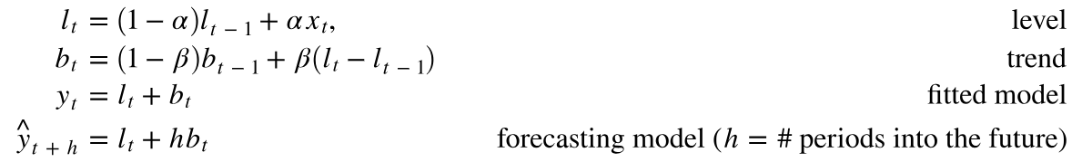
Python for Time Series
In Double Exponential Smoothing (aka Holt's Method) we introduce a new smoothing factor β (beta) that addresses trend:

Slide 61
Python for Time Series
Because we haven't yet considered seasonal fluctuations, the forecasting model is simply a straight sloped line extending from the most recent data point.

Slide 62
Python for Time Series
With Triple Exponential Smoothing (aka the Holt-Winters Method) we introduce a smoothing factor (gamma) that addresses seasonality:

Slide 63
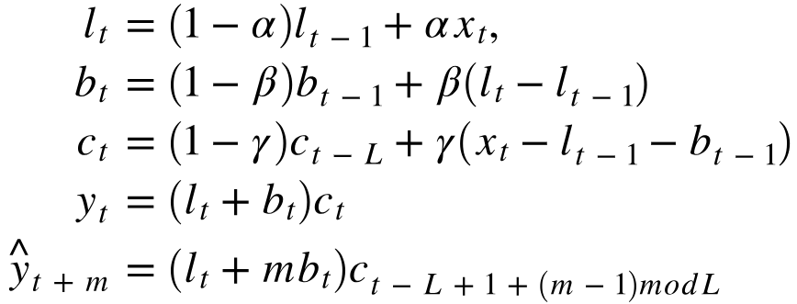
Python for Time Series
With Triple Exponential Smoothing (aka the Holt-Winters Method) we introduce a smoothing factor (gamma) that addresses seasonality:

Slide 64
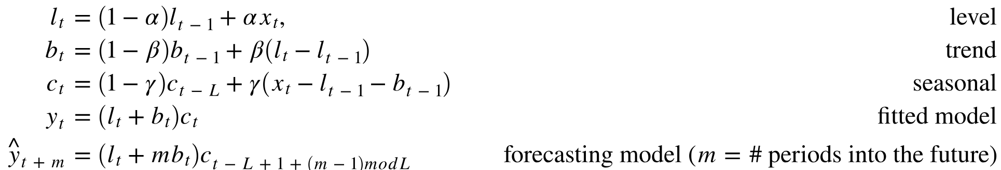
Python for Time Series
Here L represents the number of divisions per cycle. In our case looking at monthly data that displays a repeating pattern each year, we would use L=12

Slide 65
Holt Winters Methods
Code Along

Slide 66
Statsmodels
Time Series Exercises

Slide 67
Statsmodels
Time Series Exercises
SOLUTIONS

