Slide 1

General Forecasting
Models

Slide 2
Python for Time Series
So far we have learned foundational tools for working and analyzing time series data, such as pandas, numpy, and statsmodels.
We have also worked with methods that can model time series behaviour.

Slide 3
Python for Time Series
We now move onto forecasting time series data.
This means we’ll explore many different model types for various types of time series.

Slide 4
Python for Time Series
Forecasting Procedure
Choose a Model
Split data into train and test sets
Fit model on training set
Evaluate model on test set
Re-fit model on entire data set
Forecast for future data

Slide 5
Python for Time Series
Section Overview
Introduction to Forecasting
ACF and PACF plots
AutoRegression - AR
Descriptive Statistics and Tests
Choosing ARIMA orders
ARIMA based models

Slide 6
Let’s get started!

Slide 7
Introduction to Forecasting
PART ONE

Slide 8
Python for Time Series
We’ve already seen how the Holt-Winters methods can model an existing time series.
Let’s now see how we can use that model on future dates, forecasting for dates that haven’t happened yet!

Slide 9
Python for Time Series
We’ll take a brief aside before Part Two of this lecture to discuss evaluating Forecasting Predictions.

Slide 10
Test Train Split

Slide 11
Python for Time Series
Test sets will be the most recent end of the data.

Slide 12
Python for Time Series
How do we decide how large the test data should be?

Slide 13
Python for Time Series
The size of the test set is typically about 20% of the total sample, although this value depends on how long the sample is and how far ahead you want to forecast. The test set should ideally be at least as large as the maximum forecast horizon required.

Slide 14
Python for Time Series
The test set should ideally be at least as large as the maximum forecast horizon required.
Keep in mind, the longer the forecast horizon, the more likely your prediction becomes less accurate.

Slide 15
Evaluating Predictions

Slide 16
Evaluating Predictions
Let’s take a quick break to discuss evaluating forecasting results.
After we fit a model on the training data, we forecast to match up to the test data dates.
Then we can compare our results for evaluation.

Slide 17
Evaluating Predictions
You may have heard of some evaluation metrics like accuracy or recall.
These sort of metrics aren’t useful for time series forecasting problems, we need metrics designed for continuous values!

Slide 18
Evaluating Predictions
Let’s discuss some of the most common evaluation metrics for regression:
Mean Absolute Error
Mean Squared Error
Root Mean Square Error

Slide 19
Evaluating Predictions
Whenever we perform a forecast for a continuous value on a test set, we have two values:
y - the real value of the test data
ŷ - the predicted value from our forecast

Slide 20
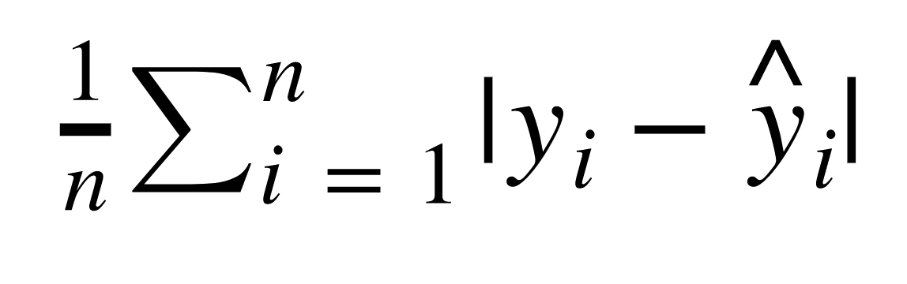
Evaluating Predictions
Mean Absolute Error (MAE)
This is the mean of the absolute value of errors.
Easy to understand

Slide 21
Evaluating Predictions
An issue with MAE though, is that simply averaging the residuals won’t alert us if the forecast was really off for a few points.
We want to be aware of any prediction errors that are very large (even if there only a few)

Slide 22
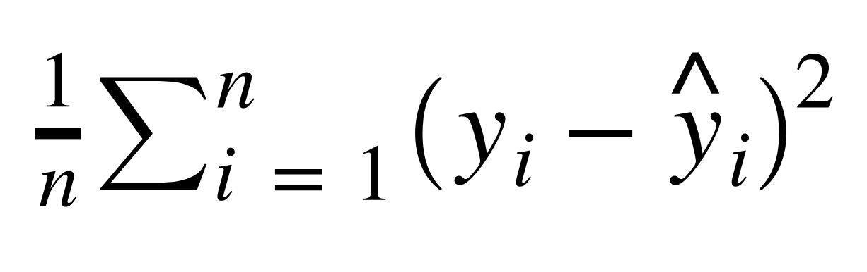
Evaluating Predictions
Mean Squared Error (MSE)
This is the mean of the squared errors.
Larger errors are noted more than with MAE, making MSE more popular.

Slide 23
Evaluating Predictions
There is an issue with MSE however!
Because we squared the residual, the units are now also squared.
For example, if our forecast units was in dollars, the MSE returns back an error in units of dollars squared, which is hard to interpret!

Slide 24
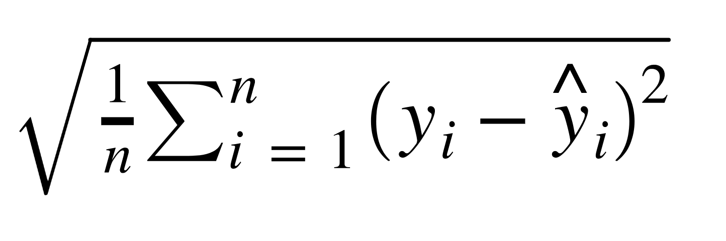
Evaluating Predictions
Root Mean Square Error (RMSE)
This is the root of the mean of the squared errors.
Most popular (has same units as y)

Slide 25
Evaluating Predictions
The most common question from students:
“What is an acceptable RMSE value?”
Unfortunately, the answer is complicated and depends on your data!

Slide 26
Evaluating Predictions
For example, if we have a RMSE of $20.00 USD for a dataset, is that good or bad?
Depends on the data!
That is great error range for predicting the future price of a house, but horrible for the future price of a candy bar!

Slide 27
Evaluating Predictions
You will need to use your own judgement and compare the RMSE to the average values in your data set’s test set.
Then make a decision for the acceptability of the error.
There are no 100% correct answers here!

Slide 28
Evaluating Predictions
Another common question:
“How do we evaluate a forecast for future dates?”
Answer:
You can’t! Those dates haven’t happened yet so it is impossible to evaluate your predictions!

Slide 29
Evaluating Predictions
This is why it is so important to perform the train test split on our data!
Otherwise, we wouldn’t have any intuition to how well the model can perform on dates it hasn’t seen yet.

Slide 30
Evaluating Predictions
Let’s continue with our Introduction to Forecasting and show you how to grab these error metrics and forecast for future dates we haven’t seen before!

Slide 31
Introduction to Forecasting
PART TWO

Slide 32
ACF and PACF
Theory

Slide 33
Python for Time Series
Let’s learn about 2 very useful plot types
ACF - AutoCorrelation Function Plot
PACF - Partial AutoCorrelation Function Plot
To understand these plots, we first need to understand correlation!

Slide 34
Python for Time Series
Correlation is a measure of the strength of the linear relationship between two variables.

Slide 35
Python for Time Series
The closer the correlation is to +1, the stronger the positive linear relationship
The closer the correlation is to -1, the stronger the negative linear relationship.
And the closer the correlation is to zero, the weaker the linear relationship, or association.

Slide 36
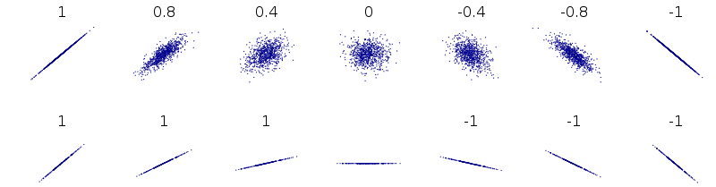
Python for Time Series

Slide 37
Python for Time Series
An autocorrelation plot (also known as a Correlogram ) shows the correlation of the series with itself, lagged by x time units.
So the y axis is the correlation and the x axis is the number of time units of lag.

Slide 38
Python for Time Series
Imagine we had some sales data.
We can compare the standard sales data against the sales data shifted by 1 time step.
This answers the question, “How correlated are today’s sales to yesterday’s sales?”

Slide 39
Python for Time Series
Sales on Day i
Sales on Day i-1

Slide 40
Python for Time Series
Sales on Day i
Sales on Day i-1

Slide 41
Python for Time Series
Correlation 0.8
Sales on Day i
Sales on Day i-1

Slide 42
Python for Time Series
1
Correlation 0.8
Autocorrelation
0
1
Shift

Slide 43
Python for Time Series
Sales on Day i
Sales on Day i-2

Slide 44
Python for Time Series
Correlation 0.7
Sales on Day i
Sales on Day i-2

Slide 45
Python for Time Series
1
Autocorrelation
0
1
2
Shift

Slide 46
Python for Time Series
An autocorrelation plot shows the correlation of the series with itself, lagged by x time units.
You go on and do this for all possible time lags x and this defines the plot.
Let’s see some typical examples!

Slide 47
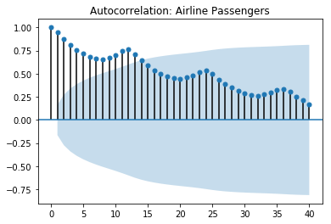
Python for Time Series
Gradual Decline

Slide 48
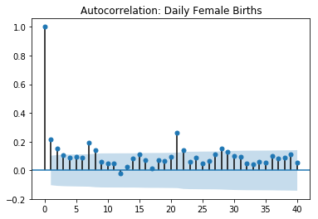
Python for Time Series
Sharp Drop-off

Slide 49
Python for Time Series
It makes sense that in general there is a decline of some sort, the further away you get with the shift, the less likely the time series would be correlated with itself.

Slide 50
Python for Time Series
The actual interpretation and how it relates to ARIMA models can get a bit complicated, but there are some basic common methods we can use for the ARIMA model.

Slide 51
Python for Time Series
There are also partial autocorrelation plots!
These are a little more complicated than autocorrelation plots, but let’s show you the basics.

Slide 52
Python for Time Series
Sales on Day i
Sales on Day i-1

Slide 53
Python for Time Series
Residual
Sales on Day i
Sales on Day i-1

Slide 54
Python for Time Series
Sales on Day i
Residuals
Sales on Day i-1
Sales on Day i-1

Slide 55
Python for Time Series
Residuals
Sales on Day i-1

Slide 56
Python for Time Series
Residuals
Residuals fitted on Day i-1
Sales on Day i-1
Sales on Day i-2

Slide 57
Python for Time Series
Residuals
Residuals fitted on Day i-1
Sales on Day i-1
Sales on Day i-2

Slide 58
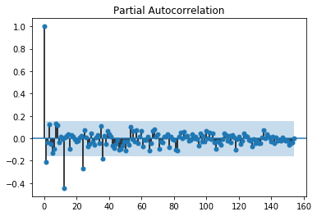
Python for Time Series
Let’s see an example of what the plot can look like:

Slide 59
Python for Time Series
We essentially plot out the relationship between the previous day’s residuals versus the real values of the current day.
In general we expect the partial autocorrelation to drop off quite quickly.

Slide 60
Python for Time Series
The ACF describes the autocorrelation between an observation and another observation at a prior time step that includes direct and indirect dependence information.

Slide 61
Python for Time Series
The PACF only describes the direct relationship between an observation and its lag.

Slide 62
Python for Time Series
These two plots can help choose order parameters for ARIMA based models.
Later on, we will see that it is usually much easier to perform a grid search of the parameter values, rather than attempt to read these plots directly.

Slide 63
Python for Time Series
Let’s explore how to create these plots with statsmodels!

Slide 64
ARIMA Overview

Slide 65
Python for Time Series
We will now discuss one of the most common time series models, ARIMA.
Many models are based off the ARIMA model, which stands for AutoRegressive Integrated Moving Average

Slide 66
Python for Time Series
It is important to understand that ARIMA is not capable of perfectly predicting any time series data.
Beginner students often want to directly apply ARIMA to time series data that is not directly a function of time, such as stock data.

Slide 67
Python for Time Series
Stock price data for example has so many outside factors that much of the information informing the price of the stock won’t be available with just the time stamped price information.

Slide 68
Python for Time Series
ARIMA performs very well when working with a time series where the data is directly related to the time stamp, such as the airline passenger data set.
In that data we saw clear growth and seasonality based on time.

Slide 69
Python for Time Series
But it is important to keep in mind that an ARIMA model on that data wouldn’t be able to understand any outside factors, such as new developments in jet engines, if those effects weren’t already present in the current data.

Slide 70
Python for Time Series
This is all to state that while ARIMA based models are extremely powerful tools, they are not magic, and a large part of using them effectively is understanding your data!

Slide 71
Python for Time Series
ARIMA models can be complex!
Make sure to make full use of the various links and extra resources presented throughout this section if you want to later use ARIMA models for other problems.

Slide 72
Python for Time Series
AutoRegressive Integrated Moving Average (ARIMA) model is a generalization of an autoregressive moving average (ARMA) model.

Slide 73
Python for Time Series
Both of those models (ARIMA and ARMA) are fitted to time series data either to better understand the data or to predict future points in the series (forecasting).

Slide 74
Python for Time Series
ARIMA (Autoregressive Integrated Moving Averages)
Non-seasonal ARIMA
Seasonal ARIMA (SARIMA)
Also understanding SARIMA with exogenous variables, such as SARIMAX.

Slide 75
Python for Time Series
We will start by discussing non-seasonal ARIMA models and then move on to seasonal ARIMA models.
Then we’ll learn about more complex models built off of ARIMA.

Slide 76
Python for Time Series
ARIMA models are applied in some cases where data show evidence of non-stationarity, where an initial differencing step (corresponding to the "integrated" part of the model) can be applied one or more times to eliminate the non-stationarity.

Slide 77
Python for Time Series
Differencing is actually a very simple idea, but let’s put it on hold for now, and talk a bit more about ARIMA!
We’ll touch back on differencing later on.
Let’s talk about the major components of ARIMA.

Slide 78
Python for Time Series
Non-seasonal ARIMA models are generally denoted ARIMA(p,d,q) where parameters p, d, and q are non-negative integers.
Let’s discuss what these three components are!

Slide 79
Python for Time Series
Parts of ARIMA model
AR (p): Autoregression
A regression model that utilizes the dependent relationship between a current observation and observations over a previous period

Slide 80
Python for Time Series
Parts of ARIMA model
I (d): Integrated.
Differencing of observations (subtracting an observation from an observation at the previous time step) in order to make the time series stationary.

Slide 81
Python for Time Series
Parts of ARIMA model
MA (q): Moving Average.
A model that uses the dependency between an observation and a residual error from a moving average model applied to lagged observations.

Slide 82
Python for Time Series
Stationary vs Non-Stationary Data
To effectively use ARIMA, we need to understand Stationarity in our data.
So what makes a data set Stationary?
A Stationary series has constant mean and variance over time.

Slide 83
Python for Time Series
A Stationary data set will allow our model to predict that the mean and variance will be the same in future periods.
Let’s take a look at a few examples!

Slide 84
Python for Time Series
Mean needs to be constant
Stationary
Non-Stationary

Slide 85
Python for Time Series
Variance should not be a function of time
Stationary
Non-Stationary

Slide 86
Python for Time Series
Covariance should not be a function of time
Stationary
Non-Stationary

Slide 87
Python for Time Series
There are also mathematical tests you can use to test for stationarity in your data.
A common one is the Augmented Dickey–Fuller test (we will see how to use this with Python’s statsmodels)

Slide 88
Python for Time Series
If you’ve determined your data is not stationary (either visually or mathematically), you will then need to transform it to be stationary in order to evaluate it and what type of ARIMA terms you will use.

Slide 89
Python for Time Series
One simple way to do this is through “differencing”.
The idea behind differencing is quite simple, let’s see an example...

Slide 90
Python for Time Series
First Difference
Second Difference
Original Data
Time1 | 10
Time2 | 12
Time3 | 8
Time4 | 14
Time5 | 7
Time1 | NA
Time2 | 2
Time3 | -4
Time4 | 6
Time5 | -7
Time1 | NA
Time2 | NA
Time3 | -6
Time4 | 10
Time5 | -13

Slide 91
Python for Time Series
You can continue differencing until you reach stationarity (which you can check visually and mathematically)
Each differencing step comes at the cost of losing a row of data!

Slide 92
Python for Time Series
For seasonal data, you can also difference by a season.
For example, if you had monthly data with yearly seasonality, you could difference by a time unit of 12, instead of just 1.

Slide 93
Python for Time Series
Another common technique with seasonal ARIMA models is to combine both methods, taking the seasonal difference of the first difference.

Slide 94
Python for Time Series
With your data now stationary it is time to go back and discuss the p,d,q terms and how you choose them.
There are two main ways to choose these p,d, and q terms.

Slide 95
Python for Time Series
Method One (Difficult):
AutoCorrelation Plots and Partial AutoCorrelation Plots.
Using these plots we can choose p,d and q terms based on viewing the decay in the plot.

Slide 96
Python for Time Series
Method One (Difficult):
These plots can be very difficult to read, and often even when reading them correctly, the best performing p,d, or q value may be different than what is read.

Slide 97
Python for Time Series
Method Two (Easy but takes time):
Grid Search
Run ARIMA based models on different combinations of p, d, and q and compare the models for on some evaluation metric.

Slide 98
Python for Time Series
Method Two (Easy but takes time):
Due to computational power becoming cheaper and faster, its often a good idea to use the built-in automated tools that search for the correct p, d, and q terms for us!

Slide 99
Python for Time Series
Later on we will discuss SARIMA models designed to handle seasonal data.
SARIMA is very similar to ARIMA, but adds another set of parameters (P, D, and Q) for the seasonal component.

Slide 100
Python for Time Series
Let’s begin by focusing on a special case of ARIMA, where the I and MA components are zero, leaving us with a simplified AR model.

Slide 101
AutoRegression - AR

Slide 102
Python for Time Series
In a moving average model as we saw with Holt-Winters, we forecast the variable of interest using a linear combination of predictors.

Slide 103
Python for Time Series
In our example we forecasted numbers of airline passengers in thousands based on a set of level, trend and seasonal predictors.

Slide 104
Python for Time Series
ARIMA stands for AutoRegression Integrated Moving Average.
If we drop the Integrated and Moving Average components, then we’re only left with AR.

Slide 105
Python for Time Series
Later on we will revisit the idea of a full ARIMA model, but for now, let’s explore the simplified AR model.

Slide 106
Python for Time Series
In an autoregression model, we forecast using a linear combination of past values of the variable. The term autoregression describes a regression of the variable against itself. An autoregression is run against a set of lagged values of order p.

Slide 107
Python for Time Series
The autoregressive model specifies that the output variable depends linearly on its own previous values and on a stochastic term (an imperfectly predictable term).

Slide 108
Python for Time Series
Together with the moving-average (MA) model, it is a special case and key component of the more general ARMA and ARIMA models of time series, which have a more complicated stochastic structure; it is also a special case of the vector autoregressive model (VAR).

Slide 109
Python for Time Series
Let’s check out the formula for AR.
Where c is a constant, ф_1 and ф_2 are lag coefficients up to order p, and ε_t is white noise

Slide 110
Python for Time Series
Let’s check out the formula for AR.
Where c is a constant, ф_1 and ф_2 are lag coefficients up to order p, and ε_t is white noise

Slide 111
Python for Time Series
Let’s check out the formula for AR.
Where c is a constant, ф_1 and ф_2 are lag coefficients up to order p, and ε_t is white noise

Slide 112
Python for Time Series
Let’s check out the formula for AR.
Where c is a constant, ф_1 and ф_2 are lag coefficients up to order p, and ε_t is white noise

Slide 113

Python for Time Series
For example, an AR(1) model would follow the formula:

Slide 114

Python for Time Series
An AR(2) model would follow the formula

Slide 115
Python for Time Series
Higher order AR models become mathematically very complex.
Fortunately for us, we can let statsmodels library choose the best order for the model.

Slide 116
AutoRegression - AR
STATSMODELS

Slide 117
Descriptive Statistics
and Tests
PART ONE

Slide 118
Python for Time Series
In upcoming lectures we'll talk about different forecasting models like ARMA, ARIMA, Seasonal ARIMA and others. Each model addresses a different type of time series.

Slide 119
Python for Time Series
For this reason, in order to select an appropriate model we need to know something about the data.

Slide 120
Python for Time Series
Statsmodels provides a variety of built in tests to explore the underlying attributes of a time series.
We'll learn how to determine if a time series is stationary, if it's independent, and if two series demonstrate causality.

Slide 121
Python for Time Series
Tests for Stationarity
To determine whether a series is stationary we can use the augmented Dickey-Fuller Test.
This performs a test in the form of a classic null hypothesis test and returns a p value.

Slide 122
Python for Time Series
Dickey-Fuller Test
In this test the null hypothesis states that Φ = 1 (this is also called a unit test).
If p value is low (<0.05) we reject the null hypothesis, so we assume the dataset is stationary.

Slide 123
Python for Time Series
Dickey-Fuller Test
In this test the null hypothesis states that Φ = 1 (this is also called a unit test).
If p value is high (>0.05) we fail to reject the null hypothesis.

Slide 124
Python for Time Series
Dickey-Fuller Test
It can be tricky to remember the null hypothesis, so later on we will develop a nice function that returns an easy to read report!

Slide 125
Python for Time Series
Granger Causality Tests
The Granger causality test is a hypothesis test to determine if one time series is useful in forecasting another.

Slide 126
Python for Time Series
Granger Causality Tests
While it is fairly easy to measure correlations between series it's another thing to observe changes in one series correlated to changes in another after a consistent amount of time.

Slide 127
Python for Time Series
Granger Causality Tests
This test is used to see if there is an indication of causality, but keep in mind, it could always be some outside factor unaccounted for!

Slide 128
Python for Time Series
Evaluating Forecasts
We’re already familiar with:
MAE
MSE
RMSE
But we still haven’t touched on AIC and BIC

Slide 129
Python for Time Series
AIC - Akaike Information Criterion
Developed by Hirotugu Akaike in 1971.
His publication on it is one of the top 100 most cited publications of all time!
AIC is now such a common metric, many writers no longer cite the original paper.

Slide 130
Python for Time Series
AIC - Akaike Information Criterion
The AIC evaluates a collection of models and estimates the quality of each model relative to the others.
Penalties are provided for the number of parameters used in an effort to thwart overfitting.

Slide 131
Python for Time Series
AIC - Akaike Information Criterion
Overfitting results in performing very well on training data, but poorly on new unseen data.

Slide 132
Python for Time Series
BIC - Bayesian Information Criterion
Very similar to AIC, just the mathematics behind the model comparisons utilize a Bayesian approach.
Developed in 1978 by Gideon Schwarz

Slide 133
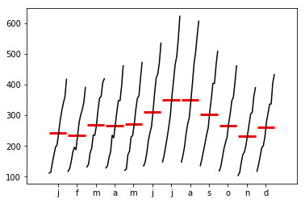
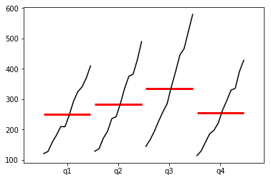
Python for Time Series
We will also explore Seasonality Plots.

Slide 134
Let’s get started!

Slide 135
Descriptive Statistics
and Tests
PART TWO

Slide 136
ARIMA Theory
Overview

Slide 137
Python for Time Series
Before we dive into how to choose orders for full ARIMA models, let’s do a quick review of the actual formulas for ARIMA.

Slide 138
Python for Time Series
Recall the 3 components
AR - AutoRegression
I - Integrated
MA - Moving Average

Slide 139
Python for Time Series
AR - AutoRegression
The AR part of ARIMA indicates that the evolving variable of interest is regressed on its own lagged (i.e., prior) values.

Slide 140
Python for Time Series
AR - AutoRegression
Building the regression model off of previous y values:

Slide 141
Python for Time Series
MA - Moving Average
Indicates the regression error is actually a linear combination of error terms whose values occurred contemporaneously and at various times in the past.

Slide 142
Python for Time Series
MA - Moving Average
A model that uses the dependency between an observation and a residual error from a moving average model applied to lagged observations.

Slide 143
Python for Time Series
MA - Moving Average
Recall that when we plotted out a moving average with pandas, it would “smooth” out the noise from the time series.

Slide 144
Python for Time Series
MA - Moving Average
We essentially set up another regression model, that focuses on this residual term between a moving average and the real values.

Slide 145
Python for Time Series
MA - Moving Average
We could then choose another order for this MA component.

Slide 146
Python for Time Series
I - Integrated
Indicates that the data values have been replaced with the difference between their values and the previous values

Slide 147
Python for Time Series
I - Integrated
This basically just means how many times did we have to difference the data to get it stationary so the AR and MA components could work.

Slide 148
Python for Time Series
Non-seasonal ARIMA models are generally denoted ARIMA(p,d,q) where parameters p, d, and q are non-negative integers.

Slide 149
Python for Time Series
p is the order (number of time lags) of the autoregressive model, d is the degree of differencing (the number of times the data have had past values subtracted), and q is the order of the moving-average model.

Slide 150
Python for Time Series
So what does this equation actually look like?
Let’s first consider just ARMA (no differencing term).

Slide 151
Python for Time Series
ARMA(p’,q) is defined by:
X_{t} is the time series data (t is the index)
α are the parameters of the AR model

Slide 152
Python for Time Series
ARMA(p’,q) is defined by:
X_{t} is the time series data (t is the index)
α are the parameters of the AR model

Slide 153
Python for Time Series
ARMA(p’,q) is defined by:
ε_{t} are the error terms
θ are the parameters of the MA model

Slide 154
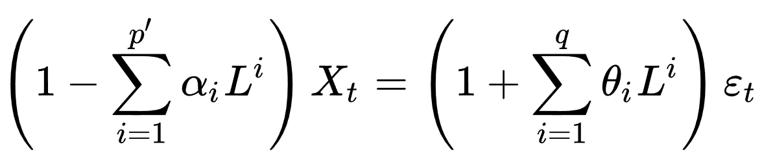
Python for Time Series
ARMA(p’,q) is defined by:
L is the lag operator

Slide 155
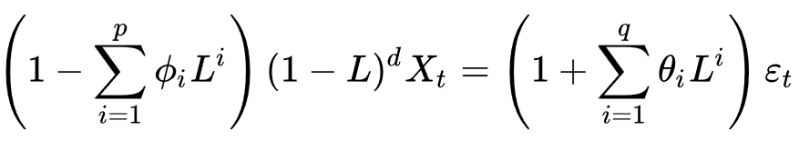
Python for Time Series
ARIMA(p’,q,d) is defined by:

Slide 156
Python for Time Series
ARIMA(p’,q,d) is defined by:

Slide 157
Python for Time Series
We see here we have 3 main parameters to choose: p, d, and q.
Let’s explore how we can choose these (or let statsmodels choose them for us).

Slide 158
Choosing ARIMA Orders
PART ONE

Slide 159
Python for Time Series
In this lecture we will discuss the best way to figure out what p,d,q, and P,D,Q values to use for ARIMA based models.
We’ll first discuss the “classical” method of reading ACF and PACF plots, then move on to discuss grid searches.

Slide 160
Python for Time Series
Our main priority here is to try to figure out the orders for the AR and MA components, and if we need to difference our data (the I component).

Slide 161
Python for Time Series
Depending on the dataset, it is quite common to only require AR or MA components, you may not need both!

Slide 162
Python for Time Series
If the autocorrelation plot shows positive autocorrelation at the first lag (lag-1), then it suggests to use the AR terms in relation to the lag

Slide 163
Python for Time Series
If the autocorrelation plot shows negative autocorrelation at the first lag, then it suggests using MA terms.
This will allow you to decide what actual values of p,d, and q to provide your ARIMA model.

Slide 164
Python for Time Series
p: The number of lag observations included in the model.
d: The number of times that the raw observations are differenced
q: The size of the moving average window, also called the order of moving average.

Slide 165
Python for Time Series
Let’s see an example of what the plot can look like:

Slide 166
Python for Time Series
Typically a sharp drop after lag "k" suggests an AR-k model should be used.
If there is a gradual decline, it suggests an MA model.

Slide 167
Python for Time Series
Identification of an AR model is often best done with the PACF.
Identification of an MA model is often best done with the ACF rather than the PACF.
View the notebook and resource links for more details.

Slide 168
Python for Time Series
Finally once you’ve analyzed your data using ACF and PACF you are ready to begin to apply ARIMA or Seasonal ARIMA, depending on your original data.
You will provide the p,d, and q terms for the model.

Slide 169
Python for Time Series
An ARIMA will then take three terms p,d, and q. (We’ll see this in the coding example)
For seasonal ARIMA there will be an additional set of P,D,Q terms that we will see.

Slide 170
Python for Time Series
As previously mentioned, it can be very difficult to read these plots, so it is often more effective to perform a grid search across various combinations of p,d,q values.

Slide 171
Python for Time Series
The pmdarima (Pyramid ARIMA) is a separate library designed to perform grid searches across multiple combinations of p,d,q, and P,D,Q.
This is by far the most effective way to get good fitting models!

Slide 172
Python for Time Series
The pmdarima (Pyramid ARIMA) is a separate library designed to perform grid searches across multiple combinations of p,d,q, and P,D,Q.
This is by far the most effective way to get good fitting models!

Slide 173
Python for Time Series
The pmdarima library utilizes the Akaike information criterion (AIC) as a metric to compare the performance of various ARIMA based models.

Slide 174

Python for Time Series
AIC was developed by Hirotugu Akaike in the 1970s.
When comparing models we want to minimize the AIC value.

Slide 175
Python for Time Series
Suppose that we have a statistical model of some data. Let k be the number of estimated parameters in the model. Let L be the maximum value of the likelihood function for the model.

Slide 176
Choosing ARIMA Orders
PART TWO

Slide 177
ARMA and ARIMA

Slide 178
Python for Time Series

Slide 179
SARIMA

Slide 180
Python for Time Series
Where ARIMA accepts the parameters (p,d,q), SARIMA accepts an additional set of parameters (P,D,Q)m that specifically describe the seasonal components of the model.

Slide 181
Python for Time Series
Here P, D and Q represent the seasonal regression, differencing and moving average coefficients, and m represents the number of data points (rows) in each seasonal cycle.

Slide 182
Python for Time Series
The statsmodels implementation of SARIMA is called SARIMAX. The “X” added to the name means that the function also supports exogenous regressor variables. We'll cover these in a future lecture.

Slide 183
SARIMAX Models
PART ONE

Slide 184
Python for Time Series
The statsmodels implementation of SARIMA is called SARIMAX. The “X” added to the name means that the function also supports exogenous regressor variables.

Slide 185
Python for Time Series
Quick Note: Label is the term we’ll be using for the column we’re trying to predict.
Examples:
Label was the CO2 Level in Mauna Loa
Label was the Number of Passengers

Slide 186
Python for Time Series
For example, let’s imagine we were trying to forecast the number of visitors to a restaurant and we had historical data on previous visitor numbers.

Slide 187
Python for Time Series
With just this previous historical data, we could attempt to use a SARIMA based model to use historical lagged values to predict future visit numbers.
But what if we had some other features we wanted to include, like holidays?

Slide 188
Python for Time Series
With just this previous historical data, we could attempt to use a SARIMA based model to use historical lagged values to predict future visit numbers.
But what if we had some other features we wanted to include, like holidays?

Slide 189
Python for Time Series
Let’s walk through an example data set, where our goal is to predict the number of total visitors across 4 restaurants.
Using our previous approaches, the only data we can use is previous historical label data.

Slide 190
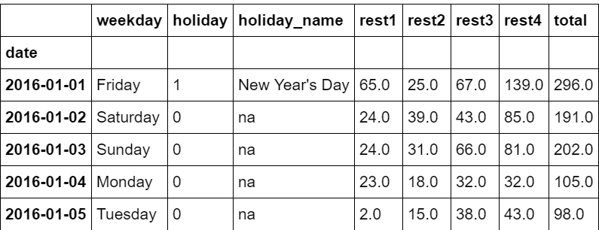
Python for Time Series
Typical data sets without exogenous variables:

Slide 191
Python for Time Series
Total daily visitors across 4 restaurants.

Slide 192
Python for Time Series
Total daily visitors across 4 restaurants.

Slide 193
Python for Time Series
Total daily visitors across 4 restaurants.

Slide 194
Python for Time Series
Notice that even though we have multiple columns, these are all still just the label!

Slide 195
Python for Time Series
Exogenous variables are outside information, not historical label data

Slide 196
Python for Time Series
We can add in exogenous variables such as holidays.

Slide 197
Python for Time Series
We could also attempt to feature engineer off of the weekday column.

Slide 198
Python for Time Series
For example, create a 0/1 column for True or False if its a weekend or not.

Slide 199
Python for Time Series
You should usually have some intuition about what relates to the column you are trying to forecast.
For statsmodels, exogenous variables should be converted to numerical values.

Slide 200
Python for Time Series
There are a variety of ways to do this (e.g. one-hot encoding, dummy variables, etc…)
This usually involves just mapping values to some 0 or 1 True or False scale.
This can be done with pandas with the pd.get_dummies() command.

Slide 201
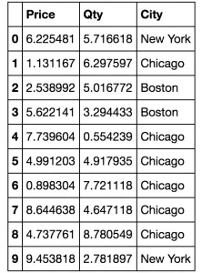
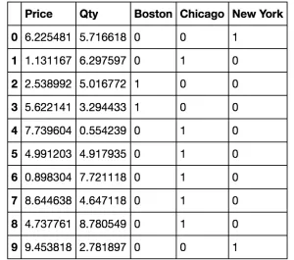
Python for Time Series
For example:

Slide 202
Python for Time Series
You should usually have some intuition about what relates to the column you are trying to forecast.
SARIMAX makes it easy to add in additional columns as exogenous variables, let’s take a look!

Slide 203
SARIMAX Models
PART TWO

Slide 204
SARIMAX Models
PART THREE

Slide 205
Python for Time Series
So far we’ve only run a SARIMA based model on our data, now let’s add in the exogenous variable!
Statsmodels makes this easy, its simply an additional parameter call.

Slide 206
Python for Time Series
However, there is something important to note here!
We need to know the future of this exogenous variable.
What does that mean exactly?

Slide 207
Python for Time Series
Let’s review the actual forecasting process for basic SARIMA:
We first re-train on all our data
We set the future date span
We forecast values

Slide 208
Python for Time Series
Date | Y Label
D1 | Y1
D2 | Y2
D3 | Y3
D4 | Y4
TRAIN

Slide 209
Python for Time Series
Date | Y Label
D1 | Y1
D2 | Y2
D3 | Y3
D4 | Y4
Date | Y Label
D5 | ?
D6 | ?
D7 | ?
D8 | ?
TRAIN
FUTURE
DATES

Slide 210
Python for Time Series
Date | Y Label
D1 | Y1
D2 | Y2
D3 | Y3
D4 | Y4
Date | Y Label
D5 | ?
D6 | ?
D7 | ?
D8 | ?
Date | Y Label
D5 | Fore_5
D6 | Fore_6
D7 | Fore_7
D8 | Fore_8
TRAIN
FUTURE
DATES
FORECASTED VALUES

Slide 211
Python for Time Series
For SARIMAX, we need to provide more information for the future dates.
We need to provide the known exogenous variable into the future.
We can not also predict this exogenous variables, because then we are attempting to predict 2 things at once!

Slide 212
Python for Time Series
Date | EXO | Y Label
D1 | X1 | Y1
D2 | X2 | Y2
D3 | X3 | Y3
D4 | X4 | Y4
TRAIN

Slide 213
Python for Time Series
Date | EXO | Y Label
D1 | X1 | Y1
D2 | X2 | Y2
D3 | X3 | Y3
D4 | X4 | Y4
Date | EXO | Y Label
D5 | X5 | ?
D6 | X6 | ?
D7 | X7 | ?
D8 | X8 | ?
TRAIN
FUTURE
DATES

Slide 214
Python for Time Series
Date | EXO | Y Label
D1 | X1 | Y1
D2 | X2 | Y2
D3 | X3 | Y3
D4 | X4 | Y4
Date | EXO | Y Label
D5 | X5 | ?
D6 | X6 | ?
D7 | X7 | ?
D8 | X8 | ?
Date | EXO | Y Label
D5 | X5 | Y5
D6 | X6 | Y6
D7 | X7 | Y7
D8 | X8 | Y8
TRAIN
FUTURE
DATES
FORECASTED VALUES

Slide 215
Python for Time Series
This means that we need to already know this future exogenous information for certain, or at least have very confident estimations for it based on some other data.

Slide 216
Python for Time Series
It wouldn’t make sense to be predicting both exogenous and the y label into the future, since we just trained our model to predict y label based on the existing exogenous variable at that same timestamp.

Slide 217
Python for Time Series
Let’s explore this process with statsmodels!

Slide 218
VAR Models
Theory

Slide 219
Python for Time Series
In our previous SARIMAX example, the forecast variable y_t was influenced by the exogenous predictor variable, but not vice versa.
That is, the occurrence of a holiday affected restaurant patronage but not the other way around.

Slide 220
Python for Time Series
However, there are some cases where variables affect each other!
What kind of model can we use in these situations?
We can attempt to use the Vector AutoRegression model!

Slide 221
Python for Time Series
All variables in a VAR enter the model in the same way: each variable has an equation explaining its evolution based on its own lagged values, the lagged values of the other model variables, and an error term.

Slide 222
Python for Time Series
VAR modeling does not require as much knowledge about the forces influencing a variable.
The only prior knowledge required is a list of variables which can be hypothesized to affect each other intertemporally.

Slide 223
Python for Time Series
Forecasting: Principles and Practice describes a case where changes in personal consumption expenditures C_t were forecast based on changes in personal disposable income I_t.

Slide 224
Python for Time Series
We've seen that an autoregression AR(p) model is described by the following:

Slide 225
Python for Time Series
A K-dimensional VAR model of order p, denoted VAR(p), considers each variable y_k in the system.

Slide 226
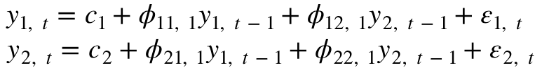
Python for Time Series
For example, The system of equations for a 2-dimensional VAR(1) model is:

Slide 227
Python for Time Series
For example, The system of equations for a 2-dimensional VAR(1) model is:

Slide 228
Python for Time Series
For example, The system of equations for a 2-dimensional VAR(1) model is:

Slide 229
Python for Time Series
Carrying this further, the system of equations for a 2-dimensional VAR(3) model is:

Slide 230
Python for Time Series
The general steps involved in building a VAR model are:
Examine the data
Visualize the data
Test for stationarity

Slide 231
Python for Time Series
The general steps involved in building a VAR model are:
Select the appropriate order p
Instantiate the model and fit it to a training set

Slide 232
Python for Time Series
The general steps involved in building a VAR model are:
If necessary, invert the earlier transformation
Evaluate model predictions against a known test set
Forecast the future

Slide 233
Let’s get started!

Slide 234
VAR Models
CODE ALONG

Slide 235
Python for Time Series
Let’s explore how we would forecast into the future using VAR for two time series that we believe have effects on eachother.
We’ll use M2 Money Stock and Personal Consumption from FRED.

Slide 236
Python for Time Series
Personal Consumption Expenditures
M2 Money Stock
savings deposits
small-denomination time deposits
balances in retail money market mutual funds

Slide 237
Python for Time Series
Recall the system of equations for a 2-dimensional VAR(1) model is:

Slide 238
Python for Time Series
Y1 = Personal Consumption Expenditures
Y2 = M2 Money Stock

Slide 239
Python for Time Series
We’ll need to see what is the best value of p through code!

Slide 240
Python for Time Series
We will need to figure our optimal order (p) for our VAR model.
Pyramid Auto Arima won’t do the grid search for us, but we can easily run various p values through a loop and then check which model has the best AIC.

Slide 241
Python for Time Series
Recall AIC will also punish model for being too complex, even if they perform slightly better on some other metric.
So we expect to see a drop in AIC as p gets larger and then at a certain point (lag order p value) an increasing AIC.

Slide 242
Python for Time Series
We’ll also need to manually check for stationarity and difference the time series if they are not stationary.
In the case of this lecture, we’ll notice the time series require different differencing amounts.

Slide 243
Python for Time Series
We will difference them the same amount however, in order to make sure they have the same number of rows.
Let’s get started!

Slide 244
VARMA Models
THEORY

Slide 245
Python for Time Series
Recall the system of equations for a 2-dimensional VAR(1) model is:

Slide 246
Python for Time Series
We’re also already familiar with the ARMA model (note, here the relation is solved for y_t):

Slide 247
Python for Time Series
We can create an analogous function using VARMA to consider 2 related time series:

Slide 248
Python for Time Series
Let’s explore how we can expand a VAR model to a full VARMA model.

Slide 249
VARMA Models
CODE ALONG

Slide 250
Python for Time Series
Let’s explore how we would perform VARMA on the same data sets.
This process will be very similar to the previous VAR lecture series, so we’ll guide you through the existing notebook and point out the main differences.

Slide 251
Python for Time Series
One thing we will notice at the end is that VARMA actually performs poorly on the data sets, which is a good indication that there is probably not enough interaction between these two time series to warrant the Vector component.

Slide 252
Forecasting Exercises
OVERVIEW

Slide 253
Forecasting Exercises
SOLUTIONS

