Slide 1

e-ROYAL IMPEX
GST NEW IMPLEMENTATION

Slide 2

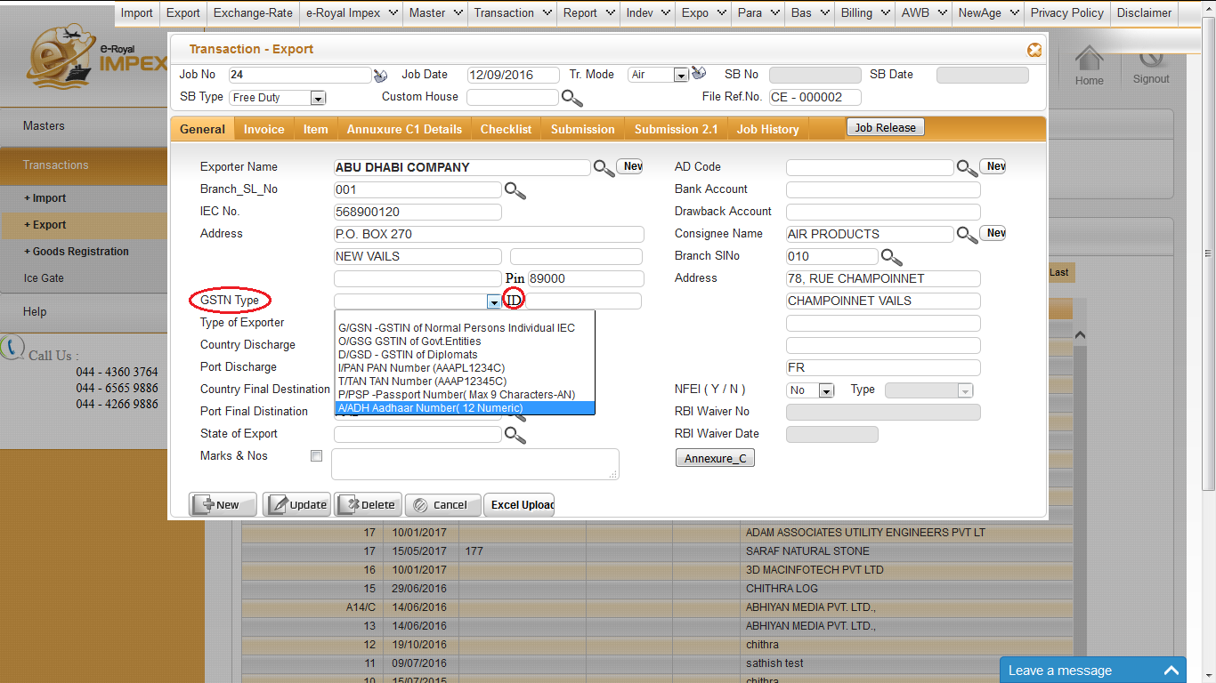
SB MAIN

Slide 3
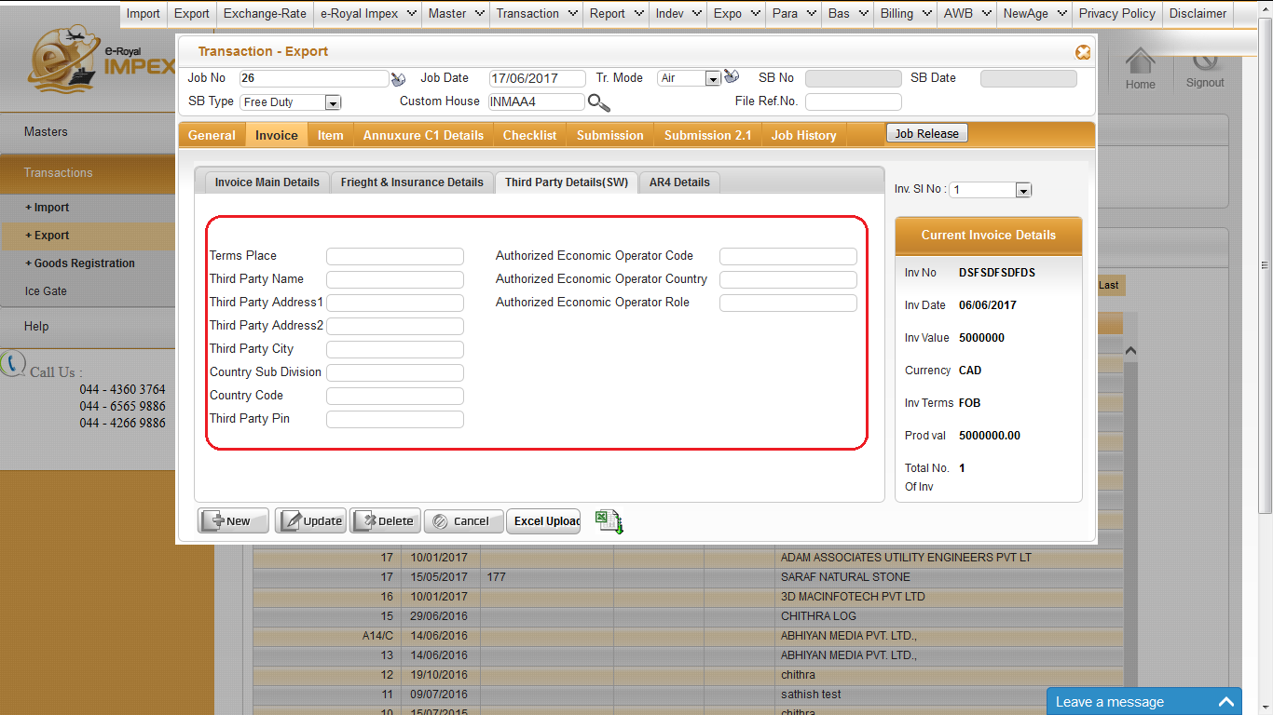
THIRD PARTY DETAILS

Slide 4
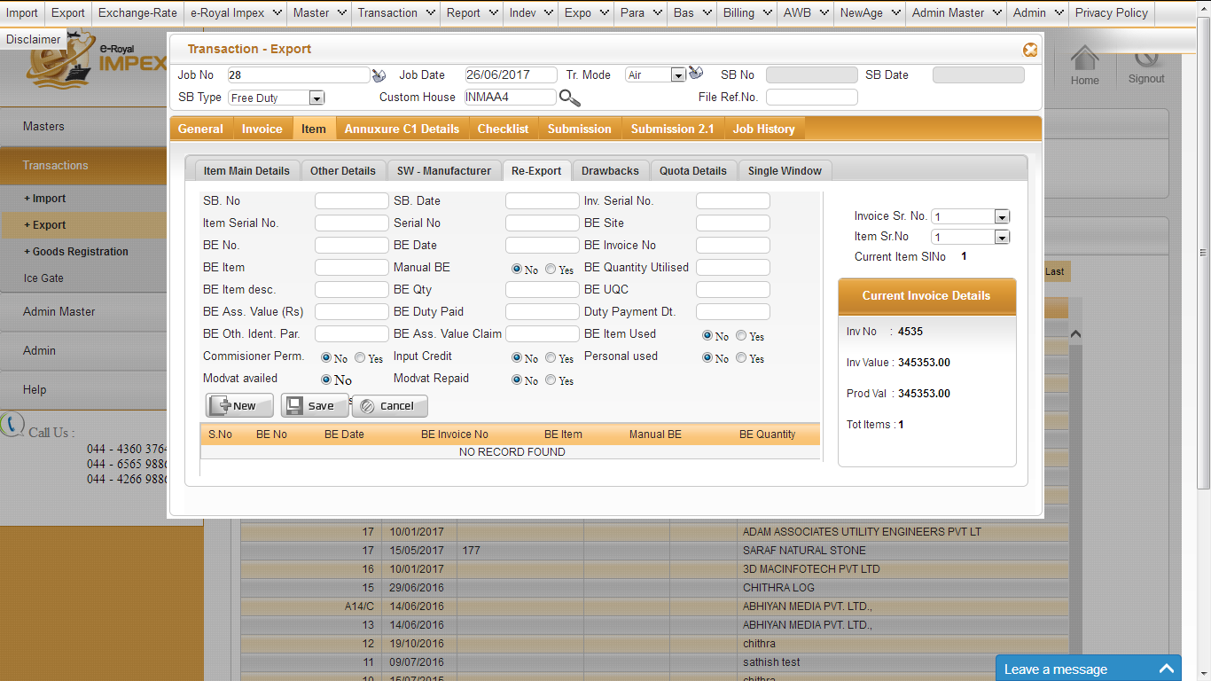
RE –EXPORT DETAILS

Slide 5
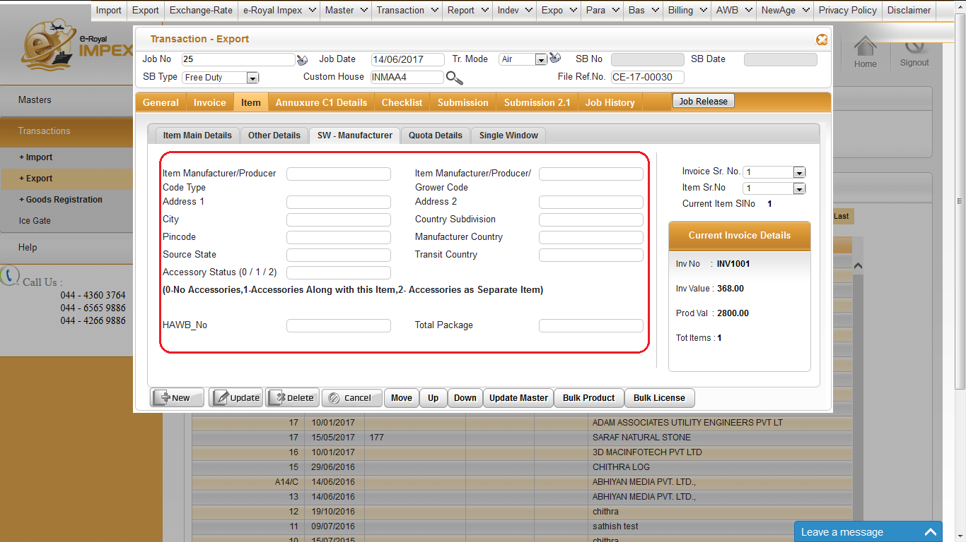
SW-MANUFACTURER DETAILS

Slide 6
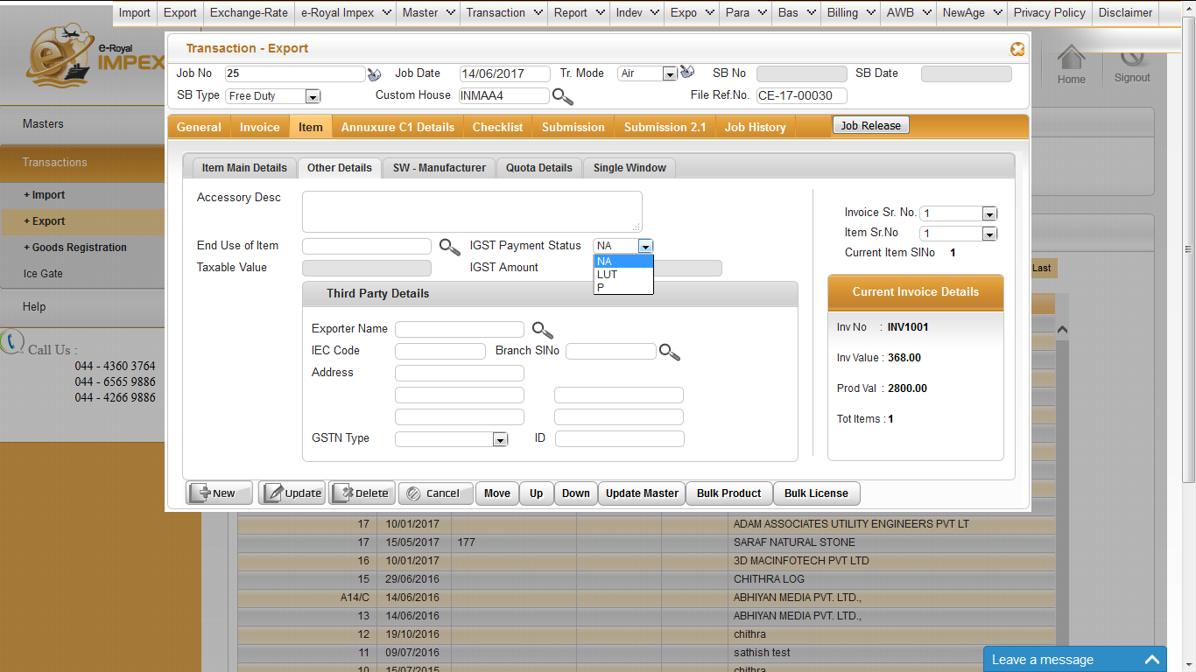
OTHER DETAILS

Slide 7
OTHER DETAILS
IGST PAYMENT STATUS :
NA - Not Applicable
LUT - Export Under Bond (Not Paid)
P - Export Against Payment

Slide 8
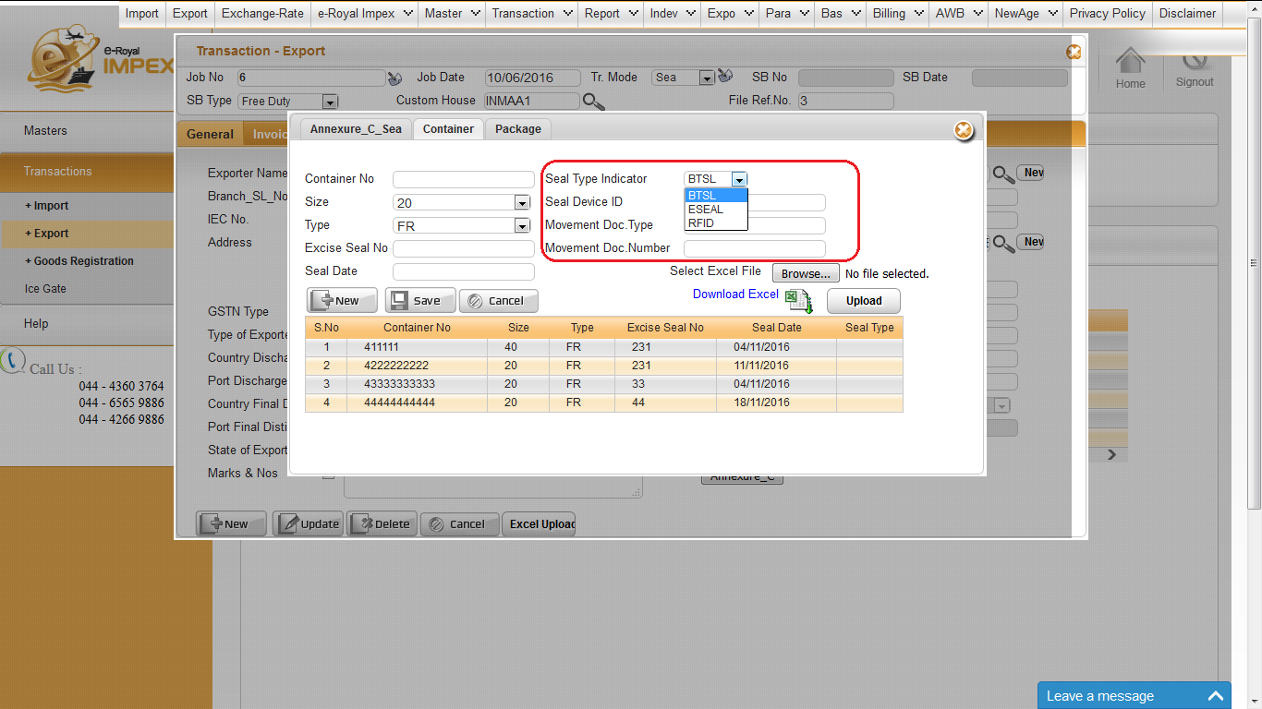
CONTAINER DETAILS

Slide 9
CONTAINER DETAILS :
Seal Type Indicator -To indicate the type of seal used BTSL,ESEAL,RFID.
Seal Device ID –To indicate device ID which would be static for reusable device.
Movement Document Number -Document Reference Number.

Slide 10
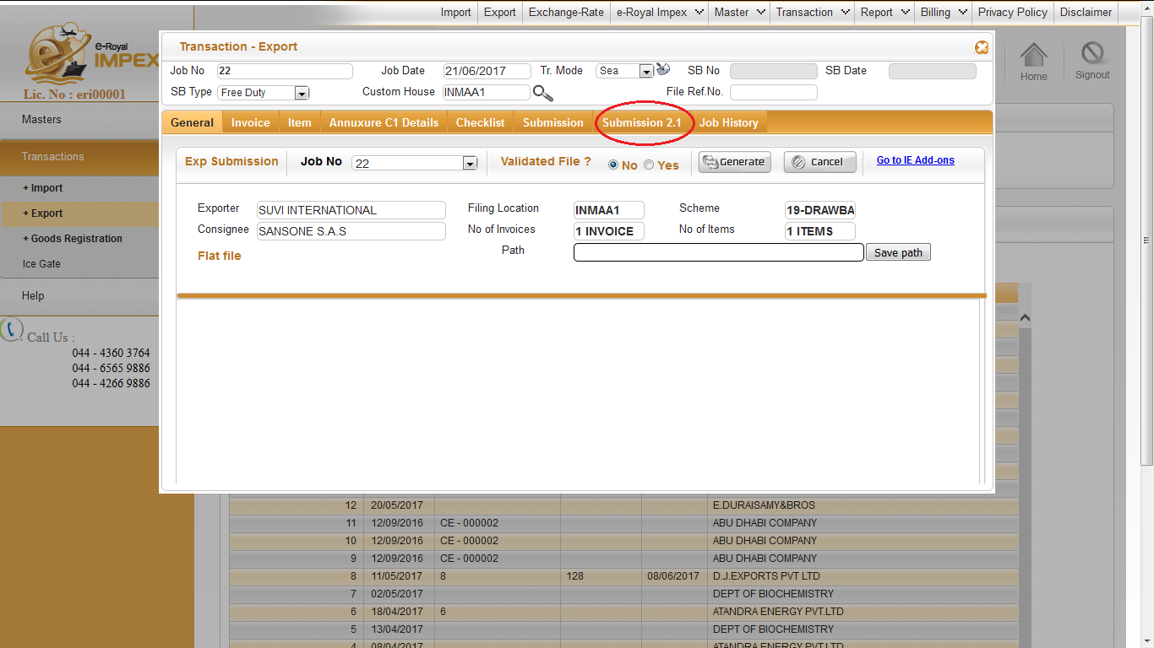
JOB SUBMISSION

Slide 11
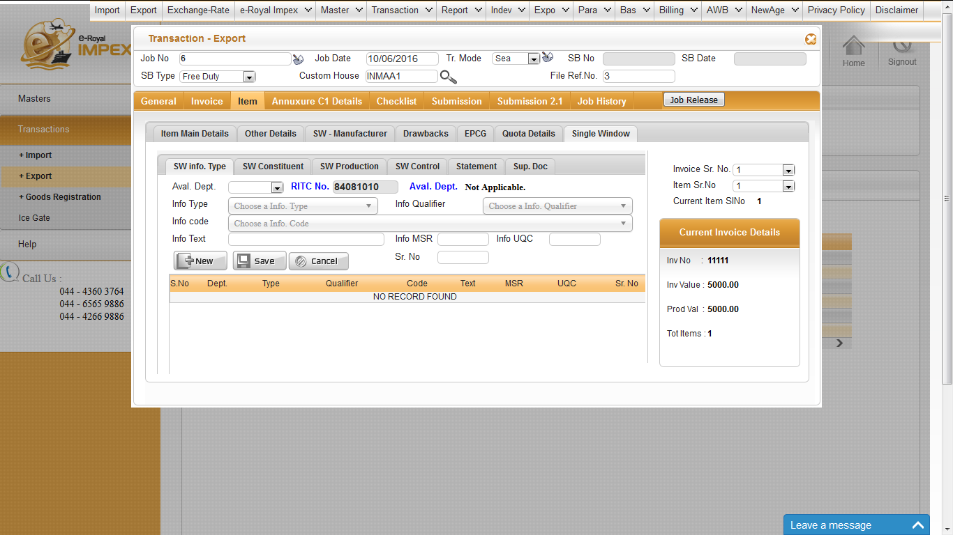
SINGLE WINDOW DETAILS

Slide 12
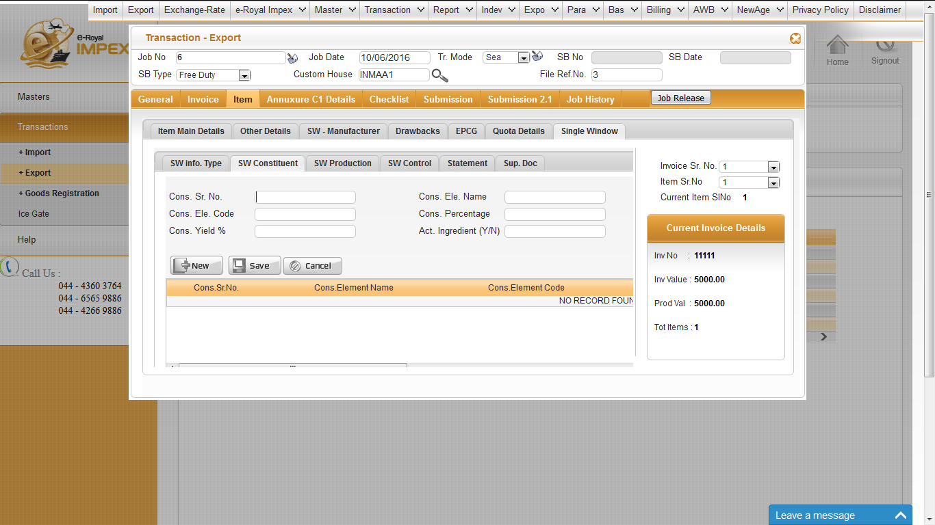
SINGLE WINDOW DETAILS

Slide 13
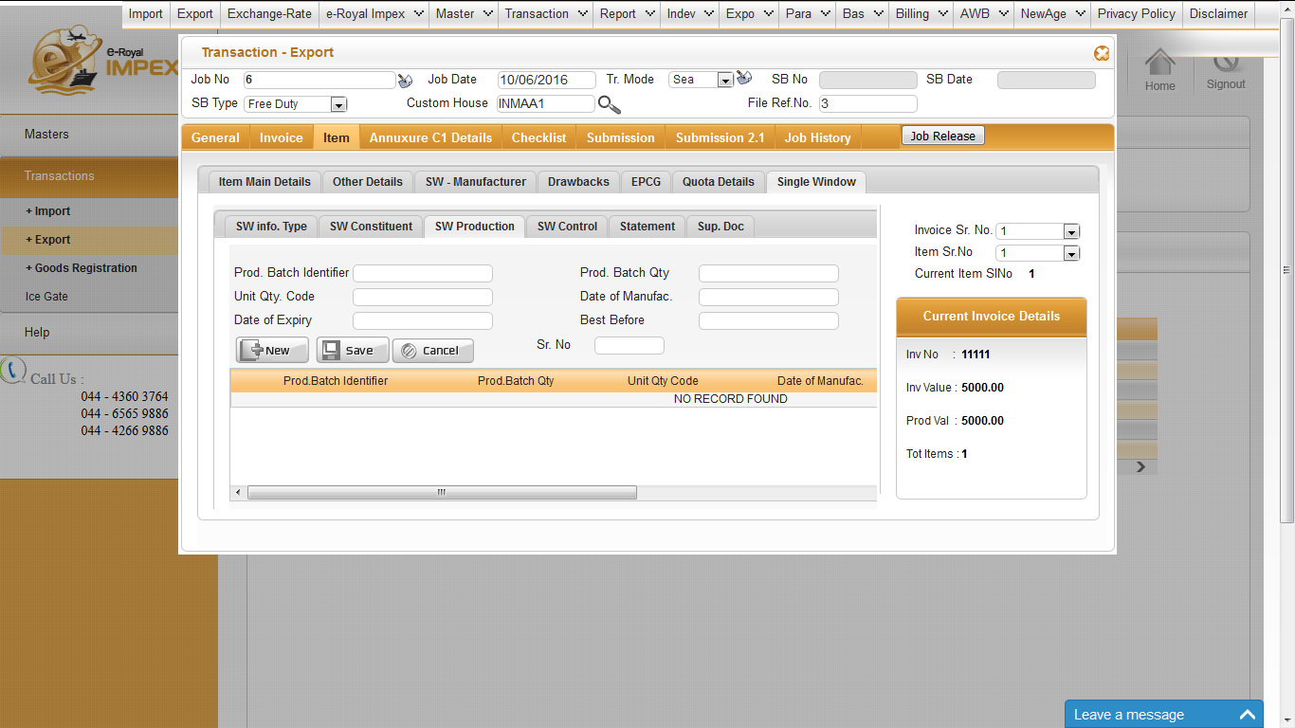
SINGLE WINDOW DETAILS

Slide 14
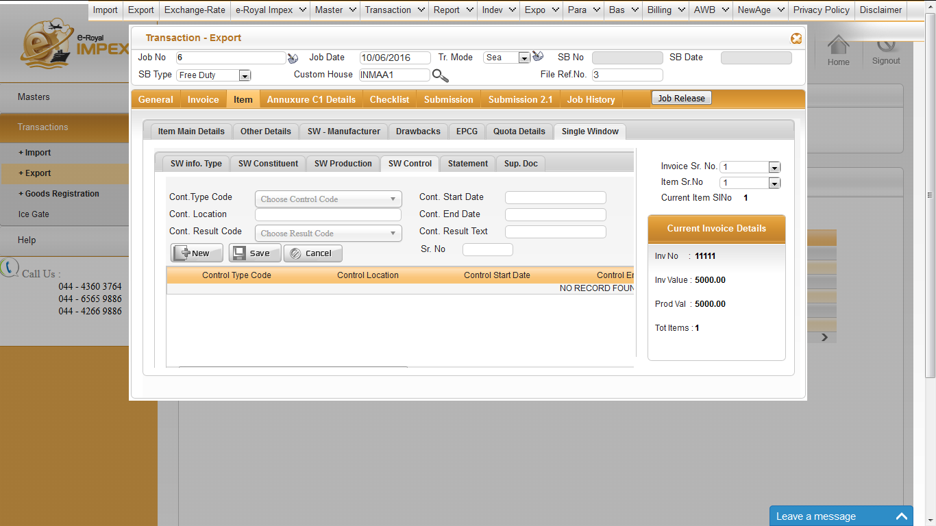
SINGLE WINDOW DETAILS

Slide 15
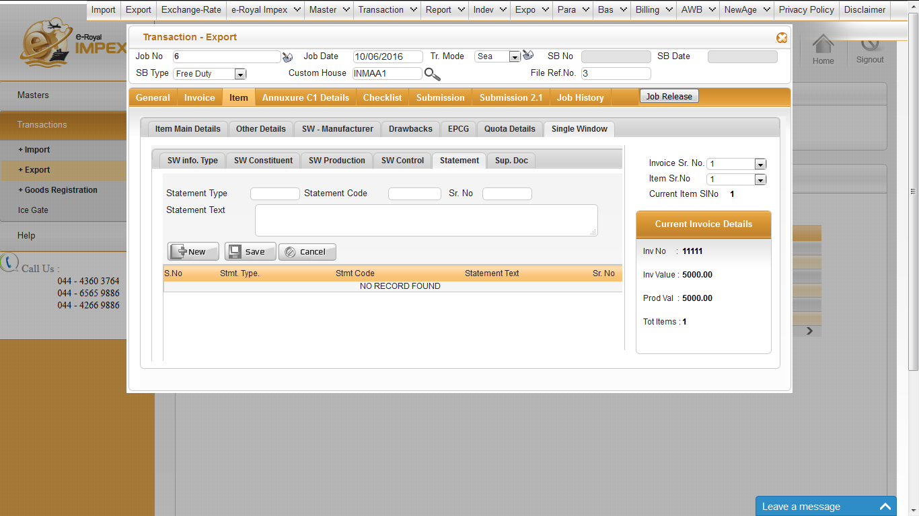
SINGLE WINDOW DETAILS

Slide 16
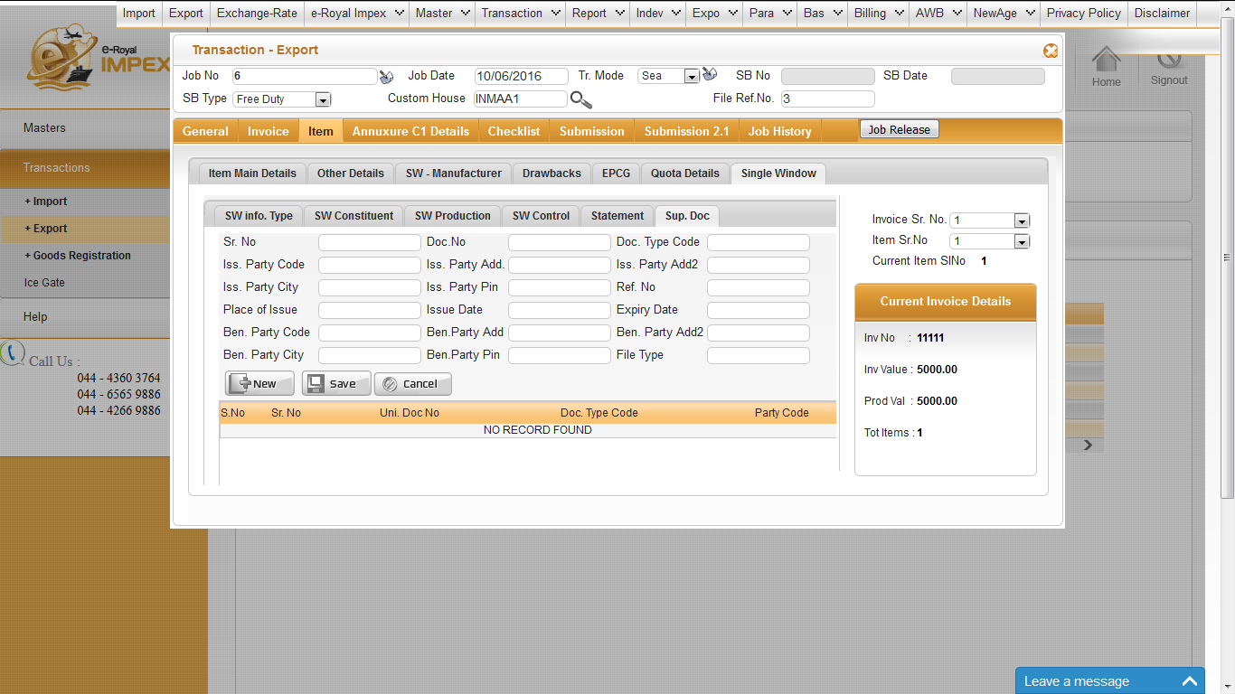
SINGLE WINDOW DETAILS

Slide 17

www.royaltechsystems.co.in

