Slide 1





CVR College of Engineering
Department of Emerging Technologies.
IOMP:
SAFESURF
Chrome Extension
Domain: Cyber Security
Supervisor
G. SAHITHI
Assistant
Department of CSE(CS)
Team
T. Vivekananda – 22B81A6263
E. Srimani Teja – 22B81A6251
K. Vigneshwar – 22B81A6260

Slide 2
Domain Introduction
Domain: Cyber Security
Key Concepts:
URL and File Scanning in Real Time
Browser-based Threat Detection
Chrome Extensions with Security APIs
VirusTotal

Slide 3
Motivation
Cyber threats like phishing and malware are rising fast, and users often fall into traps by visiting harmful websites or downloading infected files. Most existing tools only scan URLs or files—not both—leaving a security gap that attackers can exploit. This weakness creates room for serious threats to go undetected.
Attackers often chain phishing sites with malicious downloads to bypass conventional protection. For example, a fake login page might trick users into downloading an infected file disguised as a document or installer. That’s why a dual-layered defense system is now essential.
SafeSurf bridges this gap by integrating real-time URL and file scanning into a single Chrome extension. It uses trusted threat intelligence platforms to detect threats instantly and alerts the user before damage is done. Plus, it includes customizable whitelist/blacklist settings for personalized protection.

Slide 4
Problem Statement
Current browser security extensions often scan either URLs or downloaded files, but not both. This split approach leaves users exposed to multi-vector attacks, where a malicious website leads to a harmful file download.
Without real-time, integrated protection, threats like drive-by downloads, exploit kits, or phishing+malware combos can bypass detection. Users remain vulnerable as the tools fail to connect the full threat chain.
There’s a strong need for a unified solution that scans both URLs and files simultaneously, offering end-to-end protection against complex cyber attacks.

Slide 5





Existing Technologies
The existing browser extensions:
These extensions comes with either URL Scanning or File Scanning.
Our extension combines both, allowing URL and file scanning. Additionally, files can be scanned either manually by uploading or automatically during the download process.

Slide 6
Limitations of Existing Technologies
Although various browser security tools exist, most extensions only focus on either URL scanning or file scanning. This lack of integration leaves users exposed to multi-stage threats, such as phishing sites triggering malicious downloads. Without unified, real-time protection, attackers can easily exploit these gaps.
Additionally, many tools rely on static blacklists that quickly become outdated, making them ineffective against zero-day threats or new phishing domains. Some extensions also lack automation, requiring manual scanning and reducing overall usability for the average user.
User customization is another common limitation. Most tools don’t allow users to manage whitelists or adjust scanning preferences, leading to excessive warnings or false positives. These inefficiencies, along with performance lags, highlight the need for a smarter, all-in-one browser security solution.

Slide 7
Project Objectives
Real-Time Threat Detection (URL + File)
Integrated Dual Security Model
Lightweight & Background Operable
User-Friendly Alerts and Dashboard
Custom Whitelist/Blacklist Controls
Use of Global Threat Intelligence

Slide 8
Proposed Methods
SafeSurf is a lightweight Chrome extension that scans URLs and downloaded files for phishing, malware, and suspicious activity using VirusTotal and Google Safe Browsing.
Monitors activity with webRequest & downloads APIs
Scans URLs and computes SHA256 hashes for files
Alerts users via popups
Runs asynchronously with custom whitelist/blacklist for better control.
Modular Design: • Content Script – Captures browsing events • Background Script – Handles API logic • Popup UI – Displays alerts/settings

Slide 9
Technology Description
Frontend: HTML + CSS (Popup UI)
Backend: JavaScript (async, modular)
Browser APIs: WebRequest, Downloads, Storage, Notifications
Security APIs: VirusTotal
IDA: VS Code
Version Management: GitHub

Slide 10
Project Modules
Content Script → Captures browsing activity and sends data to the background script.
Background Script → Handles API calls (VirusTotal, Google Safe Browsing), scanning logic, and manages events.
Popup UI → Simple interface to show alerts, threat status, and settings.
Manifest File (manifest.json) → Core config for permissions, scripts, and extension metadata.
Whitelist/Blacklist Module → Stores trusted and blocked URLs/files for custom control.
Notification System → Displays real-time alerts to users via Chrome notifications or popup.

Slide 11
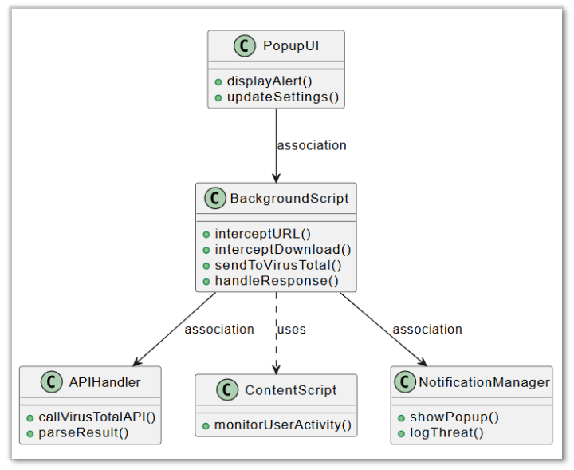
Class Diagram

Slide 12
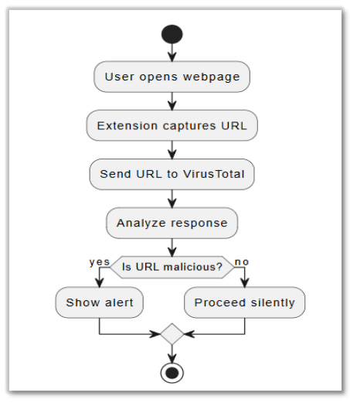
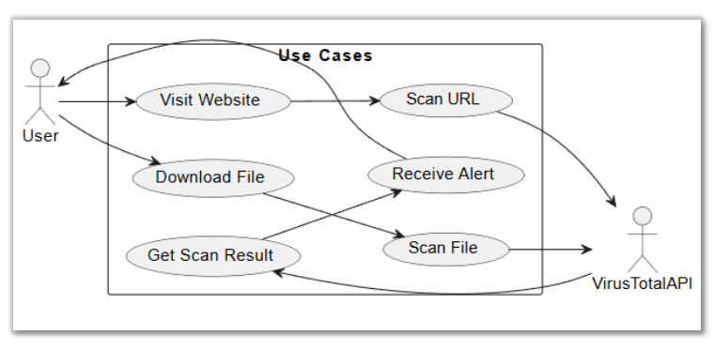
Activity Diagram
Use Case Diagram

Slide 13
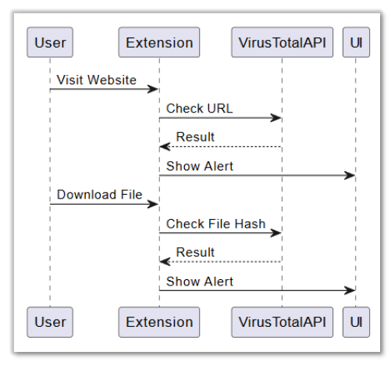
Sequence Diagram

Slide 14
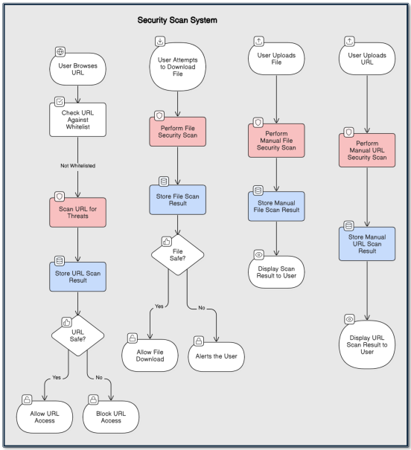
System Architecture

Slide 15
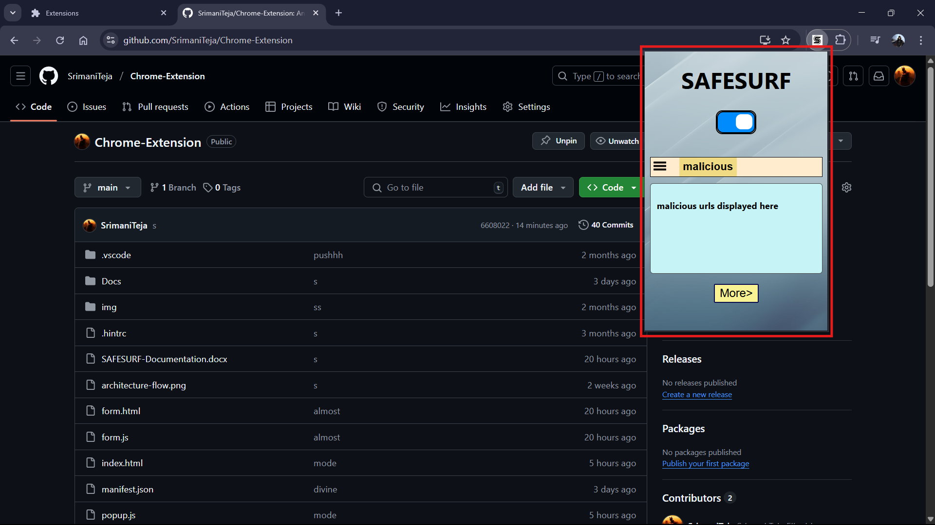
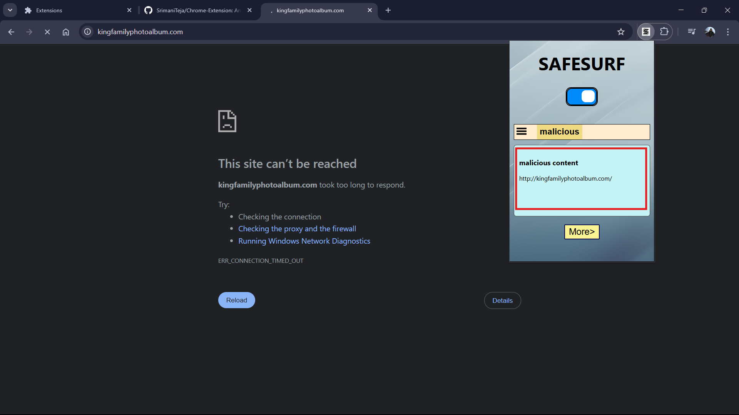
Project Output
Extension
Block result

Slide 16
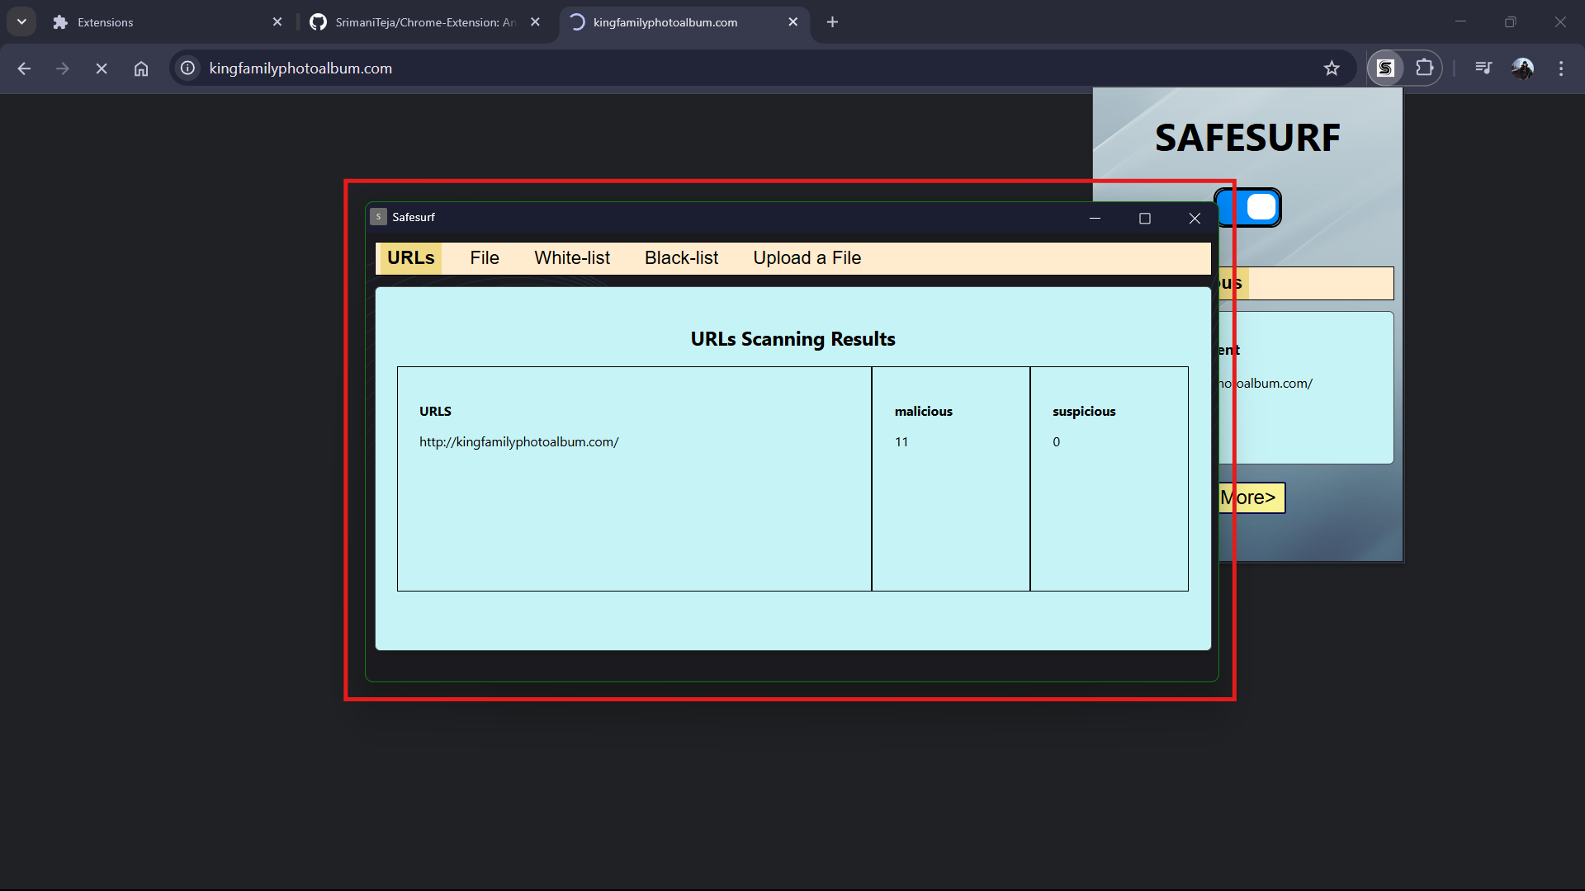
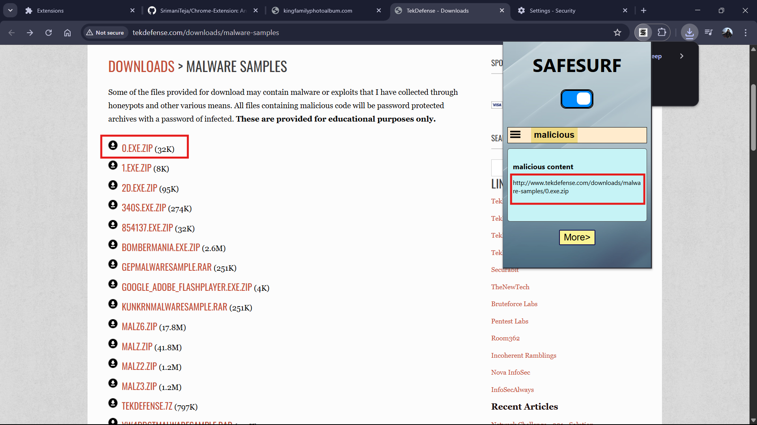
Project Output
More options
Block result

Slide 17
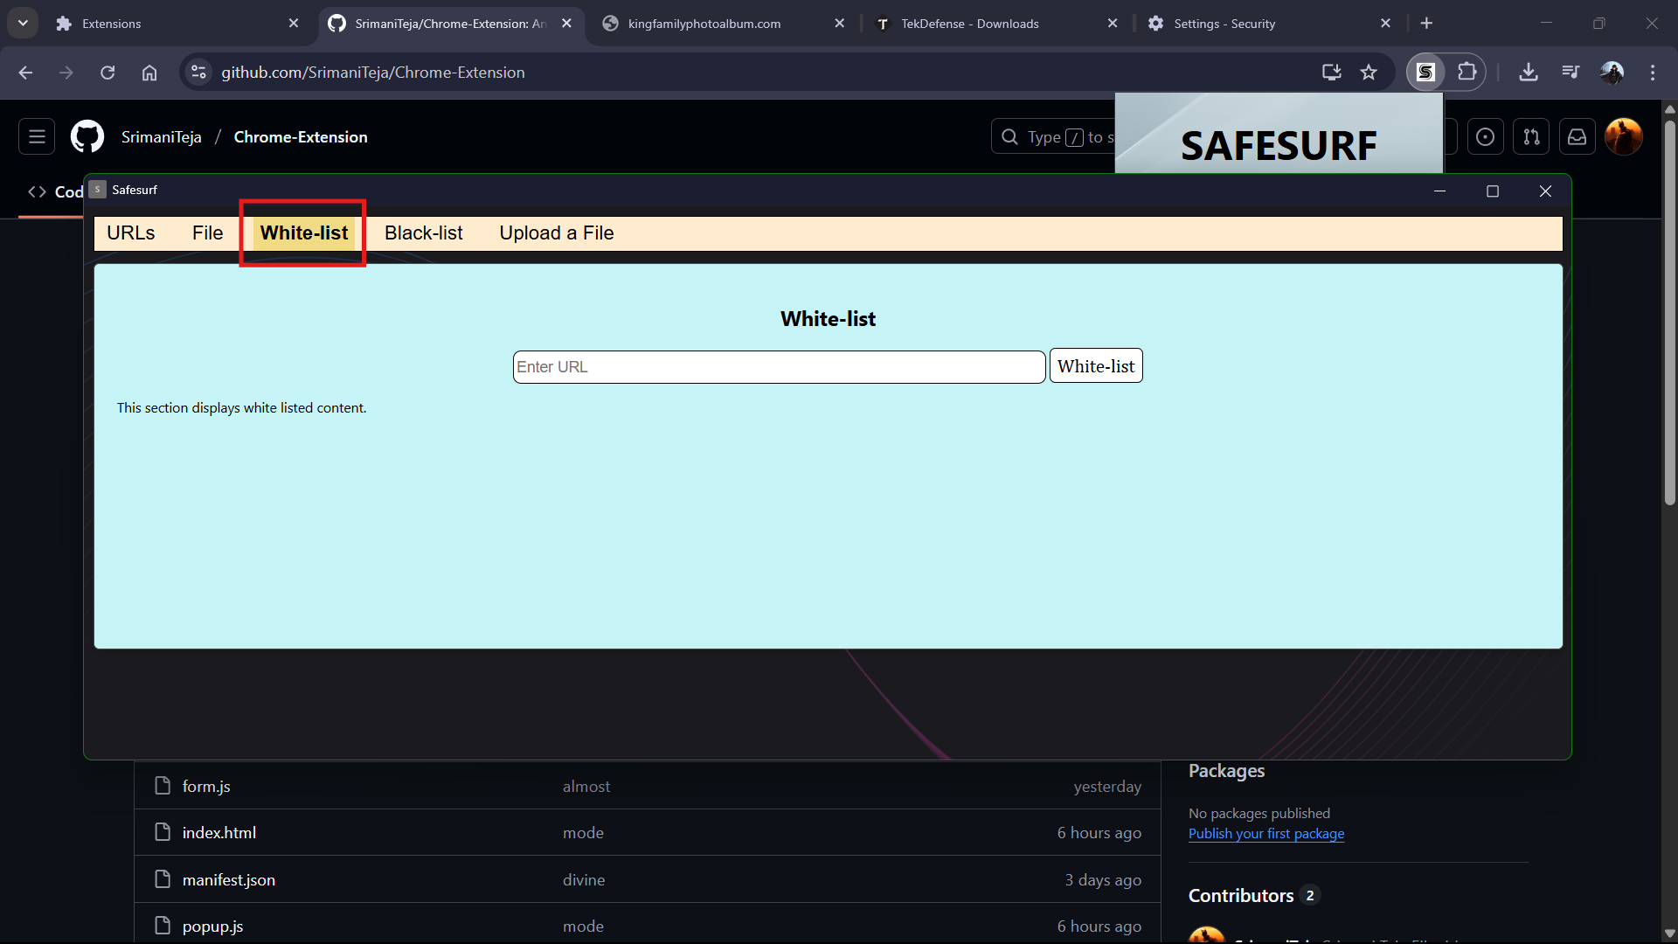
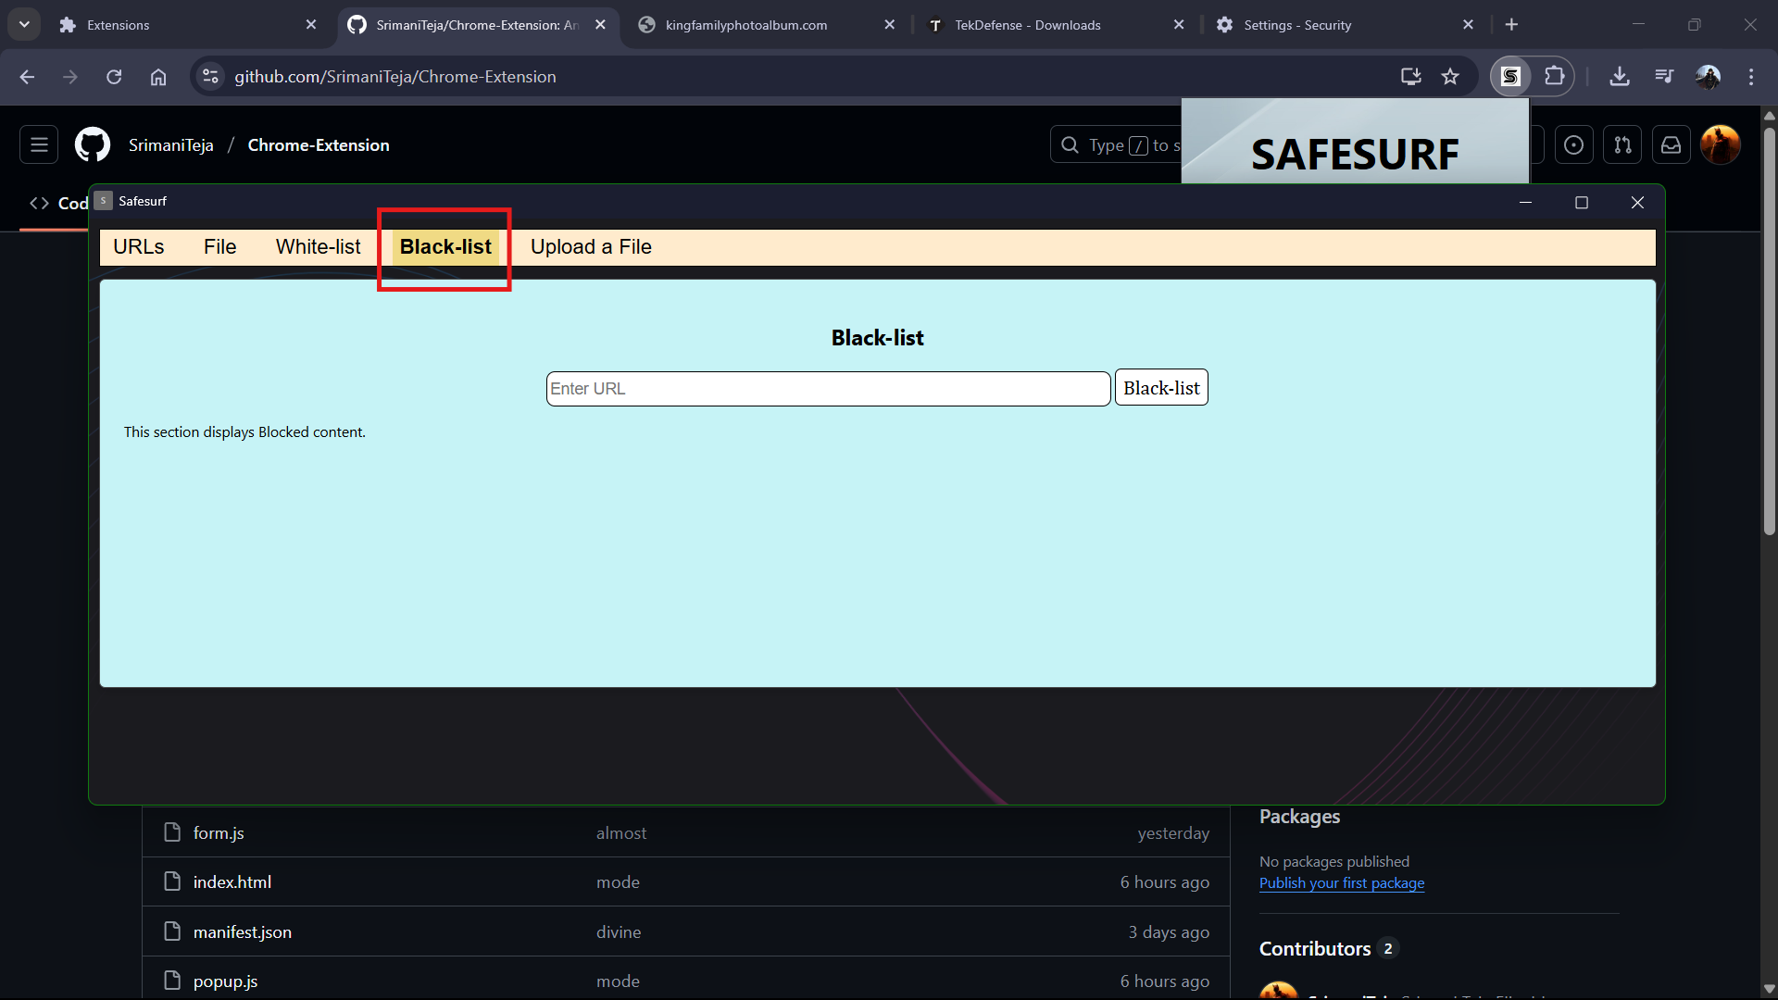
Project Output
Whitelisting
Blocklisting

Slide 18
References
1. VirusTotal (2004). A multi-engine scanning platform for detecting malware.
2. Virustotal File Scanning (2004). Cloud-based malware scanning for downloads.
3. PhishTank (2006). A community-driven phishing database.
4. Avast Online Security (2012). Browser extension for real-time URL threat detection.
5. Malwarebytes Browser Guard (2019). Enhancing browser security against malicious content.
7. Z. Chen, et al. (2022). A real-time threat detection framework for browsers. IEEE Transactions on Cybersecurity.

Slide 19
Software Requirements
Languages:
JavaScript
HTML, CSS
IDE:
Visual Studio Code
Browser developer tools (Chrome DevTools)
Version Control:
Github

Slide 20
Hardware Requirements
System Specifications:
RAM: Minimum 4 GB (8 GB for smooth development).
Memory: Minimum 100MB of free space.
Operating System:
Windows 10 or higher / Ubuntu 20.04 or higher
Processor:
Minimum: Dual-core 2.5 GHz (Intel i3 or equivalent).
Recommended: Intel i5/i7 or AMD equivalent for faster builds and better multitasking.

Slide 21


THANK YOU

