Slide 1
Employee Data Analysis using Excel
STUDENT NAME:S.Srimathi
REGISTER NO:2213211042065
DEPARTMENT:B.com(Corporate Secretaryship)
COLLEGE: Presidency College Chennai-5

Slide 2
PROJECT TITLE
Employee Performance Analysis using Excel

Slide 3


AGENDA
Problem Statement
Project Overview
End Users
Our Solution and Proposition
Dataset Description
Modelling Approach
Results and Discussion
Conclusion
3/21/2024 Annual Review

Slide 4

PROBLEM STATEMENT Analysing individual and team performance helps identify top performers, areas where training is needed and how to better align employee efforts with organisational goal. Performance analysis helps organization pinpoint areas where they are excelling and areas that need improvement.

Slide 5

PROJECT OVERVIEW Employee performance analyzing means analyzing the performance of the employee by considering various factors like Gender, Performance Score, Rating and their achievements. It also identify the trends and patterns of different categories of employee performance
.

Slide 6

WHO ARE THE END USERS? 1. Executive Leadership 2. Managers and Department heads 3. HR Team 4. Financial Analysts and accountants 5. Project Managers 6. Sales and Marketing Teams 7. IT and Data Analysts 8. Quality Assurance Teams 9. Operations Teams 10. External stakeholders

Slide 7

OUR SOLUTION AND ITS VALUE PROPOSITION
Conditional formatting - Missing
Filter - Remove
Formula – Performance
Pivot – Summary
Graph – Data Visualization

Slide 8
Dataset Description
Employee = Edunet
27 - Features
9 - Features
Employee id - Number
Name - Text
Employee type - Text
Performance level - Text
Gender - Male, Female
Employee Rating – Number

Slide 9

THE "WOW" IN OUR SOLUTION
Performance level = IFS ( Z8>=5,”VERY
HIGH”,Z8>4,”HIGH“,Z8>=3,”MED”,TRUE,”LOW”)
3/21/2024 Annual Review
9

Slide 10
MODELLING
Data Collection
1) Download the data in the edunet website
2) And ready to work project
Feature collection
1) Identify the employee id
2) And identify the priority
3) Group similar features together
Data Cleaning
1) Identify the missing value
2) And filter the missing values
10

Slide 11
Performance level
1) Calculating the performance level
2) find the performance level with the help of rating of
the employee
Summary
1) Create the pivort table
2) The features are used in pivot chart
3) Row – Business Unit
4) Column – Performance level
5) Values – First Name
6) Filter – Gender Code, Department Type

Slide 12
Visualisation
1) The features are used in pivot chart
3) Row – Business Unit
4) Column – Performance level
5) Values – First Name
6) Filter – Gender Code, Department Type

Slide 13
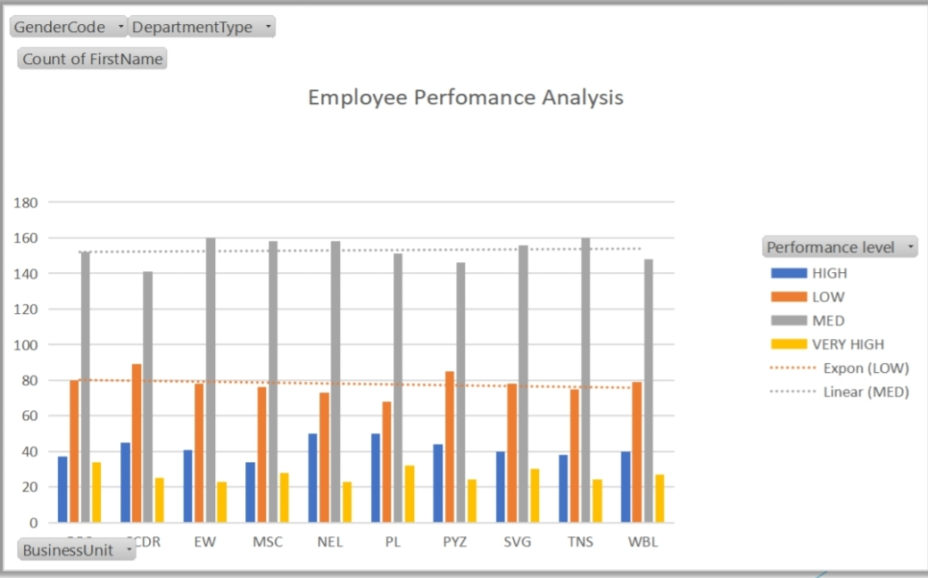
RESULTS
13

Slide 14
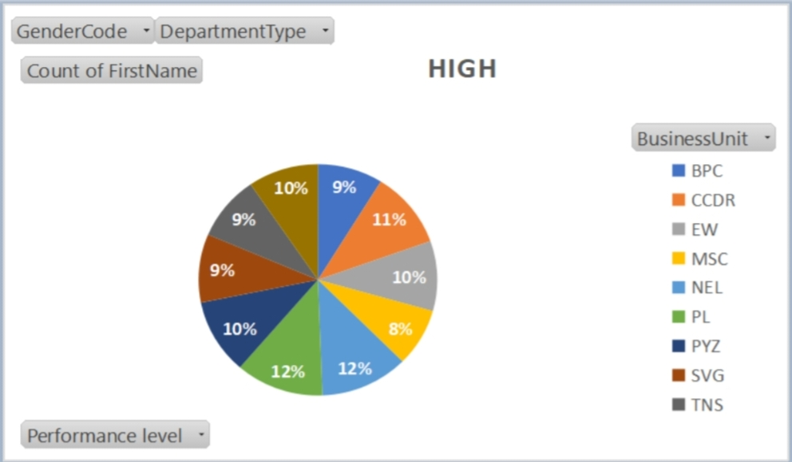
Disscusion

Slide 15
conclusion
Performance analysis is a crucial process for organizations
striving to optimize their operations improve efficiency and achieve strategic goals. The insights gained from performance analysis enable informed decision-making allowing leaders to allocate resources effectively refine processes, and set realistic, data-driven objectives Performance analysis is not just about assessing past and present performance; it’s about building a foundation for future success. By continuously monitoring and analyzing performance, organization can ensure they are on the right path toward sustained improvement
and long term achievement.

