Slide 1
Employee Data Analysis using Excel
STUDENT NAME:S.SRIMATHI
REGISTER NO: 312204634,6168C782677AA1F948F40E51303BFADBS
DEPARTMENT: COMMERCE
COLLEGE:K.C.S KASI NADAR COLLEGE OF ARTS & SCIENCE

Slide 2
PROJECT TITLE
Employee analysis according to
Department

Slide 3

AGENDA
Problem Statement
Project Overview
End Users
Our Solution and Proposition
Dataset Description
Modelling Approach
Results and Discussion
Conclusion
3/21/2024 Annual Review

Slide 4
PROBLEM STATEMENT
To evaluate and compare employee performance and engagement across different departments within the organization. The goal is to identify trends, strengths, and areas for improvement to enhance overall productivity and employee satisfaction.
Total of per day rate of employee
Average total of hourly rate

Slide 5
PROJECT OVERVIEW
This structured approach helps in effectively evaluating employee performance and contributions within the context of a department project.
Tables
Conditional formatting
Pivot chart-line chart, pie chart
Sum formulas
Slicers

Slide 6

WHO ARE THE END USERS?
Sales Department
Research and Development Department
Human resources Department

Slide 7
OUR SOLUTION AND ITS VALUE PROPOSITION
Scenario Analysis :
* Used to analyse different situation
Visual representation
* Chars and graphs
Advanced Analytics tools
*Formulas and functions
* Pivot tables
Comprehensive Data management
* Data organization
*Data integration
User-Friendly Interface
*Accessibility
*Ease of use

Slide 8
Dataset Description
Data overview :
To analyze employee data by department, first aggregate key metrics like headcount, performance, and turnover rates for each department.
Then, compare these metrics across departments to identify trends and disparities
Data field:
Employee lD
Age
Department
Education field
Gender
Hourly rate
Marital status
Per day rate

Slide 9
MODELLING
Data cleaning. Creating table. Creating pivot chart. Creating dashboard. Inserting pivot chart in dashboard. Inserting formulas in dash board to make interaction. Creating interactive dashboard by putting all together elements
9

Slide 10
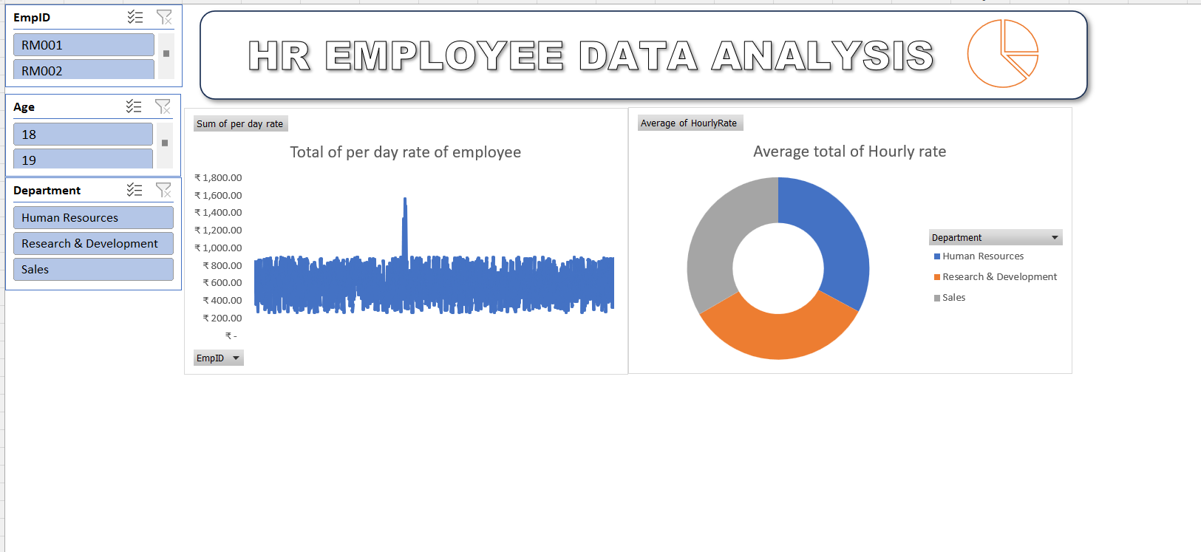
RESULTS
10

Slide 11
conclusion
In conclusion, analyzing employees by department reveals variations in performance, turnover, and workforce composition.
These insights can guide targeted interventions to address specific departmental needs, optimize resource allocation, and improve overall organizational effectiveness. Tailored strategies can enhance employee satisfaction and operational efficiency.

