Slide 1
Indian Penal Code Section Identification for Crime Using Sequential Neural Networks
SRIMATHI G (210701259)
SRIMATHY R (210701260)

Slide 2
ABSTRACT
Identifying the Indian penal code for the crime committed requires in-depth knowledge in crime as well as remembering Indian penal code (IPC) sections which have high chances of human error. So the aim is to build a prediction model using feed forward neural network or Sequential neural network helps in giving judgements or the appropriate Indian Penal Code sections for the crime committed using the keywords of the crime which benefits everyone related to the case and can get an insight of the prediction over judgment. This model uses text analysis which involves tokenization regularization techniques and building a neural network using the preprocessed set. The output provides the IPC sections based on the keyword entered as input.

Slide 3
INTRODUCTION
The use of machine learning algorithms can detect and analyze the crime pattern and forecast the acts in accordance with IPC sections . Source of data is collected from the criminal record law enforcement database to take appropriate measures . Neural networks are the subset of machine learning composed of node layers, containing an input layer , one or more hidden layers and an output layer. Each node ( real time criminal record words) maps or connects itself to the associated weight ( tokenized words from offense and description in the dataset using preprocessing techniques ).The output layer provides us with the punishment along with the Indian Penal Code (IPC) section in context to input layer .

Slide 4
LITERATURE REVIEW
S NO | TITLE | AUTHOR | YEAR | CONTRIBUTIONS
1. | Machine Learning Algorithms for Crime Prediction under Indian Penal Code | Rabia Musheer Aziz, Prajwal Sharma , Aftab Hussain | 2024 | This paper presents a data-driven approach using regression models, notably random forest regression, to analyze Indian crime data and predict regional crime occurrences
2. | Indian Penal Code Recognition Using Multiclass Classification Algorithms in Machine Learning | Prakash Aryan | 2023 | This author uses the multiclass classification model that can determine the applicable Indian Penal Code according to the description provided by the user.
3. | Text similarity algorithms to determine Indian penal code sections for offence report | Ambrish Srivastav, Shaligram Prajapat | 2021 | This system making the decision by finding the right IPC Section from the result of text similarity between IPC section document and FIR, investigation report.

Slide 5
LITERATURE REVIEW
S NO | TITLE | AUTHOR | YEAR | CONTRIBUTIONS
4. | Investigation of Decision Support System for Indian Penal Code Section Using Similarity Algorithm and Fuzzy Logic | Ambrish Srivastav, Shaligram Prajapat | 2023 | This research study focuses on the development and investigation of a Decision Support System (DSS) for Indian Penal Code (IPC) Sections using a combination of similarity algorithm and fuzzy logic.
5. | AI-Based Police Penal Code Identification Based on Keywords in FIR Report | Swati Shilaskar , Rituraj Sharma | 2024 | The author highlights the increasing number of crimes on the Indian subcontinent alongside a positive trend of rising FIR filings using NLP.
6. | Legal Judgement Prediction System | Kavita Shirsat1,, Aditya Keni2,, Pooja Chavan3,, Manasi Gosavi4 | 2021 | In this paper, we analyze the basic description of the case, and apply a machine learning model to predict the possible IPC Section that will be applicable based on the fact of the case.

Slide 6
LITERATURE REVIEW
S NO | TITLE | AUTHOR | YEAR | CONTRIBUTIONS
7. | Cognizable crime rate prediction and analysis under Indian penal code using deep learning with novel optimization approach | Rabia Musheer Aziz, Aftab Hussain, Prajwal Sharma | 2023 | The study presents a new PS-CS algorithm for crime prediction, achieving 99.87% accuracy and offering a robust solution for controlling crime rates in India.
8. | Implementation of Smart Legal Assistance System in Accordance with the Indian Penal Code Using Similarity Measures | Dipti Pawade, Avani Sakhapara, Hussain Ratlamwala | 2019 | The author suggests using NLP with Word Mover's Distance to bridge the gap between citizens' lack of awareness and the legal system, accurately assigning IPC sections to crime descriptions and validating results with lawyers for accuracy assessment.

Slide 7
LITERATURE REVIEW
S NO | TITLE | AUTHOR | YEAR | CONTRIBUTIONS
9. | Giving Precedence to the Indian Penal Code | Stanley Yeo | 2019 | The paper highlights the enduring appeal of the Indian Penal Code (IPC) while acknowledging its shortcomings, advocating for courts to prioritize solutions rooted in the IPC's principles and legal history before turning to common law.
10. | The history of Indian penal code | Dr.G.Devadas | 2016 | This paper is a comprehensive code intended to cover all substantive aspects of criminal law.

Slide 8
RESEARCH GAPS
The system emphasizes keyword identification but does not address how it will handle context-specific nuances. Crimes often involve complex scenarios that simple keyword matching may not fully capture. Research could focus on incorporating context-aware models. The proposal lacks insights into how law enforcement officers and legal professionals perceive and interact with the system.

Slide 9
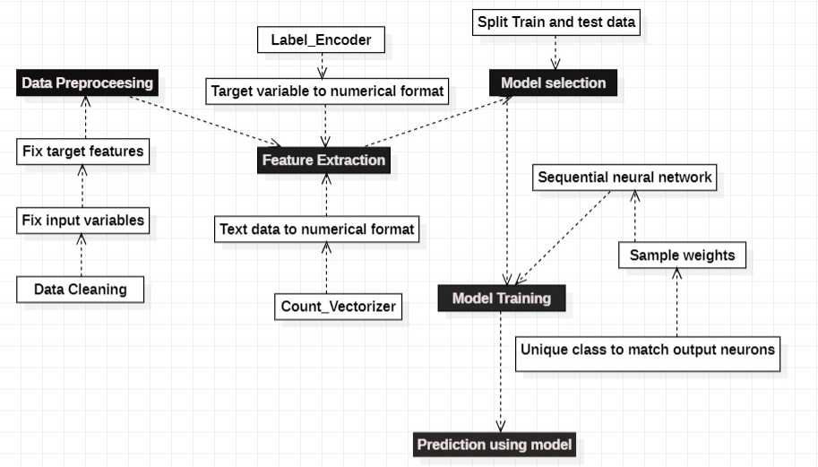
PROPOSED METHODOLOGY

Slide 10
RESULT AND DISCUSSION
The result would be a user-friendly tool accessible to the general public. When a user enters keywords like "killed" or "robbery," the system would promptly display the corresponding sections of the Indian Penal Code (IPC) related to those keywords.
The approach towards finding the IPC section uses FIR (first Information report) and NLP(natural language processing) to find the input keywords and predict the related IPC Section. But the approach might not be so feasible as it always requires sensitive data like information from FIR . Our system tries to overcome this by providing an advancement in algorithms using Sequential neural networks.

Slide 11
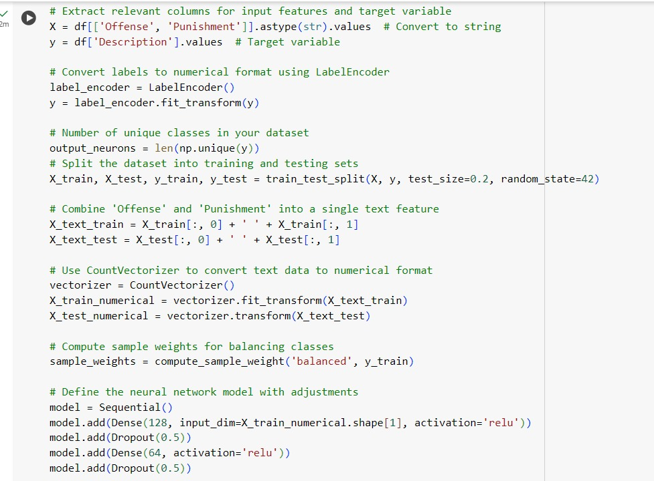
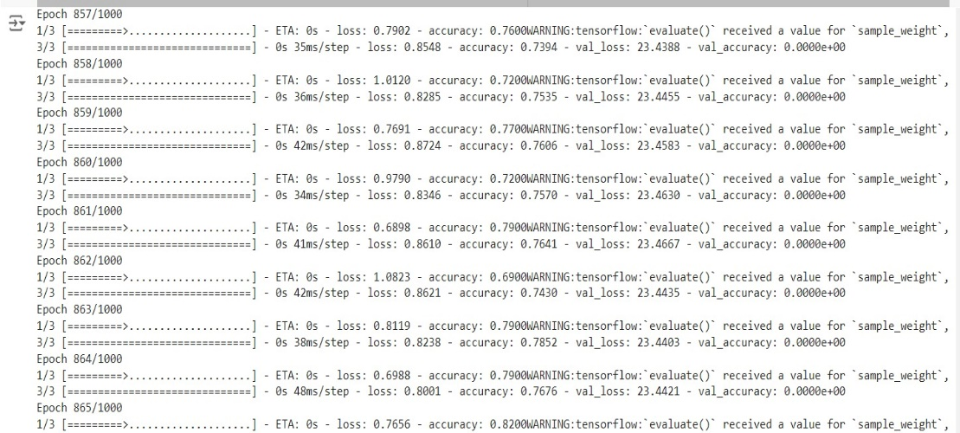
IMPLEMENTATION

Slide 12
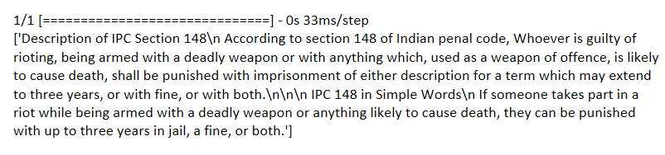
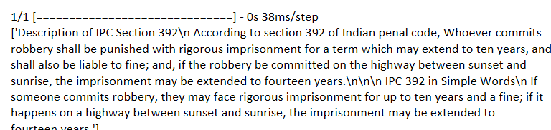
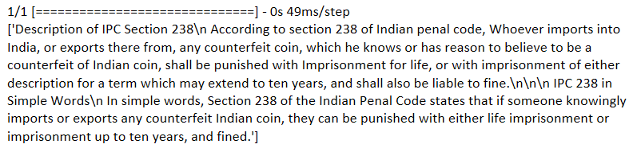
RESULT

Slide 13
COMPARATIVE ANALYSIS
The approach in base paper identifies the keywords match them with keywords extracted from crime dataset using natural language processing while we try to map the crime keywords formatted as numerical input using Sequential neural network to the keywords identified from ipc section description.

Slide 14
CONCLUSION
Thus this work, we explored the application of machine learning techniques to predict relevant sections of the Indian Penal Code (IPC) based on given legal cases. The prediction of IPC sections is a complex task due to the nuanced and context-specific nature of legal texts. By employing a variety of natural language processing (NLP) techniques and machine learning models, we demonstrated the feasibility of automating the identification of relevant IPC sections from case descriptions.

Slide 15
FUTURE ENHANCEMENT
To further advance the field of IPC section prediction using machine learning, Continue exploring advanced NLP techniques such as transfer learning, domain adaptation, and multi-task learning to enhance model performance. Techniques like zero-shot learning could also be beneficial in predicting sections for unseen cases .Develop methods to improve the explainability of model predictions. Legal professionals require transparent and interpretable models to trust and adopt these systems in practice.

Slide 16
REFERENCES
[1] Aziz, R.M., Sharma, P. & Hussain, A. Machine Learning Algorithms for Crime Prediction under Indian Penal Code. Ann. Data. Sci. 11, 379–410 (2024).
[2] Aryan, Prakash. "Indian Penal Code Recognition Using Multiclass Classification Algorithms in Machine Learning."
[3] Pawade, Dipti, et al. "Implementation of smart legal assistance system in accordance with the Indian Penal Code using similarity measures." Advances in Computing and Data Sciences: Third International Conference, ICACDS 2019, Ghaziabad, India, April 12–13, 2019, Revised Selected Papers, Part II 3. Springer Singapore, 2019.
[4] Srivastav, Ambrish, and Shaligram Prajapat. "Investigation of Decision Support System for Indian Penal Code Section Using Similarity Algorithm and Fuzzy Logic." UK Workshop on Computational Intelligence. Cham: Springer Nature Switzerland, 2023.
[5] Shilaskar, Swati, et al. "AI-Based Police Penal Code Identification Based on Keywords in FIR Report." 2024 Second International Conference on Emerging Trends in Information Technology and Engineering (ICETITE). IEEE, 2024.
[6] Shirsat, Kavita, et al. "Legal judgement prediction system." International Research Journal of Engineering and Technology (IRJET) 8 (2021).
[7] Aziz, Rabia Musheer, Aftab Hussain, and Prajwal Sharma. "Cognizable crime rate prediction and analysis under Indian penal code using deep learning with novel optimization approach." Multimedia Tools and Applications 83.8 (2024): 22663-22700.
[8] Pawade, Dipti, et al. "Implementation of smart legal assistance system in accordance with the Indian Penal Code using similarity measures." Advances in Computing and Data Sciences: Third International Conference, ICACDS 2019, Ghaziabad, India, April 12–13, 2019, Revised Selected Papers, Part II 3. Springer Singapore, 2019.
[9] Yeo, Stanley. "Giving Precedence to the Indian Penal Code." The Indian Yearbook of Comparative Law 2018 (2019): 341-364.
[10] Devadas, G. "THE HISTORY OF INDIAN PENAL CODE." Editorial Board 5.6 (2016): 102.

