Slide 1

ShopFast Customer Retention Analysis
Executive Summary
By Srimathy,
Junior Data Analyst

Slide 2
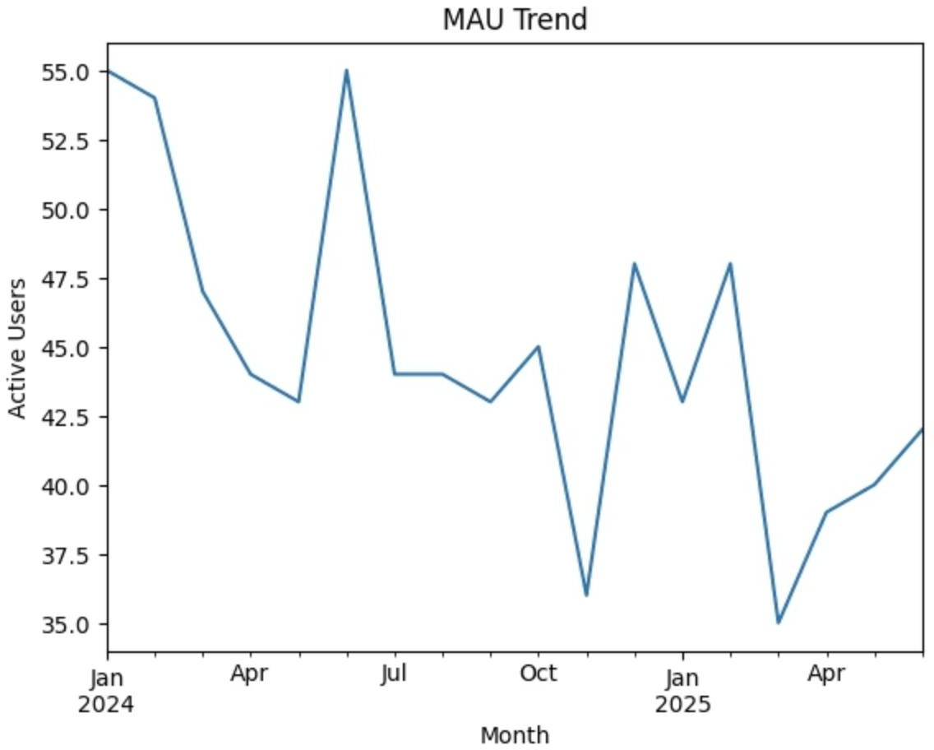
Customer Retention Overview
Key Finding
Monthly Active Users (MAU) have shown a clear decline following the mid-2024 peak. After January 2025, activity dropped noticeably and has reached recent lows.
Critical Insight
Customer weakening signaling
engagement patterns reveal
repeat customer activity, retention challenges that
require immediate attention.

Slide 3

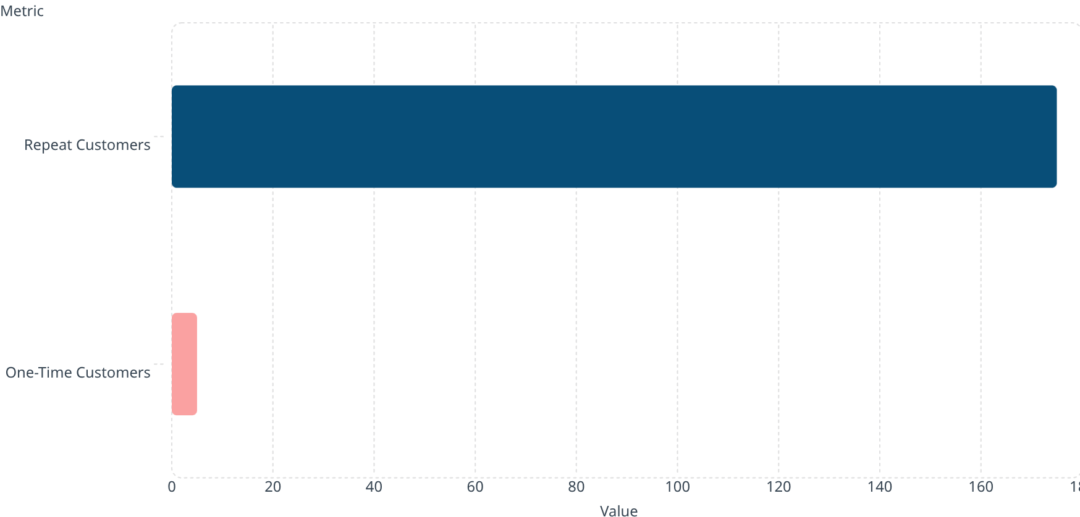
Customer Behavior Analysis
97%
175
Repeat Customer Orders
Over 97% of all orders come from repeat customers
Repeat Buyers
Strong base of loyal repeat customers
5
One-Time Customers
Very few new customers placing orders
175
5
Source:
Critical Insight: ShopFast has built a loyal customer base, but these existing customers
are buying less frequently now, driving the decline in overall activity.

Slide 4
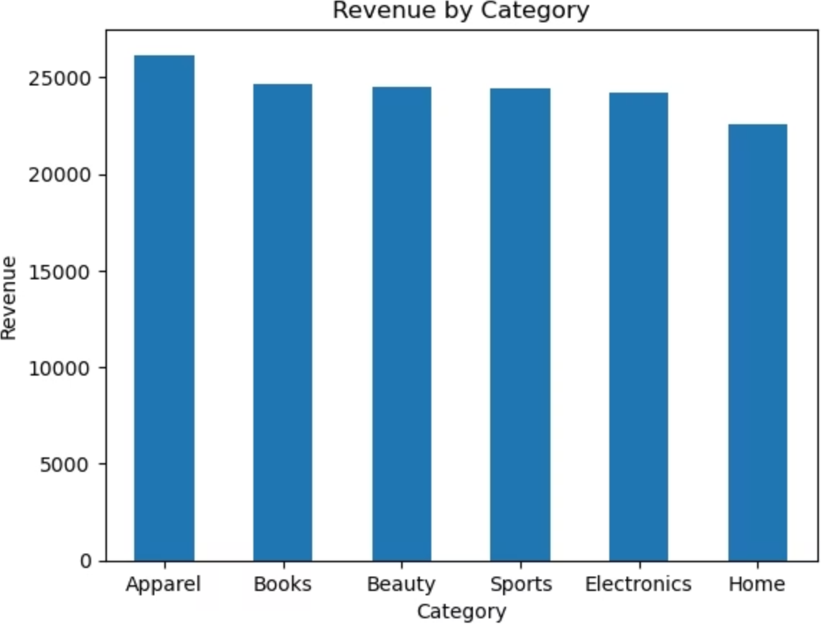
Revenue Insights by Category
Apparel
Highest revenue-generating
category at approximately 26K
Books
Significant contributor to overall sales performance
Home
Lowest performer at approximately
22K—requires attention

Slide 5




Recommendations
1. Improve Shipping Speed
(Highest Priority)
Current: Average shipping time is 13–15 days. 5-star ratings receive orders in ~11 days, while 1–2 star ratings exceed 15–18 days.
Action: Operations team should reduce delivery time to under 10 days, especially for Apparel and Books, by optimizing logistics or using faster delivery partners.
Expected Impact: Higher customer satisfaction and
increased repeat purchases.
2. Launch Re-engagement Campaigns
Target Inactive Users
Current: MAU declined from ~55 users at peak to ~35–
40 users recently.
Action: Marketing team should run "We Miss You" campaigns targeting customers inactive for 45–60 days using Email/SMS.
Expected Impact: Reactivation of inactive users and
stabilization of MAU.

Slide 6




Recommendations
3. Leverage High Repeat Customer Base
4. Focus on High-Revenue Categories
Current: Apparel contributes highest revenue (26K)
followed by Books, while Home generates lowest (22K).
Action: Marketing and product teams should prioritize promotions, bundles, and inventory expansion for Apparel and Books, while improving strategy for underperforming categories.
Expected Impact: Maximized revenue growth from high-performing segments.
Current: Over 97% of customers are repeat buyers (≈175 repeat vs 5 one-time), but overall activity is declining.
Action: Introduce loyalty programs, referral rewards,
and personalized offers for existing customers to increase purchase frequency.
Expected Impact: Higher Customer Lifetime Value
(CLV) and improved retention rates.

