Slide 1

By soec-c k.srinadh vtu no:16967
Vel Tech Rangarajan Dr.Sagunthala R&D Institute Of science & technology
Guided by,
Mr.S.siva kumar Associate.professor,EEE Dept Ms.M.jayadurgalakshmi
Asst.professor,Civil Dept.

Slide 2
Anti sleep device
A mini project Report
by
K.srinadh
under the guidance of
Mr.S.siva kumar sir and
Ms.M.jayadurga Lakshmi mam

Slide 3
Problem selecting:
modern-times, owing to hectic schedules it becomes very difficult to remain active all the time. Imagine a situation where a person is driving home from work, dead tired after facing all the challenges of the day. His hands are on the wheel and foot on the pedal but suddenly he starts feeling drowsy, his eyes start shutting and his vision blurs and before he knows it, he’s asleep. Falling asleep on the wheel can lead to serious consequences, there may be accidents,so many accidents are seeing in roads,mostly 60% people died,because the main reason is sleeping and driving at late night’s, that’s why we take a severe action against this and reduce the accidents,so this project is very useful for who are traveling at late night’s and long distance.

Slide 4
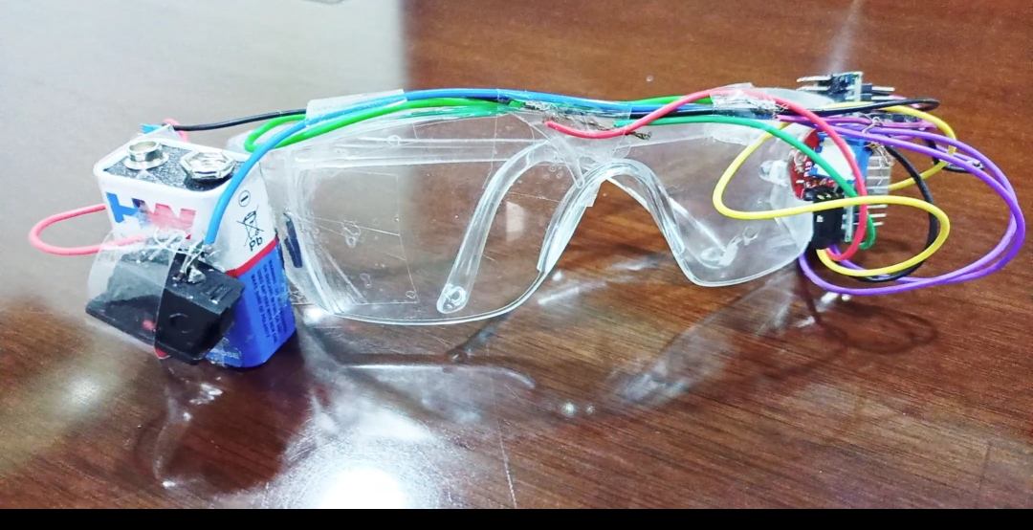

Slide 5
Existing method:
By using a non intrusive machine vision based concepts, drowsiness of the driver detected system is developed.Many existing systems require a camera which is installed in front of driver [4]points straight towards the face of the driver It points straight towards the face of the driver and monitors the driver‟s eyes in order to identify the drowsinessFor large vehicle such as heavy trucks and buses this arrangement is not pertinent. Bus has a large front glass window to have a broad view for safe driving,If place a camera on the window of front glass, the camera blocks the frontal view of driver so it is not practical. If the camera is placed on the frame which is just about window, then the camera is unable to detain the anteriorview of the face of the driver correctly The open CV detector detects only 40% of face of driver in normal driving position in video recording of 10 minutes. In the oblique view, the Open CV eye detector (CV-ED) frequently fails to trace the pair of eyes. If the eyes are closed for ffivsuccessive frames the system concludes that the driver is declining slumbering and issues a warning signal [4]. Hence existing system is not applicable for large vehicles. In order to conquer the problem of existing system, new detection system is developed in this project work.

Slide 6
Proposed system:
Instead of using cameras for monitoring drivers. Eyeblink sensor can be used which is cost effective and easy to implement. • If the driver is found to be sleepy or tired then eyeblink sensor enableswater to be sprinkled upon driver’s face. Fire sensor is relatively new concept which detects fire and allows the motor to gradually stop and doors of the automobile get opened. Immediately water gets sprayed to put off fire.

Slide 7
Cost Analysis:
Matrials: Cost:
Arduino nano - 330
Eye blink sensor goggles - 448
Usb cable - 100
Jumper wires - 60
9v battery - 25
Buzzer - 16
Switch - 10
Some wire - 50
Totally - 1,039

Slide 8
Literature survey:
Literature Survey 2.1 SYSTEM REVIEW This survey is done to comprehend the need and prerequisite of the general population, and to do as such, we went through different sites and applications and looked for the fundamental data. Based on these data, we made an audit that helped us get new thoughts and make different arrangements for our task. We reached the decision that there is a need of such application and felt that there is a decent extent of progress in this field too. 2.2 TECHNOLOGY USED a. PYTHON - Python is an interpreted, high-level, general-purpose programming language. Python’s design philosophy emphasizes code readability with its notable use of significant whitespace. Its language constructs and object-oriented approach aim to help programmers write clear, logical code for small and large-scale projects. Python is dynamically typed AND supports multiple programming paradigms, including procedural, object-oriented, and functional programming. B. JUPYTER Lab - Project Jupyter is a nonprofit organization created to develop open-source software, open-standards, and services for interactive computing across dozens of programming languages. C. IMAGE PROCESSING – In computer science, digital image processing is the use of computer algorithms to perform image processing on digital images. D. MACHINE LEARNING - Machine learning is the scientific study of algorithms and statistical models that computer systems use in order to perform a specific task effectively without using explicit instructions, relying on patterns and inference instead. It is seen as a subset of artificial intelligence. Machine learning algorithms build a mathematical model based on sample data, known as “training data”, in order to make predictions or decisions without being explicitly to make predictions Or descions Without being Explicitly Told.

Slide 9
Advantages:
The various advantages of the implemented system are
mentioned below
1. Detection of drowsiness
2. Decreasing road accidents
3. No need of monitoring cameras or other devicesare
attached or aimed at the driver. 4. This method is practically applicable.

Slide 10
Conclusion:
The analysis and design of driver drowsiness detection and alert system is presented. The proposed system is used to avoid various road accidents caused by drowsy driving. And also this system used for security purpose of a driver to caution the driver if any fire accident or any gas leakage .This paper involves avoiding accident to unconsciousness through Eye blink. Here one eye blink sensor is fixed in vehicle where if driver lose his consciousness, then it alerts the driver through buzzer to prevent vehicle from accident. The alcohol and temperature sensor are used for further safety system in the vehicle. Development of a hybrid microcontroller for a vehicle which also consists of an alcohol and temperature detector which will sense if the driver is drunk and would not start the vehicle. A complete study on road safety is going to be the next boom for the automobile industry for it to flourish and survive every human from the risk

Slide 11
Reference:
[1] Ueno H., Kanda, M. and Tsukino, M. “Development of Drowsiness Detection System”, IEEE Vehicle lNavigation and Information Systems Conference Proceedings,(1994), ppA1-3,15-20. [2] Sean Enright, Electronics Engineering Student, 506-650-3611, May 26-2011, Alcohol Gas Detector “Breathalyzer”. [3] Weirwille, W.W. (1994). “Overview of Research on Driver Drowsiness Definition and Driver Drowsiness Detection,” 14th International Technical Conference on Enhanced Safety of Vehicles, pp23-26. [4] Arpit Agarwal, “Driver Drowsiness Detection System”, portfolio of projects on human computer interaction, December,2010.[5] Paul Stephen Rau, National Highway Traffic Safety Administration, United States, Paper Number05-0192 Drowsy Driver Detection and Warning System for Commercial Vehicle Drivers: Field Operational Warning System for Commercial Vehicle Drivers: Field Operational Test Design, Data Analyses andprogressive[5] Weirwille, W.W. (1994). “Overview of ReseAnalyse Driver Drowsiness Definition and Driver DDrowsinesDetection,” 14th International Technical Conference oEnhanced Safety of Vehicles.

