Slide 1
Secure Data Hiding in Image Using Steganography
CAPSTONE PROJECT
Presented By
Student Name : SRINADH CHINTAKINDI
College Name & Department : Christu Jyothi institute of Technology and Science

Slide 2
OUTLINE
Problem Statement
Technology used
Wow factor
End users
Result
Conclusion
Git-hub Link
Future scope

Slide 3
Problem Statement
Traditional encryption methods make hidden data noticeable, where as steganography can used to handle this challenge efficiently by concealing it within in images without altering visual appearance of images. The problem involving to develop an efficient algorithm to hide the data within image maintaining quality of image and security

Slide 4
Technology used
Platforms used:
Operating System : Windows 11
Editor : Visual studio
Language : Python

Slide 5
Wow factors
LSB-Based Steganography: Hides Data within Last significant Bit ensures the visual appearance
Simple User Interface : CLI based usage ,easy to integrate with projects, ideal for automation
Fast and Lightweight: written in python language, ensures the high performance

Slide 6
End users
Cybersecurity Professionals – Use steganography for secure data transmission and covert communication.
Forensic Experts – Extract hidden information from images for digital investigations.
Government & Defense Agencies – Securely embed sensitive data in images for intelligence and confidential operations.
Researchers & Academics – Study and improve steganographic techniques for data security and cryptography.
Privacy-Conscious Users – Individuals who want to protect personal or confidential information from unauthorized access

Slide 7
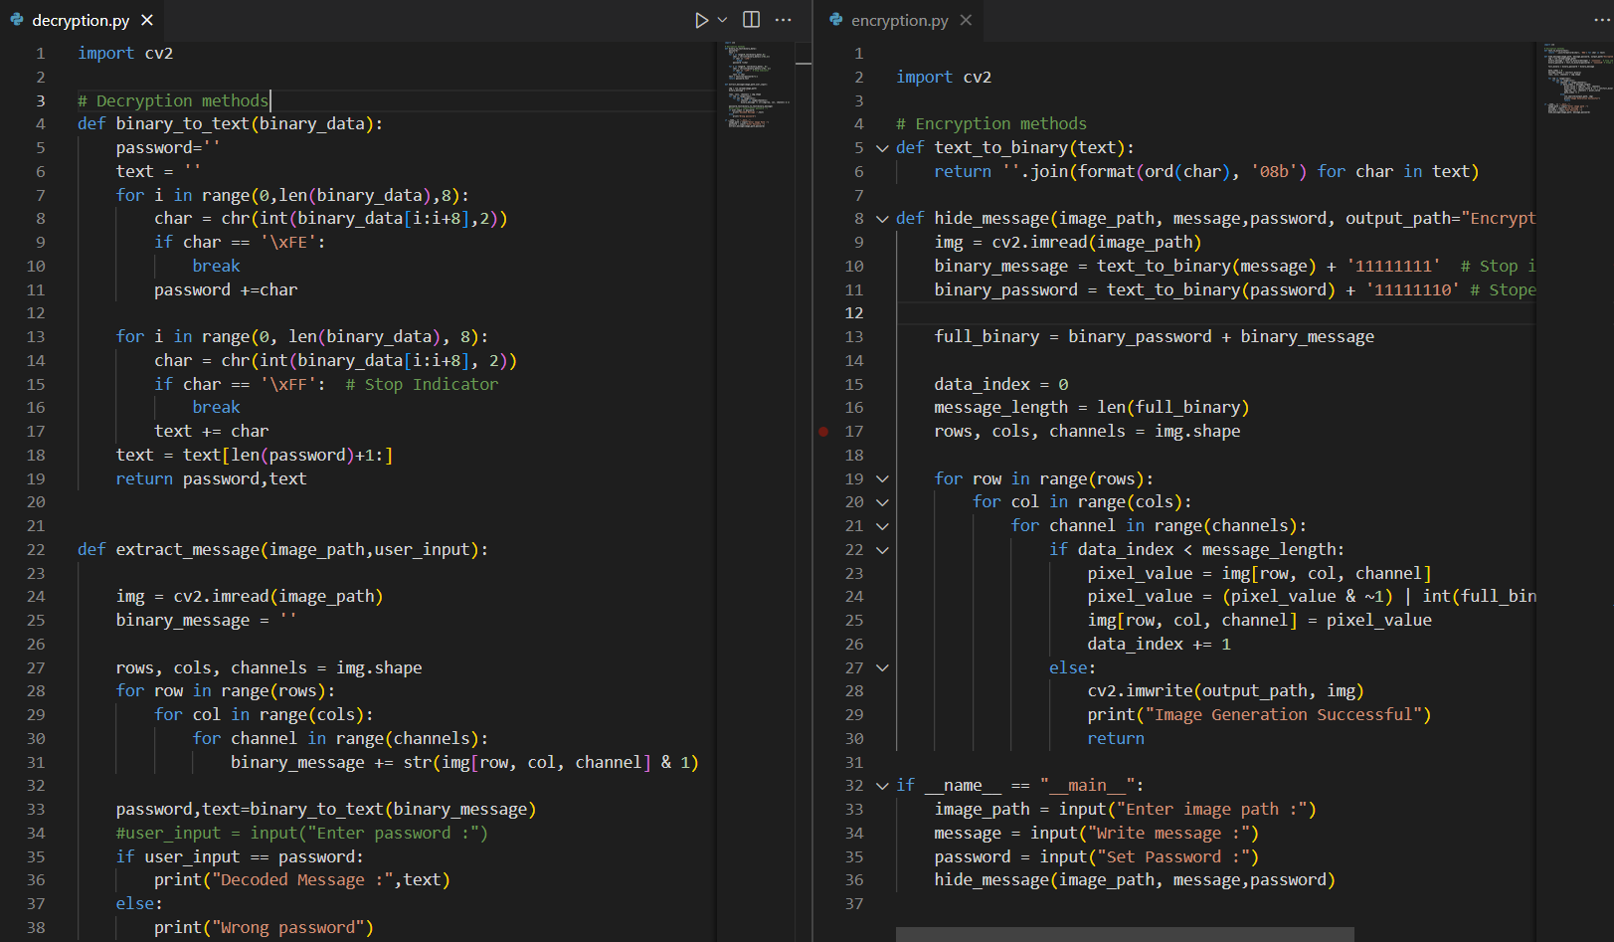
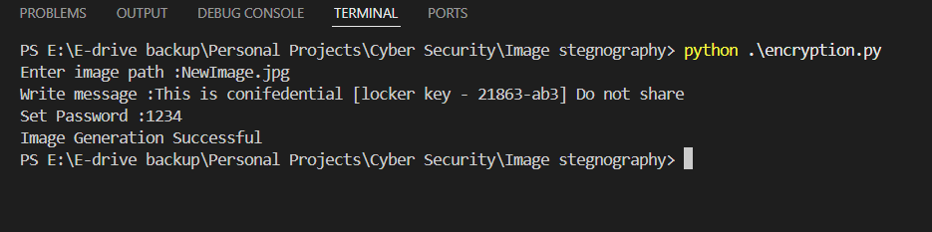
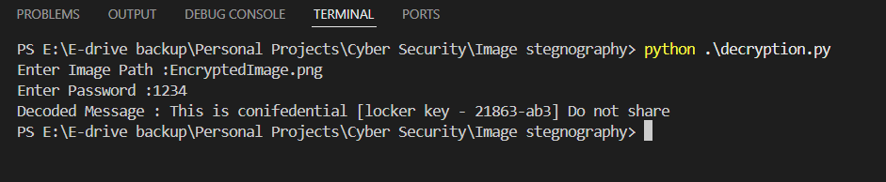
Results

Slide 8
Conclusion
This project successfully addresses the challenge of securely hiding data within an image using LSB-based steganography. By modifying the Least Significant Bit (LSB) of pixel values in images, it ensures that sensitive information remains hidden without noticeable visual changes. The approach maintains data integrity, works efficiently with minimal dependencies, and provides a simple CLI interface for embedding and extracting data. While the current implementation supports various image files, it can be extended to support other formats like PNG or use DCT-based methods for JPEG. This project provides a lightweight, fast, and secure solution for data confidentiality, making it useful for cybersecurity, forensics, and private communication

Slide 9
GitHub Link
Github link : https://github.com/Srinadhch07/Image_Steganography.git
Repository Contents:
📂 Source Code – Python files for encryption and decryptions
📂 Samples :
Upload_images: Contains input images
Encrypted_images : Contains Encrypted images
📂 Presentation – PPT slides summarizing the project.

Slide 10
Future scope(optional)
User Interface improvement , typically GUI
Two step authentication for additional security
Data compression to improve speed the decryption process
Providing customization options for choosing encryption methods

Slide 11
THANK YOU

