Slide 1
SIH25017_ Digital Platform for Centralized Alumni Data Management and Engagement
Final Year Project - 2026
Review-4
Batch Number: CSE_201
Roll Number | Student Name
20221CSE0412 | SIDDHARDHA VARMA
20221CSE0556 | SRINATH K S
20221CSE0402 | RITEESH
Under the Supervision of :
Ms . Rajitha Reddy
Assistant Professor
School of Computer Science and Engineering
Presidency University
Name of the Program: B . TECH
Name of the HoD: Dr. Asif Mohamed HB
Name of the Program Project Coordinator: Dr.Jayavadivel R
Name of the School Project Coordinators: Dr. Sampath A K , Dr. Geetha A

Slide 2
Content
Problem Statement
Objectives
Background and Related work for title Selection
Analysis of Problem Statement
Innovation or Novel Contributions
Timeline of the Project
References

Slide 3
Problem Statement :
Educational institutions across the country face significant challenges in maintaining, managing, and utilizing alumni information in a structured and centralized manner. Alumni data is often scattered across spreadsheets, physical records, social media platforms, or outdated databases, making it difficult for institutions to keep information updated and reliable.
The proposed solution is to develop a web-based digital platform that enables centralized alumni data management and engagement. The platform will act as a single point of access for alumni, students, and institutional administrators, ensuring efficient data handling, seamless communication, and long-term relationship building.

Slide 4
OBJECTIVES :
1.To develop a centralized and secure alumni data management system To create a unified digital repository for storing, updating, and managing alumni academic and professional information.
2.To enable structured alumni–student interaction and mentorship To provide a digital platform where students can connect with alumni for mentorship, career guidance, and professional networking.
3.To support job referrals and institutional engagement activities To allow alumni to post job opportunities, manage event participation, and contribute to institutional development.
4.To provide administrators with monitoring and analytics tools To help institutions analyze alumni trends, engagement levels, placement statistics, and system usage patterns.

Slide 5
Background and Related work for title Selection
Alumni are valuable contributors to institutional growth and student development
Many institutions lack a centralized alumni management system
Alumni data is stored in scattered formats like spreadsheets and manual records
Existing methods lead to outdated, inconsistent, and duplicate data
Students have limited access to alumni for career guidance and mentoring
Social media platforms are not institution-controlled or data-verified
There is a growing need for a secure, centralized digital alumni platform

Slide 6
Analysis of Problem Statement : Methodology
Analyze existing alumni management problems
Identify system requirements and user roles
Design system architecture and database schema
Develop user-friendly web interface
Implement secure user authentication
Enable centralized alumni data storage
Provide role-based access control
Develop student–alumni interaction features
Implement admin monitoring and control
Integrate reporting and analytics module
Perform unit and integration testing
Deploy system and ensure maintenance

Slide 7
Innovation
Centralized Institution-Controlled Alumni Repository A single, secure platform maintained by the institution to store and manage verified alumni academic and professional information.
Verified Alumni Registration System Alumni profiles are verified by administrators to ensure authenticity and prevent fake or duplicate accounts.
Role-Based Access Control System Different system roles (Admin, Alumni, Student) ensure controlled access, data privacy, and secure operations.
Integrated Alumni–Student Mentorship Module Students can request mentorship from alumni, and alumni can approve or reject mentorship requests through the platform.
Job and Internship Referral Portal Alumni can post job opportunities and internships, and students can apply directly through the platform.
Event and Announcement Management System Institutions can organize alumni events, reunions, webinars, and broadcast announcements using a single system.
Advanced Analytics and Reporting Dashboard Administrators can visualize alumni engagement, placement trends, domain distribution, and participation metrics.

Slide 8
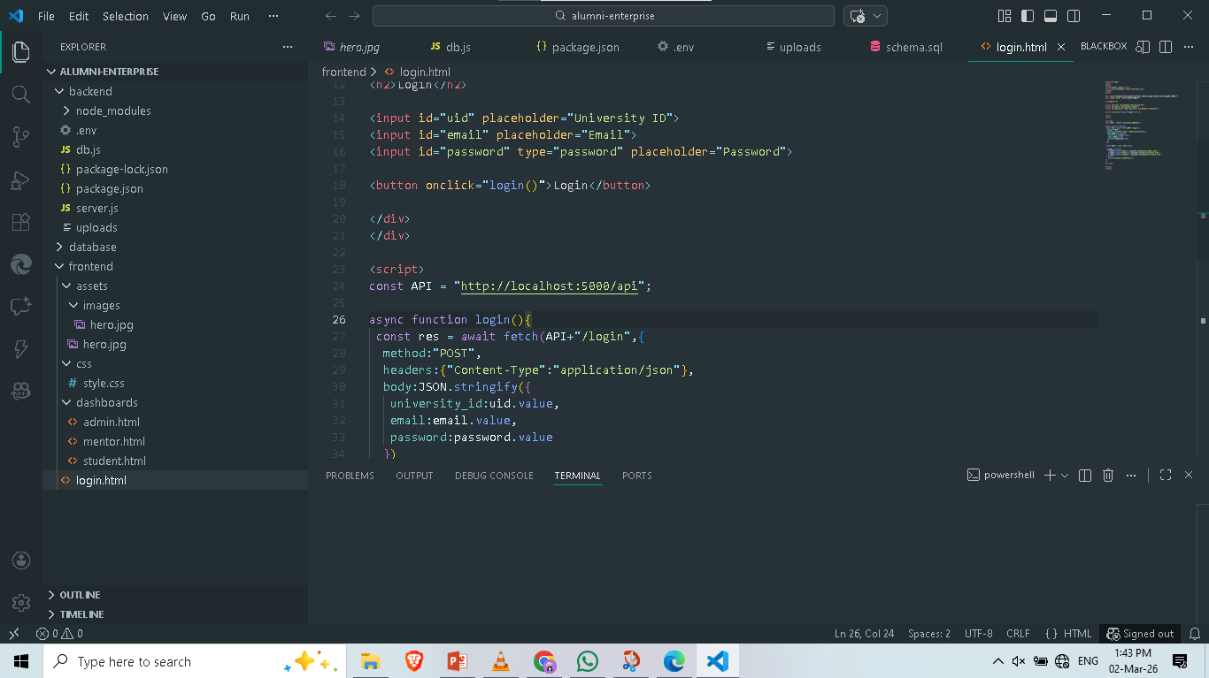
PROJECT IMPLEMENTATAION(Source code):

Slide 9
Timeline of the Project (Gantt Chart)
● Jan 13 2026 (Review-1): Project planning, finalization of objectives, and comprehensive literature review.
● Feb 3-27 2026 (Review-2 & 3): Dataset collection, ML model development, and integration into the web application.
● March 28 2026 (Review-4): AI voice assistant integration, rigorous testing, and refinement based on feedback.
● April 2026 (Final Viva): Final deployment of the platform, documentation, and final demonstration.

Slide 10
References:
“Enhancing Mentoring Between Alumni and Students via Smart Alumni System” — H. Chi et al. (conference paper / Elsevier Procedia / 2012) Summary: proposes adding social-network features and data-mining ideas to support mentoring; proof-of-concept prototype. Why weaker: conceptual + prototype for mentoring only; no full production system, no verified onboarding, no integrated job/referral portal, no real-time comms, no enterprise analytics.
“Design and Implementation of a Web-Based Alumni Management System” (multiple institutional B.Sc./project reports / 2019–2025) — several case studies (Edo State Polytechnic; various university projects on ResearchGate / IRJET / IJESAT) Summary: typical features: alumni profile CRUD, directory, events, simple admin pages; implemented with PHP/MySQL or MERN in some. Why weaker: most are standard CRUD portals and lack cross-module integration (no verified admin workflow, no real-time messaging, limited analytics or graph visualization). Examples: ResearchGate / IRJET listings.
“Alumni Portal System for Nigerian Universities — Case Study” (project / ResearchGate) Summary: localised alumni portal addressing relationship maintenance; focuses on contact management and news/events. Why weaker: scope limited to contact/info management and outreach; no job/referral system, no network graph, no optional blockchain verification.

Slide 11
GITHUB LINK:
https://github.com/Raghava-lerx/alumni-enterprise

Slide 12


