Slide 1


PLEDGE TO PROGRESS Sustainability Hackathon
Sponsored By
Your Team Name: ICE AND FIRE
Your team bio: We are a Team of 5 members dynamic and dedicated group of individuals.
Date: 04.04.2023

Slide 2
Problem Statement?
The increase in the number of patients has led to a decrease in the relative number of doctors per patient which results in a vicious cycle where ignored or delayed diagnostics of an ailment makes the patient more dependent on doctor’s check-ups. If the doctors or nurses didn’t note the sudden change or increase in the data of the admitted patients, this leads to the critical condition of the patient.

Slide 3
User Segment & Pain Points
The target segment would likely be healthcare professionals and organizations, such as doctors, nurses, and emergency medical technicians (EMTs). Specifically, those who work in emergency response or in situations where quick and accurate health monitoring is essential would benefit from this technology. This could include hospitals, clinics, ambulances, and other medical facilities. Additionally, first responders, such as firefighters and police officers, could also be a target audience for this product. They can use gloves on patients who are in ICU or emergency wards too to monitor the patients remotely.

Slide 4
Pre-Requisite
One existing solution is the "Smart Glove" developed by researchers at Purdue University. This glove incorporates sensors that measure the hand movements of the wearer and transmit the data to a smartphone app via Bluetooth. It could potentially be adapted for use by healthcare professionals to monitor their hand movements during procedures.
Another is the "iGlove" developed by researchers at the University of California. This glove incorporates sensors that can detect the pressure and force exerted by the wearer's hand, as well as the temperature and humidity of the environment. The data collected by the sensors can be transmitted wirelessly to a computer for analysis.

Slide 5
Tools or resources
DS18B20 Temperature Sensors Flex Sensor MQ135 Gas Sensor Vibration Sensor Heartbeat sensor / Pulse sensor

Slide 6
Any Supporting Functional Documents
For the problem, we made gloves for the patient. These gloves are worn by the patient who is in ICU. These gloves will detect the data like a heartbeat, body temperature, gases, and flex.
These detected data are sent to the doctor’s, nurse’s, and the patient’s relatives’ devices through the cloud(Firebase) and mobile application. If the data of the patient is critical, it gives an alert message to the doctor, nurse, and patient’s relatives, and also the dynamic data is continuously shared with all.

Slide 7
Key Differentiators & Adoption Plan
Our new Salient advanced Life Guard Glove will reduce the patient death rate in the ICU. We also use the patient’s data set for future use. This system will predict the future data of the patient in which we used the Sentimental algorithm and data set in this project.
In the future, if the patient had an anxiety attack, the doctors can identify it in the present by the data collected from the data set which is dynamically linked with the past data set and the health condition of the patient.

Slide 8
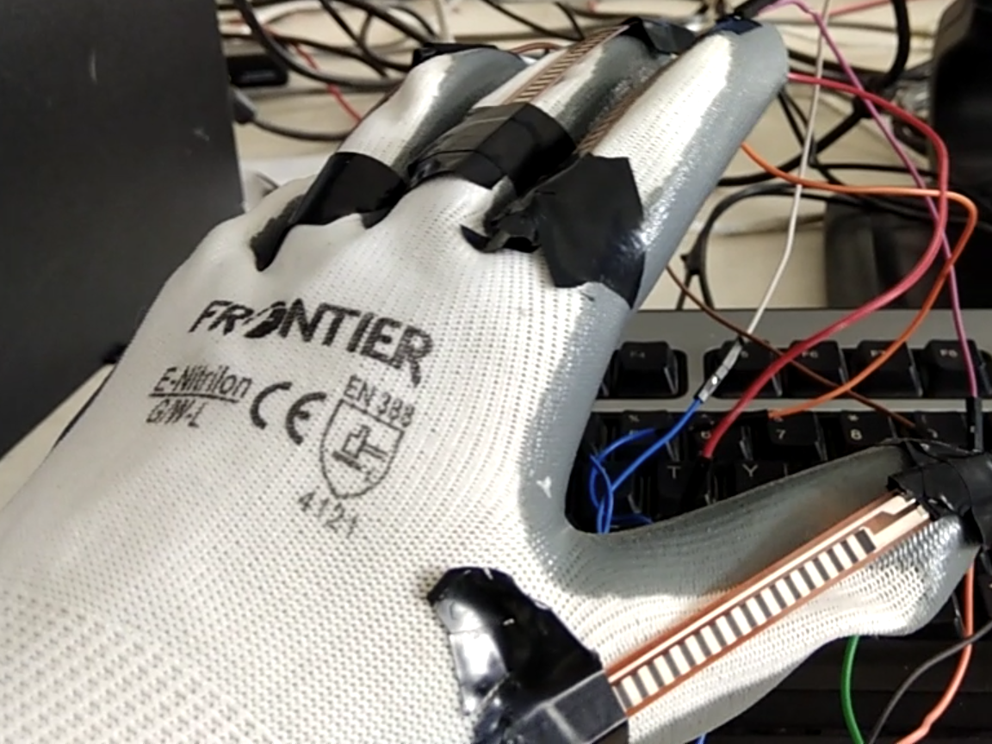
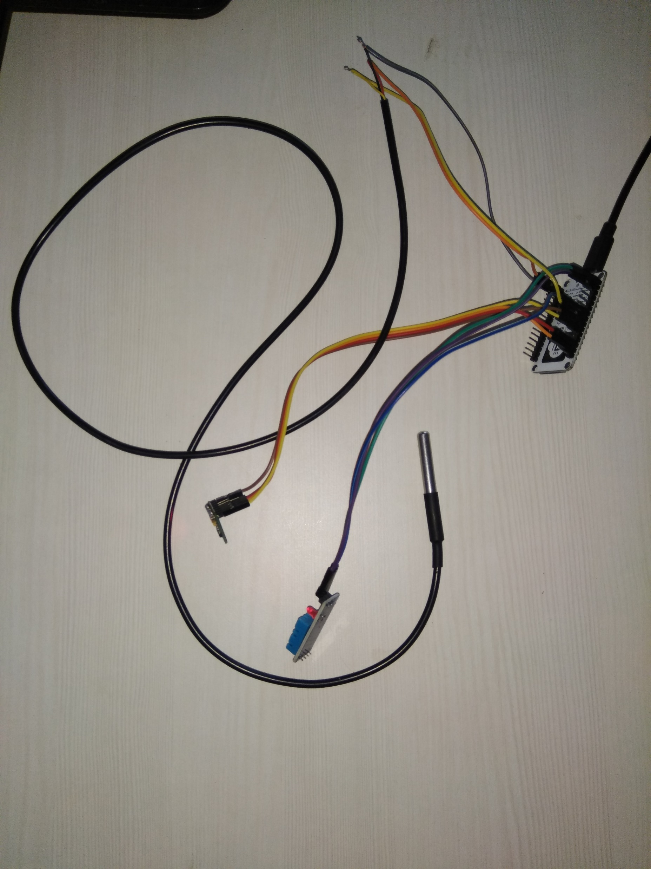
Youtube Link: https://youtu.be/85LoszsVbPI
GitHub Repository Link & supporting diagrams, screenshots, if any

Slide 9
Thank You
Team Leader: ASWATH C
Members: ASWANTH RAMANA S M
SRINATH N S S
VIGNESHWARAN C
KANISKAR K

