Slide 1

hotel management

Slide 2
abstract
In our project, we will try to show how the data/information managed in hotels. This can be achieved by dividing the project in various modules, i.e customer is provided with different services like checking in, checking out, choosing options with their comforts and advanced services etc.. . Customer can cancel their booking if they are not comfortable. If the customer wants to stay they have to provide the ID proof with details. Customer is also provided with food facility of all types and also they can enquiry about the rooms also.
Our project also contains the workers information and at the end, the bill will be provided if customer wants to check out .

Slide 3
Block diagram
HOTEL MANAGEMENT
CHECK IN
CHECK OUT
ENQUIRY AND CONFIRMING THE DETAILS
ENQUIRY ABOUT THE DETAILS IN HOTEL
CONFIRMING THE DETAILS
PROVIDING BILL FOR THE SERVICES PROVIDED
ALLOTTING THE ROOM
PAYMENT PROCESSING
PROVIDED WITH SERVICES AND PROGRAMS
CUSTOMER CHECK OUT
CUSTOMER CHECK IN

Slide 4
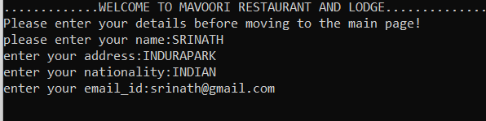
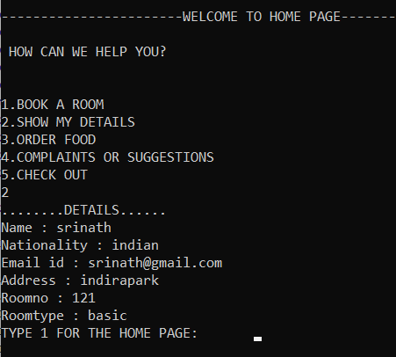
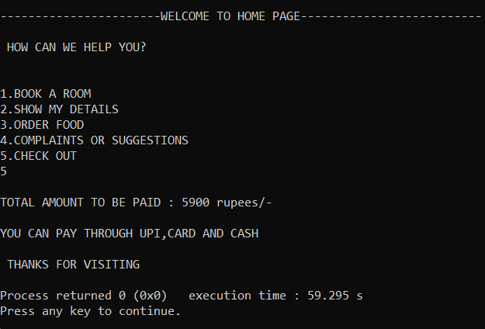
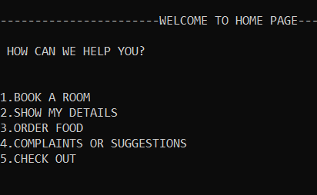
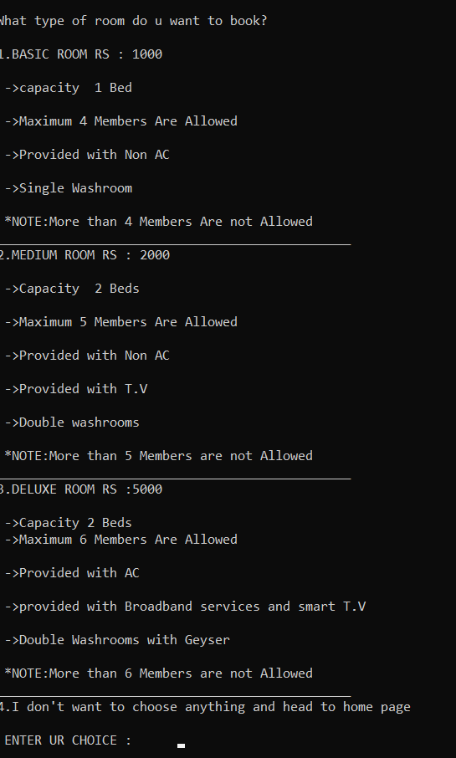
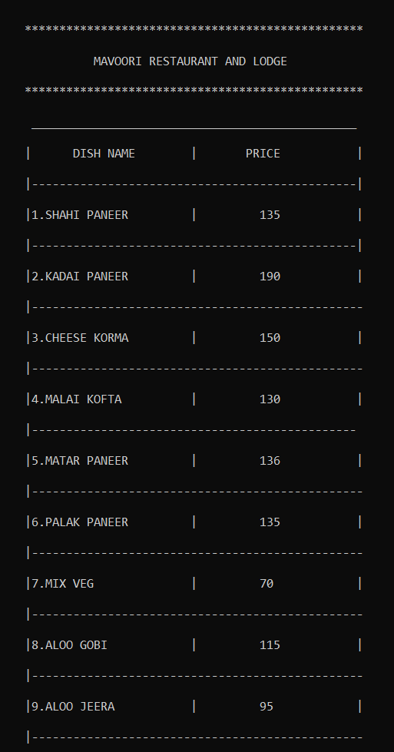
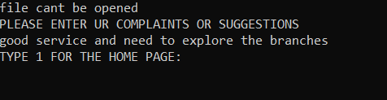
result

Slide 5
conclusion
We conclude that this code / program demonstrates regarding the hotel management and its important services like room bookings, ordering food, showing details, taking suggestions/complaints and checking out.
In case of room bookings, there are different kind of rooms like basic rooms, medium rooms and deluxe rooms which includes different kinds of facilities like beds, AC, etc..
In case of ordering food, there are almost 112 food items to order which includes rates and quantities.
In case of showing details: Name , Address, Gmail, and Nationality are taken into consideration.
In case of checking out, the total amount will be provided to the customer.

Slide 6
requirements
1.Hotel Security
2.Internet Access
3.Comfortable bedding
4.Clear ,Portable , Hot running water with proper pressure in Washrooms
5.Attentive phone services
6.Lighting
7.Fragrance
8.Great dining experience
9.Check-in and check-out experience

Slide 7
BY:
M.AKHIL(20891A1233)
N.SREENIDHI (20891A1235)
P.SRINATH(20891A1240)
M.SAI CHETANA (20891A1248)
GUIDED BY:
P.SHIVA RAMA KRISHNA
DEPARTMENT OF INFORMATION
TECHNOLOGY

