Slide 1
MALICIOUS URL DETECTION
USING
MACHINE LEARNING
under the guidance of
Dr. Motahar Reza
Department Of Mathematics
Shivani Donthi (222022502019)
Srinath Tummala (222022502027)

Slide 2
INTRODUCTION
URLs allow Internet users to move from one website to another. Fully represent access to content stored on servers somewhere in the world. URLs are available by simply clicking on a link or image or typing in our browsers.
A favorite method used by attackers and children of text is to deceive the social media because regular users still click on any link or visit any URL they find.
Cybercriminals use malicious URLs as distribution channels to distribute malicious software on the web. Attackers use browser vulnerabilities to install malicious software so that they can access the victim's computer remotely.
A malware program aims to gain access to the network, filter sensitive information, and secretly monitor targeted computer systems.
In this project, we compare models and find the best guessing model for classifying spam and ham URLs in a better way. Our proposed prediction model seeks to improve the accuracy of the forecast by using various factors that take into account the interaction effect of different parameters.

Slide 3
PROBLEM STATEMENT
Detection of malicious URLs and classifying them as malicious and benign using various machine learning classifiers. Several feature extraction methods such as lexical features and host-based features are extracted better improve performance of the classifiers.
Primary objective:
To build a binary classification model for detection and classification of malicious and benign URLs by improving the accuracy and processing time.
Secondary objectives:
Understanding the characteristics of spam and ham URLs.
To build a Machine Learning model to classify spam and ham URLs.
To select the best suited feature extraction techniques and classification algorithms for detection and classifying the malicious URLs and devise an improved method.

Slide 4
LITERATURE REVIEW
Cho Do Xuan et al.,[1] proposed A method for malicious URL detection using machine learning based on URL behaviors and attributes as well as the big data technology.
The results of this article have been used to build a free tool to detect malicious URLs on web browsers.
Among Random Forest and support vector machine, Random forest was found to give highest accuracy of about 96.28%.
Vanitha et al.,[2] proposed The approach that classifies URLs automatically by using a Machine Learning algorithm called logistic regression that is used for binary classification.
Feature extraction techniques like Blacklist Queries, lexical features are used.
Feature vectorizing methods using tf-idf were used.
It is observed that logistic regression is giving highest accuracy (98%) among other algorithm like Naive Bayes and Random Forest.
R. Naresh et al.,[3] identified Malicious uniform resource locators employing a combination of URL lexical options, payload size, and python supply options.
Feature extraction techniques such as Host-based features, lexical based features and popularity based features were used to detect the malicious URLs
They used a Support Vector Machine with a
polynomial kernel and logistic regression to attain maximum accuracy. Logistic regression achieves accuracy about 98%.

Slide 5
GAPS IDENTIFIED
There are very few ensemble models built on detection of malicious URLs.
Some data sets have incorrect URLs and may result in data imbalance and some of the works did not perform over sampling strategies to measure imbalanced data.
In most of the research, the Random Forest algorithm is used and compared which gives high accuracy.

Slide 6
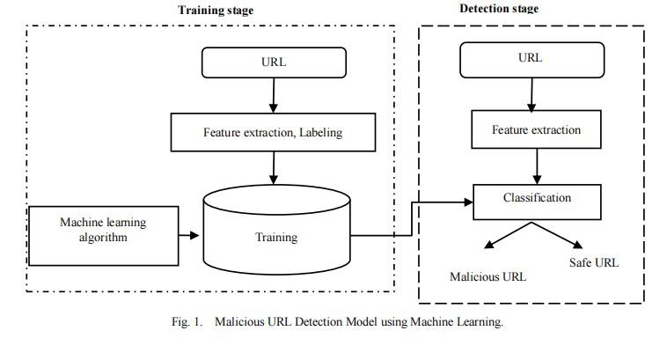
Model Flow
[4]

Slide 7
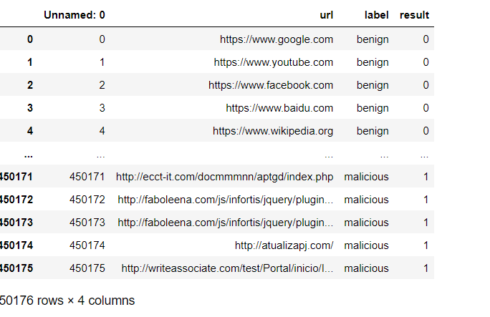
DATA DESCRIPTION
DATA COLLECTION:
The malicious URL dataset used in this model is imported from Kaggle. It comprises 450176 rows and 4 columns. Column names are Unnamed, URL, Label and Result.

Slide 8
NAME OF DATASET
The dataset named urldata.csv has been taken from Kaggle for our experimental purpose. This dataset was created to tackle the problem of malicious URLs on the cyber world. The malicious URLs can be detected using the lexical features along with tokenization of the URL strings.
NUMBER OF CLASSES
The dataset has 7043 450176 rows and 4 attributes. There are two types of classes in the dataset. They are benign and malicious URLs. The size of the dataset is 34,595 KB and each URL can be identified with a unique id. A URL in the dataset can belong to either benign or malicious class.

Slide 9
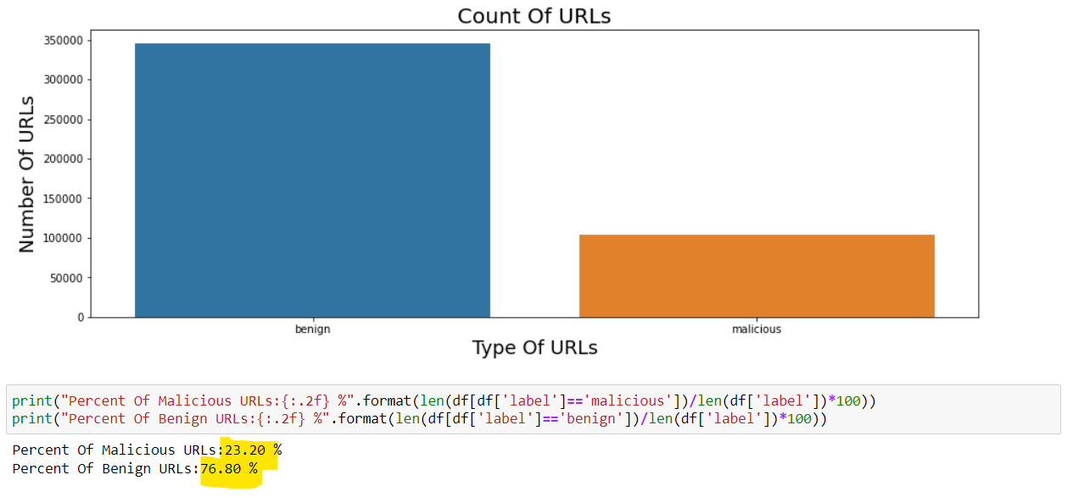
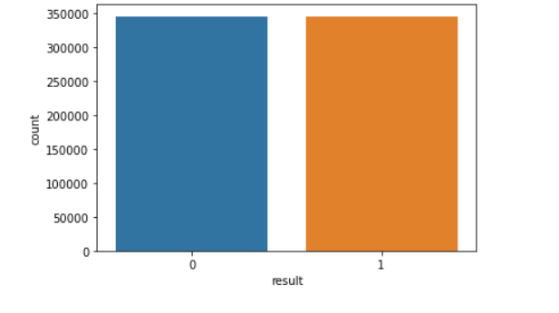
Pre Processing Techniques
Oversampling Technique:
We have observed that the data is slightly imbalanced as the malicious URLs are less (23.20%) than the Benign URLs (76.80%).
We have applied Oversampling Technique where malicious URLs are randomly sampled to match the size of the benign URLs.
Before Oversampling
After Oversampling

Slide 10
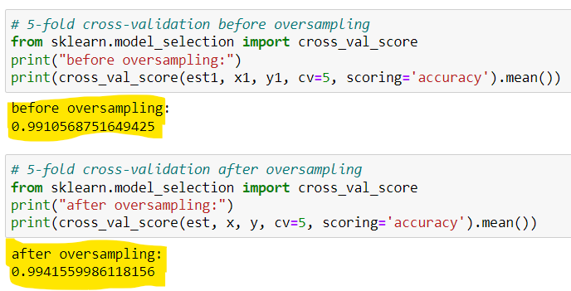
Effect of Oversampling technique

Slide 11
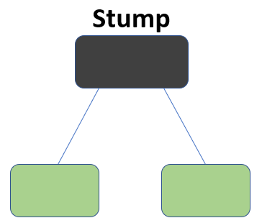
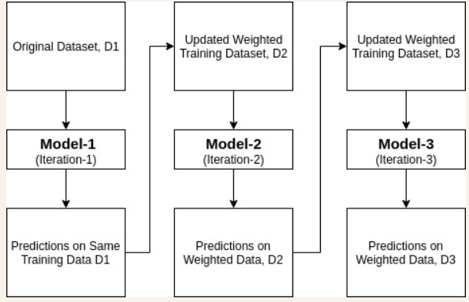
METHODOLOGY
AdaBoost Algorithm:
[5]
[6]

Slide 12
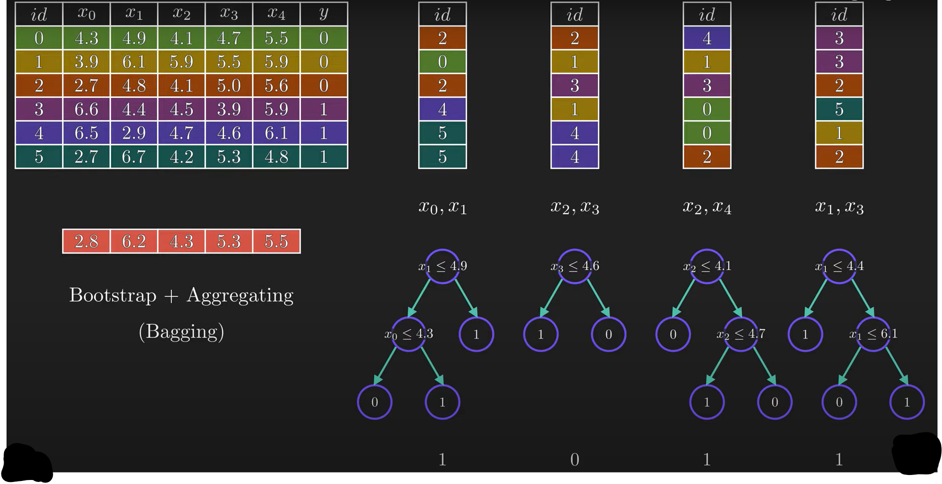
Random Forest Algorithm:
[7]

Slide 13
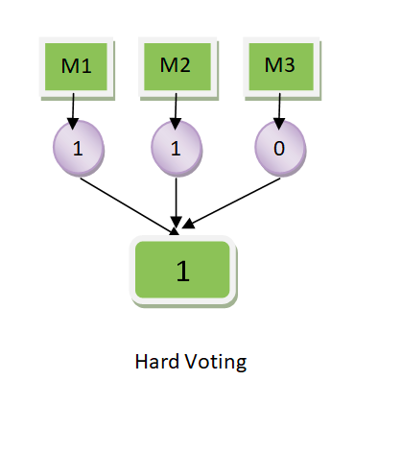
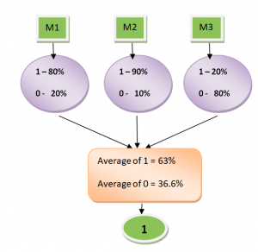
Voting Classifier:
[8]

Slide 14
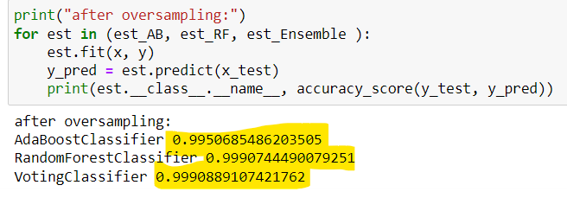
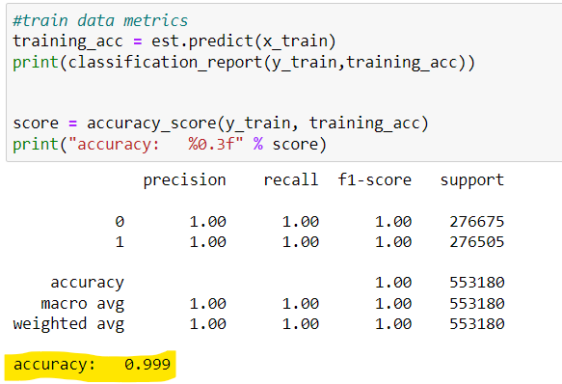
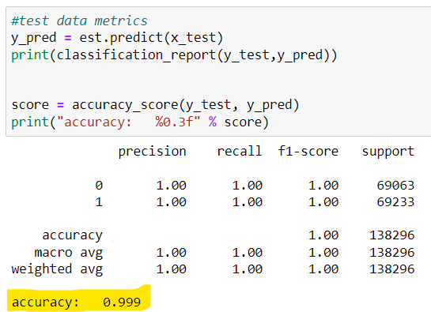
Performance Analysis

Slide 15
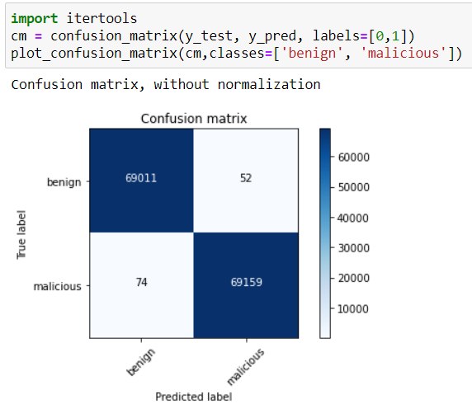
Model Evaluation/Validation

Slide 16
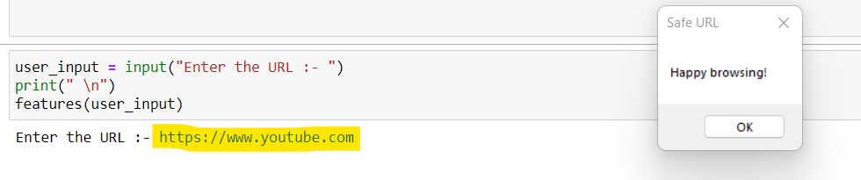
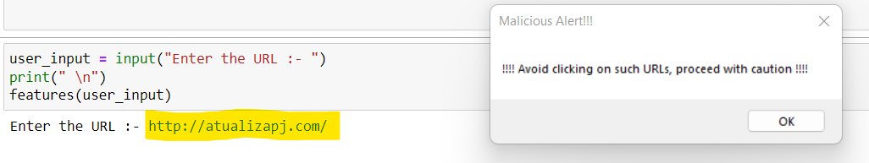
Model Results
Result for Benign URL
Result for Malicious URL

Slide 17
Conclusion
ADVANTAGES:
Machine Learning algorithms are efficient to do binary classification and to detect the malicious URLs.
Advantages of malicious URL detection using a machine learning model is that it accepts the URL as user input and detects and classifies it as benign or malicious one. If the URL is malicious then the alert message box opens stating that “Avoid clicking on such URLs”, else “Safe URL” is printed.
Model does binary classification with 99% accuracy. This model can be used in the cyber security domain and also to avoid digital attacks by knowing the malicious and benign URLs in prior. Safety measures can be taken if the URL is found malicious.
LIMITATIONS:
Every application requires that it should be trained specifically.
Need huge quantity of customized, structured training data.
The Learning model is required to be supervised learning i.e. Training data must be labelled/structured data.
Needs rigorous training.

Slide 18
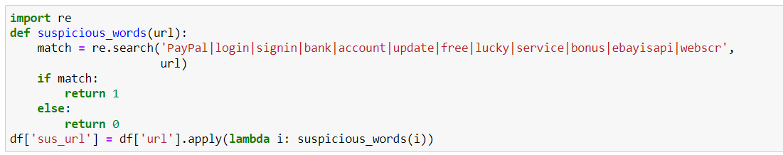
Future Work and Recommendations
To build ready-to-use machine learning models for detection of Malicious URLs.
Blacklisting of malicious URLs that have been detected as malicious ones.
To make domain specific applications based on suspicious words or keywords.
To try out deep learning algorithms
This is an example of how this project can be implemented to specific domains.

Slide 19
References
[1] C.D.N.N.T.V. Xuan, "Malicious URL detection based on machine learning," International
Journal of Advanced Computer Science and Applications, vol. 11, no. 1, pp. 148-153, 2020.
[2]V. V. V. N, "Malicious-URL Detection using Logistic Regression Technique," International
Journal of Engineering and Management Research, vol. 09, no. 06, pp. 108-113, 2019.
[3]R.A.G.S. Naresh, "Malicious URL detection system using combined SVM and logistic
regression model," International Journal of Advanced Research in Engineering and Technology,
vol. 11, no. 4, pp. 63-73, 2020.
[4] C. D. N. N. T. V. Xuan, "Malicious URL detection based on machine learning," International Journal of Advanced Computer Science and Applications, vol. 11, no. 1, pp. 148-153, 2020.
[5] Analytics Vidhya - Adaboost Guide
[6] DataCamp - Adaboost Tutorial
[7] Normalized Nerd - Random Forest Algorithm Explanation
[8] VitaFlux - Hard Voting vs Soft Voting

