Slide 1
Predictive Modeling of Biomechanical Joint Angles via Ensemble Learning

Slide 2
INTRODUCTION
Analyze human gait patterns using multivariate sensor data.
Understand the biomechanical relationship between time and joint angle movements.
Predict joint angles to support diagnosis and rehabilitation in healthcare.
Identify abnormal gait signatures for early detection of mobility issues.
Enhance the interpretation of movement data for clinical and sports applications.

Slide 3
ABOUT DATA SET
The dataset is sourced from the UCI Machine Learning Repository (Multivariate Gait Data).
It contains 181,800 rows capturing real-world human gait movement across various conditions.
Key features include: subject, condition, replication, leg, joint, time, and angle.
Data is collected using wearable sensors placed on different joints during gait cycles.
The angle column (target) represents joint movement and is continuous (regression).
Covers multiple experimental conditions (e.g., flat, incline) for diverse motion analysis.
Enables advanced time-series and multivariate modeling for predictive biomechanics.

Slide 4
DATA CLEANING
Used the IQR method to detect outliers in the angle column and identified 10,762 extreme values.
Handled outliers using RobustScaler to minimize their effect while retaining the core data structure.
Detected right skewness in the angle column with a skew value of 1.38, indicating asymmetric distribution.
Considered log and Box-Cox transformations but retained robust scaling to preserve variance and minimize distortion.
Applied One-Hot Encoding to categorical features and used RobustScaler on the angle column for uniform scaling.

Slide 5
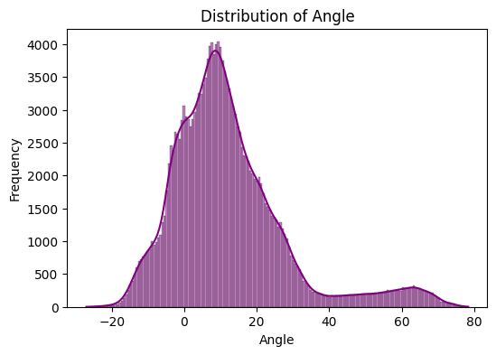
EXPLORATORY DATA ANALYSIS
Angle Distribution by Condition
Different walking conditions affect the angle variation significantly.
Condition 1 shows higher average angles compared to others.

Slide 6
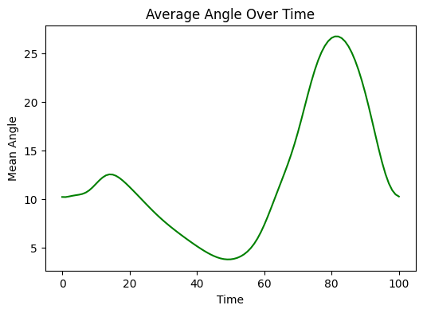
Average Angle Over Time
The average joint angle fluctuates rhythmically over time intervals.
Peak angles occur around mid-time, indicating stride midpoint dynamics.

Slide 7
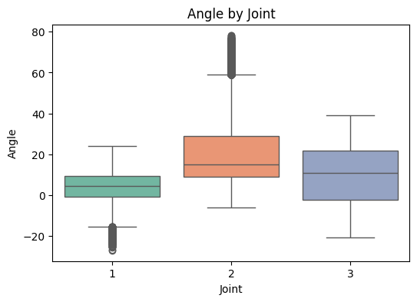
Angle by Joint Type
Hip joints demonstrate wider angle ranges compared to knee and ankle.
Angle values differ clearly between joint types, showing motion diversity.

Slide 8
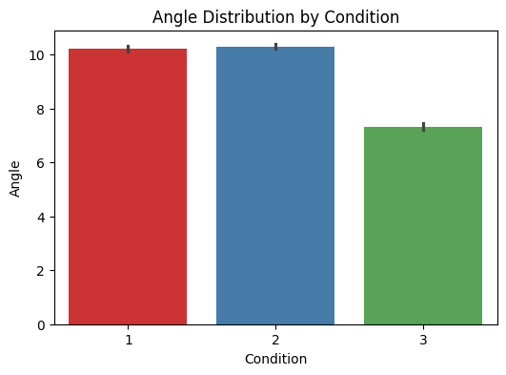
Barplot: Mean Angle by Joint
Hip joints show the highest average angles among all joint types.
Knee and ankle joints exhibit relatively consistent lower mean angles.

Slide 9
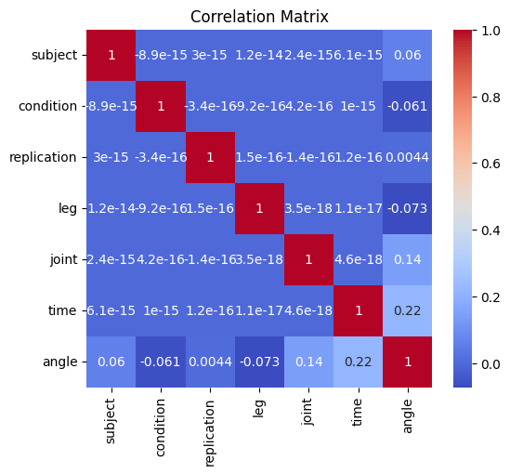
Correlation Heatmap
Angle is weakly correlated with time, indicating temporal variability.
Subject, leg, and joint are uncorrelated with angle (categorical encoded numerically).

Slide 10
DATA PRE-PROCESSING
Categorical columns like subject, condition, replication, leg, and joint were treated as discrete variables.
OneHotEncoder was applied directly using fit_transform to convert categorical data into binary format.
RobustScaler was used to scale numeric features and reduce the effect of outliers.
The target variable angle was used without any scaling or transformation.
All encoded and scaled features were manually combined before model training without using a pipeline.

Slide 11
MODEL DEPLOYMENT
XGBoost Regressor was used for its ability to handle large data, outliers, and complex patterns effectively.
It performs regularization internally, reducing overfitting and improving generalization.
The model was trained using the transformed features and the target variable without a pipeline.
A train-test split ensured reliable evaluation of the model on unseen data.
Model accuracy was assessed using R² and RMSE to validate prediction quality.

Slide 12
MODEL EVALUATION
XGBoost explained over 97% variance in joint angle predictions.
RMSE was low for both training (2.643) and testing (2.693).
Training and testing scores were nearly identical, showing strong generalization.
Predicted vs actual values aligned closely along the diagonal line.
Residuals were normally distributed around zero, indicating low bias.

Slide 13
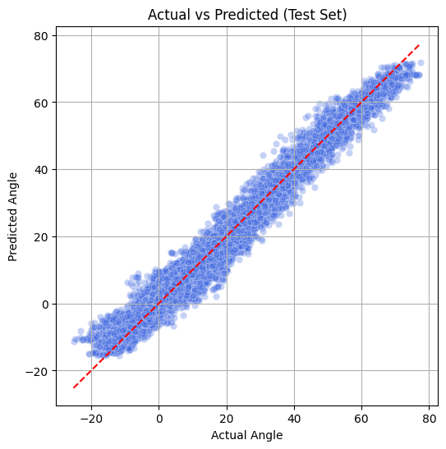
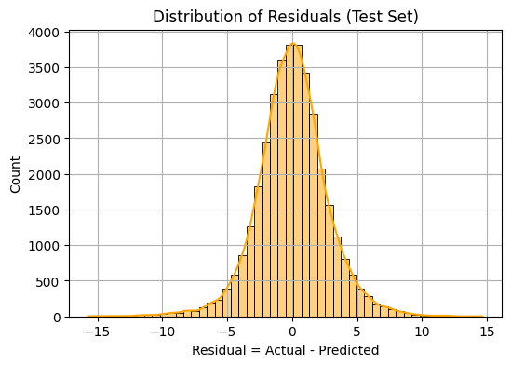
Predicted Vs Actual Angle Plots
Distributions to Residuals of XGBoost Regressor Predicted

Slide 14
CONCLUSION
XGBoost Regressor delivered highly accurate predictions on the gait dataset.
Data preprocessing significantly improved model performance and stability.
The model achieved over 97% R² score, indicating excellent explanatory power.
Low RMSE values confirmed minimal prediction errors across training and testing.
Residual analysis showed a normal distribution, proving unbiased predictions.
Overall, the system is reliable, generalizable, and suitable for real-time joint angle forecasting.

Slide 15
Thank You

