Slide 1
presentation-1
Introduction , ann’s , why deep learning

Slide 2
introduction
In this presentation we will learn about the brief history of ANN’S and how deep learning is used for cyber security.

Slide 3
A brief history of ann’s
ANN’S are computing systems that are inspired from the human brain.
ANN is made of three layers . They are :
1) Input layers
2) Hidden layers
3) output layers

Slide 4
ANN’S are nothing but multi layered perceptrons which act as artificial neurons.
A Perceptron is a neural network unit that does certain computations to detect features or business intelligence in the input data. It is a function that maps its input “x,” which is multiplied by the learned weight coefficient, and generates an output value ”f(x).

Slide 5
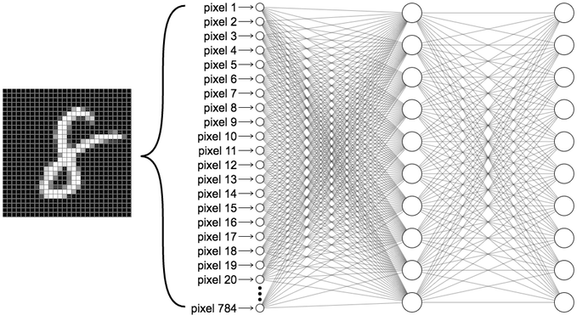

Slide 6
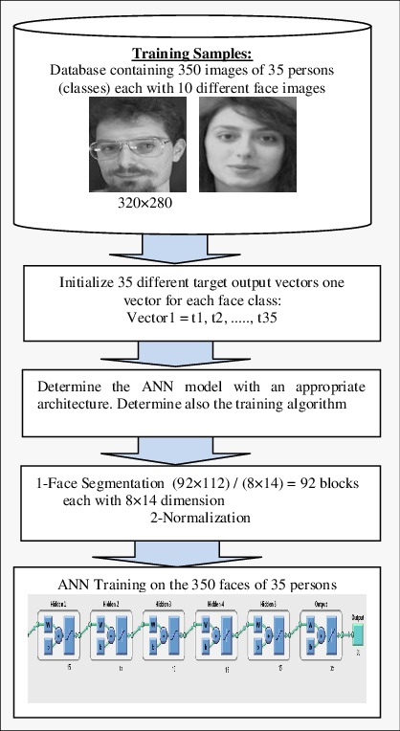
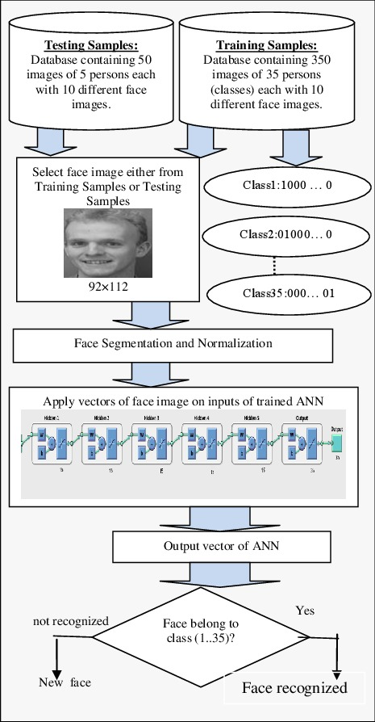
Face recognition ANN

Slide 7
Why deep learning ?
Deep learning is preferred over the machine learning because when the amount of data is huge at certain level machine learning techniques get saturated .
And deep learning techniques are used to overcome the saturation and continue the work.
So deep learning is preferd.

Slide 8
Thank you
-srinesh pendyala

