Slide 1
Assignment 2 – Problem Statement 4
Fine-Tuning a Text-to-Image Model Using Crowd-Sourced Text - Image Pairs
Group 143 Team Members
Courtesy: Slides adopted from Computer Version lecture PPT

Slide 2

Topics
Showing inference (already run code in some env)
Overall project flow
Challenges (including most challenging aspect of problem statement)
Real world use cases and Next Steps (Organization / Daily Life)
3

Slide 3
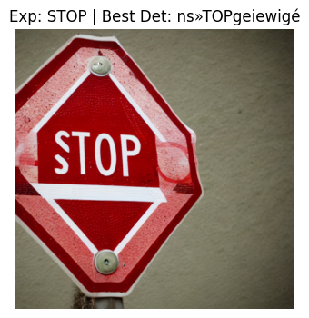
Showing inference (already run code in some env)
In local PC (to be demoed as well)

Slide 4
Overall project flow
Setup environment
Import libraries
Import dataset and perform EDA
Data preprocessing
Model preparation and training
Output generation and evaluation

Slide 5
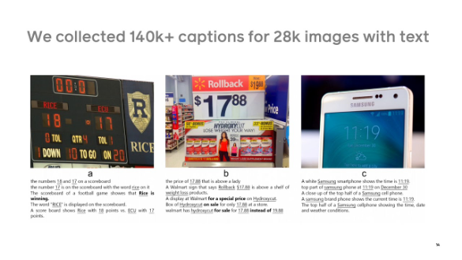
Project Flow – Exploratory Data Analysis
Dataset: TextCaps
Scale: 21,953 training samples containing natural text.
Content: Diverse images (street signs, books, screens) with corresponding captions.
Challenge: High variability in font styles, perspectives, and occlusions.
Preprocessing: Images are "squished" to 512x512 to preserve text features that might be lost in cropping.

Slide 6
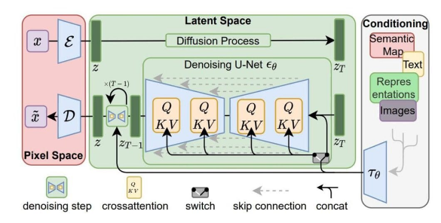
Model Structure
Stable Diffusion + LoRA is used
Base Model: Stable Diffusion v1.5 (RunwayML).
LoRA (Low-Rank Adaptation): Efficient fine-tuning by injecting rank decomposition matrices into the U-Net. Rank 64 used for higher expressivity.
SNR Gamma Weighting: Critical for text. Standard diffusion loss neglects high-frequency details (like text edges) at certain noise levels. Gamma=5.0 forces the model to focus on these structural details.

Slide 7
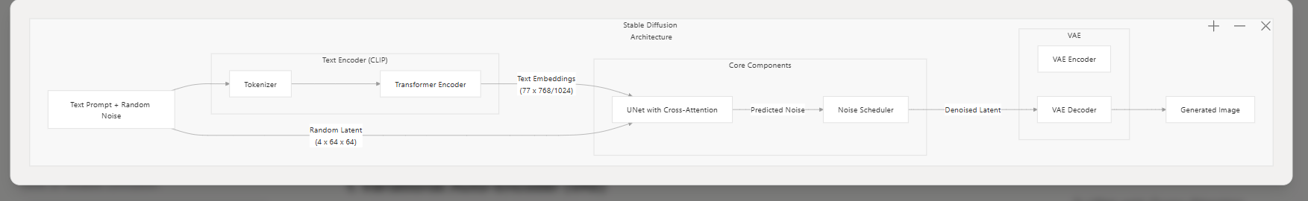
Stable Diffusion Architecture

Slide 8
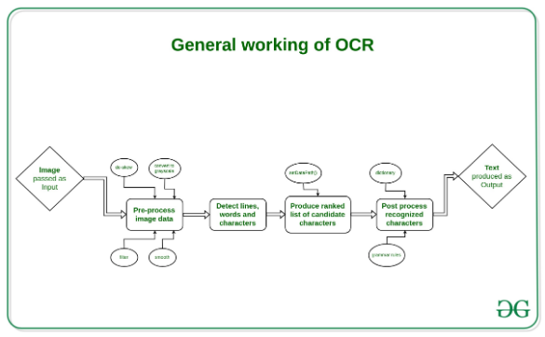
Evaluation Methodology
OCR-Based Metric
Subjective visual inspection is insufficient for text models. We quantify readability using an Optical Character Recognition (OCR) pipeline.
Tool: Tesseract OCR engine applied to generated images.
Sampling: "Best of 3" and "Best of 10" generation strategies to maximize hit rate.
Metric: Intersection of characters between the Prompt and the OCR Output.

Slide 9
Challenges (including most challenging aspect of problem statement)
Choosing the right dataset
  Issues: Some datasets just had images, some with one word captions as identification etc.,
Image samples taken
  If number of images taken are more, then in local PC / Colab things crash. This gives an intuition to think on how to implement this in production environment later.
Model Used
  Stable diffusion v1.5 generates very good images, but there more advanced models in Stable diffusion as well which gives a lot accurate image. It is powerful.
  However, using this model gave a very nice idea of how to implement a text-based rendering + image generation + OCR activity, it gives a feel of providing a Nano Banana proto version as an application ;) that’s one plus point of this assignment
OCR
  Finding right OCR was a bit difficult to us (alternates), although Tesseract is used widely.

Slide 10
Challenges – Contd. (including most challenging aspect of problem statement)
Model related – Gradient optimization (Adam 8 bit vs Adam<>, no. of training samples, LoRA Configuration effects, number of training steps (if less = underfitting, learning rate related – higher one created data loss)
Preprocessing related – Image cropping vs image squishing (impacts on how important words are missed with cropping e.g., CROP may be visible as RO)
Inference stage:
  Stuttering of text generated
  OCR hallucinations

Slide 11
Next steps and how it can be applied in projects
Apply in GenAI related projects, or in any project
  Example 1: Image generation for tutorials from customer support agent
  Example 2: Knowledge sharing across teams, for this images can be created (something like a training agent)
  Example 3: Personal – create similar to Nano Banana with no cost (only PC required)

Slide 12
Live Demo

Slide 13

Our starting point of reference, and model specifics:
          Research paper: https://arxiv.org/abs/2003.12462
        Dataset:
        - (only for understanding domain specifics, not used for assignment): COCO dataset - https://cocodataset.org/
        - Dataset selected: lmms-lab/TextCaps (https://huggingface.co/datasets/lmms-lab/TextCaps)
        Pre-trained model: Stable Diffusion (https://huggingface.co/CompVis/stable-diffusion-v1-4)
        OCR engine: Tesseract OCR
        Evaluation metric: Character-level accuracy (Levenshtein distance)
71

Slide 14

Thank you
72

