Slide 1

Project Phase-II Presentation on “Market Basket Analysis With Customer Profiling And Exploratory Analysis Using Data Mining”
Student:
B R Sriniketan
(1RN14CS017)
K S Koushik (1RN14CS044)
Guide:
Prof. Reshma Jakabal
Asst. Prof. Dept. of CSE, RNSIT
Department of Computer Science and Engineering
RNS Institute of Technology

Slide 2
CONTENTS
INTRODUCTION
MARKET BASKET ANALYSIS
DATASETS
EXPLORATORY ANALYSIS
CONCLUSION
REFERENCES

Slide 3
INTRODUCTION
An E-commerce site that sells items such as groceries, beverages, produce and others.
The site can only store data for accounting and bookkeeping but is unused for sales.
Sales are dull. They required computerized sales information system that can help facilitate the sales process and the recording of sales transactions (memorandum) to the customer.
In turn, must help accountants for bookkeeping and sales should increase.
The Question is: HOW?

Slide 4
MARKET BASKET ANALYSIS
It is a process that can determine customer buying patterns by finding relationships between different items in a sales transaction.
Market basket analysis analyzes the buying habits of customers as to which products are tend to be purchased together.
The results that have been obtained can be used by retails such as E-commerce/ Supermarket develop a marketing strategy to see the items that may be purchased simultaneously by consumers.
The possible percentage of the relation of combined items gives the new knowledge so therefore it is very useful for the determiner to take the decision.
One of the best examples are, SuperMarket.

Slide 5
Market Basket Analysis….
A Coffee Analogy is used to understand how Market Basket Analysis works.
Assume a customer makes a list of products. Customer wants to buy in a supermarket. The customer enters into the Supermarket and buys the Bread. He sees Milk beside the Bread section and realises to buy Milk too. Then, he sees the coffee powder near Milk section. The customer wondered, who has systematically arranged what he wants?
Let’s assume that we analyzed customers’ transactions and realized that “many of them”, if they had Bread in their baskets, they also have Milk!

Slide 6
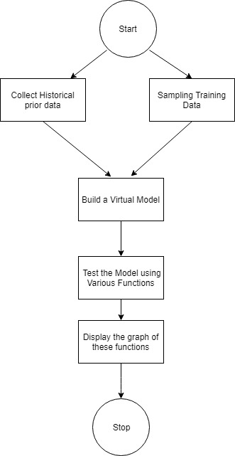
Architecture

Slide 7
DATASETS
The Datasets used for Exploratory Analysis are :
AISLES.CSV
DEPARTMENTS.CSV
ORDER_PRODUCTS_PRIOR.CSV
ORDER_PRODUCTS_TRAIN.CSV
ORDERS.CSV
PRODUCTS.CSV

Slide 8
Exploratory Analysis
Exploratory Data Analysis (EDA) is an approach to analyzing data.
The EDA approach is precisely that--an approach--not a set of techniques, but an attitude/philosophy about how a data analysis should be carried out.
The particular graphical techniques employed in EDA are often quite simple, consisting of various techniques of:
Plotting the raw data (such as Data traces, Histogram,Bihistograms, Probability plots, Lag plots, Block plots, and Youden plots.
Plotting simple statistics such as Mean plots, Standard deviation, Box plots and main effects plots of the raw data.
Positioning such plots so as to maximize our natural pattern-recognition abilities, such as using multiple plots per page.

Slide 9
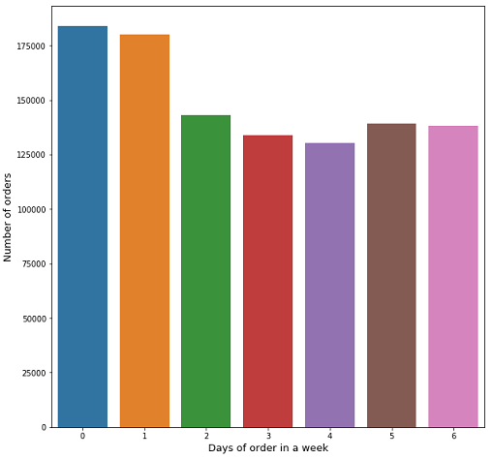
Exploratory Analysis…
For example: Days of order in week, based on datasets.

Slide 10
Exploratory Analysis…
From the previous graph we get to know, People usually order at days 0 and 1 (days and probably the week end)
Potential uses of this are wide-ranging, but ultimately, it boils down to this: exploratory data analysis is about getting to know and understand your data before you make any assumptions about it.
It helps you avoid accidentally creating inaccurate models, or building accurate models that are built on the wrong data.

Slide 11
CONCLUSION
Data mining technology is application-oriented from the beginning.
It is not only a simple specific-database search and call, but also includes the data statistics, analysis, synthesis and reasoning from the angle of micro, micro or even macro.
The purpose is to guide the actual problem solving and attempt to find linkages between events, and even to predict future activity on basis of the existing data.
Future Work:
Recommendation Recipe using output of the Exploratory Data Analysis
Building an E-commerce site based on the Model-Based Analysis

Slide 12
REFERENCES
[1] N. Rifai and K.A. Gupta, “Bussiness Intelligence,” Class assignment,
Faculty of Industrial Engineering, Bandung Institute of Technology,
Bandung (Indonesia).
[2] J. Han and M. Kamber, Data Mining: Concepts and Techniques, 1st
ed., USA: Morgan Kauffman.
[3] Kusrini and E.T. Luthfi, Algoritma Data Mining [Data Mining
Algorithms], Yogyakarta (Indonesia): Andi Publisher.
[4] P. Giudici and S. Figini, “Market Basket Analysis,” in Applied Data
Mining for Business and Industry, 2nd ed., Chichester (UK): John
Wiley & Sons, ch. 7, doi: 10.1002/9780470745830.ch7.
[5] M.B. Romney and P.J. Steinbart, Accounting Information Systems,
12th ed., New Jersey (NJ, USA): Prentice Hall.
[6] https://www.Wikipedia

Slide 13
Questions???

Slide 14
THANK YOU!!!

