Slide 1
CREDIT EDA CASE STUDY
Srinivasaragavan Vijayaraghavan

Slide 2
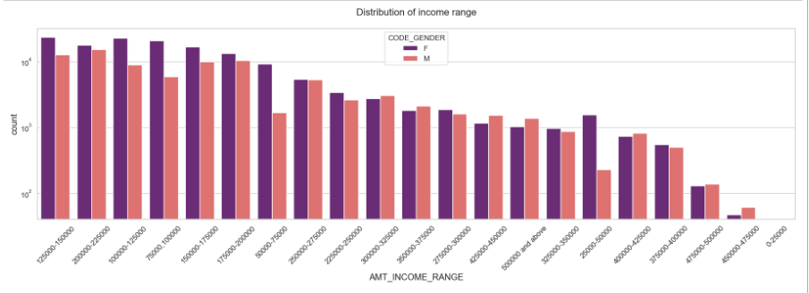
Uni-variate analysis for categories for Target - 0 ( Client with no payment difficulties )
Inferences and insights from the above plot :
Female counts are higher than male.
Income range from 100000 to 200000 is having more number of credits.
This graph show that females are more than male in having credits for that range.
Very less count for income range 400000 and above.

Slide 3
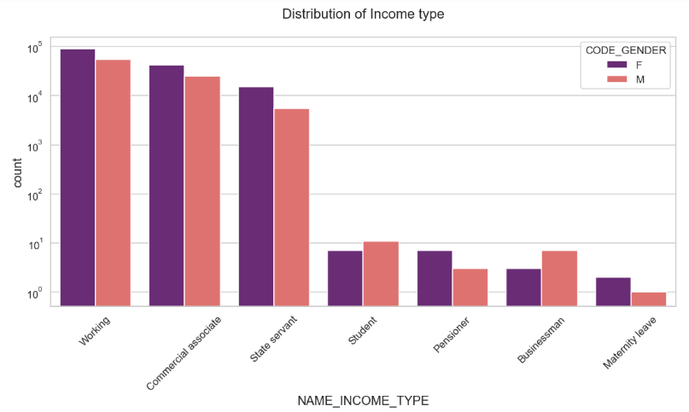
DISTRIBUTION OF INCOME RANGE
Insights Derived from the above plot :
For income type ‘working’, ’commercial associate’, and ‘State Servant’ the number of credits are higher than others.
For this Females are having more number of credits than male.
Less number of credits for income type ‘student’ ,’pensioner’, ‘Businessman’ and ‘Maternity leave

Slide 4
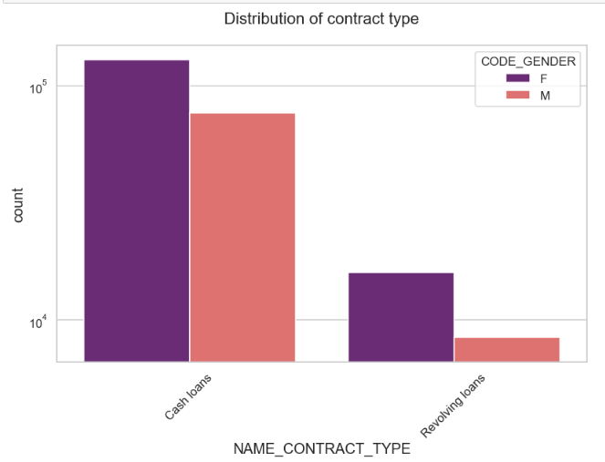
Distribution for contract type
Insights Derived from the above plot :
For contract type ‘cash loans’ is having higher number of credits than ‘Revolving loans’ contract type.
Female is leading for applying credits.

Slide 5
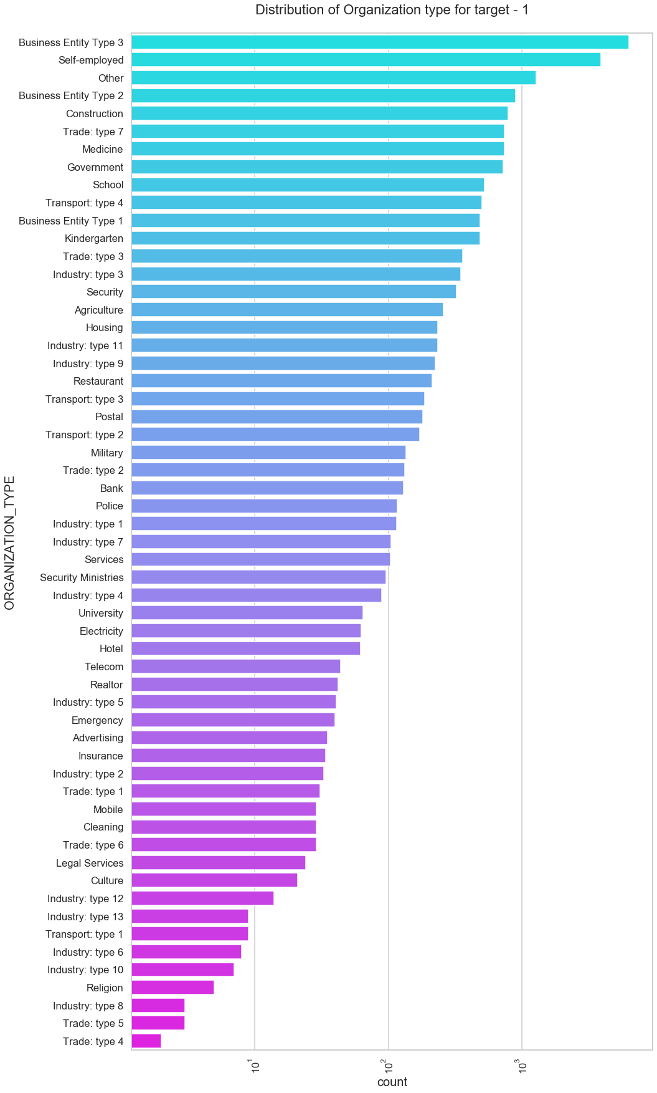
Distribution of Organization for Target-1(Client with payment difficulties)
Insights inferred from the above plot
Clients which have applied for credits are from most of the organization type
‘Business entity Type 3’ , ‘Self employed’, ‘Other’
Less clients are from Industry type 4,type 8, type 5, religion and trade type 10, type 6

Slide 6
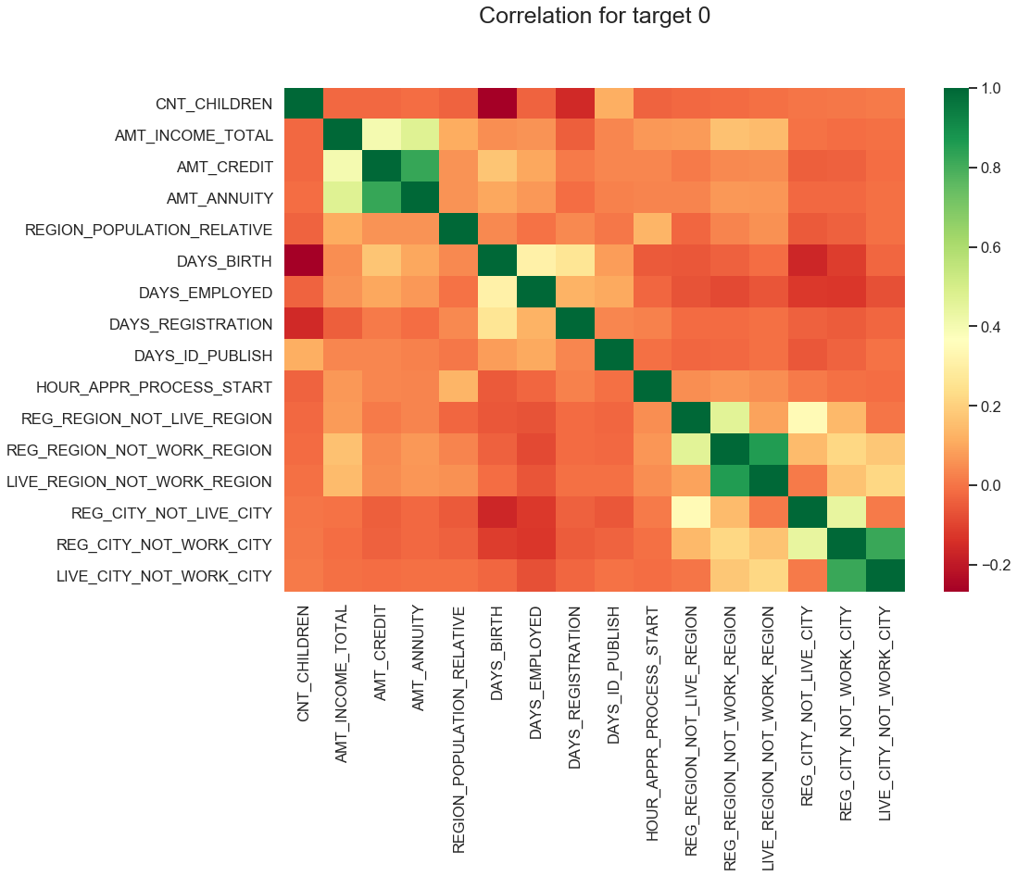
Correlation for Target 0
As we can see from above correlation heatmap, There are number of observation we can point out
Credit amount is inversely proportional to the date of birth, which means Credit amount is higher for low age and vice-versa.
Credit amount is inversely proportional to the number of children client have, means Credit amount is higher for less children count client have and vice-versa.
Income amount is inversely proportional to the number of children client have, means more income for less children client have and vice-versa.
less children client have in densely populated area.
Credit amount is higher to densely populated area.
The income is also higher in densely populated area

Slide 7
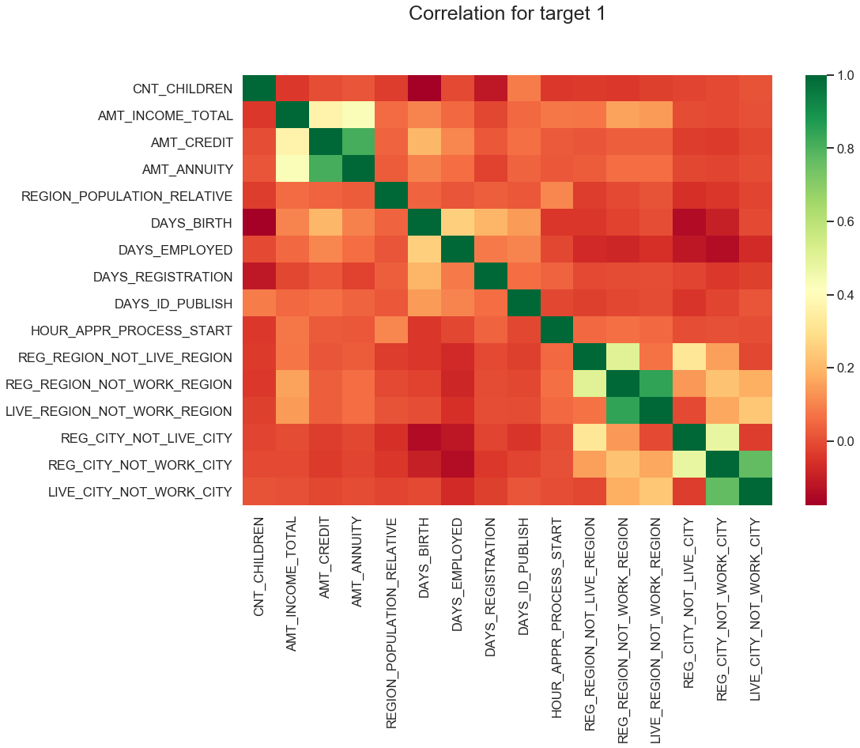
Correlation for Target-1
This heat map for Target 1 is also having quite a same observation just like Target 0. But for few points are different. They are listed below.
The client's permanent address does not match contact address are having less children and vice-versa
The client's permanent address does not match work address are having less children and vice-versa

Slide 8
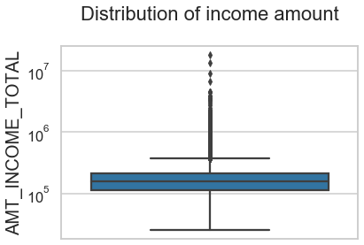
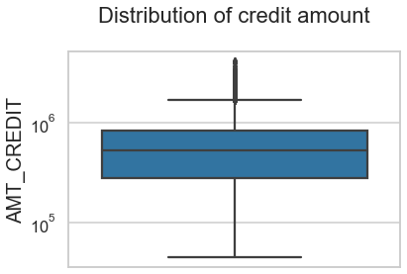
For Target-0 Univariate Analysis check outliers using Boxplot
Few points can be concluded from the graph above.
Some outliers are noticed in income amount.
The third quartiles is very slim for income amount.
Few points can be concluded from the graph above.
Some outliers are noticed in credit amount. The first quartile is bigger than third quartile for credit amount which means most of the credits of clients are present in the first quartile.

Slide 9
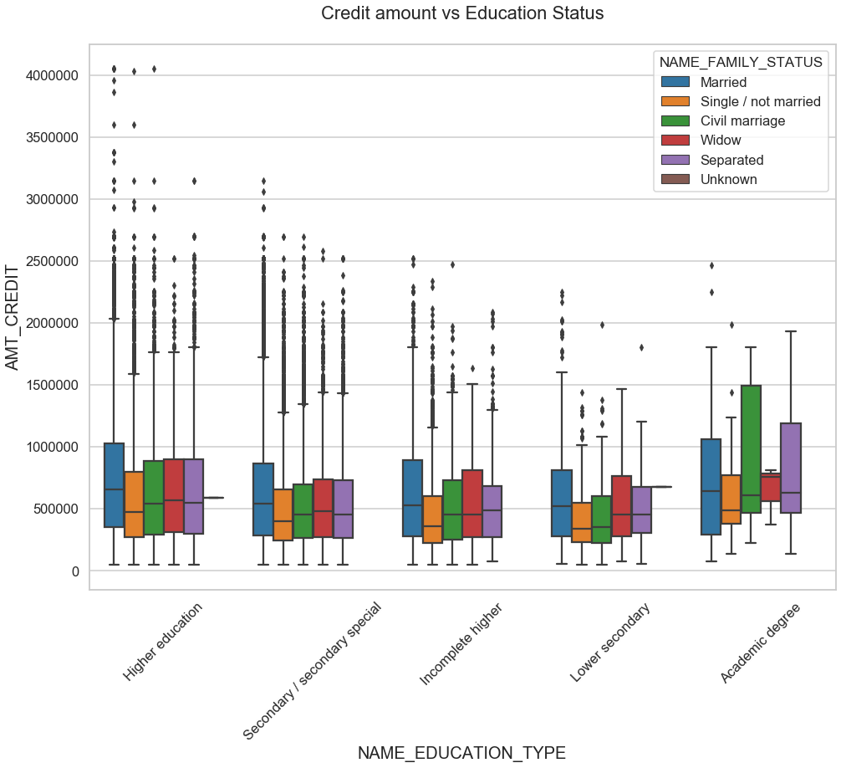
Bivariate analysis for Target 0
From the above box plot we can conclude that Family status of 'civil marriage', 'marriage' and 'separated' of Academic degree education are having higher number of credits than others. Also, higher education of family status of 'marriage', 'single' and 'civil marriage' are having more outliers. Civil marriage for Academic degree is having most of the credits in the third quartile.

Slide 10
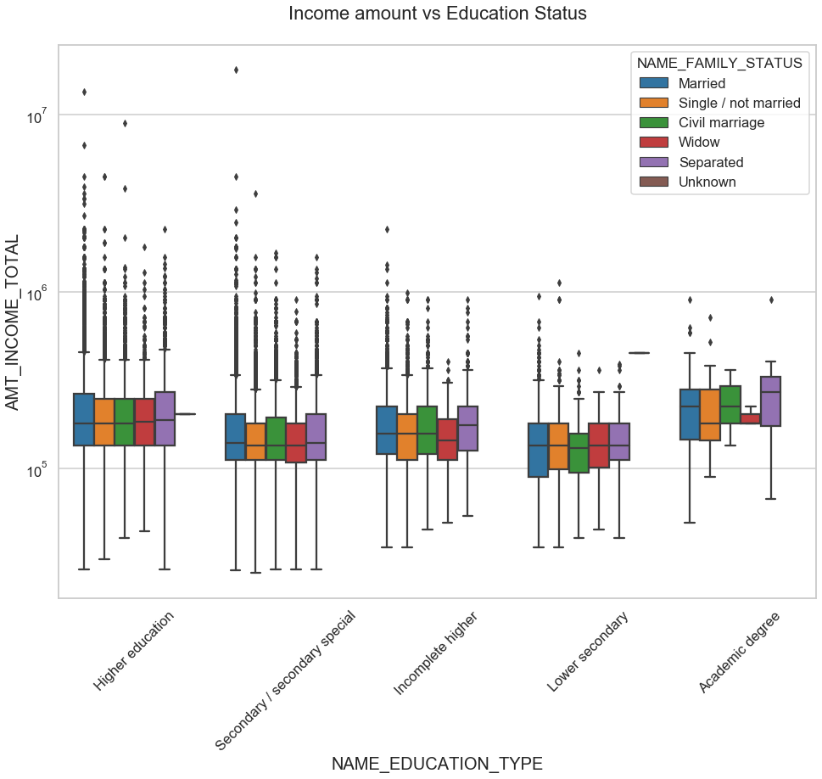
Bivariate analysis between Income vs Education for
Target 0
From above boxplot for Education type 'Higher education' the income amount is mostly equal with family status. It does contain many outliers. Less outlier are having for Academic degree but there income amount is little higher that Higher education. Lower secondary of civil marriage family status are have less income amount than others.

Slide 11
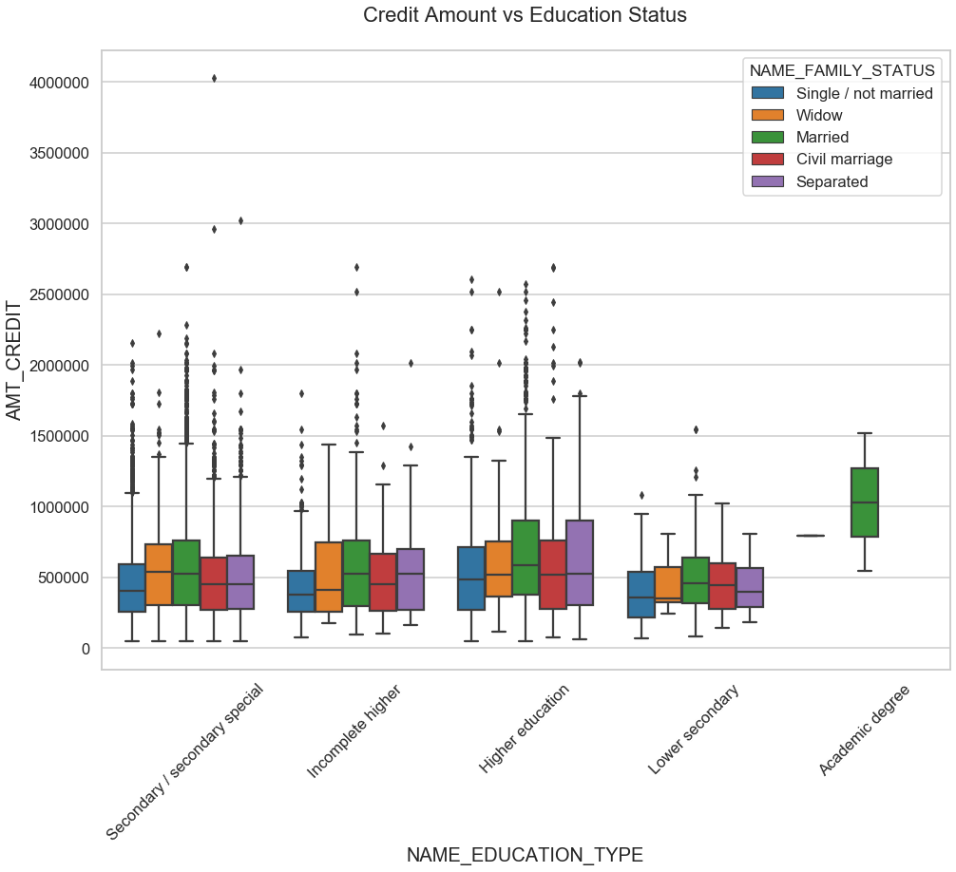
Bivariate analysis between Credit amount vs Education for Target 1
There is a difference here when compared to Target-0 with Target 1 .
Only Married family status people in having an academic degree have higher credit than other categories.
We could see lot of outliers in other categories such as secondary,Incomplete Higher,Higher Education , Lower Secondary
People seperated with higher education background have high credits as their third quartile is bigger when compared with other categories and their counterparts

Slide 12
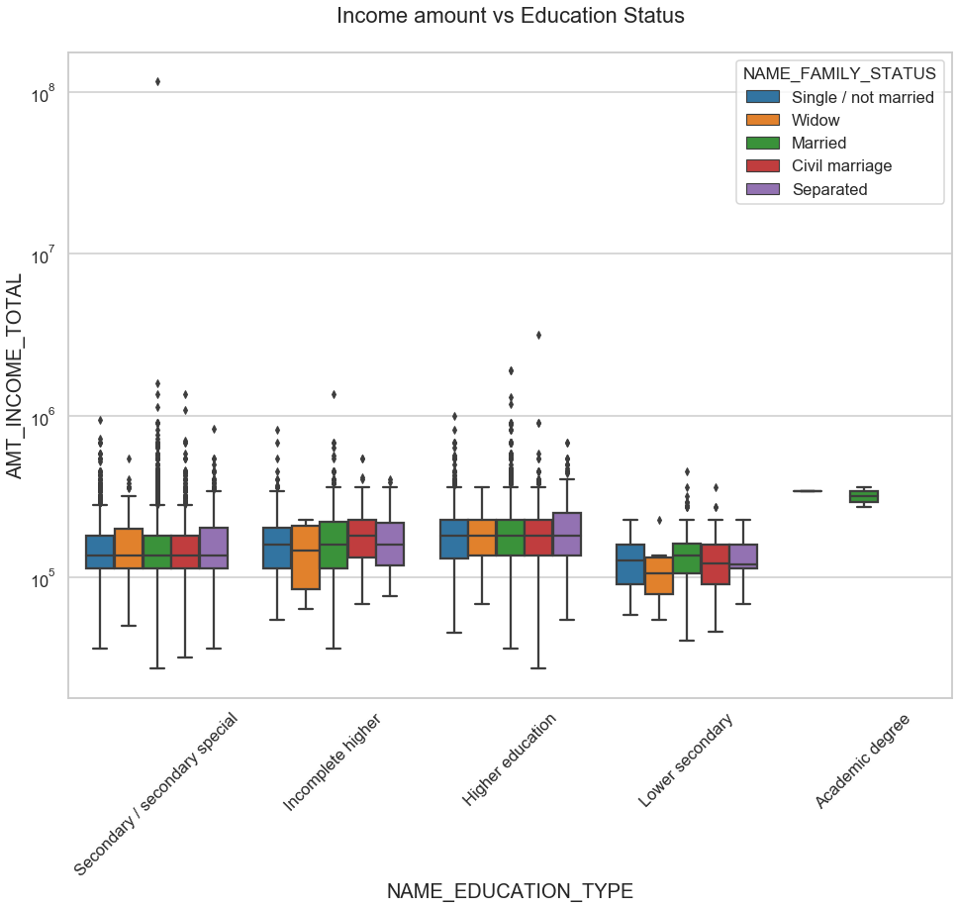
Bivariate analysis between Income amount vs Education for Target 1
From the above plot ,we could see that married customer with Academic Degree are the once who have high income than all other categories. We also could not spot any outliers in academic degree.
Most customers of different family status with lower secondary have low income when compared to all others
Customer who are Widow and of incomplete higher Education has the least income among all others.

Slide 13
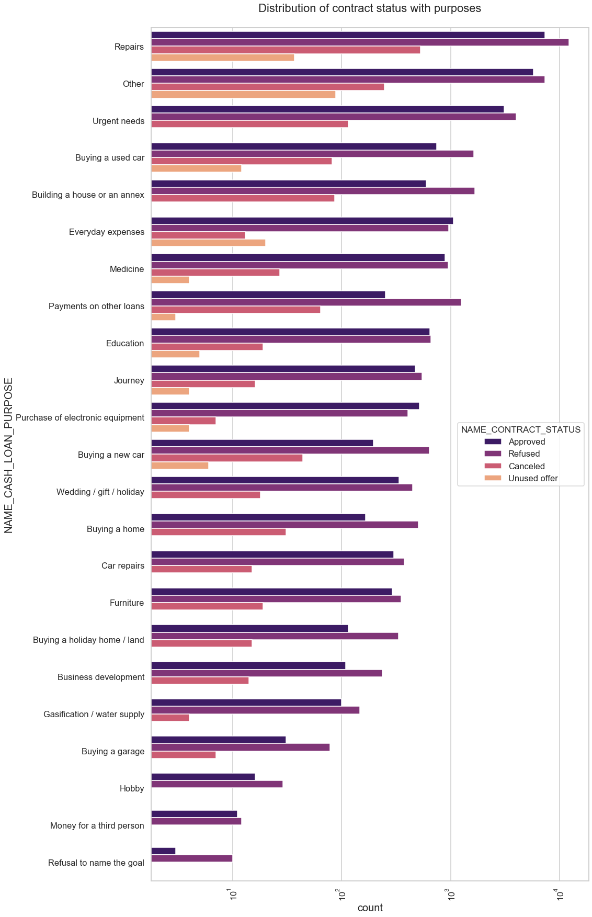
Performing Univariate Analysis for Merged Dataset
Points to be concluded from above plot:
Most rejection of loans came from purpose 'repairs'.
For education purposes we have equal number of approves and rejection
Paying other loans and buying a new car is having significant higher rejection than approves

Slide 14
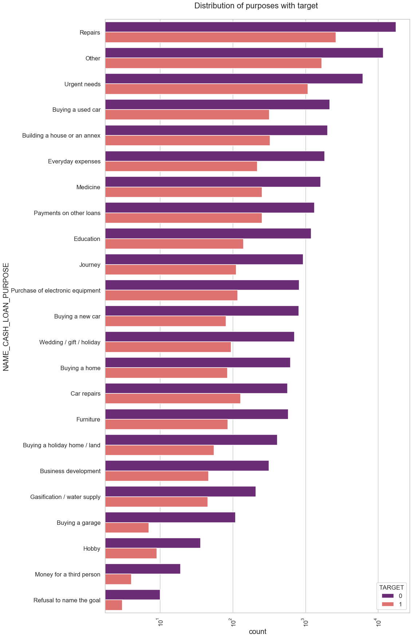
Performing Univariate analysis for Merged Dataset
Few points we can conclude from above plot:
Loan purposes with 'Repairs' are facing more difficulties in payment on time.
There are few places where loan payment is significant higher than facing difficulties.
They are 'Buying a garage', 'Business development', 'Buying land','Buying a new car' and 'Education.
Hence we can focus on these purposes for which the client is having for minimal payment difficulties.

Slide 15
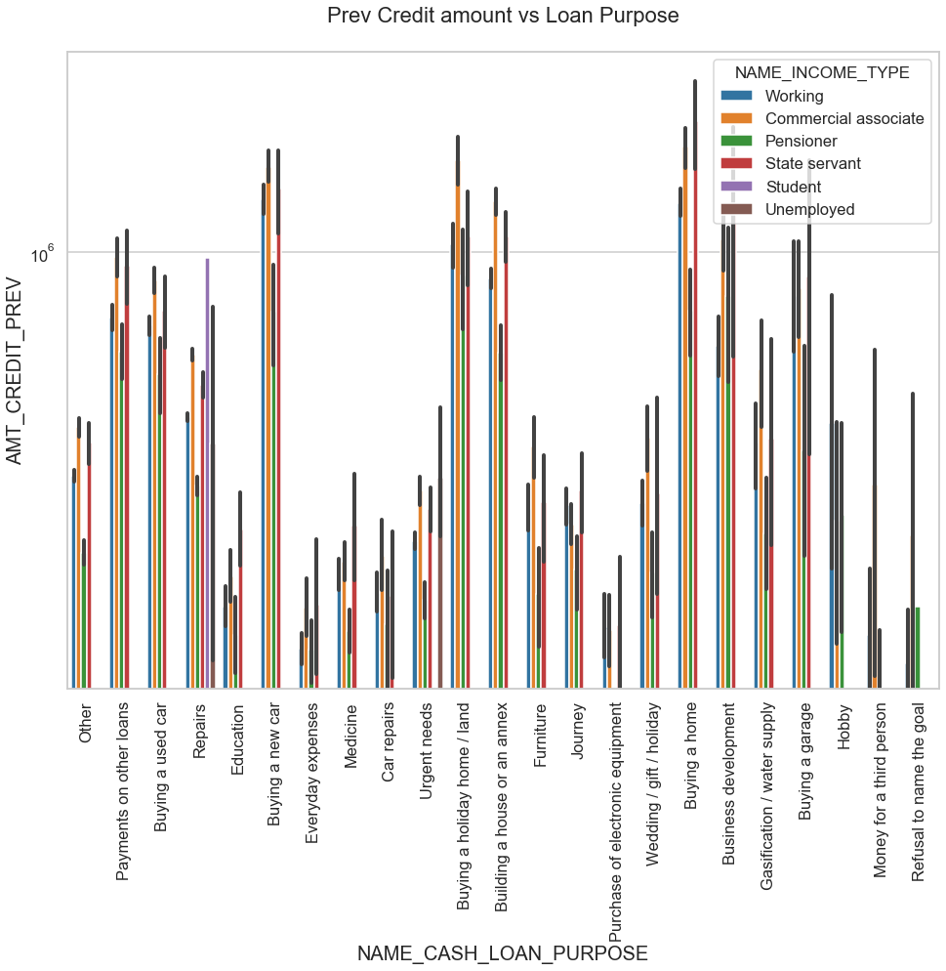
Performing Bivariate analysis for Merged Dataset
From the above we can conclude some points-
The credit amount of Loan purposes like 'Buying a holiday home','Buying a land','Buying a new car' and 'Building’ a house' is higher.
Income type of state servants have a significant amount of credit applied
Money for third person or a Hobby is having less credits applied for

Slide 16
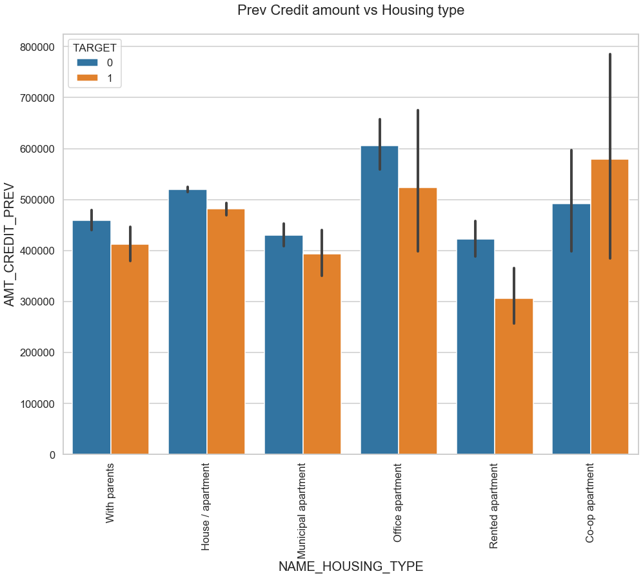
Performing Bivariate analysis for Merged Dataset
Here for Housing type, office apartment is having higher credit of Target 0 and co-op apartment is having higher credit of Target 1.
So, we can conclude that bank should avoid giving loans to the housing type of co-op apartment as they are having difficulties in payment. Bank can focus mostly on housing type with parents or House\apartment or municipal apartment for successful payments

Slide 17
CONCLUSION
1. Banks should focus more on contract type ‘Student’ ,’pensioner’ and ‘Businessman’ with housing ‘type other than ‘Co-op apartment’ for successful payments.
2. Banks should focus less on income type ‘Working’ as they are having most number of unsuccessful payments.
3. Also with loan purpose ‘Repair’ is having higher number of unsuccessful payments on time.
4. Get as much as clients from housing type ‘With parents’ as they are having least number of unsuccessful payments.

