Slide 1

Predicting House Prices using Machine Learning IBM AI GROUP 1
DEPARTMENT OF ELECTRONICS AND COMMUNICATION ENGINEERING
TEAM MEMBERS
SANDHIYA B(113321106080)
SRINIDHI M(113321106093)
SAI PREETHI (1133211066)
SHARADA S(113321106096)
PAPITA BISWAS(113321106078)

Slide 2
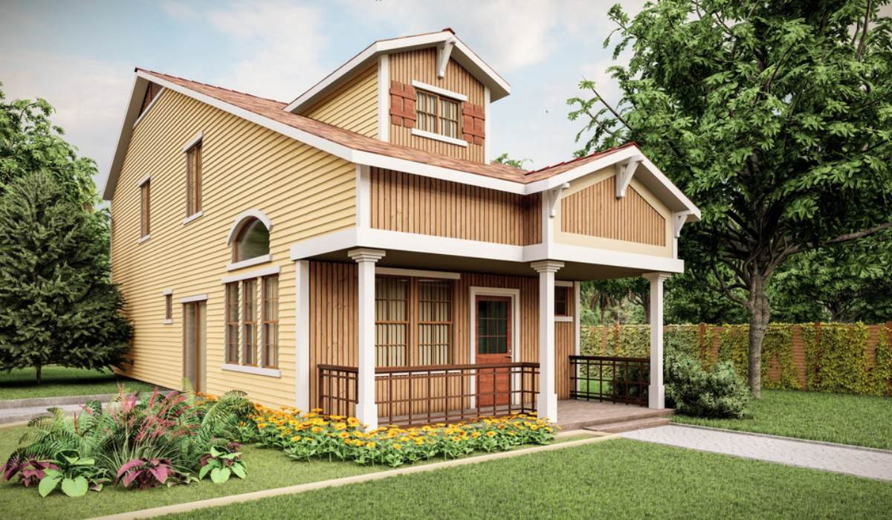
Introduction to the Problem
The Challenge
There's no one-size-fits-all formula to determine a home price. We will explore different algorithms and models to help solve this problem.

Slide 3
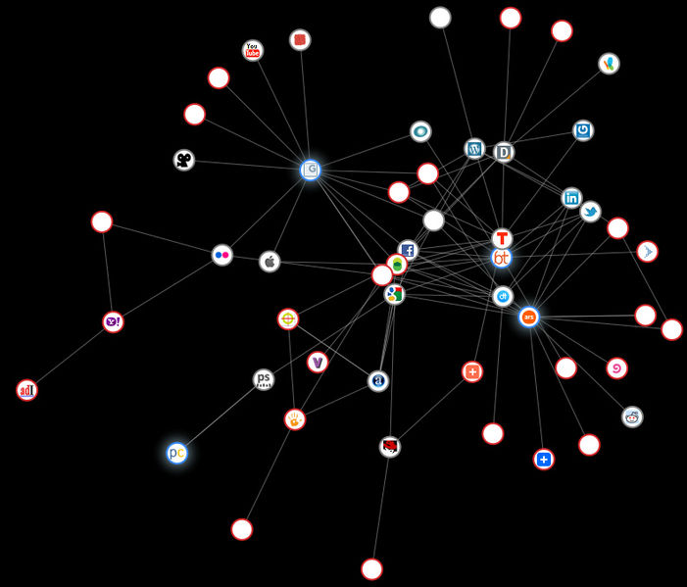
The Solution
By leveraging machine learning, we can eliminate guesswork — and the risk that comes with it — from pricing a home.

Slide 4

The Impact
Our approach ensures that potential homebuyers and sellers have access to accurate information that will enable them to make data-driven decisions.

Slide 5
Exploring the Dataset
Data Collection
We collected housing data from various sources including publicly available data, third-party agencies and private real estate companies.
Data Preprocessing
Using Python, we cleaned and merged our data through a number of techniques like data normalization and data transformation.
Data Visualization
To help us better understand key trends and patterns in the data, we explored them through visualizations like histograms and scatterplots.

Slide 6
Feature Selection and Engineeringture
1. Selection
Through trial and error, we identified the most significant features for predicting home prices such as location, square footage and number of bedrooms.
2. Feature Engineering
We also created new features like distance from nearest transportation hub, weather conditions and employment opportunities to improve model accuracy.
3. Normalization and Scaling
To ensure that features were on the same scale, we used various techniques like standardization and min-max normalization.

Slide 7
Model Selection and Training
Linear Regression
Simple yet powerful, linear regression is a good starting point for predicting home prices.
K-Nearest Neighbor
This algorithm is best suited for small datasets, where we can use distance metrics to calculate the similarity between data points.
Random Forest
One of the most popular algorithms for regression, random forest can help us overcome the challenges of overfitting and multicollinearity in a big dataset.

Slide 8
Model Evaluation and Fine-Tuning
Merits for performance evaluation
.focus on the predictive capability of a model rather than how fast it takes to classify or built models,scalability,etc..
Evaluation Metrics
Accuracy, root mean squared error and R-squared are typical metrics for regression models that help us evaluate the performance of our model.
PREDICTED CLASS
ACTUAL CLASS |  | Class -yes | Class-no
 | Class-yes | a: IP | b: FN
 | Class-no | c:FP | d: TN

Slide 9
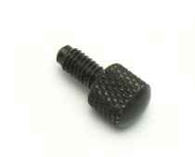
Fine-Tuning Parameters
We fine-tuned the parameters of our models to optimize their performance and avoid overfitting through techniques like cross-validation, regularization and grid search.
Compare Models
We compared the performance of different models to understand which ones are best suited for predicting house prices.

Slide 10
Deploying the Model
Web Application
We created a web application to make our models more accessible to the public with the help of Flask, a Python web application fram
Hosting
We used GCP (Google Cloud Platform) and AWS (Amazon Web Services) to host our model and web application.
API
We also used REST API or GraphQL API to allow other developers to use our model in their applications.

Slide 11
Conclusion and Future Work
Conclusion
We successfully developed and deployed a model to predict home prices using machine learning. Our model could provide more accurate predictions than traditional methods.
Future Work
In the future, we could improve the model by adding more advanced machine learning algorithms, adding real-time data from MLS and expanding the market to other regions.

Slide 12
THANK YOU

