Slide 1
ISM 6225 Distributed Information Systems
Network Security and computing infrastructures
Based on Agrawal and Sharma, Prospect Press

Slide 2
Contents
Definition of information security
Role of network security
Vulnerabilities, threats and controls
Network security controls for outgoing information
Network security controls for incoming information

Slide 3
Definition
Network security is a component of information security
Information security provides to information, the required levels of
Confidentiality
Integrity
Availability

Slide 4
Information security components
Confidentiality means preserving authorized restrictions on information to protect personal privacy and proprietary information
Integrity is to guard against improper modification or destruction of information, and ensures authenticity of information
Availability is to ensure timely and reliable use of information

Slide 5
Why information security matters
US economy increasingly reliant on services and information processing
E.g. Design, software development
IT constitutes 18.3% of S&P 500 by market cap
Most corporate information now stored only on computer systems
No paper records
Workflows increasingly dependent upon information systems

Slide 6
General information security model

Slide 7
Information security model components
Vulnerabilities
Weaknesses in an information system that could be exploited. E.g. running insecure services
Threats
Capabilities, intentions, and attack methods of adversaries to cause harm to information. E.g. SQL injection
Controls

Slide 8
Definition
Network security is the provision of information security in the presence of dangers created by computer networks
Incoming data may hack into systems to read data, modify data or to disable systems
Outgoing data may be read (confidentiality), modified (integrity) or simply blocked (availability)

Slide 9
Why network security matters
Large parts of nation’s infrastructure connected to the network
Electricity grid, payment systems
Damage can be very expensive
Hackers used weak wireless network security to steal information on over 40 million credit cards from T J Maxx
Company initially provisioned $480 million to settle claims

Slide 10
Network security controls by category
Category | Incoming information | Outgoing information
Confidentiality | Patching, authentication and authorization | Encryption
Integrity | Firewalls | Digital signatures
Availability | Virus protection, end user training | Redundancy

Slide 11
Patching
Software is very complex
Vulnerabilities are common
Developers issue updates when vulnerabilities become known
Called patches
Timely application of patches prevents many exploits
Automatic updates can be used in small organizations

Slide 12
Authentication and authorization
Authentication is the verification of claimed identity
Username and password are common methods of authentication
Authorization grants rights to users to read, write and manipulate specific information
Employees are only given keys to rooms where they need to be
Similarly, computer users should only be allowed to use computers in specified ways

Slide 13
Good passwords
Good passwords prevent intruders from being able to guess passwords.
Recommendations from Microsoft:
Include characters other than just the alphabets
Actual names or words should be avoided
Passwords should be longer than 8 characters
Passwords should be changed regularly
Also
Password reuse should be avoided, especially across financial sites
E.g. Mark Zuckerberg password leak incident
Password “dadada” reused across LinkedIn, Twitter and Pinterest

Slide 14
Firewalls
Computer that lies between two networks and regulates traffic between networks
Protects internal network from electronic attacks originating from external network

Slide 15
Firewalls
Examine every packet entering or leaving the network
Administrators can specify which packets can pass the firewall
Other packets are blocked
Typically use IP addresses (source and destination) and destination port addresses

Slide 16
Firewalls
First steps
Block insecure services (eg. telnet, ftp)
Block blacklisted networks
Allow access to trusted services
E.g. SSH
Allow access to safe services
E.g. web, DNS, email

Slide 17
Firewalls – common configuration
Public services are located in de-militarized zone
Accessible to all safe users
Internal network blocked to outside world

Slide 18
Anti-virus programs
Viruses and worms are programs that cause harm to computers
Worms are self-contained
Viruses use other programs to replicate
Of all threats, viruses cause the greatest financial losses to organizations
Modern viruses attack most targets within minutes of being launched
Patching eliminates many targets for worms
Anti-virus programs should be constantly updated

Slide 19
End user training
Important component of all security efforts
Not just network security or information security
Suspicious looking email may carry a virus
Do not open out of curiosity
Be very careful with email attachments
May carry viruses in macros
Only provide usernames and passwords on trusted web sites

Slide 20
Encryption
Rendering information unintelligible in a way so that it may later be restored to intelligible form
Readable information is called plaintext
Encrypted information is called ciphertext
Involves 2 components: Algorithm and key
Algorithm is the process to create ciphertext
Key controls operations of algorithm
2 broad types: symmetric key, asymmetric key

Slide 21
Encryption

Slide 22
Symmetric key encryption
Same key used for encryption and decryption
Example
cat → dbu
Encrypted character = plaintext character + 1
Decrypted character = encrypted character – (+1)
dog → ?
Current standard: Advanced Encryption Standard (AES)
Major problem: How do you exchange the key?

Slide 23
Asymmetric key encryption
Key exchange over network is unsafe in symmetric key encryption
Enemies can read key when it is transmitted
Asymmetric key encryption uses one key for encryption and another key for decryption
Encryption key made public
Hence, also called public key encryption
Most asymmetric key encryption algorithms use modulus operation
e.g. 21 mod 10 = 1

Slide 24
Asymmetric key encryption example
Plain text
 | 0 | 1 | 2 | 3 | 4 | 5 | 6 | 7 | 8 | 9
0 | 0 | 0 | 0 | 0 | 0 | 0 | 0 | 0 | 0 | 0
1 | 0 | 1 | 2 | 3 | 4 | 5 | 6 | 7 | 8 | 9
2 | 0 | 2 | 4 | 6 | 8 | 0 | 2 | 4 | 6 | 8
3 | 0 | 3 | 6 | 9 | 2 | 5 | 8 | 1 | 4 | 7
4 | 0 | 4 | 8 | 2 | 6 | 0 | 4 | 8 | 2 | 6
5 | 0 | 5 | 0 | 5 | 0 | 5 | 0 | 5 | 0 | 5
6 | 0 | 6 | 2 | 8 | 4 | 0 | 6 | 2 | 8 | 4
7 | 0 | 7 | 4 | 1 | 8 | 5 | 2 | 9 | 6 | 3
8 | 0 | 8 | 6 | 4 | 2 | 0 | 8 | 6 | 4 | 2
9 | 0 | 9 | 8 | 7 | 6 | 5 | 4 | 3 | 2 | 1
Ciphertext
=
plaintext * 3 mod 10

Slide 25
Asymmetric key example
Decryption can be done as
Plaintext = ciphertext * 7 mod 10
e.g. 9 * 7 mod 10 = 63 mod 10 = 3
Thus, encryption key = (3, 10); decryption key = (7, 10) in the example
In real world, choose very large numbers
1,024 – 2,048 bits
Very difficult to compute private key from known public key
Popular algorithm is RSA

Slide 26
Encryption in practice
In day-to-day use, both symmetric key and asymmetric key encryption are used together
Encryption performed using symmetric key
For computational efficiency
Also, eliminates need for end users to generate and maintain public and private key pair
A unique key generated for the session
Asymmetric key encryption used to exchange session symmetric key between sender and receiver

Slide 27
Encryption in practice – contd.
3 use cases
Exchanging financial information online
E.g. eCommerce, online banking etc
More generally, application-specific data encryption
E.g. email, online course registration
Transport layer security (TLS), formerly Secure sockets layer
Seen as https
Accessing specific corporate IT resources on the road
E.g. Files on the network
Virtual private networks (VPN)
Accessing specific computers for full access
E.g. Remote desktop
Secure Shell (SSH)

Slide 28
Encryption in practice – contd.
TLS
Implemented in applications
E.g. Browser, email clients
VPN
Requires specific VPN gateway inside organization
All access routed through gateway

Slide 29
Secure Shell (SSH)
Provides secure login and transport over an insecure (public) network
Encrypted version of telnet
Defined in RFC 4250 - RFC 4254 (Jan 2006)
Primarily RFC 4253
Uses well-known, well-established algorithms for encryption, integrity
All algorithms for encryption, key exchange, integrity are negotiated between client and server
Uses public key encryption to exchange private key, like SSL

Slide 30
SSH authentication
In addition to authenticating messages, the protocol allows hosts to be authenticated by certificate authority or other means
To prevent computers from masquerading as other hosts
However, for usability, host identity need not be proven the first time
User confirms identity based on personal knowledge
But, after a host has been identified for the first time, the protocol verifies that every subsequent connection is being made with the same host

Slide 31
SSH transaction states
TCP
TCP connection created
Client and server exchange protocol version and software used
Encryption and other algorithms, shared keys for encryption negotiated using Public key encryption
_SSH_MSG_NEWKEYS
Communication with shared key encrypted with negotiated encryption algorithm
Protocol identification
Key exchange
Shift from public to private key encryption
Communication

Slide 32
Digital signature
Used to verify integrity
If sender encrypts information with own private key, reader can decrypt with sender’s public key
If enemy modifies information en route, decryption will fail
And receiver will know that the information has been corrupted
Generally, send encrypted message digest

Slide 33
Confidentiality and integrity with asymmetric key encryption

Slide 34
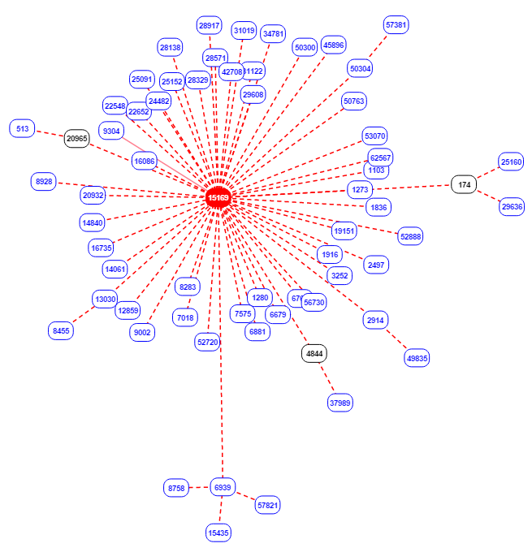
Redundancy
Surplus capacity to improve availability
Commonly used for network services such as DNS, web, email
Example of network redundancy shown in figure (Google)

Slide 35
ISM 6225 Distributed Information Systems
Computing infrastructure components
Based on Agrawal and Sharma, Prospect Press

Slide 36
Introduction
The components of a computer
Memory, ALU, operating system
The operating system
Processes, threads, file systems
Security concerns in operating systems
Privileged states, attack protection, security principles
Virtualization, Cloud architectures, big data architectures

Slide 37
Origins of modern computing
Von Neumann report
1945
5 components of a computer
Central arithmetic part
Central control part
Memory
Input
Output

Slide 38
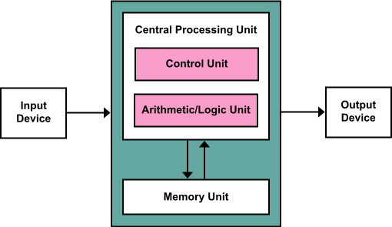
Von Neumann architecture

Slide 39
Computer architecture and software
Programming language constructs map directly to von Neumann architecture
E.g. variable assignments, instructions
Software developers need to phrase business problems in terms of von Neumann architecture constructs
Focus of programming language developments

Slide 40
Operating systems
Perform operations common to computer applications
E.g. read data from storage, print output, audit computer usage etc.
Implement system calls
Functions provided by the operating system

Slide 41
Operating systems (contd.)

Slide 42
Scaling up
Big data
5V model
volume, velocity, variety, veracity, value
Motivated need for virtual machines and warehouse scale computers

Slide 43
Virtual machines
Guest operating systems use spare computing resources on host operating system

Slide 44
Warehouse scale computers
Performance/ dollar of capital invested
Performance/ joule of energy consumed
Reliability
Request level parallelism
Handling device failures

Slide 45
Containers
Virtual machines are great
However, overkill, if the focus is just to isolate applications
Containers are a technology to provide OS virtualization
VMs provide hardware virtualization
Virtual is a synonym for “feels like, though not really”
Containers allow developers to package applications without a guest OS
Caveat
I have not personally worked with a container

Slide 46
Containers – the idea
Imagine deploying an application today
Need to ensure that the deployment server has the same set of libraries as your development laptop
.NET runtime, Java runtime, Python etc
All with the exact same versions as your laptop
Often a challenge
Docker allows developers to package all dependencies into one container file
Think of it like a zip file for applications

Slide 47
Cloud computing
5 characteristics
On demand self-service
Broad network access
Resource pooling
Rapid elasticity
Measured service

Slide 48
Cloud computing models
Access
Private
Community
Public
Hybrid
Services
IAAS
PAAS
SAAS

Slide 49
Cloud computing implementation
Hide underlying hardware details
Services accessed as APIs
Industry standardization effort is OpenStack

Slide 50
Summary
Network security
Network security is a component of an organization’s overall information security effort
Network security controls mitigate risks from threats in network
Network security controls defend data leaving the organization and hacking attempts emerging from outside the organization
Computing infrastructures
The components of a modern computer
Operating systems
Infrastructure scaling
Virtualization
Cloud architectures
Big data architectures

Slide 51
Summary
The components of a modern computer
The operating system and its components
Security concerns in operating systems
Protection mechanisms
Infrastructure scaling
Virtualization
Cloud architectures
Big data architectures

