Slide 1
PROJECT TITLE
FREELANCING APPLICATION MERN
TEAM MEMBERS
Srinidhi V
Shruthi.S
Sowmya. P
Shanmuga Priyadharshini .C.S

Slide 2
ABSTRACT
The Freelancing Application Website named Freelansters aims to connect freelancers with clients seeking services across various domains. The platform allows users to find job opportunities, apply for jobs, and hire freelancers based on their skills. The website is designed to provide a user-friendly experience with a straightforward navigation system and efficient filtering options.

Slide 3
INTRODUCTION
Freelancing has become an increasingly popular career choice due to its flexibility and the global shift towards remote work. However, finding the right freelance opportunities and matching them with suitable candidates can be a challenge. The Freelancing Application Website aims to bridge this gap by creating an efficient system that allows freelancers to browse and apply for jobs while enabling clients to find and hire skilled professionals for their projects. The system focuses on simplicity, ease of use, and effective job matching, ensuring a seamless experience for both parties.

Slide 4
PROPOSED SYSTEM
The proposed system comprises two main user roles: clients and freelancers. Clients can post job opportunities, while freelancers can search for jobs and submit applications. The website features:
Find Jobs: A search bar for job listings, allowing filtering by categories such as writing, programming, and design to showcase their skills.
Find Freelancers: A section where clients can browse and hire freelancers.
Profile Management: Authorized users can view and edit their profiles, as well as log out.

Slide 5
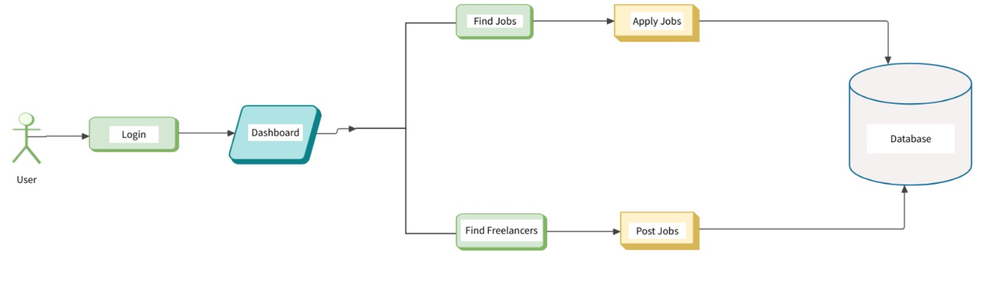
ARCHITECTURE DIAGRAM

Slide 6
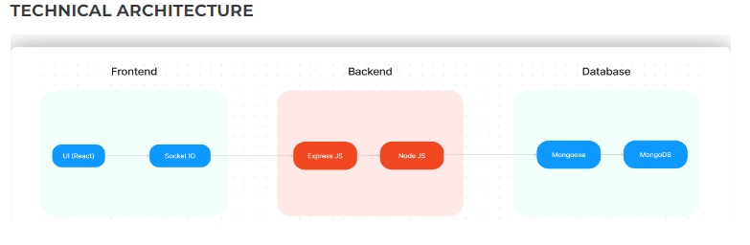
TECHNICAL ARCHITECTURE

Slide 7
FRONT-END DEVELOPMENT
The front-end of Freelansters is developed using HTML, CSS, JavaScript and React, ensuring a dynamic and responsive user experience. Key features include:
UI React: Utilizes React components for building a modular and maintainable user interface, enhancing performance through efficient rendering.
Responsive Design: Ensures the website is accessible and visually appealing across various devices.
Navigation Bar: Provides easy access to different sections (Home, Find Jobs, Find Freelancers, About Us).
Job Listings: Display of job details, including descriptions and an option to apply for jobs.
Socket ID Integration: Implements real-time communication features, allowing users to receive instant notifications about job postings and application statuses.
Filtering Options: Users can filter job postings based on categories like writing, programming, and design.

Slide 8
BACK-END DEVELOPMENT
The back-end of Freelansters is developed using Node.js, Express.js and connects to a database (MongoDB) for data storage. Important functionalities include:
User Authentication: Ensures that only authorized users can access specific features.
Job Posting Management: Allows clients to create, edit, and delete job postings.
Application Handling: Manages freelancer applications for posted jobs.

Slide 9
INTEGRATION
The integration of front-end and back-end involves :
API Development: Creating RESTful APIs for seamless communication between the front-end and back-end.
Data Flow: Ensuring data is retrieved and sent correctly between the database and user interface.
User Experience: Providing a smooth and interactive experience for users throughout their journey on the platform.

Slide 10
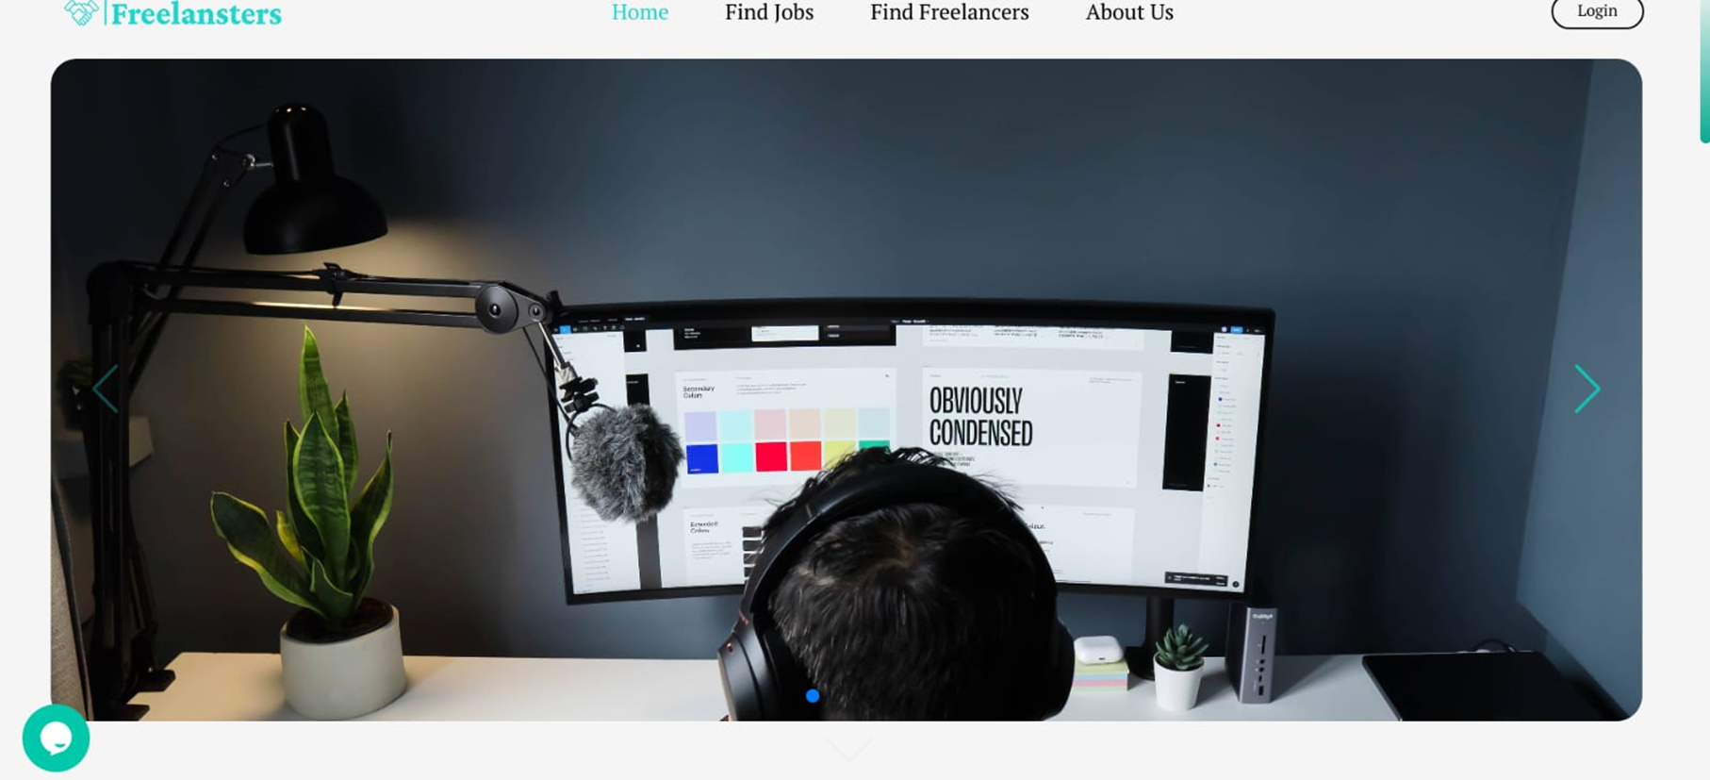
MODEL SCREENSHOTS

Slide 11
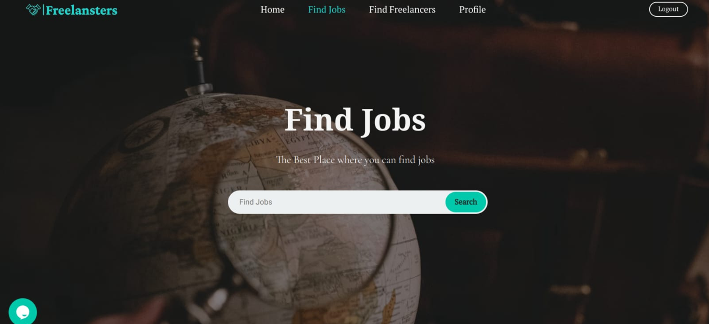

Slide 12
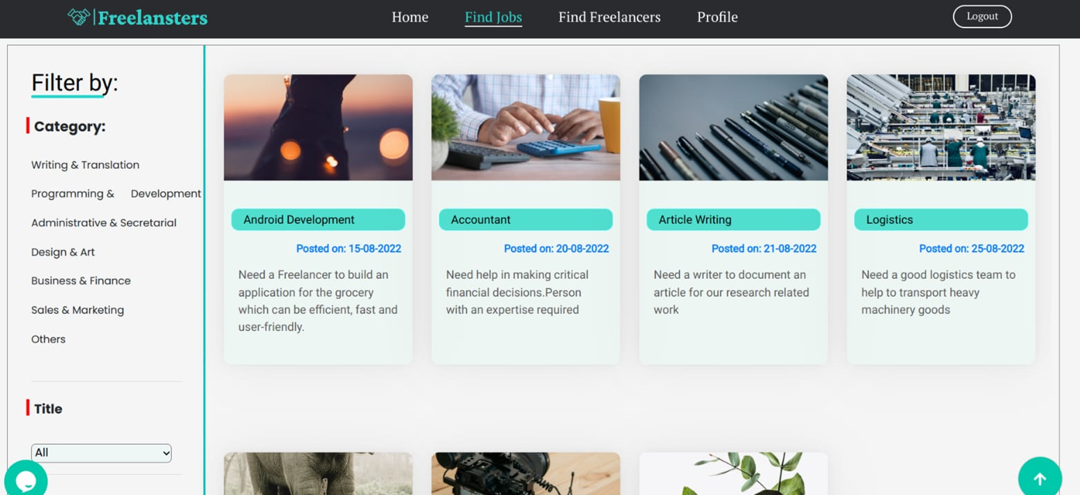

Slide 13
CONCLUSION
The Freelansters project demonstrates a comprehensive approach to building a freelancing platform that caters to both clients and freelancers. By leveraging modern web technologies, the application provides a user-friendly interface, effective job management features, and a seamless integration of front-end and back-end functionalities. This project not only enhances understanding of web development but also contributes to the growing gig economy.

Slide 14
THANK YOU!

