Slide 1


SCHOOLS

Slide 2



INTRODUCTION
This project manages student data for SRM-AP's Outcome-Based Education (OBE) framework. It provides an intuitive interface to store, view, update, and delete records, including student ID, name, grade, and description. Efficient sorting (Merge Sort) and searching (Binary Search) algorithms ensure smooth data organization and retrieval. The system aligns with OBE principles, offering reliable tools for managing and accessing student information while supporting SRM-AP's educational goals.

Slide 3
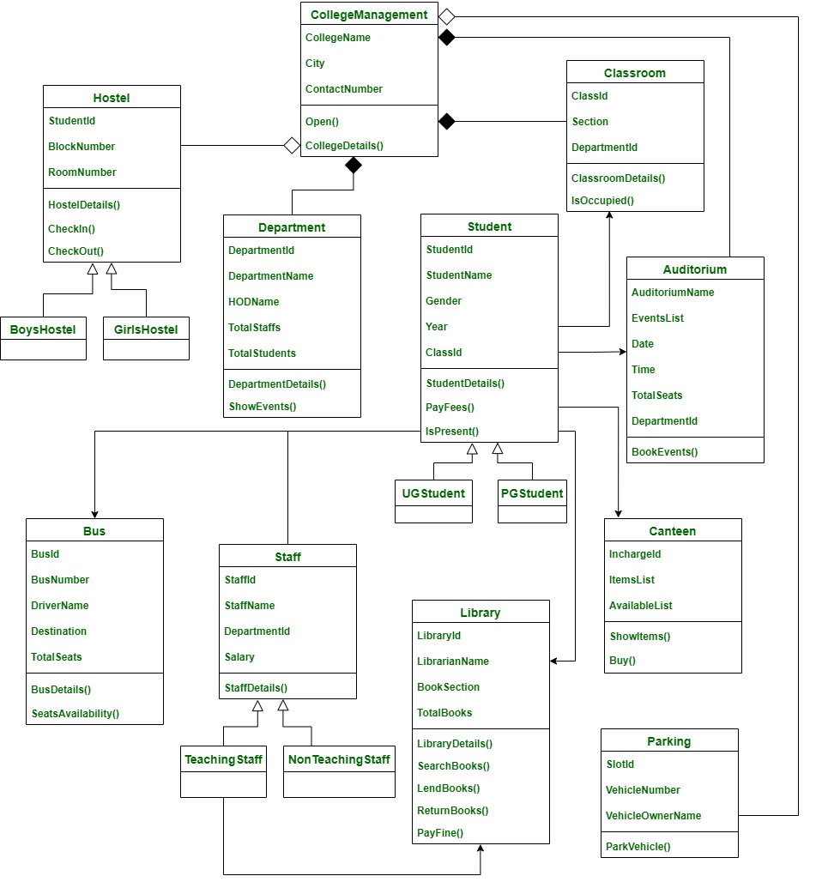
CLASS DIAGRAM FOR UNIVERSITY MANAGEMENT SYSTEM

Slide 4

MODULE DESCRIPTION
This C program module manages "schools," which are university data entries containing details like univ_id, sch_code, sch_name, sch_location, and sch_email. Data is stored in a text file (schools.txt) to ensure persistence across sessions. At startup, the program loads existing records into memory, enabling users to manage them through a command-line interface. Any additions, deletions, or updates are immediately saved back to the file, ensuring reliable data storage.
The module supports full CRUD operations:
Create: Add new school records.
Retrieve: Display all stored records.
Update: Modify records based on the school name.
Delete: Remove specific records by name.
To enhance usability, the program includes sorting and searching functionalities. Records are sorted using the Merge Sort algorithm, ensuring stable sorting with O(n log n) time complexity. Binary Search enables fast record retrieval with O(log n) time complexity.
Additionally, the module compares the time complexities of different sorting algorithms, offering an educational perspective by illustrating their efficiency. This feature helps users understand the performance trade-offs of the implemented algorithms while managing school data effectively.

Slide 5

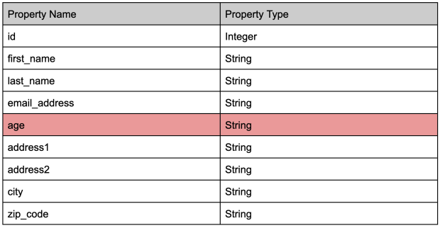
FIELD TABLE

Slide 6


SCHOOL MANAGEMENT MODULE FOR DATA HANDLING
File Name: yourregno_school_module
Function/Method Name Mapping:
Create: void titans_school_create();
Update: void titans_school_update();
Retrieve: void titans_school_retrieve();
Delete: void titans_school_delete();
Sorting: void titans_school_merge_sort(int left, int right);
Searching: int titans_school_linear_search(const char *sch_name);

Slide 7
"SEARCH AND SORT COMPARISON MODULE WITH TIME COMPLEXITY ANALYSIS"
Comparison Functions:
Searching: int sunrisers_compare_search_binarysearch(int id);
Sorting: void sunrisers_compare_sort_mergesort(int left, int right);
Time Complexity Analysis:
Searching: void sunrisers_complexity_searching();
Sorting: void sunrisers_complexity_sorting();

Slide 8
SORTING ALGORITHM
QUICK SORT
MERGE SORT
void sunrisers_schools_merge(int left, int mid, int right) {
int nl = mid - left + 1;
int n2 = right - mid;
School *L = malloc(nl * sizeof(School));
School *R = malloc(n2 * sizeof(School));
for (int i = 0; i < nl; i++)
L[i] = schools[left + i];
for (int i = 0; i < n2; i++)
R[i] = schools[mid + 1 + i];
int i = 0, j = 0, k = left;
while (i < nl && j < n2) {
if (strcmp(L[i].sch_name, R[j].sch_name) <= 0) {
schools[k++] = L[i++];
} else {
schools[k++] = R[j++];
}
}
while (i < nl)
schools[k++] = L[i++];
while (j < n2)
schools[k++] = R[j++];
free(L);
free(R);
}
void sunrisers_schools_merge_sort(int left, int right) {
if (left < right) {
int mid = left + (right - left) / 2;
sunrisers_schools_merge_sort(left, mid);
sunrisers_schools_merge_sort(mid + 1, right);
sunrisers_schools_merge(left, mid, right);
}
}
QuickSort(arr[], low, high)
if low < high
pivot = Partition(arr[], low, high)
QuickSort(arr[], low, pivot - 1)
QuickSort(arr[], pivot + 1, high)
Partition(arr[], low, high)
pivot = arr[high]
i = low - 1
for j = low to high - 1
if arr[j] is less than pivot based on the sorting criteria
swap arr[i] with arr[j]
swap arr[i + 1] with arr[high]
return i +1

Slide 9
COMPARISION OF SORTING ALGORITHM
Quick Sort
Approach: Selects a pivot, divides the array into elements smaller and larger than the pivot, and recursively sorts each partition.
Time Complexity: Best and average cases: O(n log n); worst case: O(n²).
Space Complexity: O(log n) (in-place sorting).
Applications: Often faster for large datasets with random access. Not a stable sorting algorithm.
Approach: Divides array into two halves, recursively sorts, then merges sorted halves.
Time Complexity: O(nlogn) for all cases.
Space Complexity: O(n) (uses extra space for merging).
Applications: Suitable for linked lists, stable sorting, and large external datasets.
Merge Sort

Slide 10
School: Time Complexity Of Sorting Algorithm
Quick Sort
Best Case: O(nlogn) — Pivot divides array into nearly equal halves.
Average Case: O(nlogn) — Pivot generally gives balanced splits.
Worst Case: O(n^2) — Pivot repeatedly gives unbalanced splits (e.g., sorted array)
Merge Sort
Best, Average, Worst Case: O(nlogn) — Always splits array into two equal halves and
merges, so performance remains stable regardless of data order.
Why Merge Sort is Consistent:
Since it does not depend on pivot selection, Merge Sort’s performance remains unaffected by the
initial order of elements. It always divides evenly, ensuring balanced recursion in all cases.

Slide 11
SORTING ALGORITHM
LINEAR SEARCH
BINARY SEARCH
LinearSearch(arr[],
target_code, target_name,
target_email)
for each element in arr[]
if element's code ==
target_code
and element's name
== target_name
and element's email
== target_email
return index
return -1
BinarySearch(arr[], target_code,
target_name, target_email)
left = 0
right = arr.length - 1
while left <= right
mid = (left + right) / 2
if arr[mid] matches target based on
code, name, and email
return mid
else if arr[mid] is less than target
based on sorting criteria
left = mid + 1
else
right = mid - 1
return -1

Slide 12
COMPARISION OF SORTING ALGORITHM
Linear Search
Approach: Sequentially checks each element in the list until the target is found
Time Complexity:
Best Case: O(1)O(1) — Target is the first element.
Average/Worst Case: O(n)O(n) — Target is in the middle or not present.
Requirements: Works on both sorted and unsorted lists.
Use Case: Good for small or unsorted datasets.
Approach: Repeatedly divides a sorted list in half, checking if the target is in the left or right half.
Time Complexity:
Best Case: O(1)O(1) — Target is the middle element.
Average/Worst Case: O(logn)O(logn) —Reduces search space by halfeach time.
Requirements: Requires a sorted list.
Use Case: Efficient for large, sorted datasets.
Binary Search

Slide 13
School: Time Complexity Of Sorting Algorithm
Linear Search
Best Case: O(1) — Target found at the start.
Average Case: O(n)— Searches about halfway through.
Worst Case: O(n) — Searches entire list if target is at the end or absent
Binary Search
Best Case: O(1)— Target is the middle element on the first try.
Average Case: O(logn)— Continuously halves the list until found.
Worst Case: O(logn) — Full list division until target is found or confirmed absent.
Binary search is better for large, sorted datasets because it has O(logn) time complexity. By halving the search
space each step, it finds the target much faster than linear search, which is O(n).

Slide 14
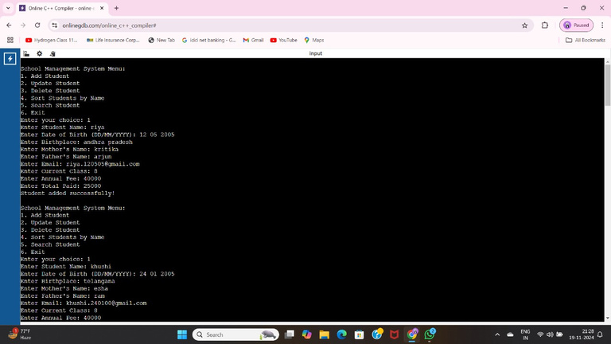
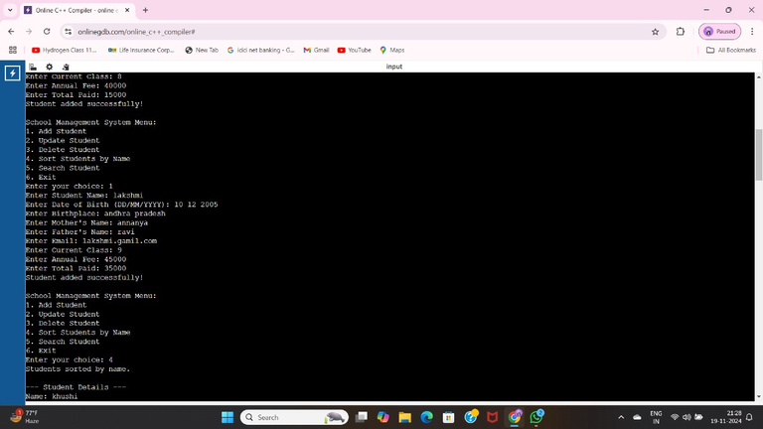

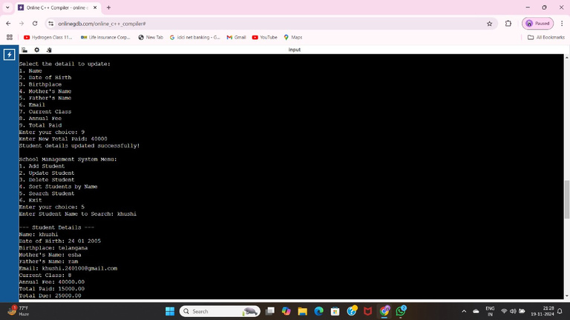

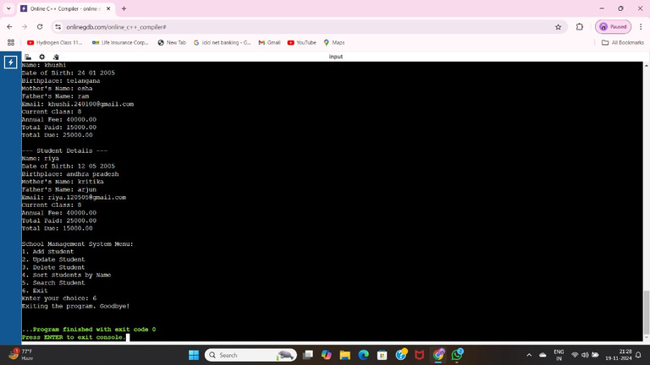
SAMPLE OUTPUTS

Slide 15
CONCLUSION
This project implements an efficient system for managing bloom level data, enabling users to store, view, update, and delete information as needed. To ensure data is well-organized and accessible, the system incorporates sorting and searching techniques. Merge Sort is employed for its consistent and reliable performance, while Quick Sort offers faster processing for initially unsorted data. For searches, Binary Search enables rapid lookups on sorted data, while Linear Search provides flexibility for unsorted datasets. Additionally, all data is stored in a file, ensuring that changes persist even after the program ends. This project highlights fundamental principles of data management, demonstrating how to select and apply algorithms based on specific requirements to build a dependable system for handling bloom level data.

Slide 16

THANK'S FOR WATCHING

