Slide 1
PROJECT PROGRESS REVIEW 2
Physics-Informed Deep Neural Network for Digital Twin Modeling of UAV-to-Ground Wireless Channels
Implementation, Digital Twin & Results
Wireless Communications · Deep Learning · Digital Twins
Team Members
S. Harshitha — 2520040017
P. Srinidhi — 2520040016
Guide: Mr. N. Lava Prasad, Assistant Professor
Department: ECE, KL University, Hyderabad
Academic Year 2026–27
Notes:
Welcome. This is our second progress review. In Review 1 we presented the problem, objectives, architecture, physics model and plan. In this review we show what has been built: a simulated dataset, a conventional DNN and a Physics-Informed DNN, the evaluation results, and an interactive Digital Twin.

Slide 2
Progress Since Review 1
Every item planned in Review 1 now has a working implementation
Planned in Review 1 | Status | Done in Review 2
Dataset & input / output | Done | Simulated air-to-ground dataset: altitude, distance, frequency → path loss
Physics model (FSPL) | Done | FSPL extended into three physics constraints used inside the loss
Conventional DNN baseline | Done | 3 → 48 → 48 → 1 ReLU network trained on labelled data only
Physics-Informed DNN | Done | Same network and data, plus a physics loss term weighted by λ
Evaluation metrics | Done | MAE, MSE, RMSE, R² on labelled-region and unseen points; 6 random seeds
Digital Twin | Done (v1) | Interactive twin: drag the UAV, change frequency and power, see predicted link
Real data & 3D trajectory | Planned | Next phase (see final slides)
KL University, Hyderabad | Progress Review 2
2
Notes:
Quick recap of the plan from Review 1 and where we stand. Dataset, physics model, both neural networks, evaluation metrics and the Digital Twin are all implemented. The two remaining items, validation on real measurements and a 3D trajectory view, are our next phase.

Slide 3
Implementation Pipeline
From a simulated channel to an interactive Digital Twin
1
2
3
4
5
6
Channel simulator
Labelled samples
Normalise
Train two models
Test
Digital Twin
FSPL + LoS / NLoS excess loss + 2 dB shadowing
150 noisy points from the labelled region only
Inputs scaled to [−1, 1]; path loss as (PL − 100) / 25
DNN and PI-DNN, identical start, 1200 epochs
400 labelled-region and 600 unseen points, noise-free
Live path loss, received power and link quality
A fair comparison. Both models receive the same 150 noisy samples and the same starting weights. The only difference is the physics penalty in the PI-DNN loss, so any gap in accuracy comes from the physics.
Training, metrics and the twin all run in one HTML page; real measurements can be swapped in later.
KL University, Hyderabad | Progress Review 2
3
Notes:
This is the end-to-end flow. We generate channel data from a simulator, take only 150 noisy samples from a small labelled region, normalise them, and train two networks side by side with identical starting weights. We then test on points that are far outside the labelled region. The key point is fairness: the only difference between the two models is the physics term in the loss.

Slide 4
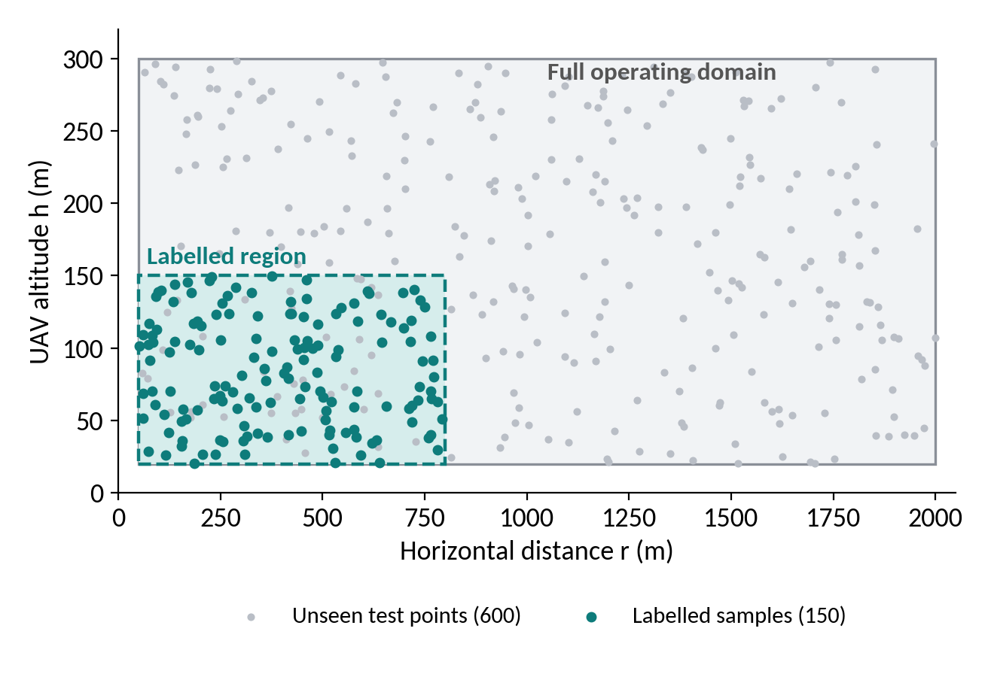
Dataset: Simulated Air-to-Ground Channel
Models see labelled data only in a small corner of the operating domain
Parameter | Full domain | Labelled region
Altitude h | 20 – 300 m | 20 – 150 m
Distance r | 50 – 2000 m | 50 – 800 m
Frequency f | 0.9 – 5.8 GHz | 1.8 – 3.0 GHz
Ground-truth channel
PL = FSPL(d, f) + p · ηLoS + (1 − p) · ηNLoS
p = probability of line of sight, set by the UAV elevation angle
Suburban excess loss (Al-Hourani et al.): ηLoS = 0.1 dB, ηNLoS = 21 dB
2 dB Gaussian shadowing added to training samples only
Test: farther, higher, or at other frequencies
KL University, Hyderabad | Progress Review 2
4
Notes:
Since we do not yet have flight-test data, we use a simulator for the air-to-ground channel: free-space path loss plus an excess loss that depends on whether the path is line-of-sight or blocked. The parameters are the standard suburban values from Al-Hourani et al. The important design choice is that the networks only see labelled data in the teal region: altitude up to 150 m, distance up to 800 m, frequency 1.8 to 3 GHz. The test points are drawn from the whole domain, so they test extrapolation.

Slide 5
Models and Training Setup
Both models share exactly the same architecture and starting weights
Setting | Value
Inputs | 3: altitude, distance, frequency
Hidden layers | 2 × 48 neurons, ReLU
Output | 1: path loss (dB)
Optimiser | Adam, learning rate 0.004, full batch
Epochs | 1200
Labelled samples | 150 (noisy, labelled region)
Physics weight λ | 1.0 (PI-DNN only)
Physics points | 64 random unlabelled points per epoch
3
48
48
1
Input
Dense + ReLU
Dense + ReLU
Output
altitude, distance, frequency
path loss (dB)
Where does transmit power go?
It is not a network input. The twin computes received power = transmit power − predicted path loss (0 dBi antennas).
KL University, Hyderabad | Progress Review 2
5
Notes:
Both networks are small multilayer perceptrons: three inputs, two hidden layers of 48 ReLU neurons and one output, the path loss. We use Adam with a learning rate of 0.004 for 1200 epochs. One clarification from Review 1: transmit power is not fed to the network, because path loss does not depend on it. The twin simply subtracts the predicted path loss from the transmit power to get received power.

Slide 6
Physics-Informed Loss
Three propagation laws, enforced where there is no labelled data
L_{total} = L_{data} + λ · L_{physics}
1
Distance law
2
Frequency law
3
Free-space floor
PL(s·d) − PL(d) = 20·log₁₀(s)
PL(k·f) − PL(f) = 20·log₁₀(k)
PL ≥ FSPL(d, f)
At a constant elevation angle, scaling the distance by s (1.25) must add exactly 20·log₁₀ s dB.
Scaling the carrier frequency by k (1.25) must add exactly 20·log₁₀ k dB.
Predicted loss may never fall below free-space loss. The penalty applies only when this is violated.
The physics loss is averaged over 64 random unlabelled points per epoch across the whole operating domain, so physical guidance reaches regions where no data exists.
KL University, Hyderabad | Progress Review 2
6
Notes:
This extends the loss function we showed in Review 1. L_data is the squared error on the labelled samples. L_physics checks three things on random points that have no labels. First, if the distance grows by a factor s at the same elevation angle, path loss must grow by exactly 20 log s. Second, the same for frequency. Third, predicted loss can never be below free-space loss. Lambda, set to 1, balances the two terms.

Slide 7
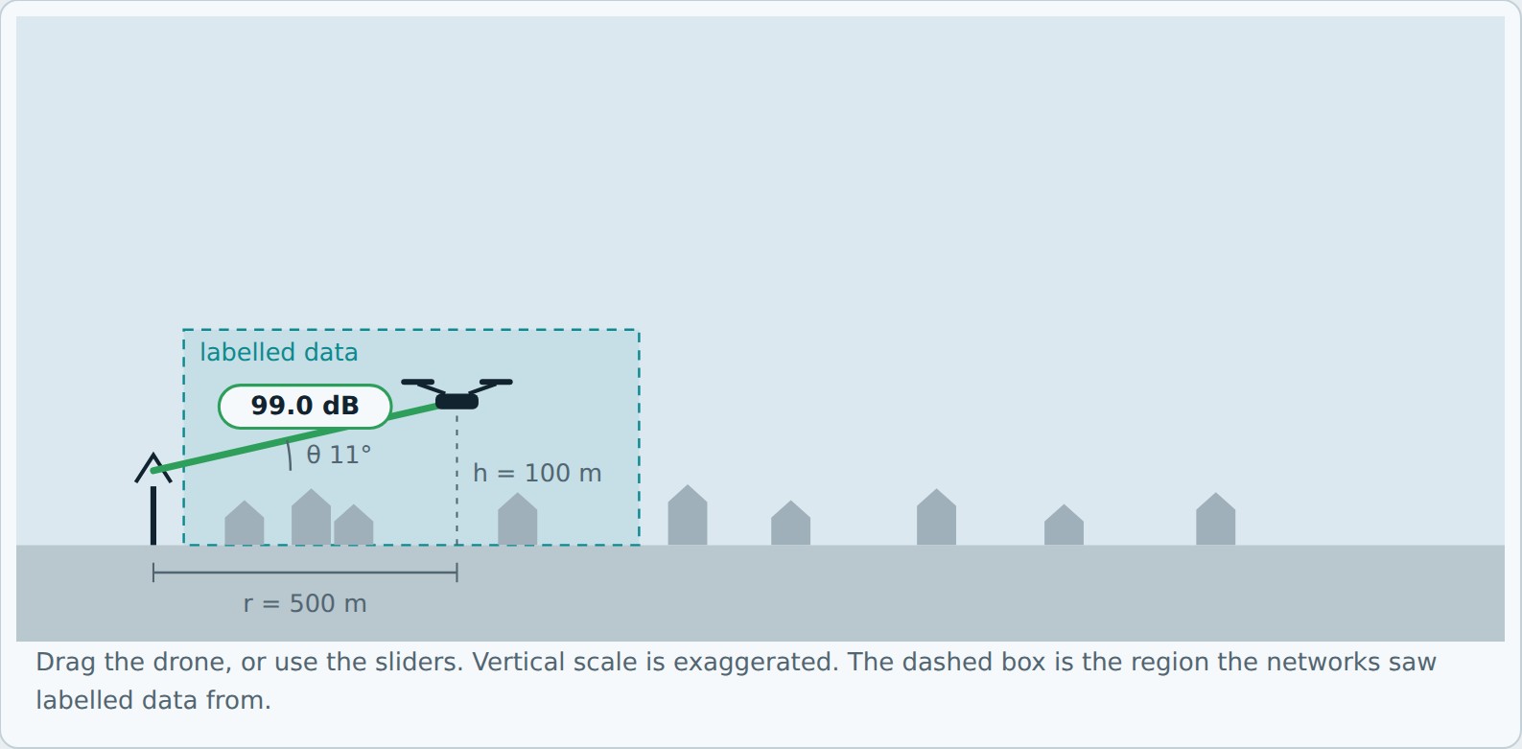
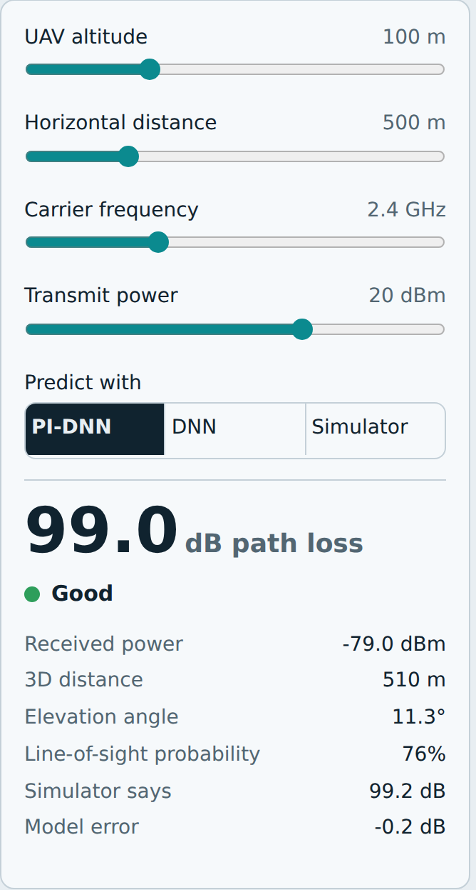
Digital Twin: Interactive Implementation
A virtual UAV, ground station and channel that respond instantly to any scenario
Drag the drone or use sliders: altitude, distance, frequency, transmit power
Switch the predictor: PI-DNN · DNN · Simulator (ground truth)
Live readout: path loss, received power, elevation angle, LoS probability, model error
Link quality: Good > −80 dBm · Fair −90 to −80 dBm · Poor < −90 dBm
KL University, Hyderabad | Progress Review 2
7
Notes:
This is the Digital Twin itself, captured from our implementation after training both networks. The left panel is the virtual scene: the ground station, the UAV, the dashed labelled-data region and the live link. The right panel is the readout. You can drag the drone, change frequency and transmit power, and switch between the PI-DNN, the plain DNN and the simulator ground truth. Link quality is classified from received power: good above minus 80 dBm, fair down to minus 90, poor below that.

Slide 8
Digital Twin: Worked Example
The XX placeholders from Review 1 are now real predicted values
Scenario input
UAV altitude | 100 m
Horizontal distance | 500 m
Frequency | 2.4 GHz
Transmit power | 20 dBm
99.0 dB
−79.0 dBm
Good
Predicted path loss (PI-DNN)
Received power
Link quality (> −80 dBm)
What if the altitude changes? (r = 500 m, f = 2.4 GHz, transmit power = 20 dBm)
Altitude | Simulator (dB) | DNN (dB) | PI-DNN (dB) | PI-DNN received power | Link
50 m | 110.3 | 112.1 | 111.1 | −91.1 dBm | Poor
100 m | 99.2 | 100.0 | 99.0 | −79.0 dBm | Good
150 m | 95.1 | 94.7 | 94.7 | −74.7 dBm | Good
200 m | 94.8 | 96.3 | 94.5 | −74.5 dBm | Good
At 50 m the elevation angle is only about 5.7°, more paths are blocked, and the link drops to Poor. The twin finds this without a single flight.
KL University, Hyderabad | Progress Review 2
8
Notes:
Here is the example from Review 1, now with real numbers. For a drone at 100 m altitude, 500 m away, at 2.4 GHz with 20 dBm transmit power, the PI-DNN predicts 99.0 dB path loss, against 99.2 from the simulator. Received power is minus 79 dBm, which is a Good link. The table shows the what-if question: if we change altitude, the twin answers immediately. At 50 m the link becomes Poor because the elevation angle is small and paths are more often blocked. These values are from our simulated channel, not field measurements.

Slide 9
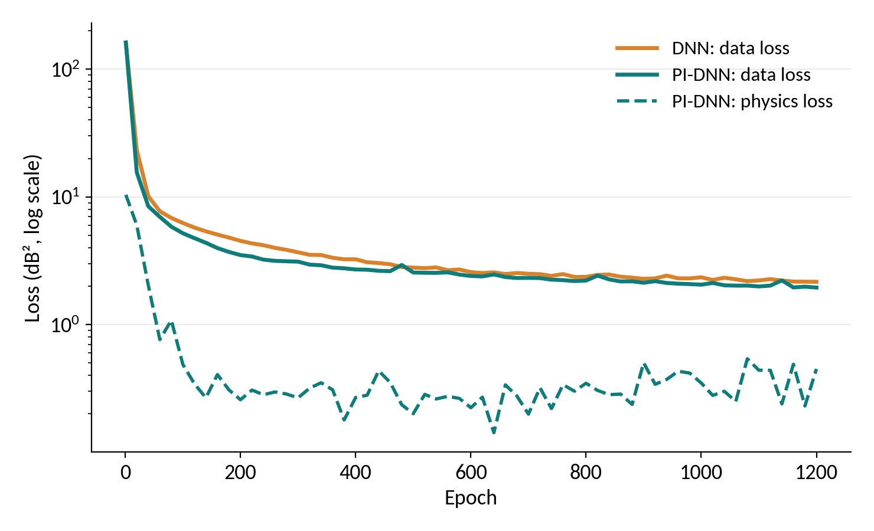
Training Behaviour
Similar data fit, but the physics loss is driven down in the PI-DNN
Same starting point
Both models begin at the same loss (about 162 dB²).
Similar data fit
Final data loss: DNN 2.16 dB², PI-DNN 1.95 dB².
Physics satisfied
PI-DNN physics loss falls from 10.4 to 0.45 dB².
A similar data fit does not mean similar generalisation. The unseen-point results follow.
KL University, Hyderabad | Progress Review 2
9
Notes:
These are the training curves from the default run. Both models start from the same loss and reach a similar data loss, about 2 dB squared. The dashed line is the physics loss for the PI-DNN, which drops from about 10 to under 0.5, showing the network learned to obey the propagation laws. Notice the data loss alone cannot separate the two models; the difference appears when we test on points the networks never saw.

Slide 10
Accuracy: Labelled Region vs Unseen Region
The physics matters most where there is no labelled data
Metric | Labelled region (400 pts) |  | Unseen region (600 pts)
 | DNN | PI-DNN | DNN | PI-DNN
MAE (dB) | 1.09 | 0.86 | 6.01 | 0.74
MSE (dB²) | 1.92 | 1.17 | 60.41 | 0.76
RMSE (dB) | 1.39 | 1.08 | 7.77 | 0.87
R² score | 0.984 | 0.990 | 0.626 | 0.995
8.9×
lower RMSE on unseen points
7.77 dB → 0.87 dB
R²: 0.626 → 0.995
Default run: 150 samples, λ = 1, 1200 epochs, seed 1. Test sets are noise-free. Inside the labelled region both models are accurate; outside it the plain DNN breaks down.
KL University, Hyderabad | Progress Review 2
10
Notes:
Now the headline result. Inside the labelled region both models are accurate, with RMSE of 1.39 dB for the DNN and 1.08 dB for the PI-DNN. On points outside that region, the conventional DNN's RMSE jumps to 7.77 dB and its R-squared falls to 0.63, while the PI-DNN stays at 0.87 dB with R-squared of 0.995. That is roughly nine times lower error. This is the run with default settings; we repeat it with six seeds shortly to show it is not luck.

Slide 11
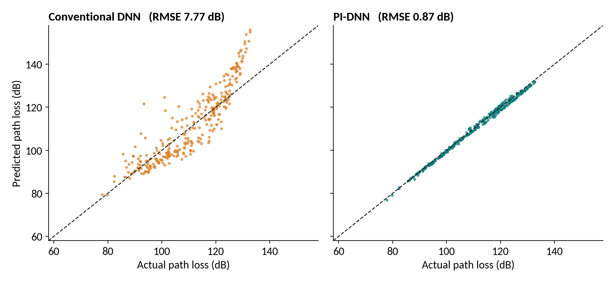
Actual vs Predicted Path Loss on Unseen Points
Points on the dashed line are perfect predictions
300 of the 600 unseen points are shown; RMSE is computed on all 600. The DNN drifts and overshoots outside the labelled region.
KL University, Hyderabad | Progress Review 2
11
Notes:
This is the same result seen point by point. On the left, the conventional DNN's predictions scatter widely around the ideal line and overshoot badly for very high path losses. On the right, the PI-DNN's predictions sit almost exactly on the line, even though none of these points were in the training region.

Slide 12
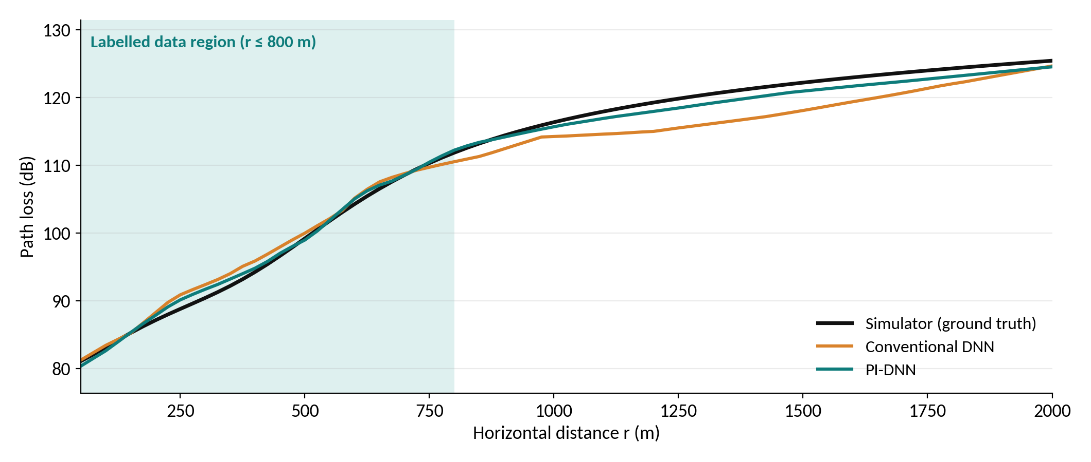
Path Loss Along the Flight Path
UAV at 100 m altitude, 2.4 GHz, flying outward from 50 m to 2000 m
Both models fit well inside the labelled region. Beyond 800 m the DNN sags below the simulator while the PI-DNN stays close to it.
KL University, Hyderabad | Progress Review 2
12
Notes:
This is the flight-path view that the twin also shows. As the drone flies outward, both models match the simulator inside the shaded labelled region. Beyond 800 metres, there is no labelled data. The plain DNN drifts below the true curve by about four dB at 1500 metres, while the physics-informed model follows the true curve more closely. The PI-DNN is not perfect; it sits about one dB low around 1500 metres.

Slide 13
Robustness: Six Random Seeds and Physics Weight
The improvement is consistent, not a lucky run
Unseen-point RMSE per seed (dB)
Effect of physics weight λ on unseen RMSE (dB)
Mean over seeds 1–3
Mean unseen RMSE over 6 seeds: DNN 15.76 dB (σ = 12.02) vs PI-DNN 0.80 dB (σ = 0.11) — PI-DNN better in 6 of 6 runs
KL University, Hyderabad | Progress Review 2
13
Notes:
To check this is not a lucky seed, we repeated the experiment with six random seeds. The conventional DNN is very unstable outside its data, with unseen RMSE anywhere from 7 to nearly 40 dB, while the PI-DNN stays between 0.6 and 1.0 dB every time. On the right, we varied the physics weight lambda. Even a small value of 0.1 gives most of the improvement, and values from 0.5 to 3 perform similarly, so the method does not need delicate tuning. The lambda sweep uses three seeds to keep run time reasonable.

Slide 14
Discussion and Limitations
What the results show, and what they do not yet show
What the results show
Limitations
Inside the labelled region both models are accurate (RMSE 1.39 vs 1.08 dB). Physics helps most where data is missing.
Outside it the plain DNN is unstable: unseen RMSE ranged from 7 to 40 dB across seeds, against 0.6 to 1.0 dB for the PI-DNN.
Any λ ≥ 0.1 gives most of the gain; λ from 0.5 to 3 performs similarly, so no delicate tuning is needed.
All data is simulated. The channel is a model, not a measurement campaign.
The physics terms match the free-space core of the simulator, so part of the gain comes from that agreement.
Real channels add multipath, terrain and antenna effects that need richer physics terms.
The twin is a 2-D side view with three network inputs; 3D trajectories are still to come.
KL University, Hyderabad | Progress Review 2
14
Notes:
It is important to be honest about what we have and have not shown. The results are strong, but they are on simulated data, and our physics terms match the free-space part of that simulator. So some of the advantage comes from that agreement. The real test is real measurements, where multipath and terrain add effects our current physics does not capture. That is the main focus of our next phase.

Slide 15
Next Steps Towards the Final Review
From a simulated proof of concept to a validated model
1
Validate on real data
Test on measured or public air-to-ground path-loss datasets
2
Richer physics
Add LoS / NLoS, two-ray ground reflection and multipath terms
3
Ablation study
Measure the contribution of each physics term separately
4
3D trajectory twin
Fly the virtual UAV along a path and track link quality over time
5
Final report
Complete documentation, reproducible code and final review
KL University, Hyderabad | Progress Review 2
15
Notes:
Our plan for the final review. The top priority is validating on real or public measurement data, because that tells us whether the simulated results hold up. Then we will extend the physics with line-of-sight, ground reflection and multipath terms, run an ablation to see which physics term matters most, add a 3D trajectory to the Digital Twin, and complete the final report with reproducible code.

Slide 16
Conclusion
A working pipeline: simulated channel → DNN and PI-DNN → interactive Digital Twin.
On unseen UAV positions the PI-DNN reaches 0.80 dB RMSE against 15.76 dB for the conventional DNN (6-seed mean).
The twin answers what-if questions on altitude, distance, frequency and power without a flight.
Next: real measurements and richer physics to confirm these results beyond simulation.
Thank You
Questions & Feedback welcome
KL University, Hyderabad | Progress Review 2
16
Notes:
To conclude: we built the full pipeline, showed that adding physics reduces error on unseen UAV positions from about 15.8 dB to 0.8 dB on average across six seeds, and delivered an interactive Digital Twin. We are clear that this is on simulated data, and validating on real measurements is our next step. Thank you, we are happy to take questions.

