Slide 1
LogoCraft_GenAI
TEAM MEMBERS:
Narra Hoshitha(22B81A6779)
Uppununthala Hasine Priya(22B1A6778)
Koorella Shriya Pradyuthi(22B81A67A9)
Poreddy Srinidhi(22B81A67B4)

Slide 2
INTRODUCTION
Problem Statement:
Businesses need unique and creative logos, but professional design services can be expensive.
AI-generated logos provide an affordable and scalable alternative.
Objective:
Develop an AI-powered logo generator using the Hugging Face API.
Provide a cost-effective and scalable solution for businesses and startups.
Automate logo creation from text-based brand descriptions.
Ensure a user-friendly interface with easy selection and download options.

Slide 3
Technologies Used
Backend: Flask (Python)
API: Hugging Face (Model: stabilityai/stable-diffusion-xl-base-1.0)
Frontend: HTML, CSS, JavaScript
Libraries: Flask-CORS, Requests, Python-dotenv, Pillow, fpdf
File Handling: Supports PDF format for saving logos.
Security: Environment variables are used to manage API keys securely.

Slide 4
Project Workflow
User Input: The user provides a brand description.
API Request: Flask backend sends the input to Hugging Face API.
Logo Generation: Stability AI's Stable Diffusion model creates logo images.
Response Handling: Flask processes and displays logos on the frontend.
User Selection: Users select their preferred logo.
Download Feature: The selected logo is converted into a downloadable format using Pillow and fpdf.

Slide 5
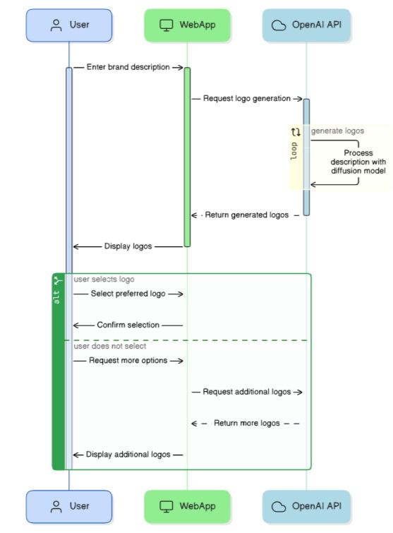

Slide 6
API Role in the Project
Why Use an API?
Access to pre-trained AI models without training from scratch.
Reduces computational load on local servers.
Hugging Face API:
Uses stabilityai/stable-diffusion-xl-base-1.0 for logo generation.
Accepts a text description and returns generated logos.
Offers fast and scalable AI model inference.

Slide 7
System Architecture
Frontend: HTML, CSS, JavaScript (User Interface)
Backend: Flask (Handles API requests & responses)
API: Hugging Face (AI-based logo generation)
Storage & Download: Processed via Pillow and fpdf.
Security Measures: API keys stored in .env file for security.

Slide 8
Conclusion
Advantages:
Cost-effective and scalable.
Provides unique AI-generated logos instantly.
Simple and user-friendly interface.
Future Enhancements:
Integrate user customization options.
Improve logo quality with additional AI refinements.
Enable direct integration with business branding tools.

Slide 9
THANK YOU

