Slide 1

Exploratory Data Analysis of Indian Premier League Data
Srinidhi Kalgundi Srinivas
Ritika Kishore Kumar
Sepehr Aiden Bostan
LingYi Li
Jonathan Cayaban

Slide 2
Cricket - Overview
Cricket is a bat-and-ball game played between two teams of eleven players on a field
The batting side - scores runs by striking the ball bowled (pitched) by the opposite side and then running between the wickets
The bowling/fielding side - tries to prevent this by preventing the ball from leaving the field and getting the ball to either wicket
2 innings of 20 overs; the toss-winner decides if they want to bat or field in the first inning and then the teams switch; a bowler bowls 6 times in one over
A team wins by scoring more runs or getting all of the opposing team's batters out
Indian Premier League (IPL):
IPL is a men’s cricket league of India (started in 2008)
Players from all of the international teams play in this franchise (Soccer fans: think La Liga or Premier League)

Slide 3

Goal of the EDA
See how toss-winner/toss-decision affects game outcome
Compare statistics between different players
See how player statistics can be used by teams to strategize games
See how management decisions for auctioning players affects team success

Slide 4
Datasets
Exploratory Data Analysis for IPL (2008-2022)¹
Matches
Deliveries
Kaggle: IPL Player Auction Dataset - From Start to Now (2013-2022)³
IPL Auction dataset scraping Wikipedia² (2008 - 2012)
Data was scraped using BeautifulSoup module
Some data cleaning and editing needed to be done for efficiency
[1] - https://www.kaggle.com/code/ambarish/exploratory-data-analysis-ipl/data
[2] - https://www.kaggle.com/datasets/kalilurrahman/ipl-player-auction-dataset-from-start-to-now
[3] - https://en.wikipedia.org/wiki/List_of_2008_Indian_Premier_League_auctions_and_personnel_signings

Slide 5
Methodology
Data gathered from Kaggle
Created classes to read from the data file and to clean the data
IPL auction information was scraped from the web to find the correlation between money spent and the number of wins
Created functions for analysis and plotting:
Match statistics
Player statistics
Team spending

Slide 6
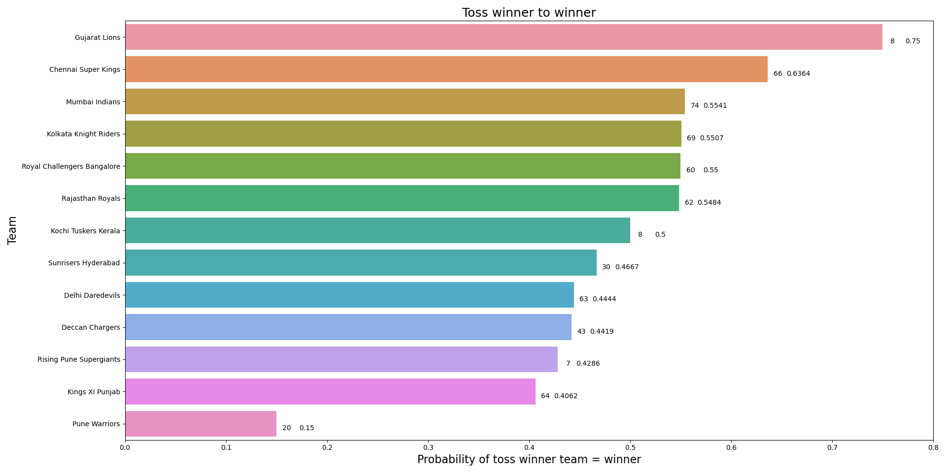
Team performance as toss winner
Plot showing probability a team wins when it wins the toss
Interpretation:
Various between teams
Chennai Super Kings wins most of time when it is toss winner
Kings XI Punjab is relatively weak
Pune Warriors should change strategy to take advantage of toss winner
#team wins when toss & probability of toss winner = win

Slide 7
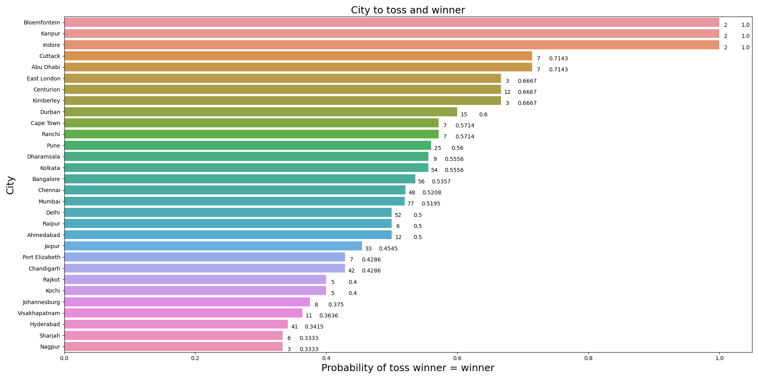
Venue affects the outcome
Plot shows the chances of a team winning the game given they won the toss in a particular ground
Interpretation:
Overall prob slightly > 50%
If a city holds more competition, the probability will converge to 50%
Hyderabad is special which held relatively more competitions but with relatively lower probability for toss winner=winner
Overall=50.79%
#competition held in the city & probability of toss winner = win

Slide 8
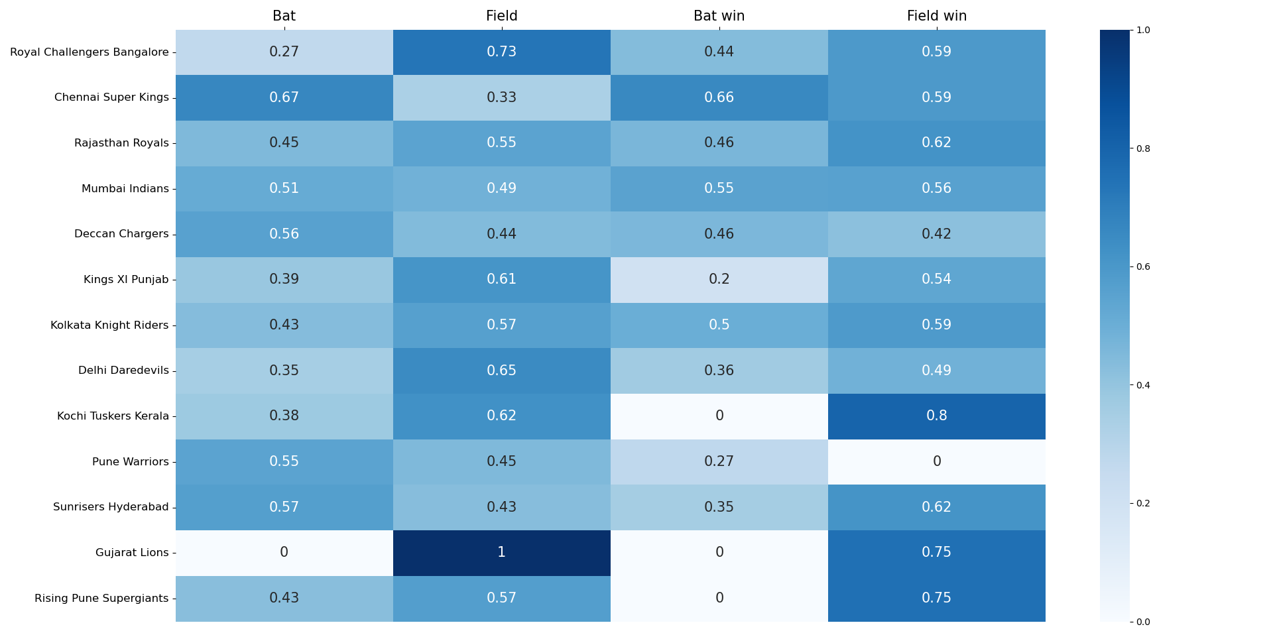
Choice & Result
Toss Winner
Bat
Field
Bat win
Field win
Most of teams do right choice
Rising Pune Supergiants Kochi Tuskers Kerala should always choose “Field” as toss winner

Slide 9
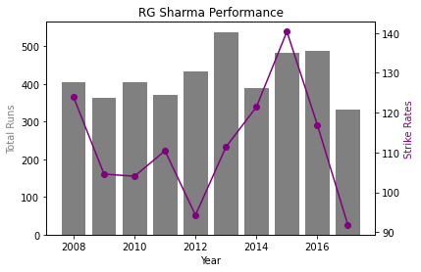
Batsman Performance
This graph plots the total runs scored by a batsman each season and the line plot gives an intuition of their strike rate in that season.
Interpretation -
Line plot: Higher the better
Bar plot: Higher the better

Slide 10
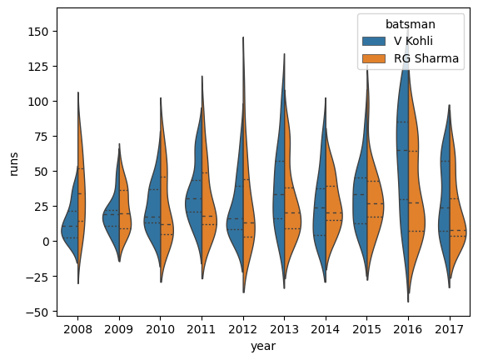
Batsman Stats
This graph talks about a batsman consistency (or form) over a whole season. This can be used by auctioneers to see how consistent a player is through a season. Also compare the same stats with another batsman.
Blue is the bell curve of runs over all matches by V Kohli in the given year. Orange is the same but for RG Sharma
Notes:
- lower std deviation is better

Slide 11
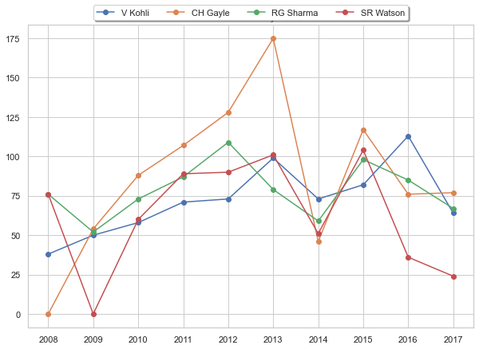
Batsman Comparison
Plot showing comparison of top 4 batsmen performance over the course of multiple seasons
Commentators use this data to predict each season who would be the top player and so.
Interpretation: Higher the better, 0 indicates that the player has not participated in that season

Slide 12
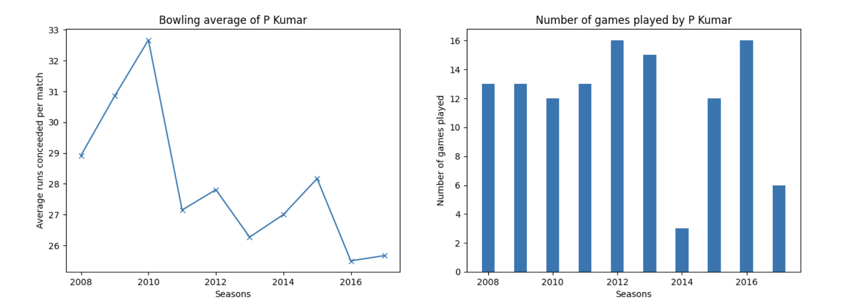
Bowler Statistics
Interpretation Lower the better
Useful information on how costly the bowler is
Useful for the teams to decide on the bowling strategy
Notes:
2016

Slide 13
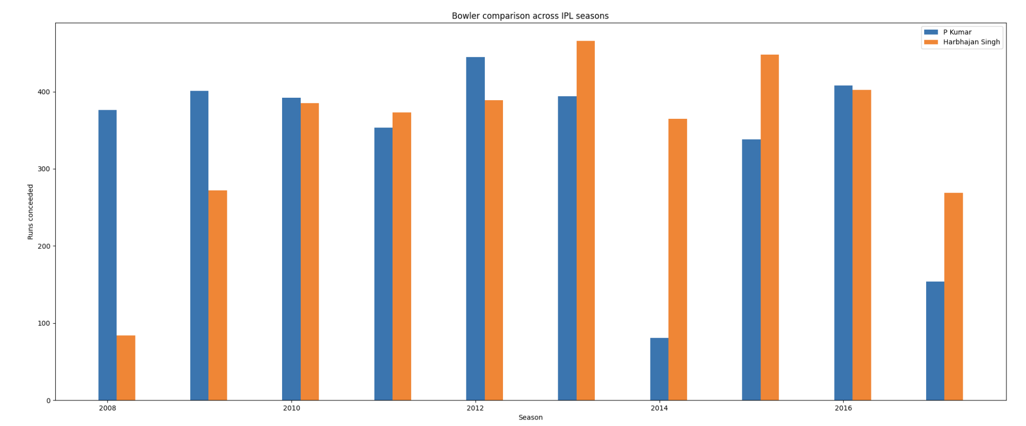
Bowler Statistics
Interpretation: Lower the better
Provides neat comparison between two bowlers across their IPL career
Aids teams to make the right decision during auction

Slide 14
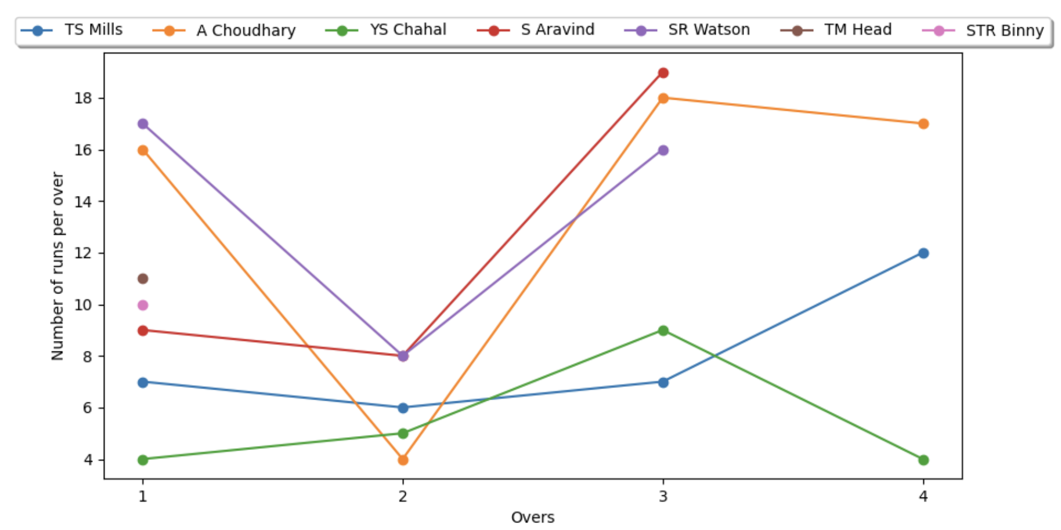
Bowling statistics (per inning)
Interpretation: Lower the better
Provides useful information about bowler’s ability to bowl final overs
Notes:
Chahal: consistent across 4 overs
* graph shows single inning

Slide 15
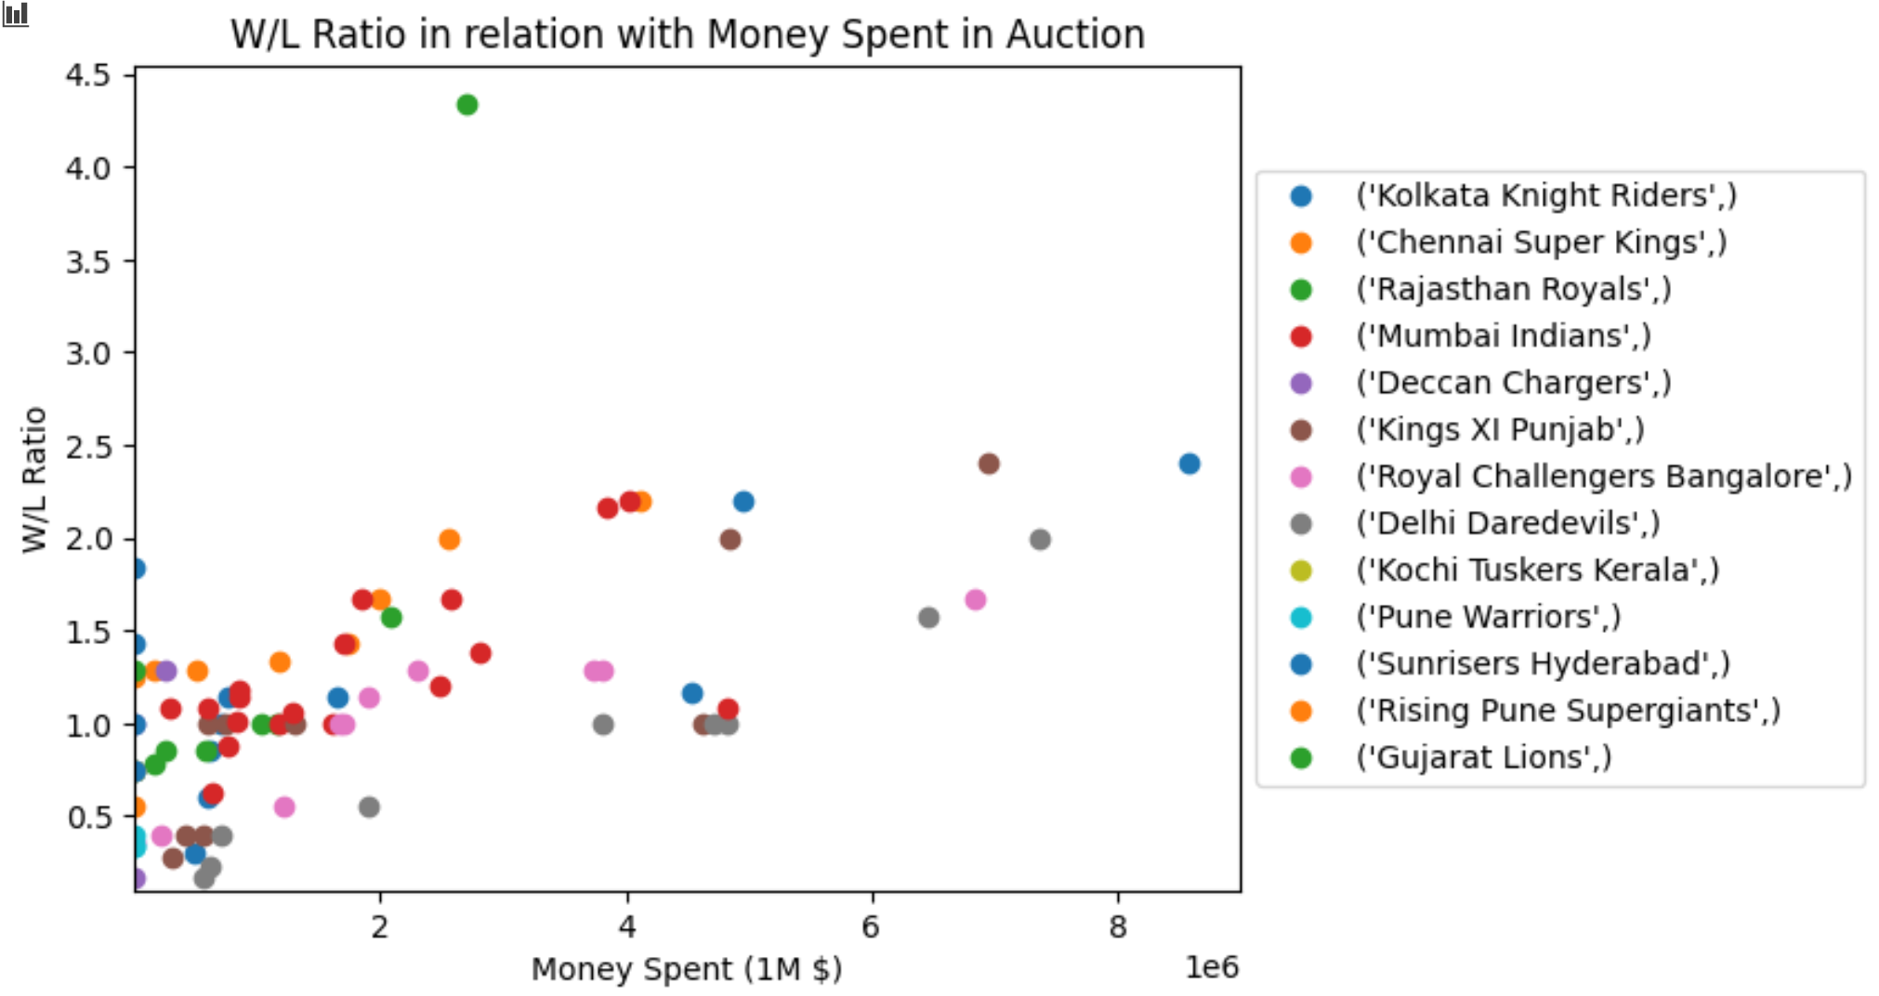
Win/Loss Ratio V.S. Auction Spendings
Win:Loss to money spent per year by each team data points
Positive correlation b/w them
More money spent indicates higher chance of success
Notes:
Shows positive correlation but not strength of correlation

Slide 16
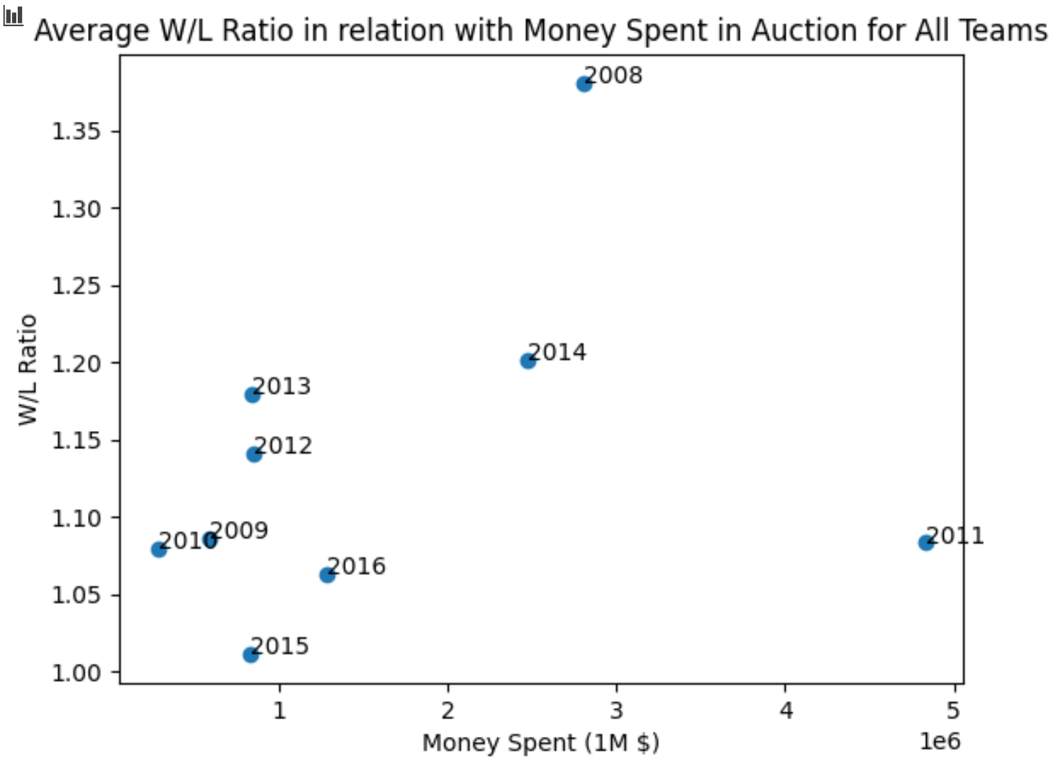
Average W:L vs Auction Spending
Average W:L to average of total spending by all teams per year
Positive but rather weak correlation
Money matters but there are other more important factors such as:
Familiarity with team members
Strategy
Etc
Notes:
Shows strength of correlation

Slide 17
Summary and Applications
Summary of results:
Team success based on in-game strategy:
Able to find useful information for teams to strategize based on toss-decision and player rotation
Other data to consider: field positions, specific player matchups (bowler vs. batter)
Team success based on management decisions:
Positive but weak correlation between win-rate and money spent on players
Other data to consider: team synergy (which players to put on the same team), money spent on training facilities, money spent on coaches
Applications:
Team management can base their investment decisions on these statistics
Individual players can compare their own stats against other players to determine areas where they should improve
Sports-bettors can use these statistics to make better-educated bets
The methodology in this EDA can be applied to any sport

