Slide 1





PROPERTY
INSURANCE SYSTEM
End-to-End Full Stack Insurance Management Platform
Developed By:
K. Srinidhi
Intern at Hartford India

Slide 2

Project Overview
What It Does
A full-stack web application automating the entire lifecycle of property insurance — from customer onboarding through risk calculation to claim settlement and rewards.
4
25+
Customer Registration & Login
User Roles
API Endpoints
Policy Browsing & Request Submission
Agent Assignment & Risk Calculation
Policy Approval Workflow
Claims Filing & Verification
10
18+
Invoice Generation
Referral Reward System
Domain Entities
Angular Features
Light / Dark Mode UI
Real-time Notifications
Property Insurance System · .NET 8 + Angular (v20+)

Slide 3








System Architecture — Clean Architecture (4-Layer)
Domain Layer
Separation of Concerns
Entities · Enums · BaseEntity
Each layer has a single defined role
▼
Application Layer
Scalable & Maintainable
Interfaces · DTOs · Business Logic
New features without breaking existing code
▼
Infrastructure Layer
Enterprise Design
DbContext · AuthService · JwtToken
Industry-standard pattern for large systems
▼
API Layer
Fully Testable
8 Controllers · 25+ Endpoints · Swagger
Business logic fully isolated for xUnit tests with 61 Test Cases
Property Insurance System · .NET 8 + Angular (v20+)

Slide 4

Technology Stack
BACKEND
FRONTEND
C# / .NET 8
Angular (v18+)
ASP.NET Core Web API
TypeScript
Entity Framework Core
RxJS & State Management
SQL Server
HttpClient
JWT Authentication
Tailwind CSS
BCrypt Password Hashing
Angular Auth Guards
Swagger
Unit Testing
xUnit Testing (4 Projects)
Property Insurance System · .NET 8 + Angular (v20+)

Slide 5

Domain Layer — Core Business Entities
10 Core Entities
BaseEntity
ApplicationUser
PolicyRequest
Provides timestamps & soft delete for all entities
PropertyCategory
PropertySubCategory
Relationships
PropertyPlans
Claims
Properly configured FK chains via EF Core
Invoice
Notification
Type Safety
RefreshToken
BaseEntity
Enum-driven status fields for predictable state
4 Enums
UserRole
PolicyRequestStatus
ClaimStatus
PremiumFrequency
Property Insurance System ·· .NET 8 + Angular (v20+)

Slide 6
Application Layer — Interfaces & DTOs
16 Data Transfer Objects (DTOs)
Interfaces
IAuthService
RegisterRequestDto
LoginRequestDto
ICategoryService
AuthResponseDto
CreatePolicyRequestDto
CreateClaimDto
VerifyClaimDto
+ 10 more Services...
CategoryResponseDto
PolicyRequestResponseDto
+ 8 more DTOs...
Secure Exposure: DTOs hide sensitive entity fields from clients
Clean Separation: Entities never leave the domain layer boundary
Property Insurance System · .NET 8 + Angular (v20+)

Slide 7

Infrastructure Layer — Services & Data
ApplicationDbContext
Core Services
Key Capabilities
All entity relationships
AuthService — Register & Login
JWT creation & refresh tokens
Unique email index
CategoryService — Plans
EF Core migrations
Seed data (Users, Plans)
JwtTokenGenerator
Seeded demo data
FK configurations
Referral Reward Logic
Email uniqueness enforce
EF Core Eager Loading
BCrypt Hashing
Agent commission calc

Slide 8
API Layer — 8 Controllers · 25+ Endpoints
1
AuthController
2
AdminController
Register · Login · Refresh
Assign · Approve · Statistics
3
PolicyRequestController
4
ClaimsController
Submit · Track · Manage
File · Verify · Settle
5
CategoryController
6
PropertyPlansController
Categories & Subcategories
Browse · Create · Update Plans
7
InvoicesController
8
NotificationsController
Generate · Download Invoices
Push · Read · Manage Alerts
25+ · REST Endpoints
4 · Role Levels
JWT · Auth Method

Slide 9
Complete Policy Workflow — 10 Steps
01
Customer
02
Admin
Submit Policy Request
Assign Agent
03
Agent
04
Customer
Send Property Details Form
Submit Property Details
05
Agent
06
Customer
Calculate Risk & Premium
Confirm & Purchase Policy
07
Admin
08
Customer
Final Approval
File Claim (if needed)
09
Claims Officer
10
System
Verify & Approve Claim
Invoice Generated + Reward

Slide 10

Risk Calculation & Premium Logic
Risk Assessment Rules
Automated Installments
Monthly/quarterly auto-calc per PremiumFrequency
Property Age > 10 years
+30 Risk Points
Agent Commission
Commission = BasePremium × (Agent Commission % / 100)
Property Value > ₹2,50,000
+40 Risk Points
Dynamic Adjustment
Premium updates automatically with risk score
Premium Formula
Transparent Pricing
FinalPremium = BasePremium × RiskScore
Customer sees full breakdown before confirming

Slide 11


Security Implementation
JWT Bearer Auth
Role-Based Auth
Stateless token auth for all API requests
Admin · Agent · Customer · Claims Officer
BCrypt Hashing
Angular Auth Guard
Passwords salted + hashed — never plaintext
Frontend route protection by user role
HTTP Interceptor
CORS Restriction
Auto JWT injection into every outbound request
Only whitelisted origins reach the API

Slide 12

Angular Frontend Structure
Core Services
Project Structure
auth.service
policy-requests.service
📁 core/
auth.service.ts
interceptors/
claims.service
admin.service
📁 features/
admin/ · agent/ · customer/
invoices.service
notifications.service
claims-officer/
📁 shared/
components/ · models/
theme.service
rewards.service
📁 environments/
theme.service.ts
notifications.service.ts
Lazy-loaded feature modules
Role-based dashboards per user
Light / Dark theme engine

Slide 13


Role-Based Dashboards — 4 User Roles
Admin
Agent
Customer
Claims Officer
Assign agents to requests
View assigned policies
Browse insurance plans
View pending claims
Approve / Reject policies
Send property forms
Submit policy requests
Verify claim documents
View system statistics
Calculate risk & premium
Track policy status
Approve or reject claims
Manage staff & plans
Track earnings & commission
File claims · Redeem rewards
Trigger invoice generation

Slide 14
Database Design — SQL Server
9 Core Tables
Users
RefreshTokens
PropertyCategories
PropertySubCategories
PropertyPlans
PolicyRequests
Claims
Invoices
Notifications
Foreign key relationships across all entities
Indexed email field for uniqueness
Seeded demo data for dev/testing

Slide 15



Referral Rewards System
01
02
03
04
→
→
→
Customer Signs Up
Referral Detected
Reward Credited
Redeem Rewards
New user registers using a referral code from an existing customer
System automatically links the new account to the referrer
Referrer earns bonus reward points upon referred user's first policy
Reward points redeemable for premium discounts or cashback
₹50
∞
Auto
Instant
Reward per Referral
No Referral Limit
System Detected
Credit on Activation
Property Insurance System · .NET 8 + Angular (v20+)

Slide 16

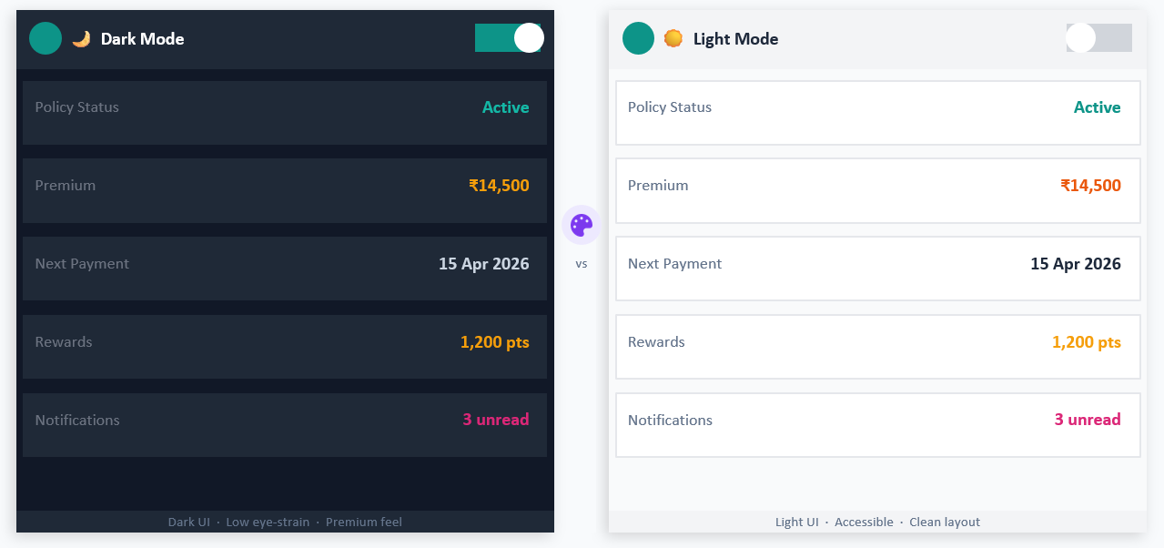
Light / Dark Mode — Adaptive UI Theme Engine
Property Insurance System · .NET 8 + Angular (v20+)

Slide 17





Notifications System — Real-Time Alerts
Notification Types
How Notifications Work
Policy Approved
01
Trigger
Your policy #P2025 has been approved by admin
System event occurs (approval, claim, invoice, reward)
Agent Assigned
02
Generate
NotificationsController creates a Notification entity
Agent Ravi Kumar has been assigned to your request
03
Store
Payment Reminder
Saved to Notifications table with userId & message
Your premium payment is due on 15 Apr 2026
04
Deliver
Claim Rejected
Angular polls & displays unread count + bell badge
Claim #C2025 was rejected — insufficient documents
05
Mark Read
User clicks notification → marked read in DB
Reward Earned
You earned 50 reward points for referral!
Property Insurance System · .NET 8 + Angular (v20+)

Slide 18
Project Scale & Key Highlights
4
10
16
Backend Projects
Domain Entities
DTOs
8
25+
20+
Controllers
API Endpoints
Angular Components
KEY HIGHLIGHTS
Clean Architecture
Dynamic Fraud Validations
Referral Reward System
Light / Dark Mode UI
Real-time Notifications
Enterprise-Level Design
Built with .NET 8 · Angular (v20+) · Clean Architecture · Enterprise Grade

Slide 19
THANK YOU
I would like to sincerely thank The Hartford for providing this opportunity and supporting learning and innovation.
I extend my gratitude to GUVI and the entire team for organizing and guiding this program.
Special thanks to Surya Thammiraju, Head and Managing Director, India – The Hartford, for leadership and encouragement.
Heartfelt thanks to Ranjan Bhatnagar, Microsoft Certified Instructor with 30+ years of experience, for sharing valuable knowledge and insights.
Thanks to Koti Rama Murthy Davuluri, Senior Staff Software Engineer at The Hartford, for guidance and technical support throughout the journey.

