Slide 1
AIRLINE CHALLENGE
SRINIDHI RACHAVELPULA

Slide 2
INTRODUCTION
We are working on a data Challenge given by the Capital One to showcase skills and abilities that align with data analysis. The challenge tests one in the areas of data management, business intelligence and building mindset.
The project considers an airline company which is looking to enter United States Domestic Market. It has to decide 5 round trips between various destination airports. It is planning in acquiring 5 new airplanes and the upfront cost for each airplane is $90 Million. The company’s motto is “On Time, For You” which is a big part of it’s brand image. The task involves analyzing 1Q2019 data to identify goals.
The company has provided us with 3 datasets - Airport_Codes.CSV which consists of data related to airport, Flights.CSV consists of data related to Flights information, Tickets.CSV which consists of data related to the tickets and it’s fare.

Slide 3
GOALS
1. The 10 busiest round-trip routes in terms of number of round-trip flights in the quarter.
Exclude canceled flights when performing the calculation.
2. The 10 most profitable round-trip routes (without considering the upfront airplane cost) in
the quarter. Along with the profit, show total revenue, total cost, summary values of
other key components and total round trip flights in the quarter for the top 10 most
profitable routes. Exclude canceled flights from these calculations.
3. The 5 round trip routes that you recommend investing in based on any factors that you
choose.
4. The number of round-trip flights it will take to breakeven on the upfront airplane cost for
each of the 5 round trip routes that you recommend.
5. Key Performance Indicators (KPI’s) that you recommend tracking in the future to
measure the success of the round trip routes that you recommend.

Slide 4
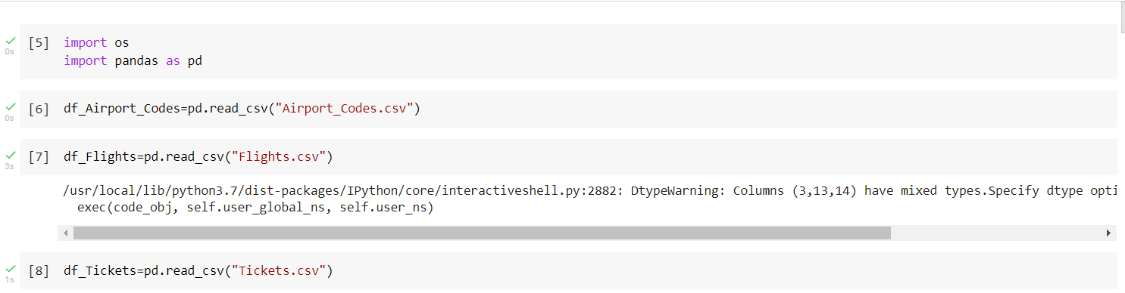
Importing Libraries and Dataset

Slide 5
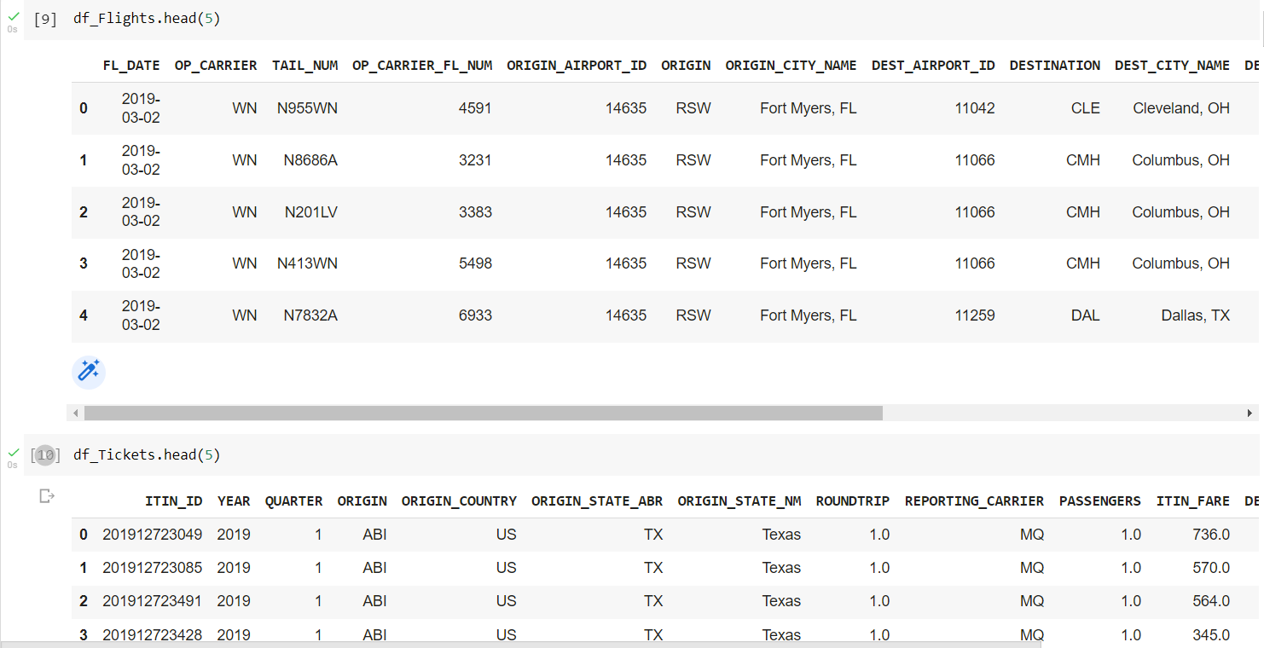
Displaying Top Five Rows of The Dataset

Slide 6
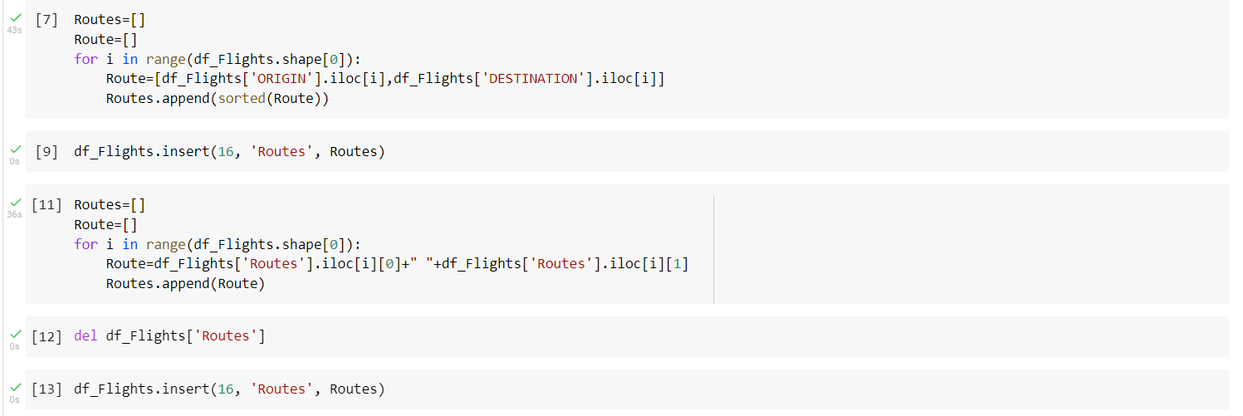
Sorting Data

Slide 7
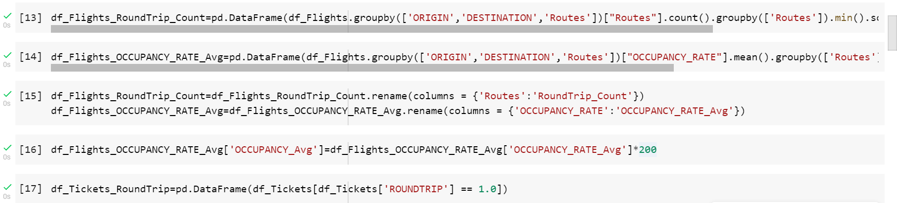
Considering Round Trips

Slide 8
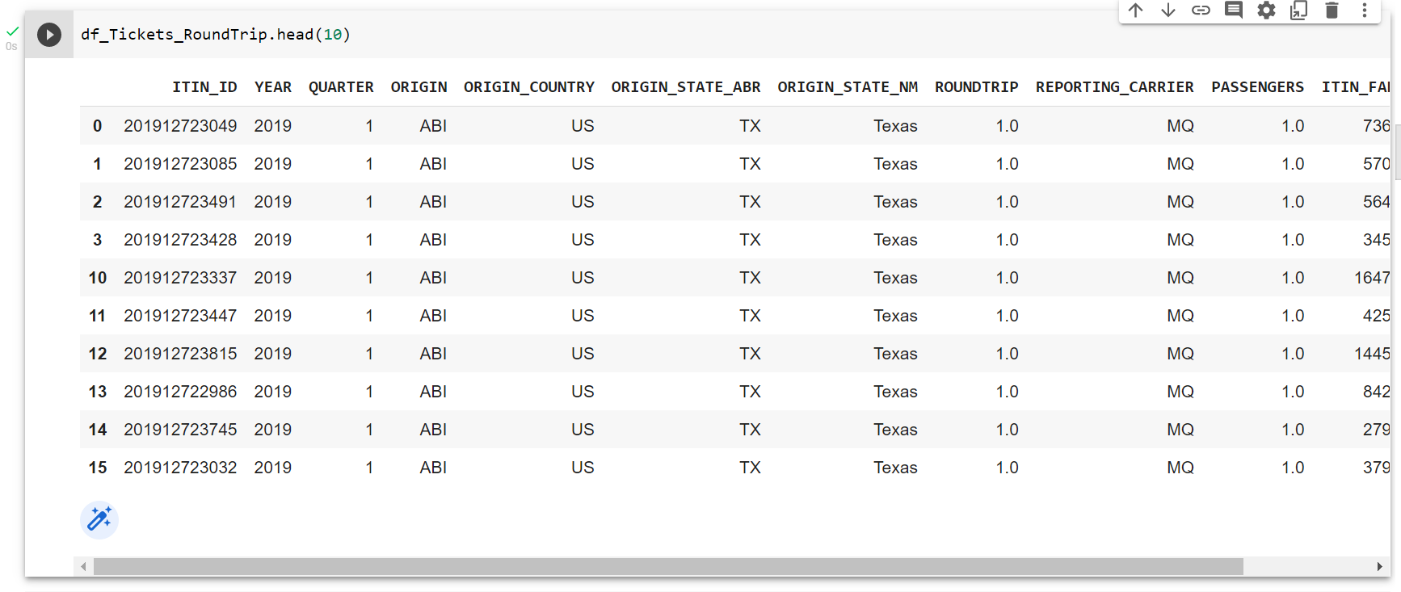
Description of Round - Trips

Slide 9
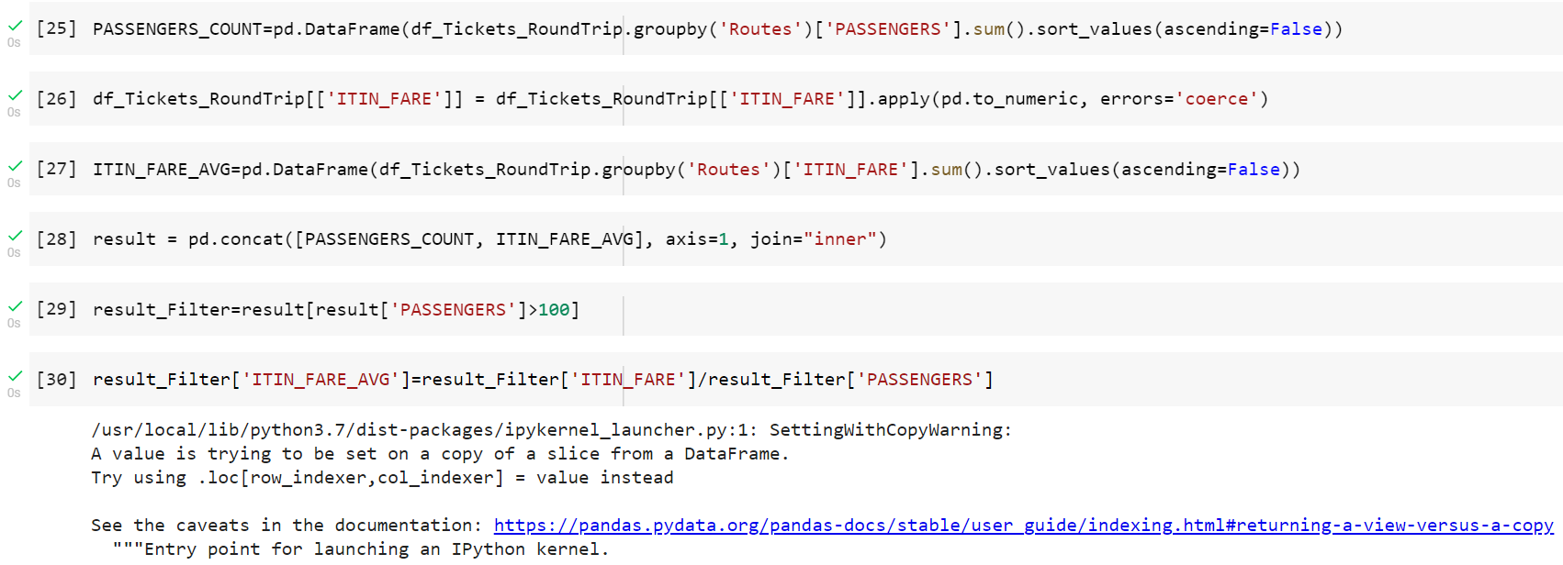
Calculating Average Fare

Slide 10
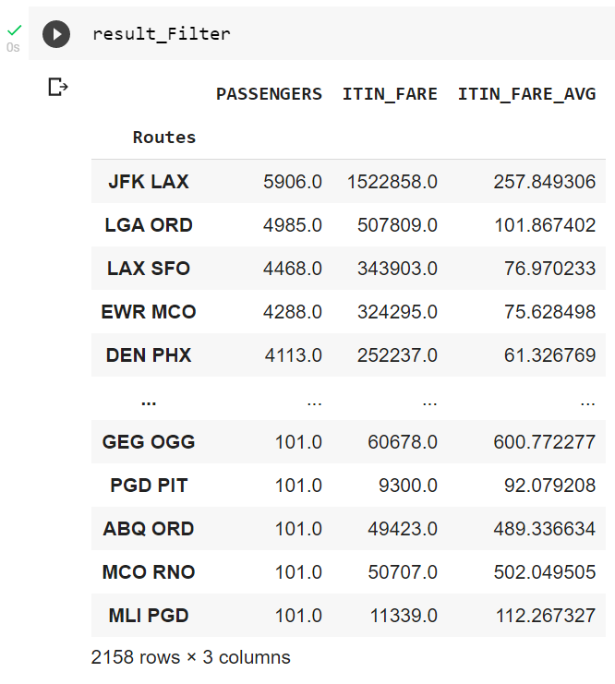
Result of Fare Charges

Slide 11
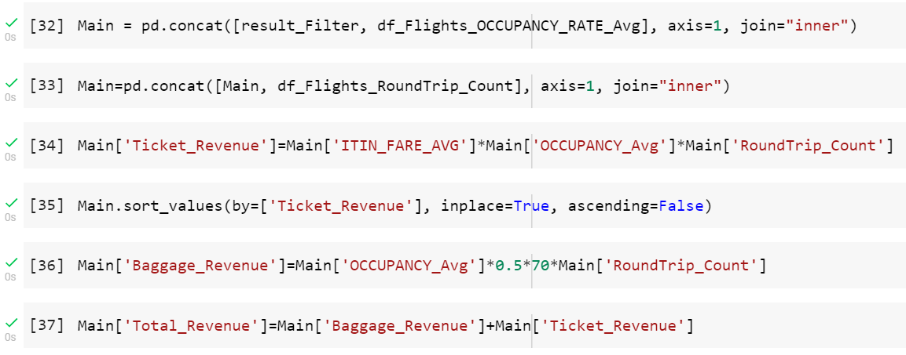
Calculating Revenues

Slide 12
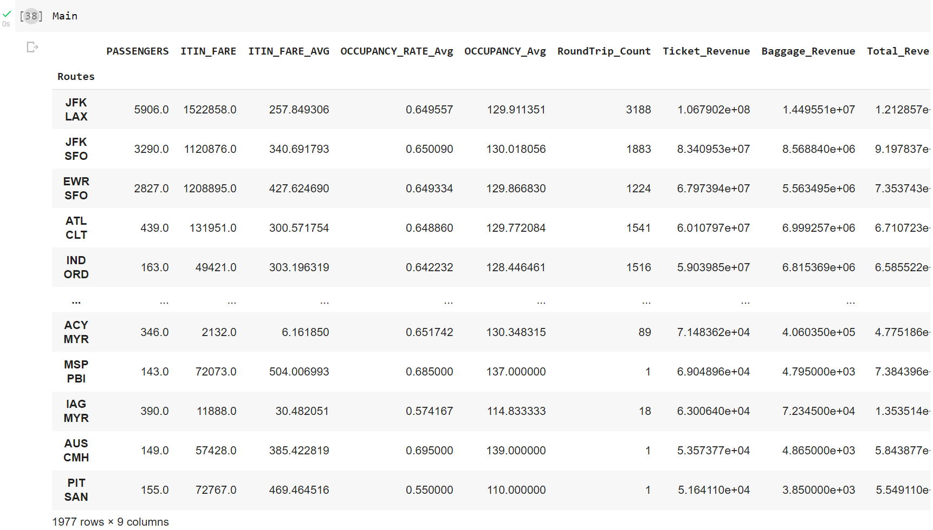
Main File(Intermediate Stage)

Slide 13
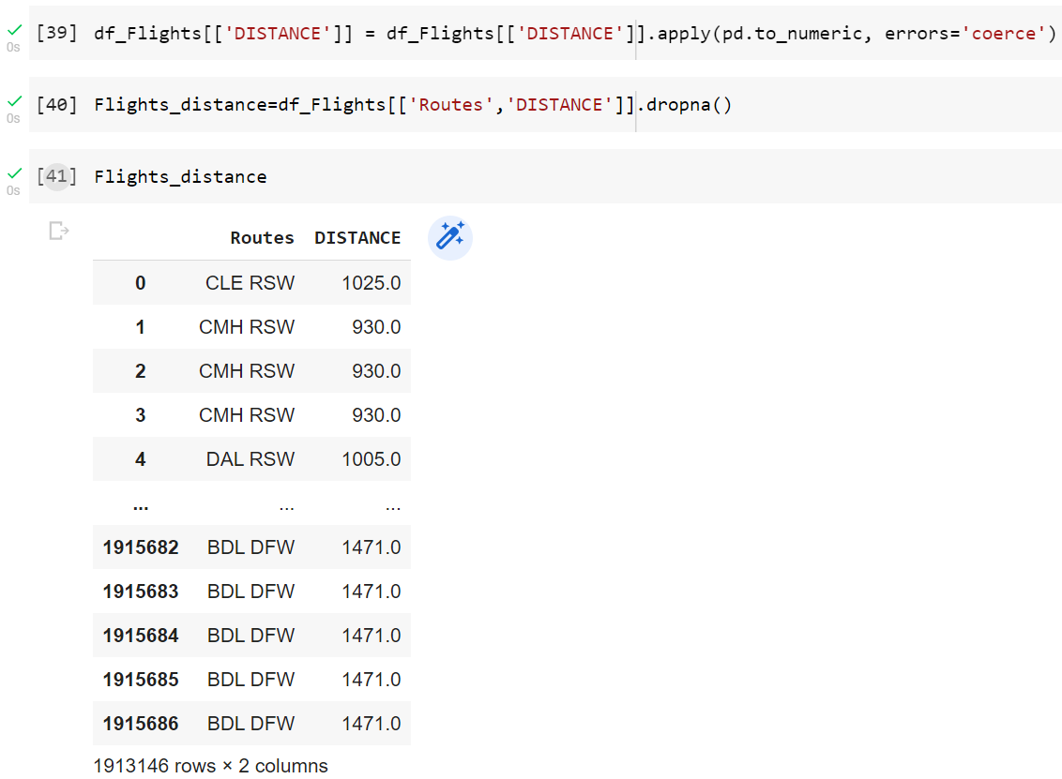
Distance Calculation

Slide 14
Addition of Flight_distance into the Main file

Slide 15
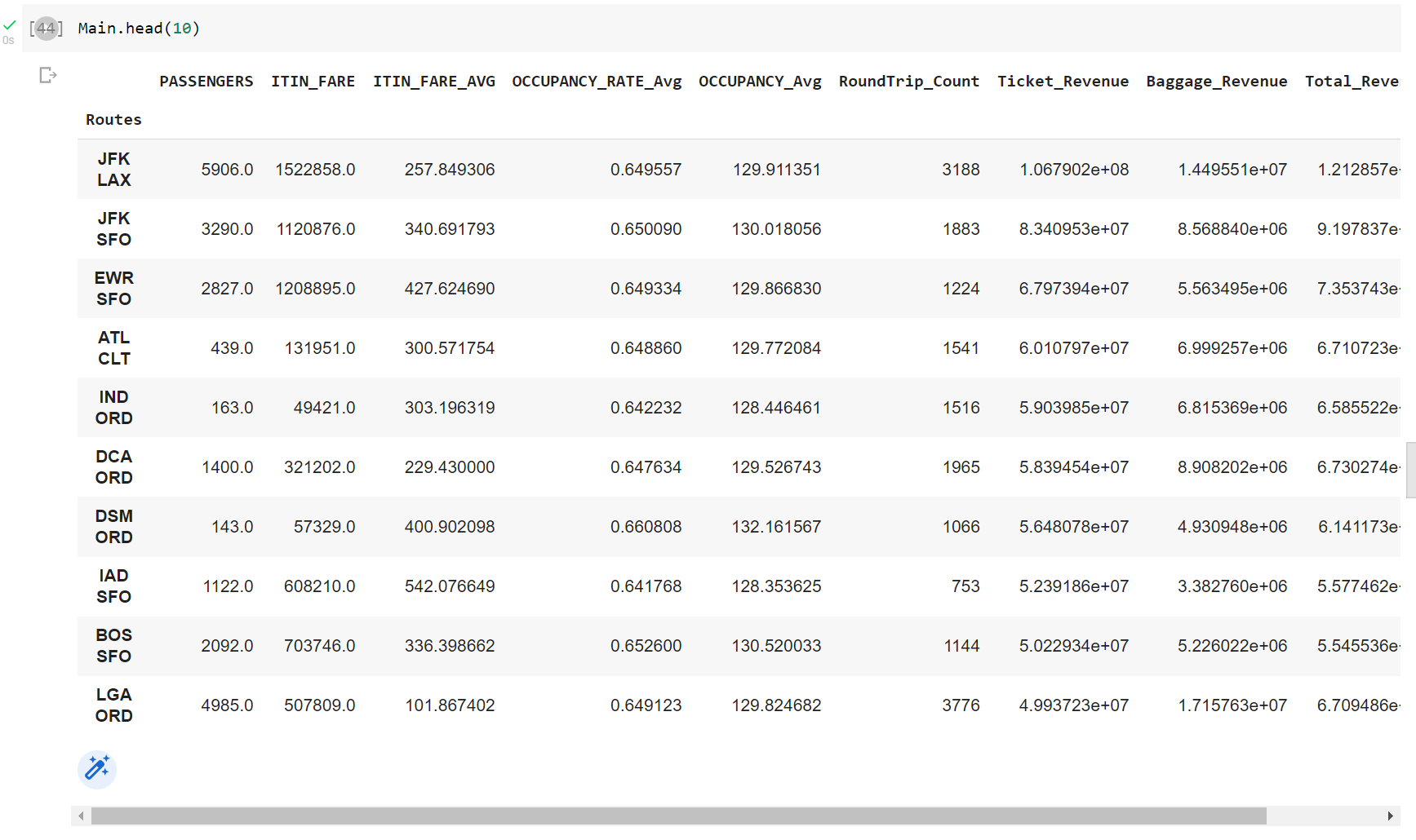
Addition of Revenue to Main File

Slide 16
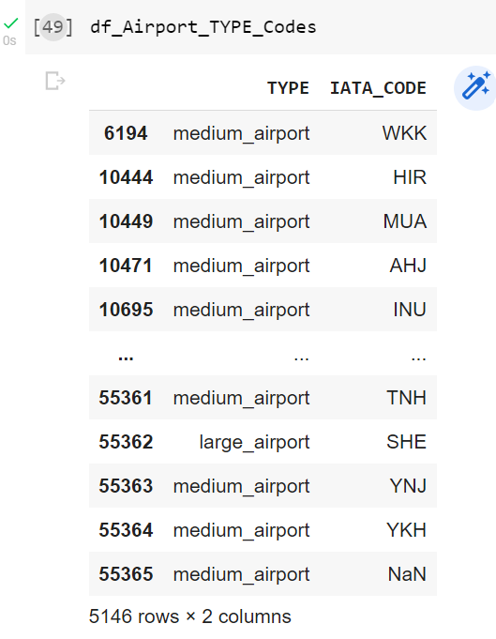
Display of Type of Airport

Slide 17
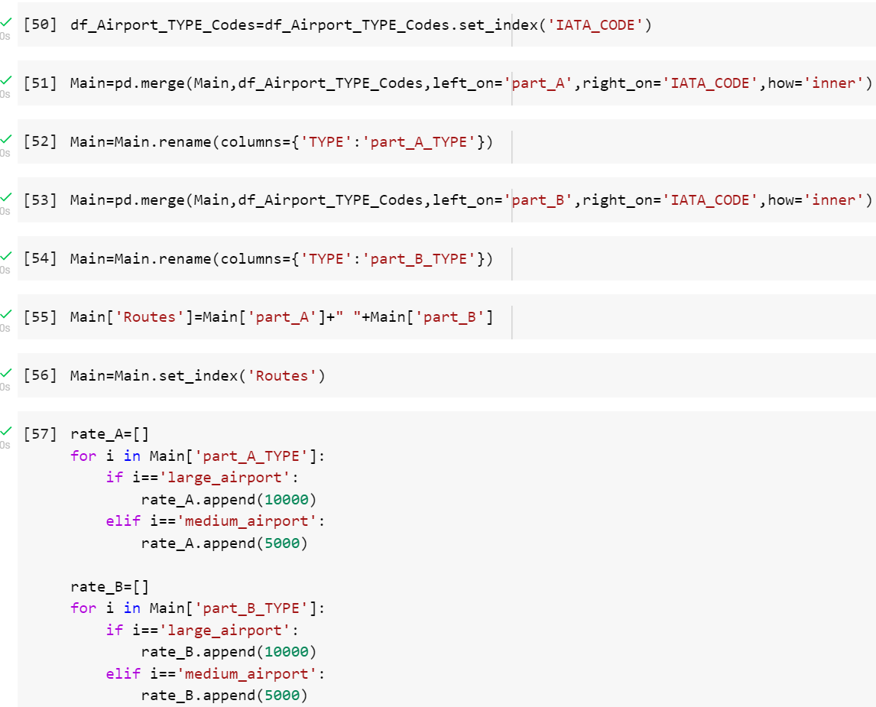
Splitting Airport Codes and Determining Types

Slide 18
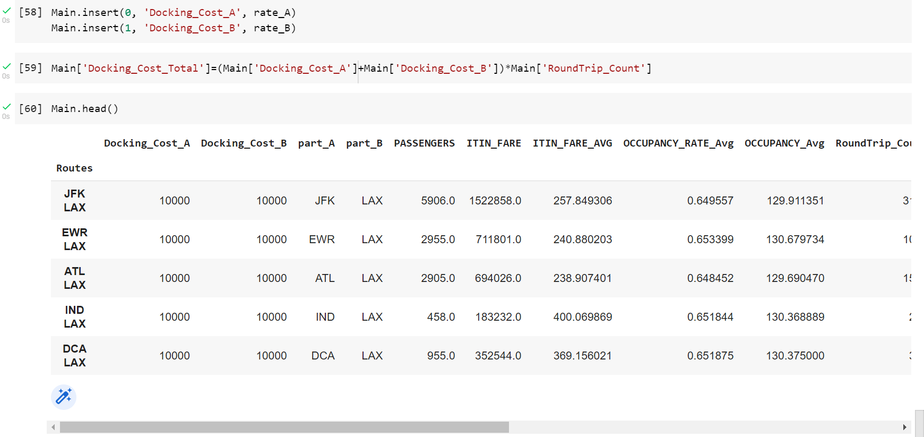
Docking Cost

Slide 19
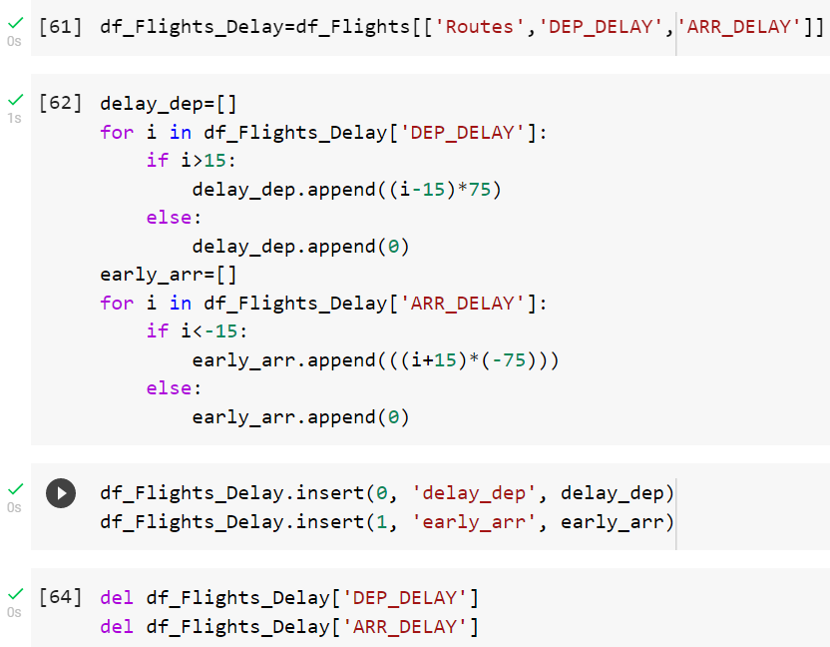
Delay Cost

Slide 20
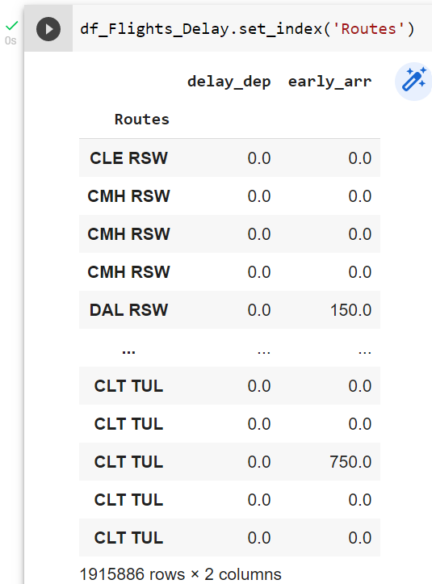
Result of Delay Cost

Slide 21
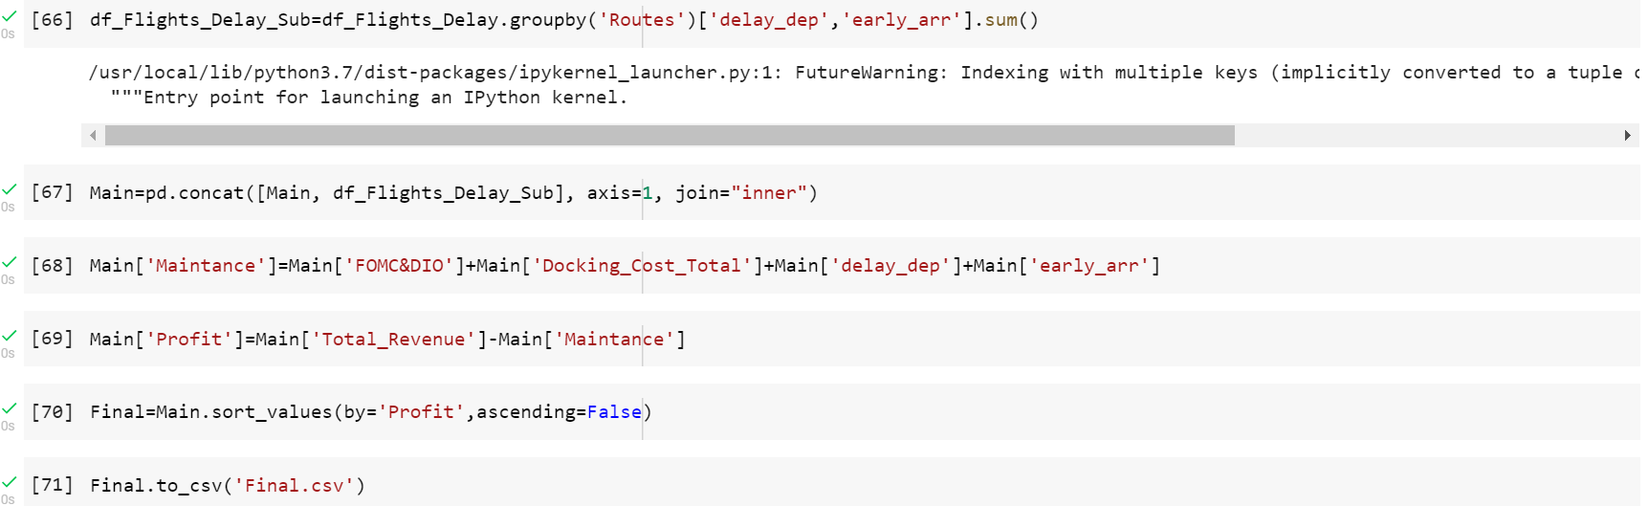
Final File Obtained

Slide 22
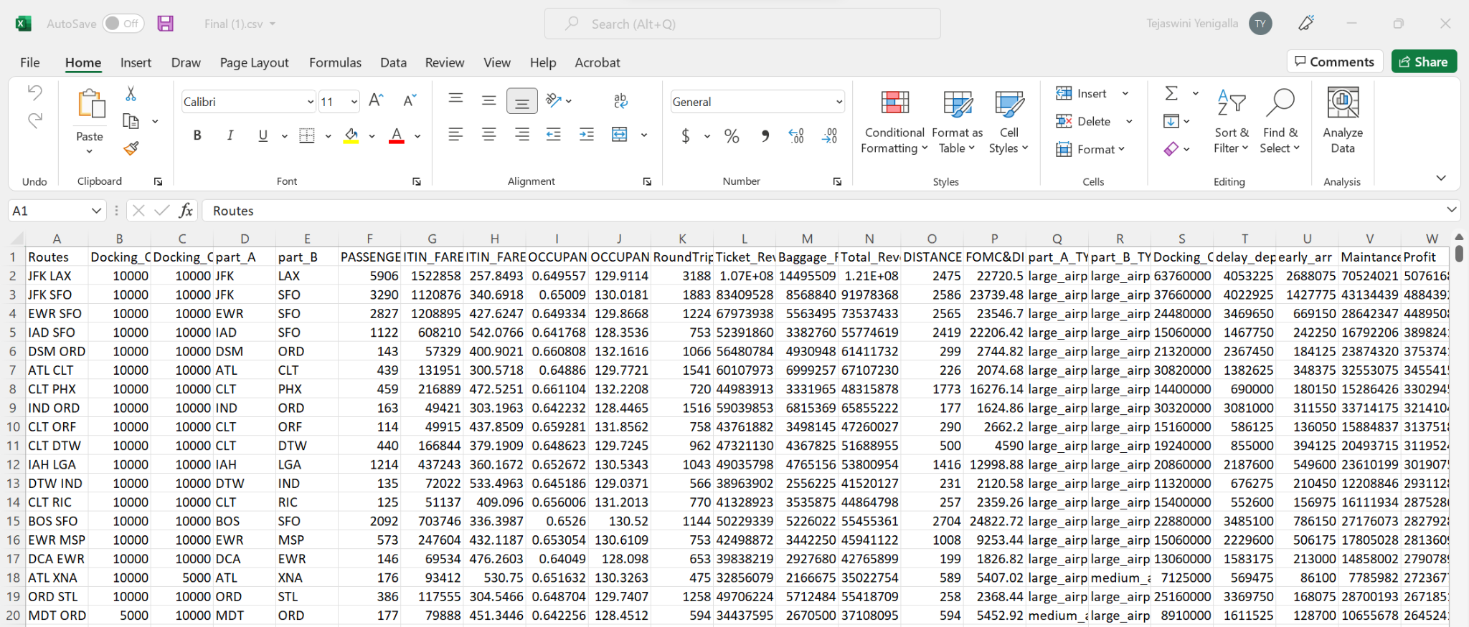
Output File

Slide 23
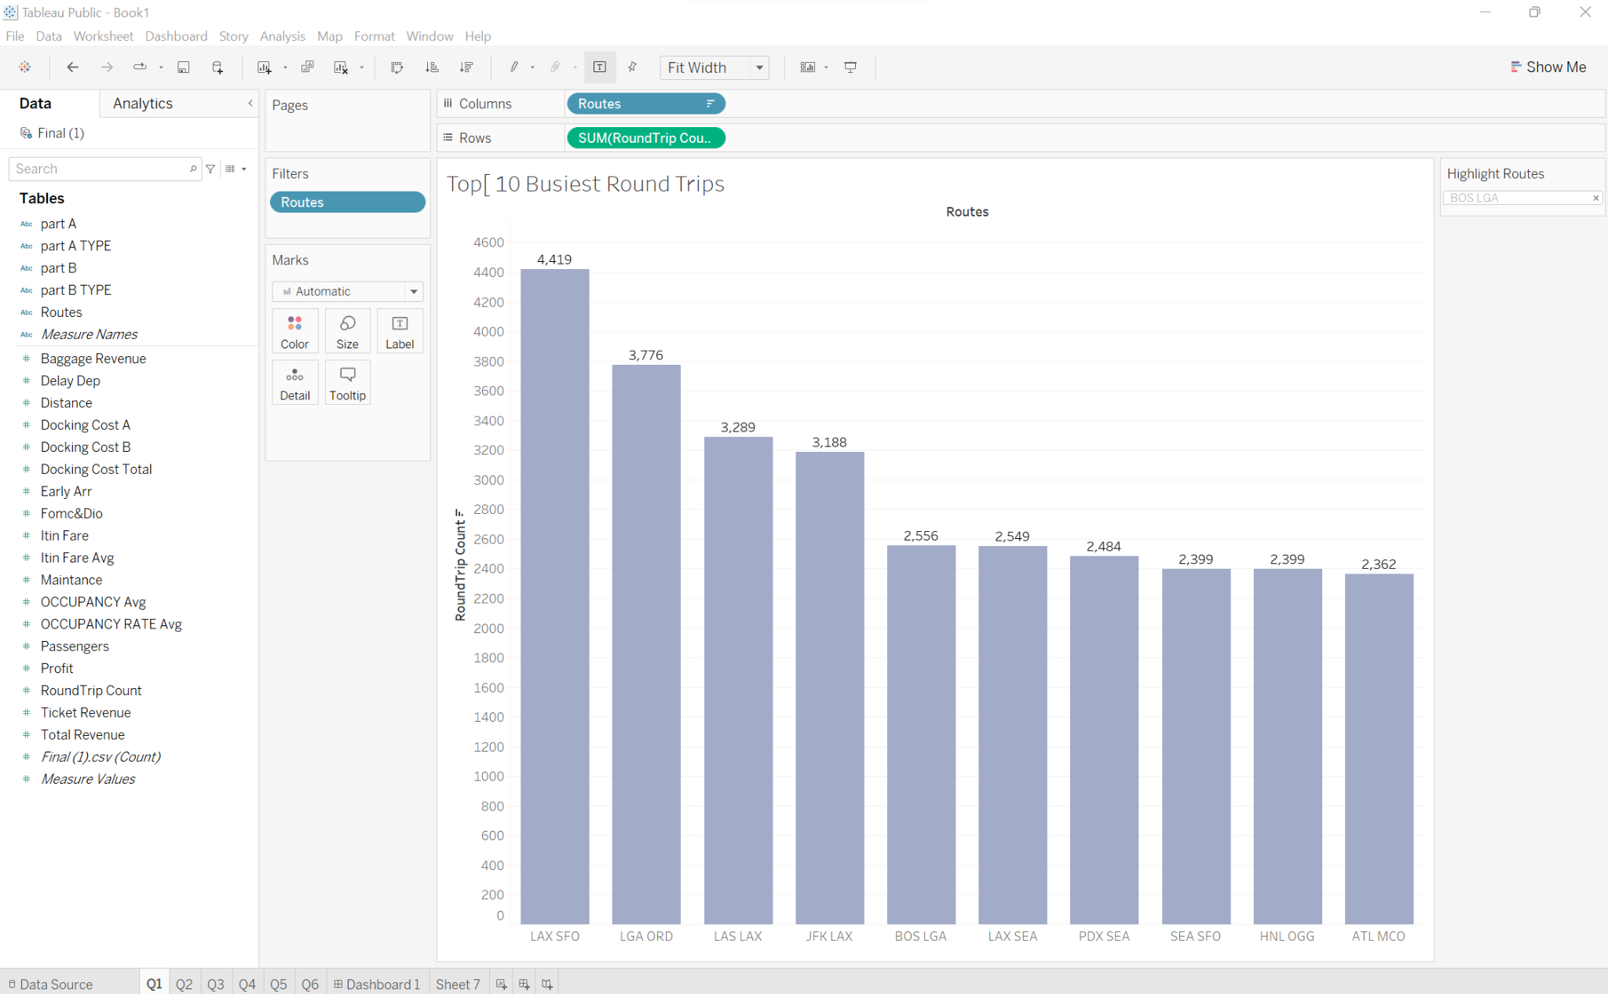
The 10 busiest round-trip routes in terms of number of round-trip flights in the quarter.
Exclude canceled flights when performing the calculation.

Slide 24
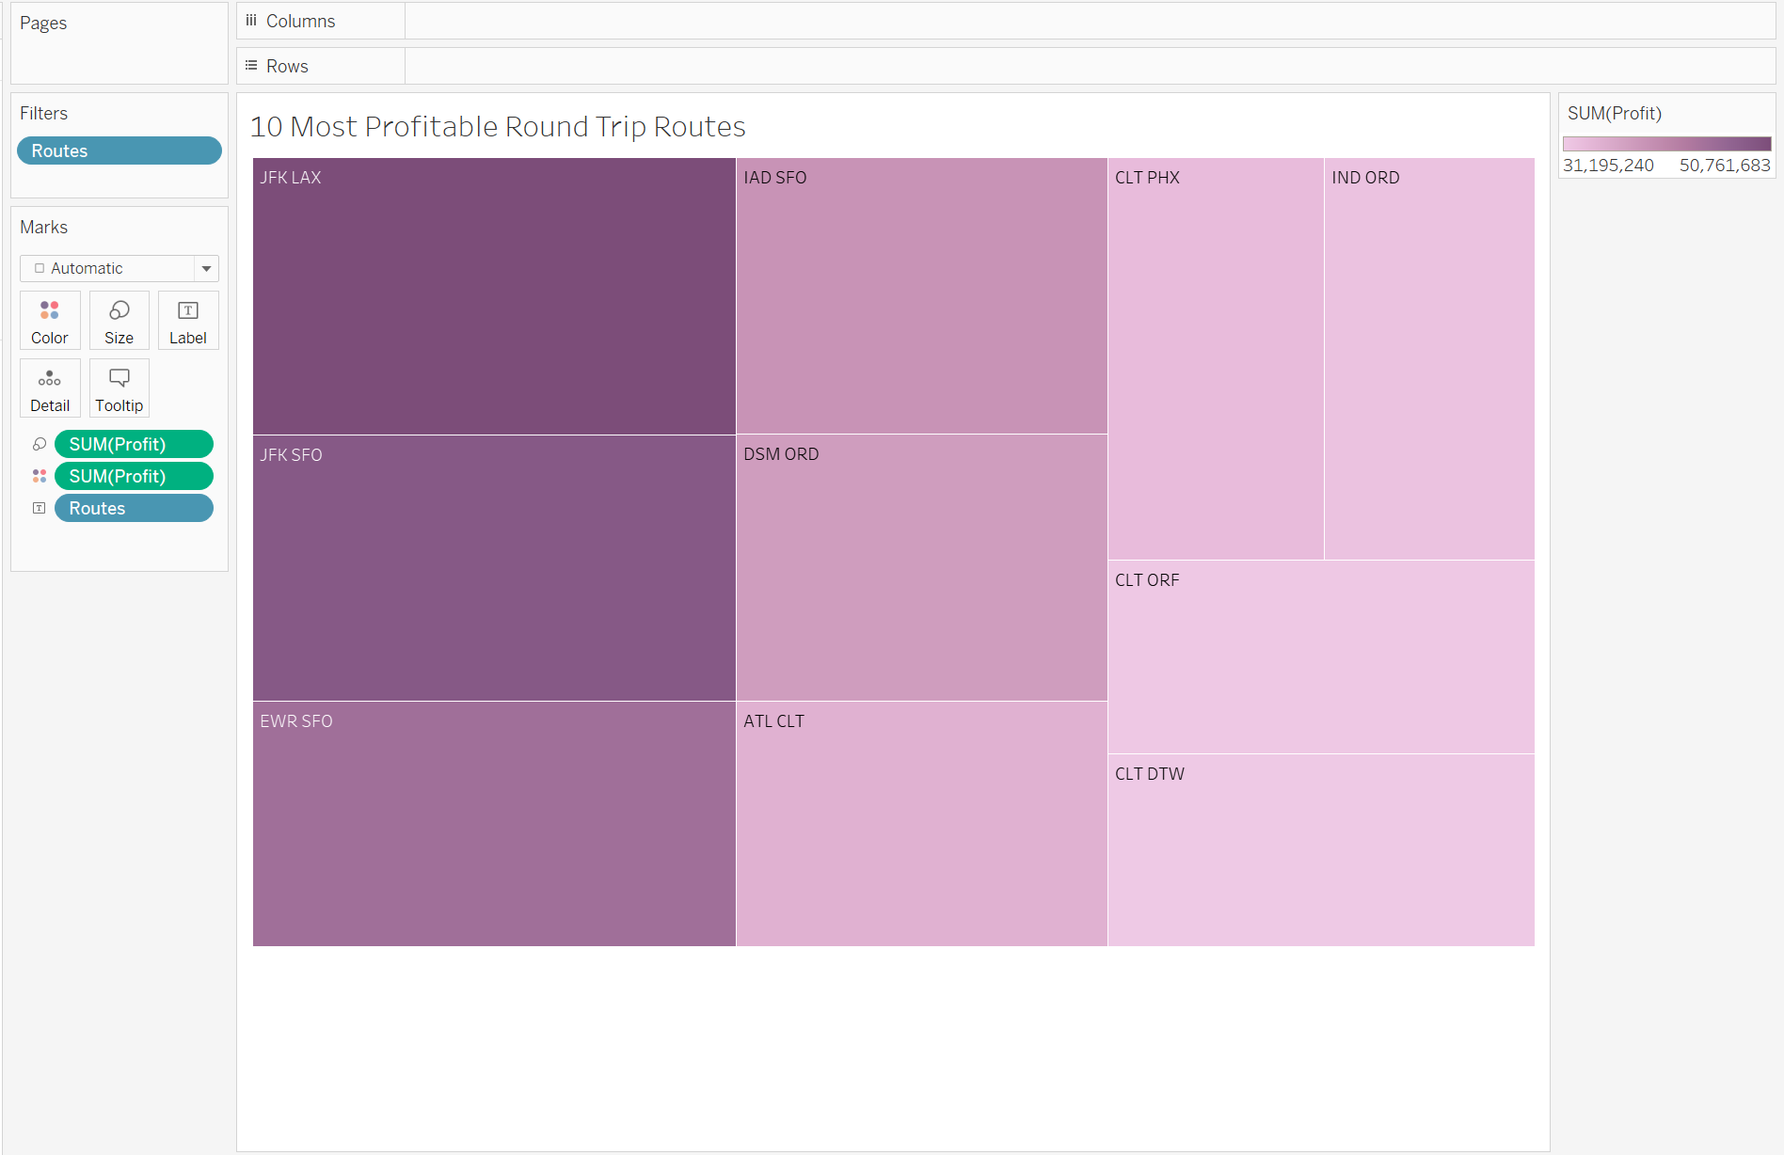
The 10 most profitable round-trip routes (without considering the upfront airplane cost) in
the quarter. Along with the profit, show total revenue, total cost, summary values of
other key components and total round trip flights in the quarter for the top 10 most
profitable routes. Exclude canceled flights from these calculations

Slide 25
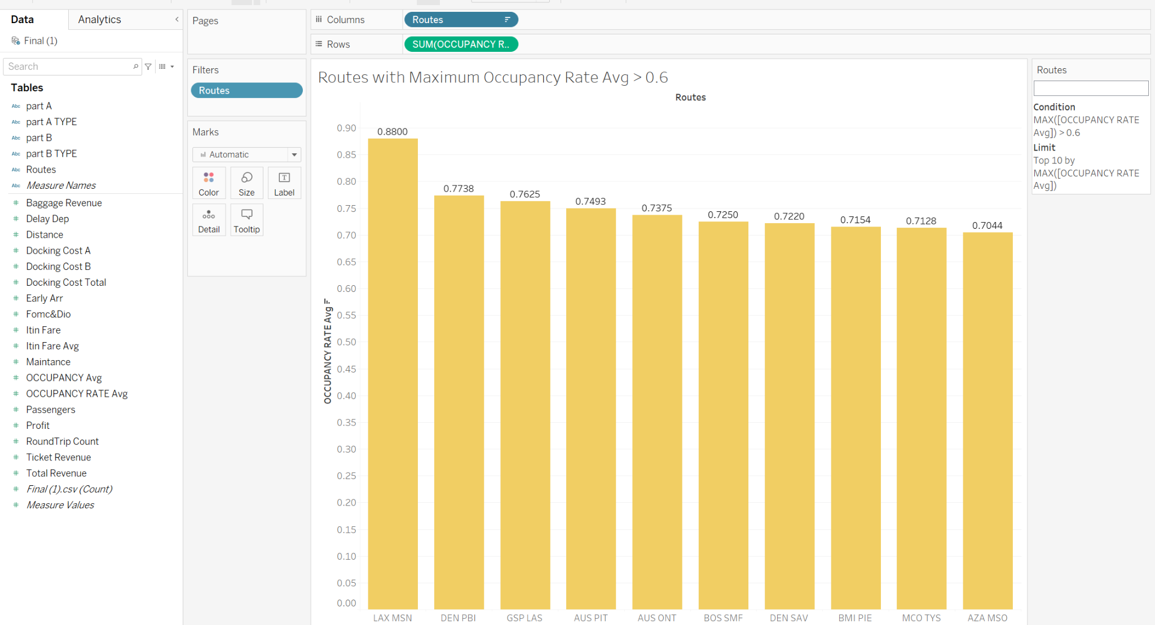
Routes with Occupancy Rate Avg > 0.6

Slide 26
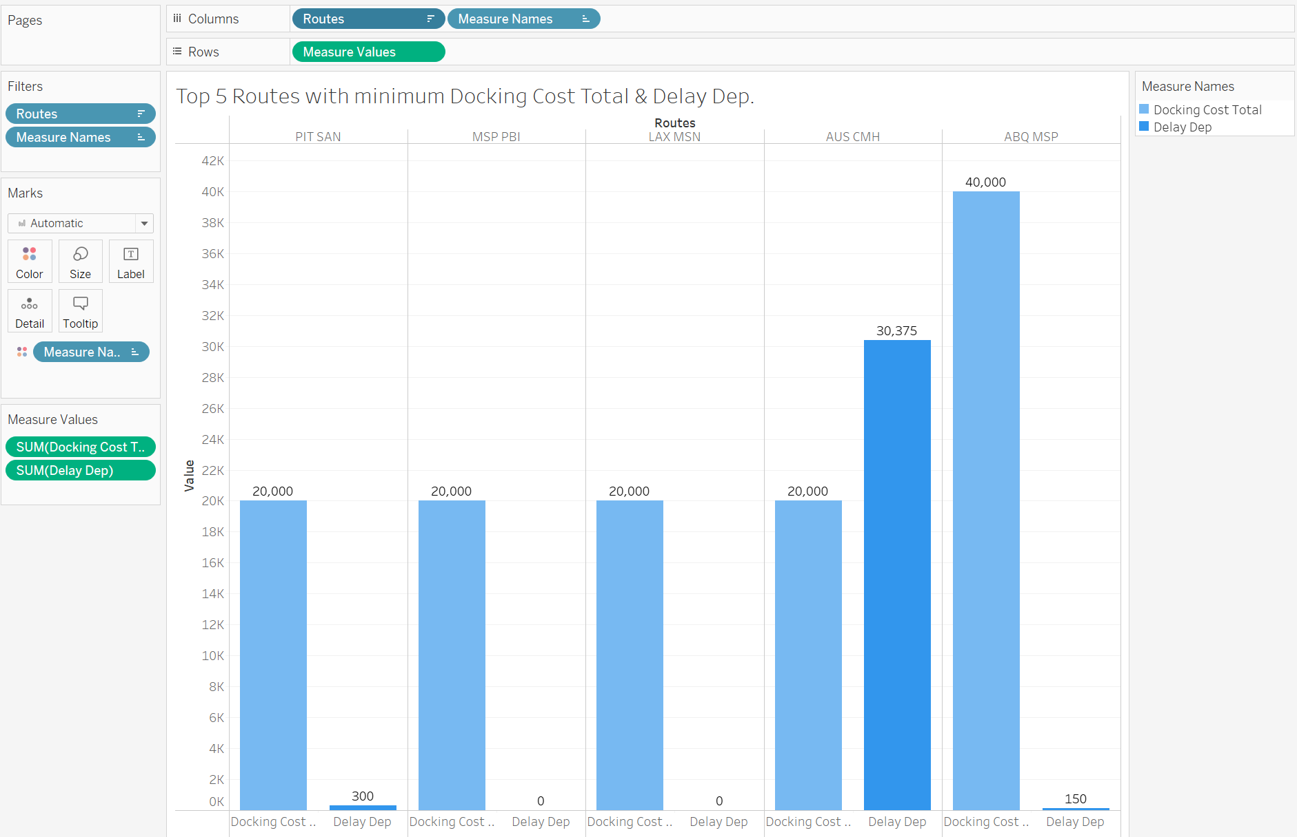
Top 5 Routes with minimum Docking Cost Total & Delay Dep.

Slide 27
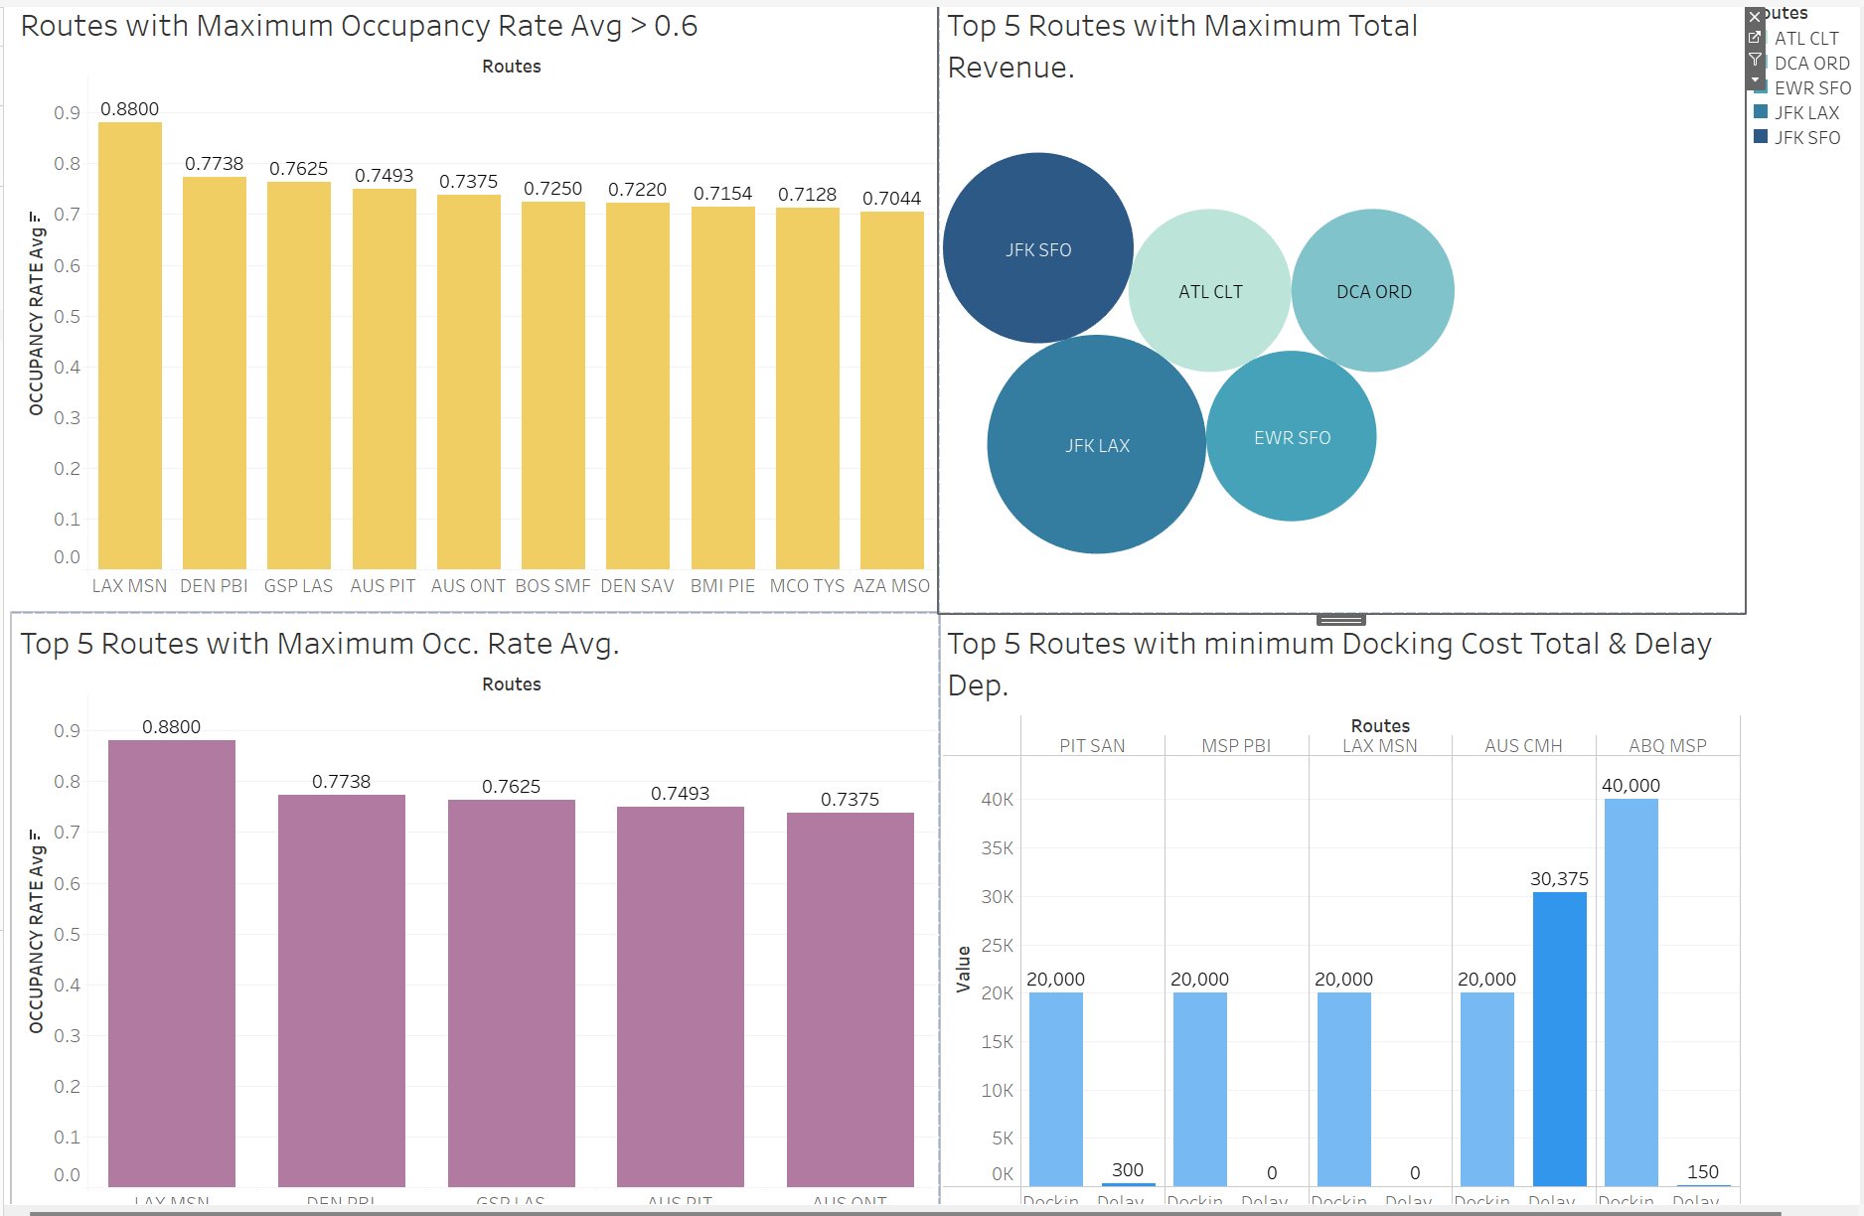
Final Dashboard.

Slide 28
The 5 round trip routes that you recommend investing in based on any factors that you
choose.
Referring to the final dashboard we conclude that the following routes are worth investing in:
PIT SAN
MSP PBI
LAX MSN
AUS CMH
ABQ MSP

Slide 29
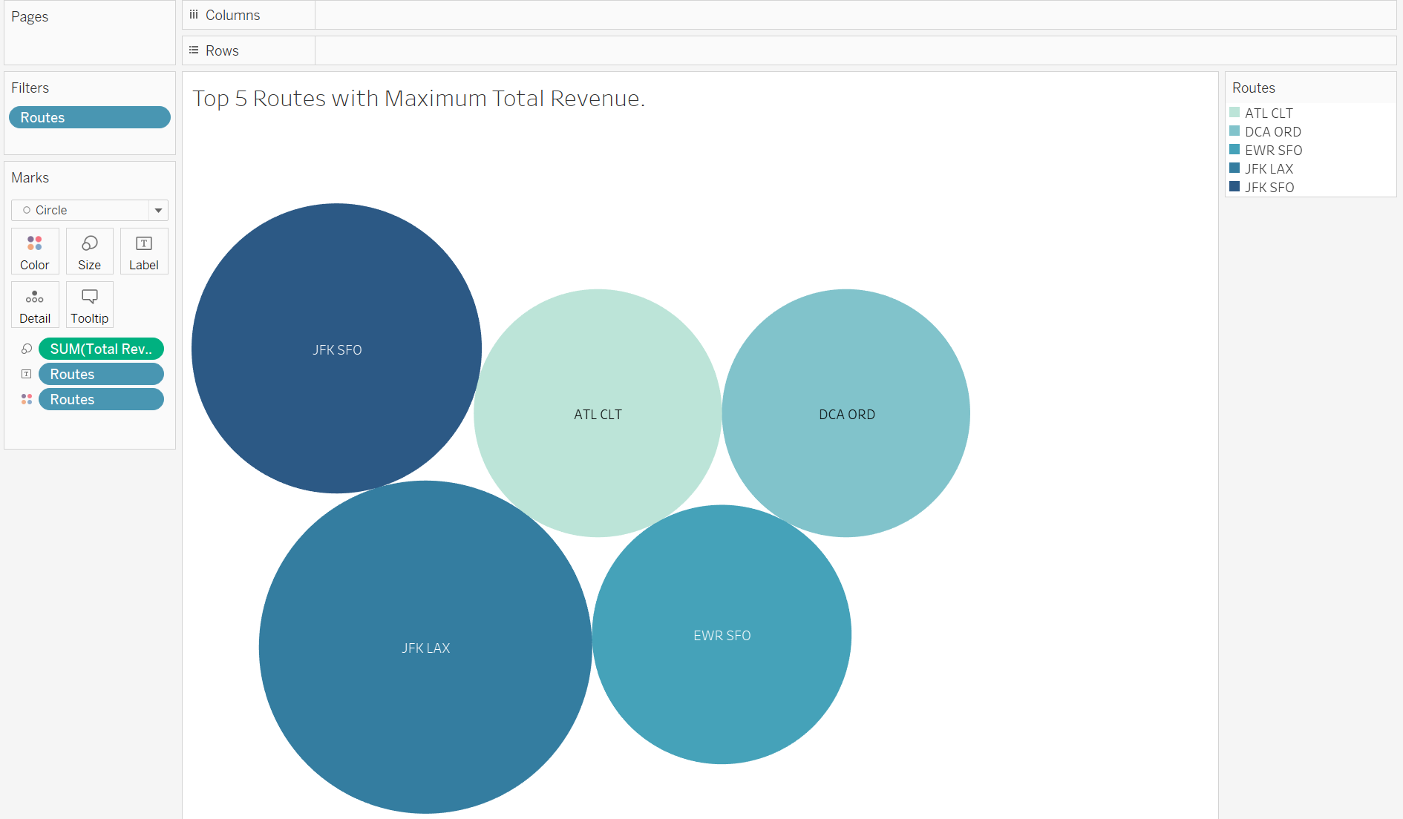
Top 5 Routes with Maximum Total Revenue.

Slide 30
The number of round-trip flights it will take to breakeven on the upfront airplane cost for
each of the 5 round trip routes that you recommend.
Based on the packed bubbles chart , we concluded the following :
JFK LAX
JFK SFO
EWR SFO
DCA ORD
ATL CLT

Slide 31
Key Performance Indicators (KPI’s) that you recommend tracking in the future to
measure the success of the round trip routes that you recommend.
Profit: We Believe that its one of the most important performance indicators out there which is important to keep it in mind. We should consider both gross and net profit margin to see how well your business is doing at generating a high return.
Sales By Region: Analyzing the flight round-trips by region will help give better insights and provide better feedback for underperform.
Customer Satisfaction: Customers drive the performance of the flights. It is mandatory to consider this as a main KPI as the company also runs on the same motto. It's also helpful in giving a better experience.

Slide 32
REFERENCES
https://www.youtube.com/watch?v=ckQNNhCfUW4
Capital One Credit Cards, Bank, and Loans - Personal and Business
GitHub - aadishchopra/CapitalOneDataChallenge: This repository is a solution to a data challenge by Capital One for Senior Data Analyst role
Capital One Assessment Test & Interview Preparation - 2022 - Practice4Me
https://www.youtube.com/watch?v=uIzFfxVH314
What is a Key Performance Indicator (KPI)?
Resources | Tableau Public

Slide 33


