Slide 1



CUSTOMER CHURN ANALYSIS FOR TELECOM INDUSTRY
Using SHAP Values for Model Explainability
K.B.SRINIDHI
DATA ANALYST INTERN AT ELEVATE LABS

Slide 2

INTRODUCTION
Customer churn is when a customer stops using a service from a company. If a company can predict churn, it can take steps to reduce churn and improve marketing for retention. In this analysis, we used data from past customers to determine what factors are correlated with churn and we analyzed the model predictions using SHAP (SHapley Additive exPlanations).
01

Slide 3
DATASET OVERVIEW
The dataset contains customer demographics, subscription details, and service usage:
Numeric: tenure, MonthlyCharges, TotalCharges, call_duration, recharge_frequency, complaints, ChurnScore.
Categorical: Contract type, PhoneService, PaperlessBilling, PaymentMethod, Gender.
Target: Whether a customer churned (Yes/No).
Encoded the categorical variables and scaled the numeric variables for modeling when we preprocessed the data.
02

Slide 4
MODEL USED
A machine learning classification model (Logistic Regression) was trained with the goal of predicting customer churn.
Key steps included:
Data preprocessing: encoding of categorical features, and addressing missing values.
Feature selection: selecting numeric features and relevant categorical features.
Training and evaluation of the model on train-test split.
The model achieved satisfactory performance metrics for the purposes of interpreting feature contributions.
03

Slide 5
SHAP OVERVIEW
It assigns each feature a SHAP value, representing its contribution to a specific prediction.
Positive SHAP value → increases likelihood of churn.
Negative SHAP value → decreases likelihood of churn.
SHAP allows businesses to understand and trust their predictive models.
04

Slide 6
SHAP SUMMARY PLOT
The summary plot shows the impact of each feature on model predictions. Features are ranked by importance. Color indicates the feature value (high vs. low). For example, higher MonthlyCharges and number of complaints increase churn probability, but a longer tenure reduces churn probability.
05

Slide 7
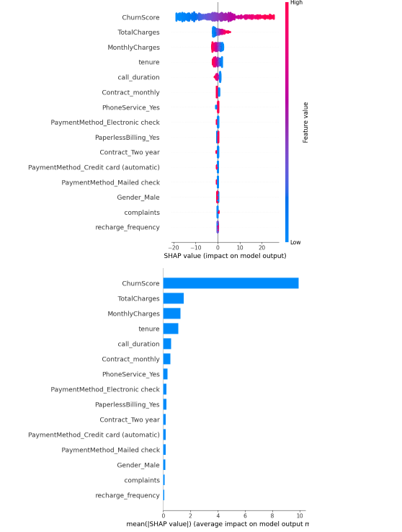
06

Slide 8
MODEL EVALUATION & FEATURE IMPACT
Our evaluation of the Logistic Regression model utilized the ROC curve, indicating its success at distinguishing churned customers from non-churned customers. The feature coefficients show the most important features that could affect customer churn, which will help in prioritizing actions to retain them.
07

Slide 9
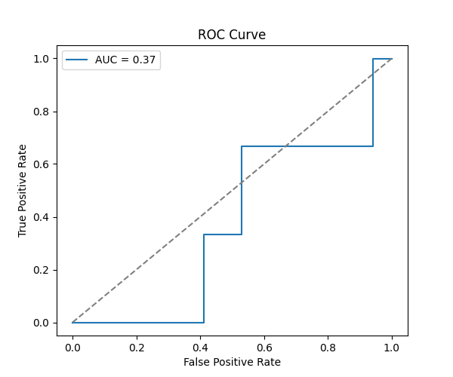
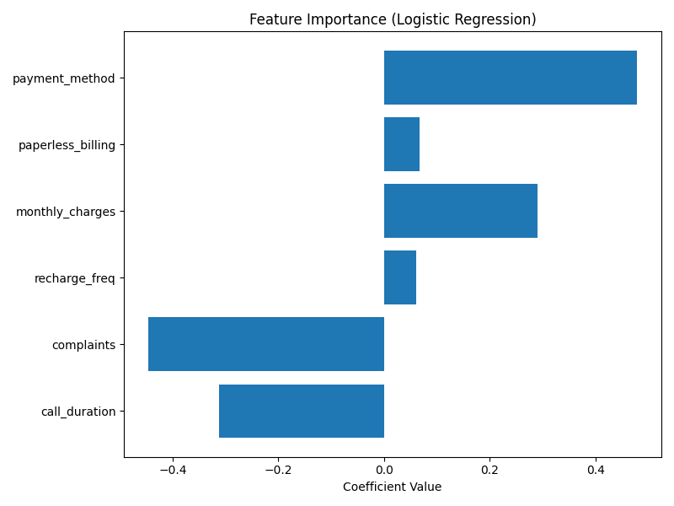
08

Slide 10

KEY INSIGHTS
According to SHAP analysis, the churn features of greatest influence are:
1. Tenure – longer tenure is associated with a reduced chance of churn.
2. MonthlyCharges – higher monthly charges increase the risk of churn.
3. TotalCharges – is correlated with customer engagement.
4. Call duration and complaints – the number of complaints and shorter usage indicate dissatisfaction.
5. Contracts, contract type, and payment method affect the potential for churn as well.
These conclusions can provide a basis for targeted retention strategies.
09

Slide 11
BUSINESS RECOMMENDATIONS
Provide incentives to potentially churn customers.
Enhance customer service to decrease complaints.
Explore pricing and contracting options for improved retention.
Analyze usage trends to target eventual churn customers.
10

Slide 12
CONCLUSION
Customer churn can be predicted and interpreted using machine learning and SHAP.
SHAP enables clear understanding of feature importance for actionable business decisions.
This approach can significantly improve customer retention strategies.
11

Slide 13
THANK YOU
12

